Slide 1
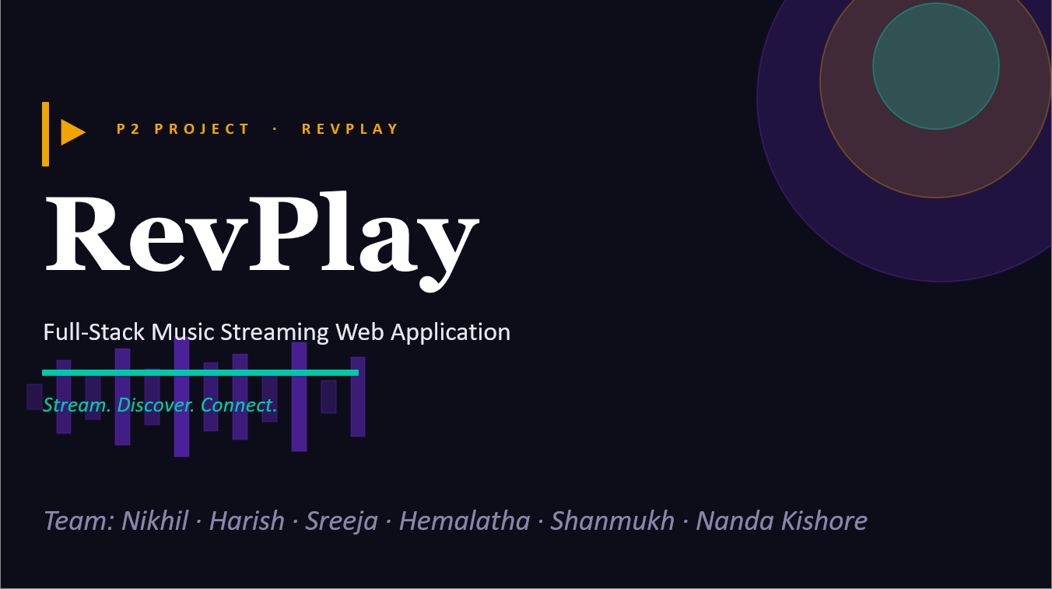

Slide 2
PROJECT
♪
🔍
Overview
Music Player
Smart Search
Integrated web player with queue, shuffle, repeat
Search songs, artists, albums, playlists
RevPlay is a full-stack monolithic music streaming web application built with Spring Boot and Thymeleaf. It enables users to stream music, manage playlists, and discover new content — while giving artists tools to upload and showcase their music.
♥
🎤
Favorites & History
Artist Dashboard
Favorites, listening history, playlist follow
Upload music, analytics, song visibility
6
Modules
2
📋
🔒
User Roles
Playlist Mgmt
Role-Based Access
50+
Features
Create, reorder, share public/private playlists
LISTENER / ARTIST with Spring Security

Slide 3
TECHNOLOGIES
Tech Stack
☕ Java 17
🌿 Spring Boot
🗄 Oracle 21c
🌐 Thymeleaf
Core language – OOP, streams, generics
Framework – REST, DI, auto-config
Relational DB – JPA / Hibernate ORM
MVC templates – server-side HTML rendering
✅ JUnit 5
📋 Log4j 2
🔀 Git
Unit + integration testing framework
Logging – AOP-based, structured logs
Version control & team collaboration

Slide 4
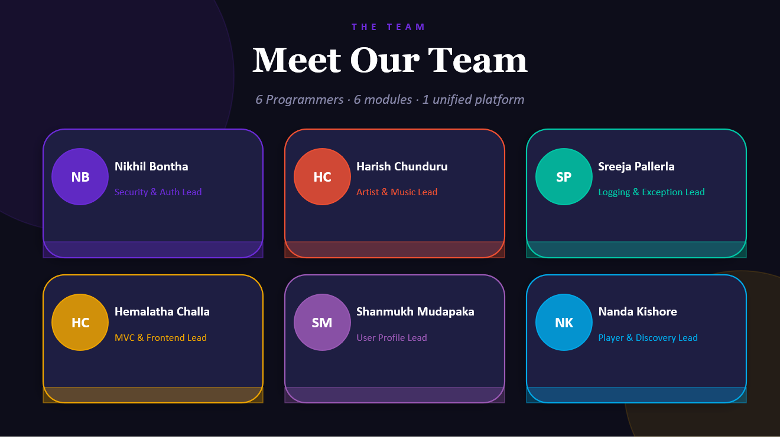

Slide 5
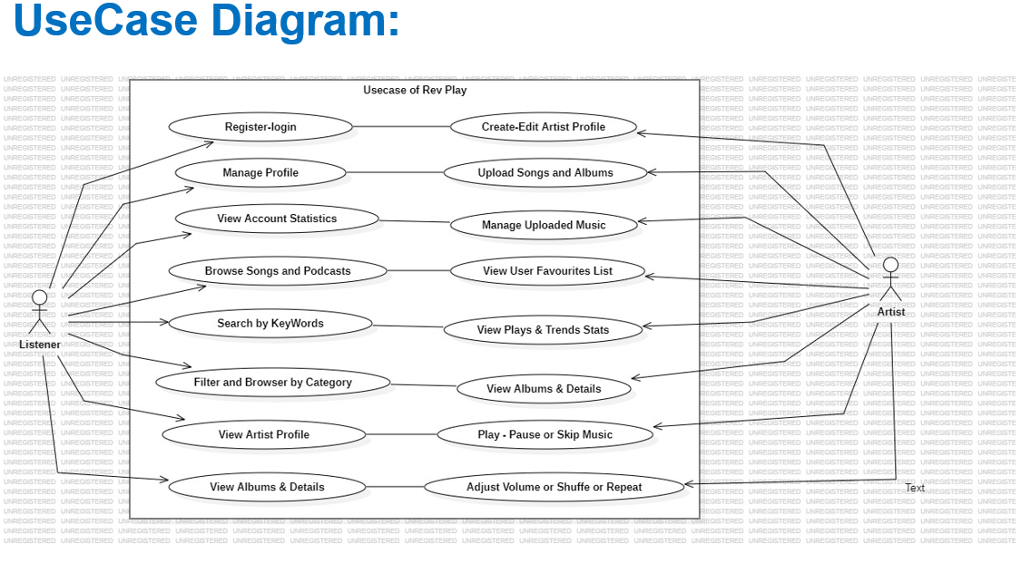

Slide 6
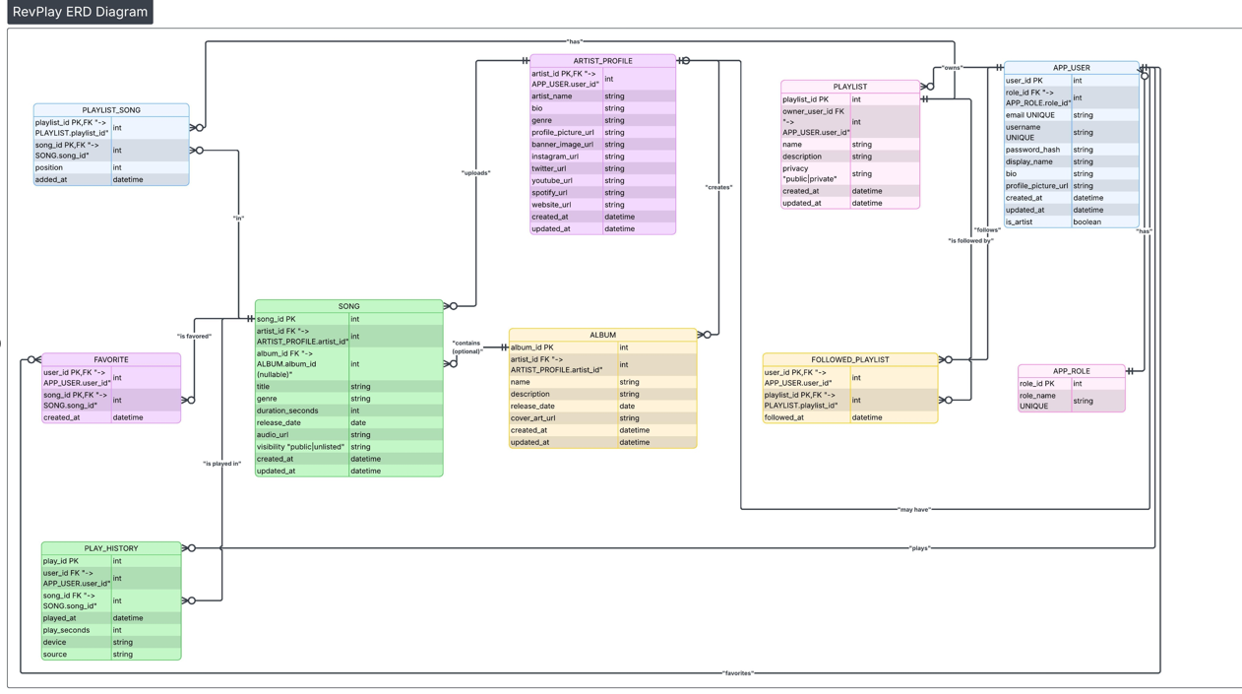

Slide 7
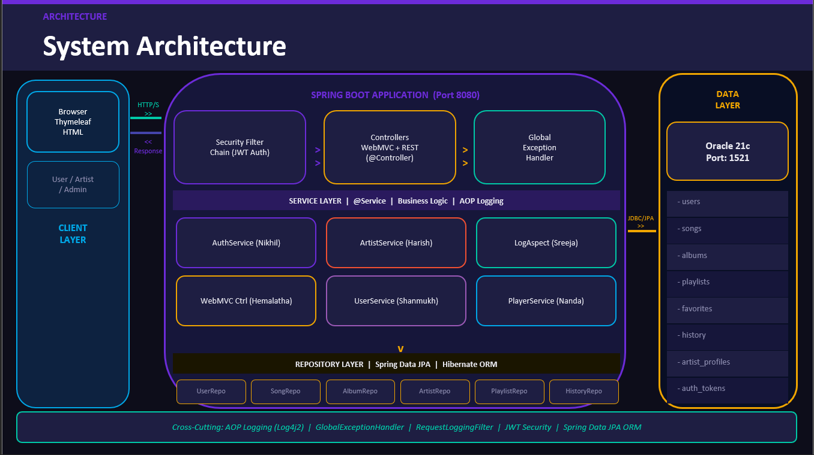

Slide 8
NB
Spring Security & Authentication
MODULE 01
ROLES & RESPONSIBILITIES
1
Design and implement Spring Security configuration with JWT-based stateless authentication flow
Nikhil Bontha
Security & Access Control Engineer
Develop secure login, registration endpoints with role-based authorization (USER / ARTIST / ADMIN)
2
PACKAGES
› security.config
3
Protect REST APIs using JwtAuthenticationFilter, authentication entry points, and access handlers
› security.jwt
› security.filters
Implement BCrypt password encryption, token validation, expiry, and refresh token management
4
› controller.auth
› service.auth
5
Ensure secure integration between backend security layer and Thymeleaf MVC frontend
⚙ Stateless auth only · All endpoints secured except /auth/** · Roles enforced via @PreAuthorize

Slide 9
HC
Artist Profile & Music Upload
MODULE 02
ROLES & RESPONSIBILITIES
1
Develop artist profile creation, editing, and management features with social media link support
Harish Chunduru
Artist Module & Content Management Engineer
Implement song upload, album creation, and media management with file storage integration
2
PACKAGES
› controller.artist
3
Integrate audio file and cover image storage with song visibility controls (public/unlisted)
› service.artist
› controller.album
Build artist dashboard showing key metrics: total songs, total plays, and favorites analytics
4
› service.album
› controller.upload
5
Ensure seamless integration of artist data with playlists, search, and listening analytics modules
⚙ Only ARTIST role can upload · Song visibility enforced · Delete blocked if album has songs

Slide 10
SP
Logging, Monitoring & Error Handling
MODULE 03
ROLES & RESPONSIBILITIES
1
Configure and manage structured application logging using Log4j2 with rolling file appenders
Sreeja Pallerla
Application Monitoring & Reliability Engineer
Implement AOP-based logging (LogAspect) for all controllers and services with performance timing
2
PACKAGES
› aspect.logging
3
Develop centralized GlobalExceptionHandler with standardized error response objects for all APIs
› filter.request
› exception.handler
Create custom exception hierarchy (ResourceNotFoundException, UnauthorizedException, etc.) for traceability
4
› exception.custom
› config.log4j2
5
Monitor request-response lifecycle via RequestLoggingFilter and maintain full error traceability
⚙ Logging in ALL services/controllers · Error codes standardized · Stack traces captured

Slide 11
HC
MVC Web Layer & UI Integration
MODULE 04
ROLES & RESPONSIBILITIES
1
Develop Thymeleaf-based MVC web controllers and view templates for all pages (index, search, player)
Hemalatha Challa
Web Layer & UI Integration Engineer
Integrate frontend with backend APIs using RestTemplate/WebClient for data binding and rendering
2
PACKAGES
› controller.web
3
Implement responsive UI layout, navigation structure, and consistent design across all pages
› templates (Thymeleaf)
› client.rest
Develop dynamic search UI with filtering views, genre browsing, and results page rendering
4
› config.web
› layout.fragments
5
Ensure consistent user experience across authentication, dashboard, player, and profile pages
⚙ All pages use shared layout fragments · Search results paginated · Mobile-responsive required

Slide 12
SM
User Profile & User Features
MODULE 05
ROLES & RESPONSIBILITIES
1
Develop user profile management with display name, bio, profile picture, and account statistics
Shanmukh Mudapaka
User Experience & Engagement Engineer
Implement favorites management: add/remove songs from favorites and quick access from player
2
PACKAGES
› controller.user
3
Build playlist follow/unfollow functionality and public playlist discovery features
› service.user
› controller.favorite
Maintain accurate user engagement metrics: total playlists, favorite song count, listening time
4
› controller.history
› service.stats
5
Track and expose listening history (last 50 songs) with timestamps and clear-history option
⚙ Users see only own data · Favorites update play stats · History capped at 50 entries

Slide 13
NK
Music Player, Playlists & Discovery
MODULE 06
ROLES & RESPONSIBILITIES
1
Implement integrated web music player with controls: play, pause, skip, seek, volume, shuffle, repeat
Nanda Kishore Peddanapati
Playback & Music Discovery Engineer
Develop playlist management: create, edit, delete, reorder songs, and set public/private privacy
2
PACKAGES
› controller.player
3
Build global search across songs, artists, albums, and playlists with keyword and filter support
› controller.playlist
› controller.search
Implement genre-based browsing, category filtering, and music discovery recommendation logic
4
› service.player
› service.search
5
Support playback analytics: trigger play count updates and listening trend data collection
⚙ Player queue managed client-side · Search indexed by title/artist/genre · Playlists paginated

Slide 14
🎵
Thank You!
RevPlay — P2 Project
THE TEAM
Nikhil
Harish
Sreeja
Hemalatha
Shanmukh
Nanda Kishore

