Slide 1
Predicting the retail customer retention potential level
| Nikhil pabbu |
Trainee Data Scientist
Id:4569

Slide 2
Overview:
Problem Statement
About Data
Visualizations
My approach
Error metric
Deployment with Streamlit
Challenges I have faced
Conclusion

Slide 3
Problem Description:
Business problem:
The business problem is to predict retail customer retention potential and classify customers as high/medium/low to make suitable marketing programs for customer retention.
Customer churn happens when a customer no longer uses the product or switches to a competitor.
Understanding defected customers' interests and preferences is useful in winning them back.
Historical data of customers containing characteristics, transactions, and interactions helps understand the customer.
By understanding customer churn, retail companies can improve customer retention, sales and increase profitability.

Slide 4
About Data:
The datasets are named as follows:
1. traindata:
CustomerID, RetentionPotential(Target)
2. Customerdata:
CustomerID, City, DateOfRegistration, OnlineCommunication, AutomaticRefill,
DoorstepDelivery, PreferredDeliveryDay
3. Emaildata:
CustomerID, EmailType, MailOpened, MailClicked
4. transactionsdata:
CustomerID, DateOfOrder, timestamp, OrderQuantity.

Slide 5
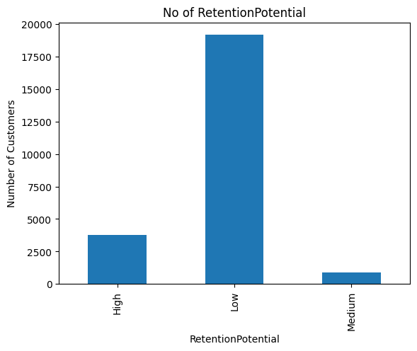
Exploratory data analysis (EDA) :
INSIGHTS
Here in RetentionPotential, many customers have low Retention Potential, and we can clearly observed that there is a class imbalance exist.

Slide 6
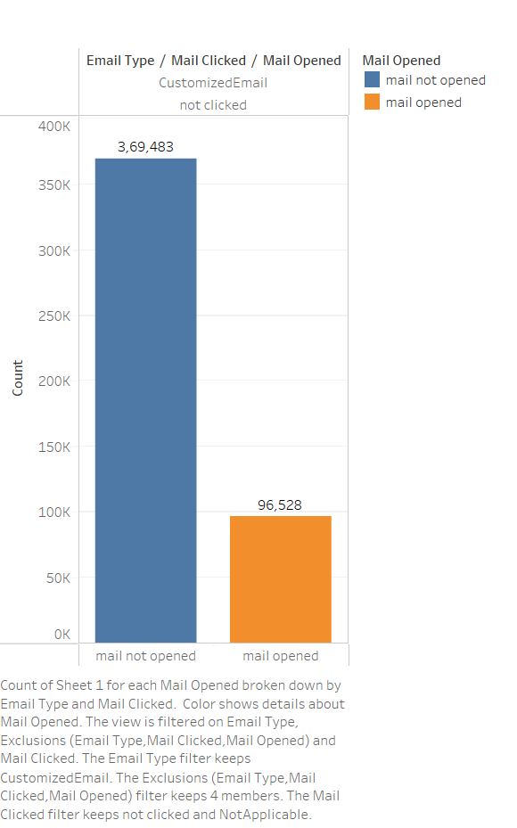
INSIGHTS
Many customers are not opening the mail so they are not clicking the link.

Slide 7
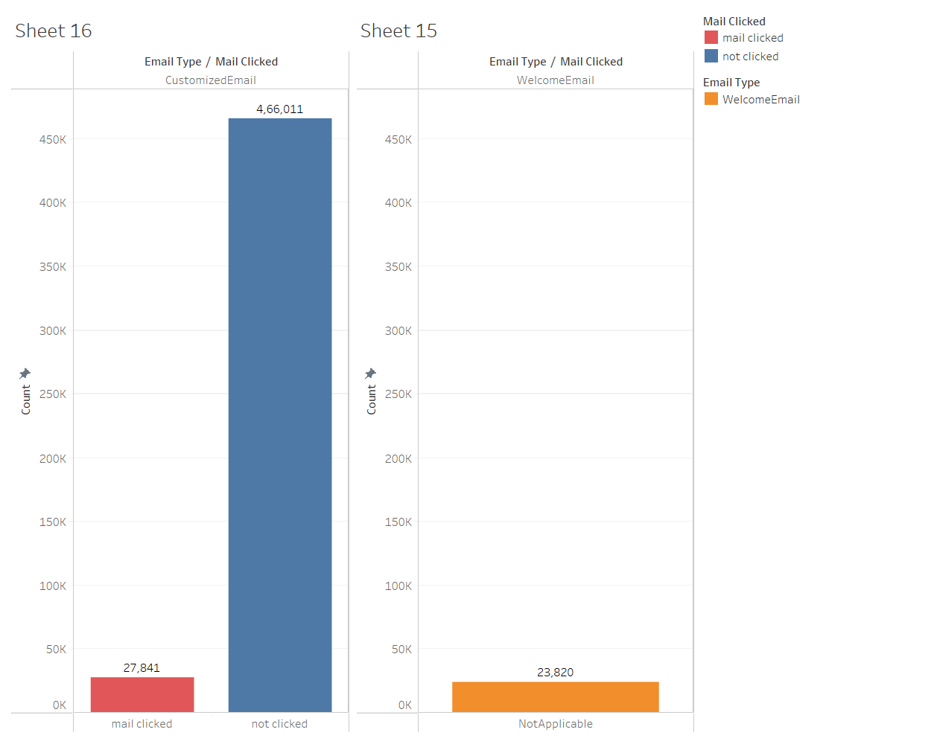
INSIGHTS
Mail Clicked is NotApplicable for every WelcomeEmail.
So we can say there is no link in the welcome email.

Slide 8
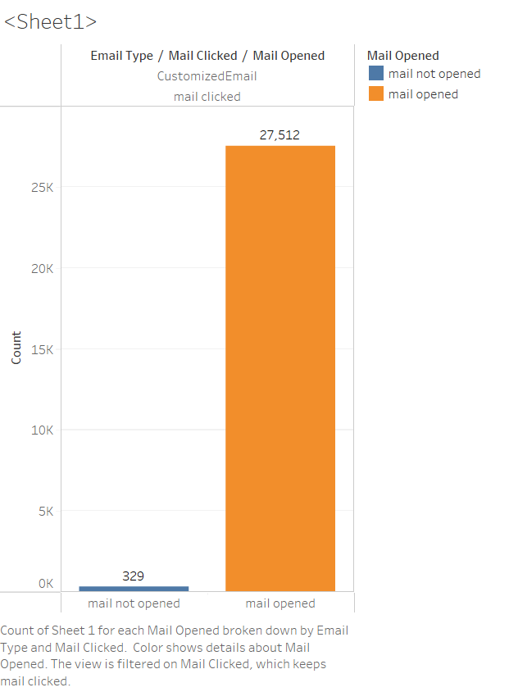
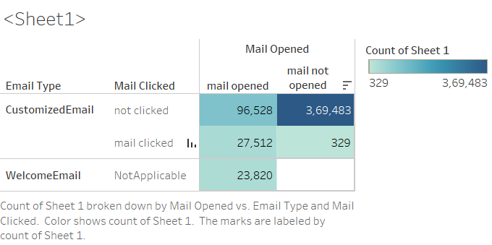
INSIGHTS
27,512 customers are mail opened and clicked.
Surprisingly, 329 are not opened mail but clicked the link ,How is this Possible?

Slide 9
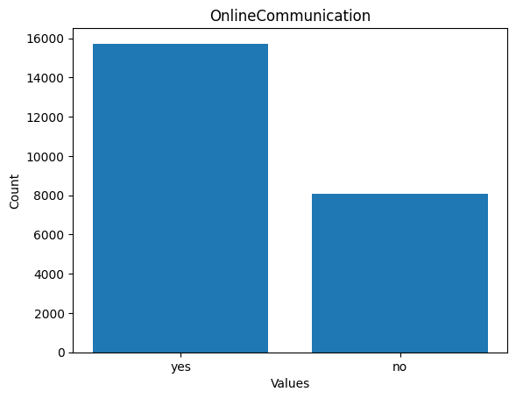
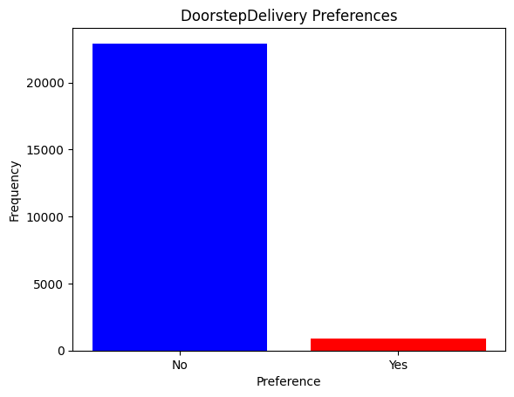
INSIGHTS
Here from the plot who prefers onlinecommunication is more but customers who prefers DoorstepDelivery are less.From this we can observe that the many customers who are prefered onlinecommunication are not actually ordering the items using onlinecommunication

Slide 10
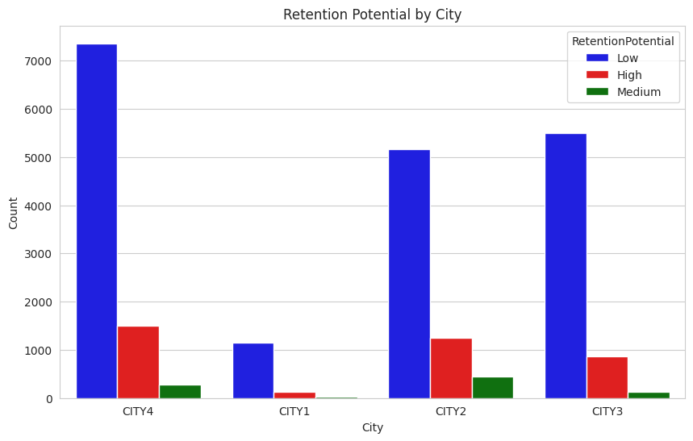
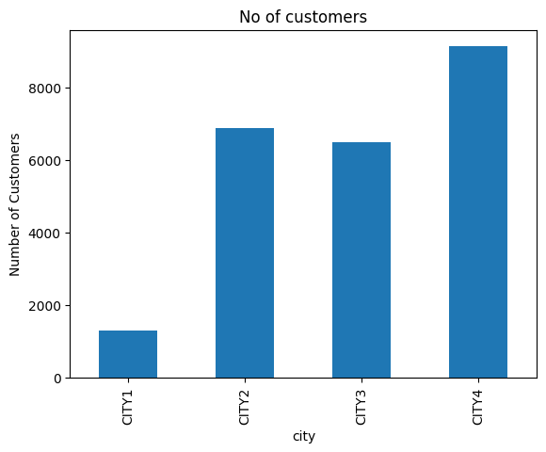
Here the company has highest customers from city4, At the same time the many customers are going to churn from city4
so an immediate action should be taken to get back those customers.

Slide 11
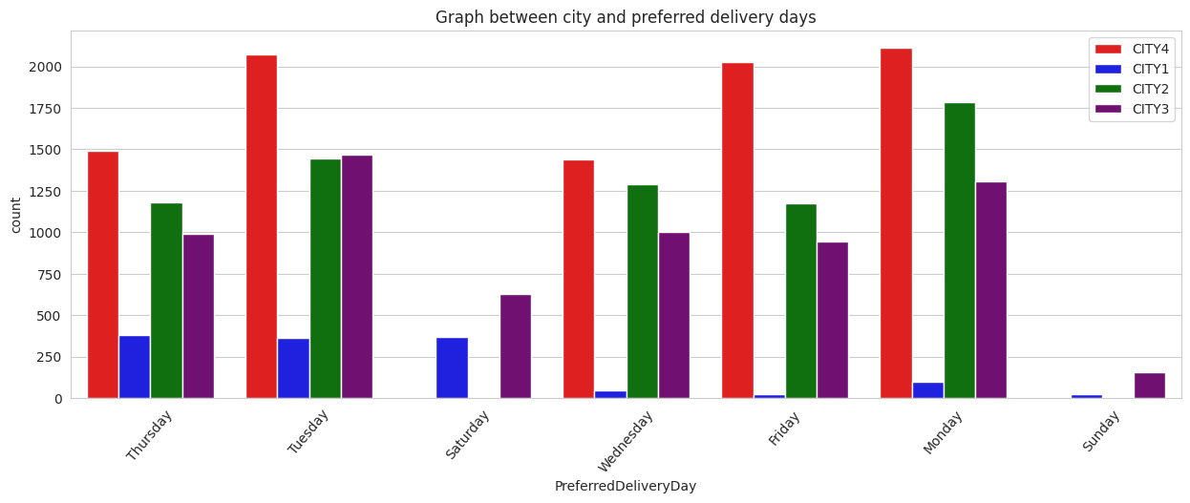
Here by observing the preferred deliverydays Customers buying online pefer more on weekdays and less in weekends.

Slide 12
My Approach
In the email dataset and the Transaction Dataset the duplicates are present.
(i.e the customerid is repeated)
So if we merge the 4 datasets directly the duplicates will become more , so that’s not the good way.
Inorder to overcome this I have created some features in the email datasets and the transaction dataset.

Slide 13
Email_df
Groupby customerid creating new columns in the email_df
welcome_email_opened: whether the customer has opened the welcome email sent by the company. If the value is 1 → customer has opened the email. 0 →customer has not yet opened the email.
no_of_customized_email : The No of customized emails sent to the customer by the company.
no_of_customized_email_opened: How many of the customized emails sent to the customer have been opened.
no_of_customized_email_clicked: No of Customized email links clicked by the customer.

Slide 14
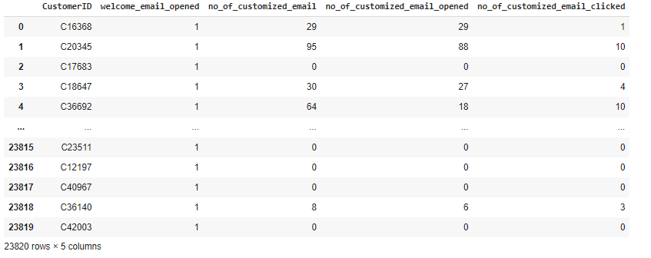
Email_df

Slide 15
Transaction_df
Groupby customerid creating new columns in the Transaction_df
TotalOrderQuantity: Total number of orders placed by the customer.
OrderFrequency : This attribute represents how often the customer places orders with the company.
A higher value of this attribute indicates that customer makes more frequent purchases.
Avg_Ordergap: This attribute represents the average time gap between the customer's orders.
Firstorder: This attribute represents the date of the customer's first order with the company.
lastorder: This attribute represents the date of the customer's most recent order with the company.

Slide 16
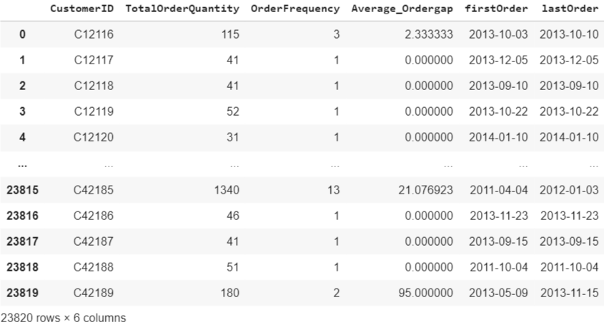
Transaction_df

Slide 17
Merging 4 datasets
I have merged the 4 datasets based on customerid
The shape of the merged data frame is (23820,17), so no duplicates are present in the data
And stared doing preprocessing steps on the merged_df

Slide 18
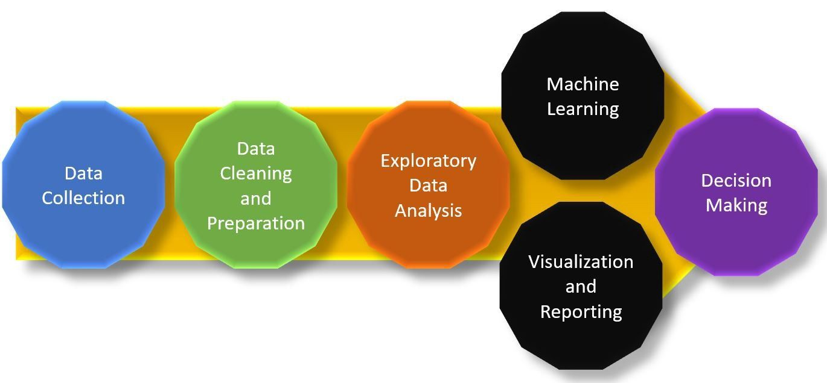
Preprocessing
1.checking missing values in each dataset
2.Feature engineering
no_of_DayswithBusiness: The duration of a customer's relationship with the business in terms of days. (Lastorder – Date of registration)
no_of_MakingBusinessDays: Duration of time in which a customer made orders from the business, in terms of days (Lastorder - firstorder)
3.encoding categorical columns
4.checked the skewness and squareroot transformed the columns
5.train test split
6.model Building

Slide 19
SMOTE
SMOTE (Synthetic Minority Over-sampling Technique) is a popular algorithm used for oversampling imbalanced datasets.
In this dataset, medium class (minority class) has a significantly lower number of samples compared to the other classes.
Applied smote to handle the class imbalance.

Slide 20
Model Building
Machine Learning algorithms that I have build are :
kNeighborsClassifier
DecisionTreeClassifier
RandomForestClassifier
GradientBoostingClassifier

Slide 21
Error Metric
Recall is the error metric for the given dataset.
Recall : It measures the proportion of actual positive instances that are correctly identified as positive by the model.
Recall = True Positive / (True Positive + False Negative)

Slide 22
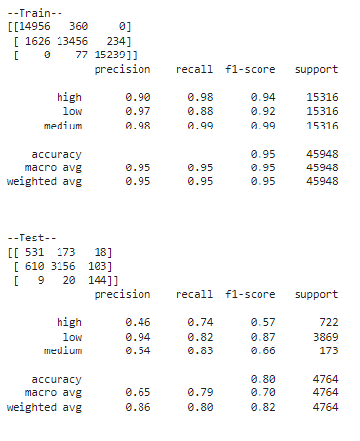
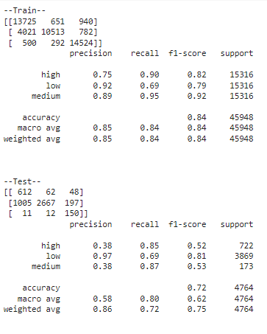
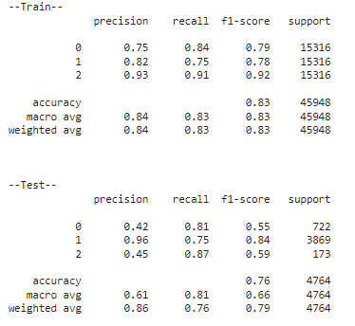
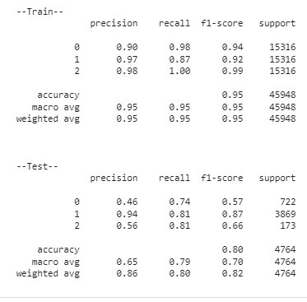
DecisiontreeClassifier outputs
Decisiontree with default hyperparameters Decisiontree after tuning the hyperparameters

Slide 23
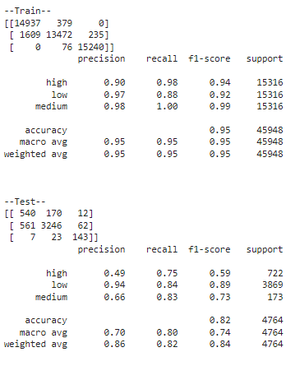
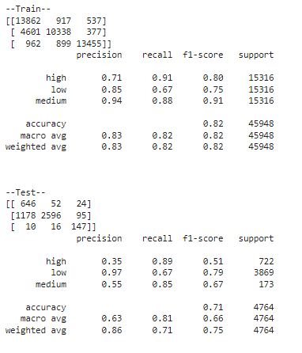
RandomforestClassifier outputs
Randomforest with default hyperparameters Randomforest after tuning the hyperparameters

Slide 24
Summary:
The recall score for the medium class is improved after hyperparameter tuning
Among all the models I got best recall score for DecisionTreeClassifier
Recall(Medium class) for train: 0.95
Recall(Medium class) for test : 0.87
So I have taken the decision tree model and done predictions on the test data.

Slide 25
Deployment with Streamlit
For the best model I have taken the pickle file
And built Streamlit interface by creating a app.py file and running it in anaconda prompt.
You can now view your Streamlit app in your browser.
Local URL: http://localhost:8501
Network URL: http://192.168.1.27:8501

Slide 26
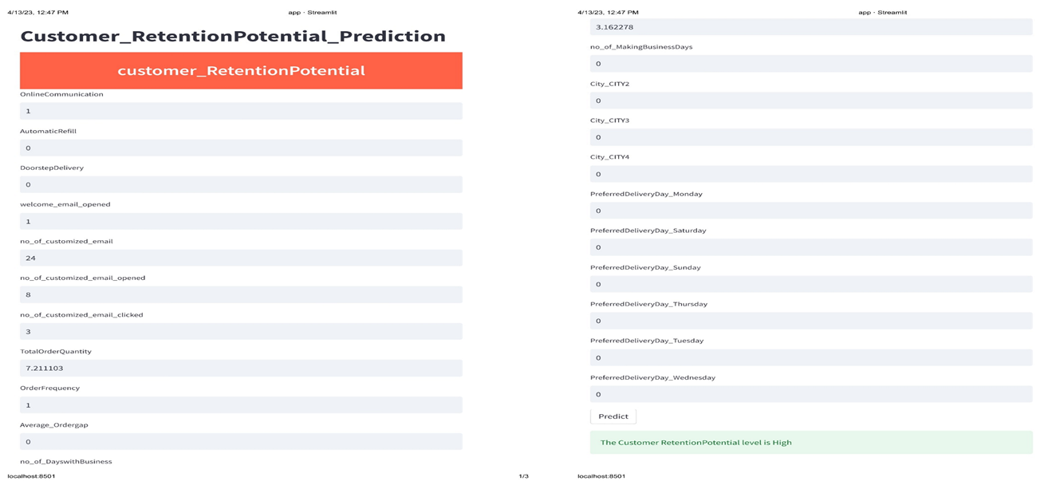

Slide 27
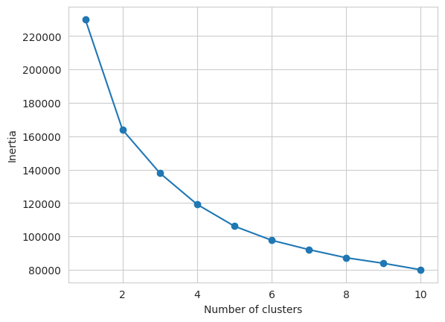
Clustering
Customer Segmentation:
I have drop the target column and done the standard scaling on the merged dataset
Then I built the kmeans model with random clusters
After I done the elbow polt and got clusters=5
Then I rebuild the model with k=5
And got the clusters for each customer.

Slide 28

Conclusion
By Entering the customer data in the streamlit webpage we can able to predict Customer RetentionPotential level as high, medium and low.
And make suitable marketing programs to improve customer retention, sales and increase profitability.

Slide 29
Challenges I have faced
The email dataset and transaction dataset have the repeated customer ids.
so, its challenging me to merge these datasets with the train data.
Biased model performance due to imbalanced dataset.
In the email dataset i strucked because some of the customers not opened the mail but clicked the link
Time consuming is more while running the grid search for random forest and gradientboosting.

Slide 30


