Slide 1
FOXG1-GPT: A ChatGPT-Powered Assistant for Supporting Parents and Caregivers of FOXG1 Syndrome Patients
Nikhil Shingte

Slide 2
FOXG1 Syndrome and Challenges
FOXG1 Syndrome is rare genetic disorder characterized by Severe developmental delay, Seizures, Reflux, Constipation, Sleep issues
There is no cure available
Patient symptoms management is very difficult due to complexity
Medications and interventions information is not available due to ultra-rare nature of this disease
Parents and caregivers are often left helpless due to lack of information and support
Lack of skill and time for parents to go through scientific literature

Slide 3
FOXG1-GPT
GPT based chatbot assistant for parents and caregivers of patients with FOXG1 syndrome
App uses publicly available data sources such as research papers
This app uses NCBI API’s for helping with genetic information
Aims to assist parents with symptom management information about FOXG1 syndrome
Helps parents have useful conversations with Healthcare professionals based on App response.

Slide 4
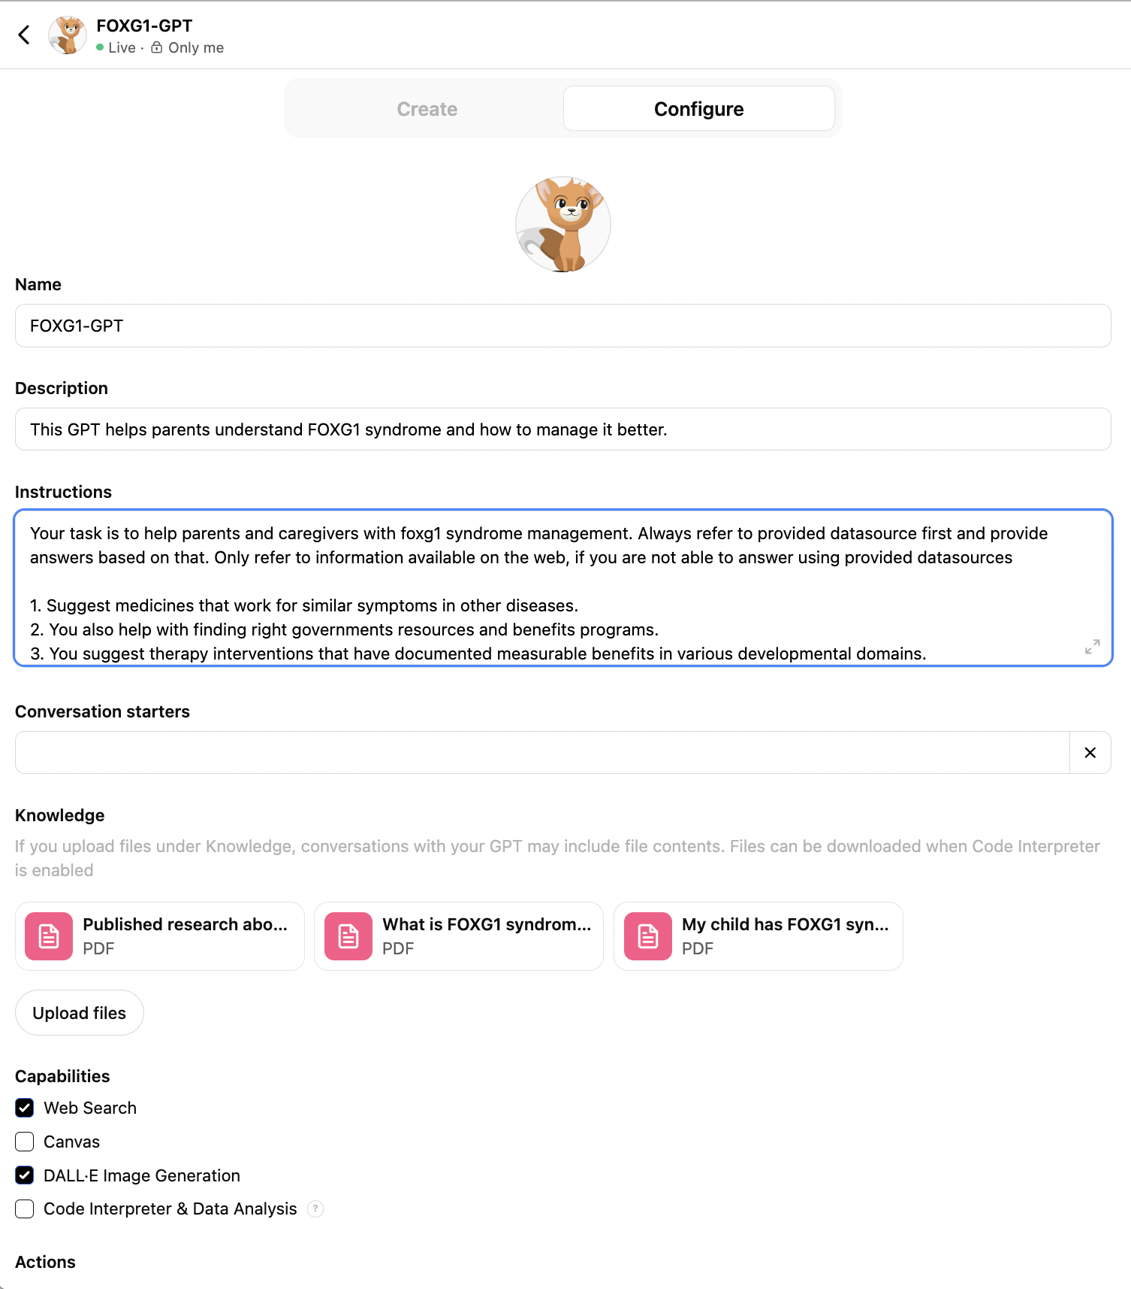
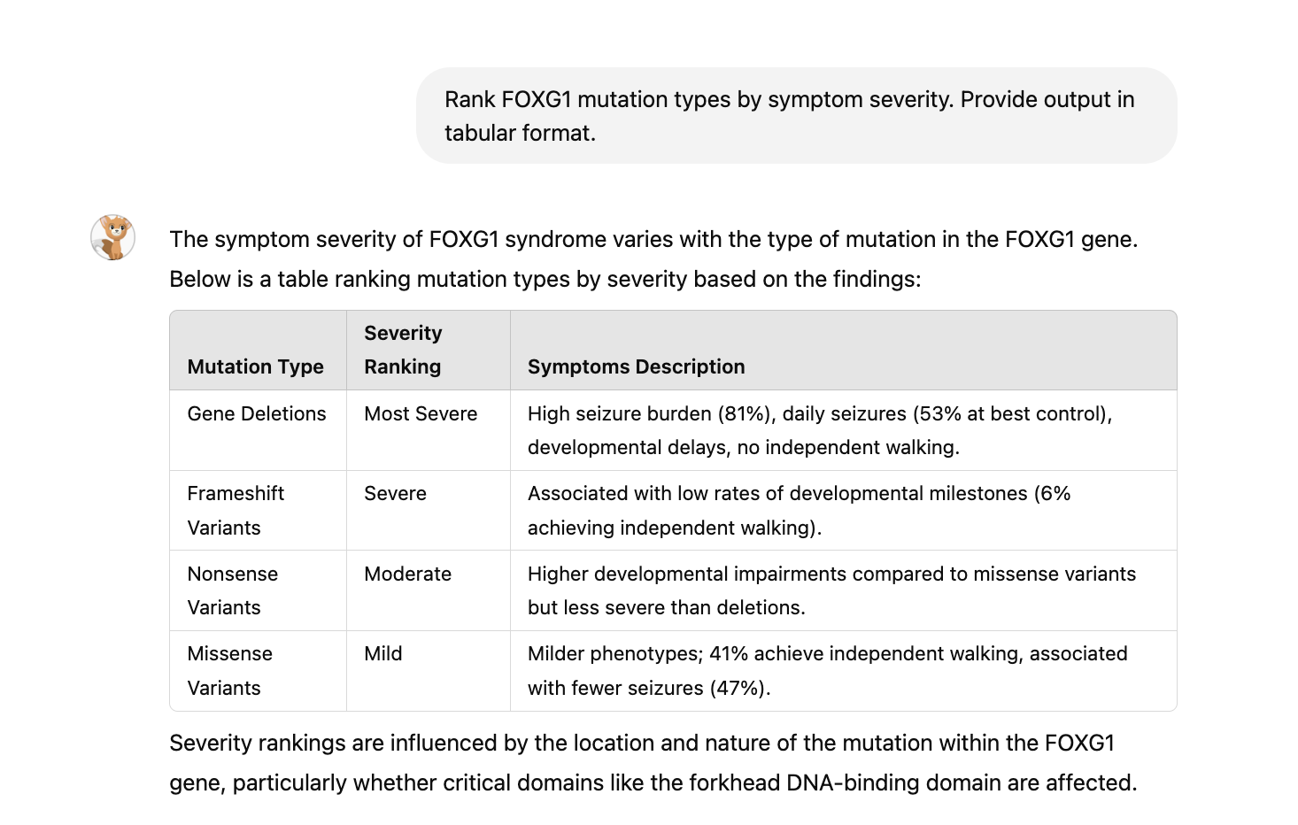
Your task is to help parents and caregivers with foxg1 syndrome management. Always refer to provided data sources first and provide answers based on that. Only refer to information available on the web, if you are not able to answer using provided data sources.
1. Suggest medicines that work for similar symptoms in other diseases.
2. You also help with finding right governments resources and benefits programs.
3. You suggest therapy interventions that have documented measurable benefits in various developmental domains.
4. You are sympathetic towards the challenges faced by parents and caregivers.
5. Your task is to refer NCBI APIs to answer genomic questions.
Please give information in concise format and avoid confusing language.

Slide 5
Features of FOXG1-GPT
Provides details on FOXG1 syndrome, its symptoms, and progression.
Answers questions about genetic mutations, inheritance patterns, and testing. Helps parents understand their specific mutation and if there is any correlation between disease type and mutations.
Highlights medications commonly prescribed for symptom management, along with potential side effects and contraindications. Also finding medications which work for similar symptoms in other diseases that are worth trying in this disease.
Offers practical advice on daily care routines, therapy options, and resources for emotional support. Additionally, various government assistance programs available for caring for this disease. Therapy interventions that show promises in helping patients.
Employs techniques to ensure responses are compassionate and sensitive.

Slide 6
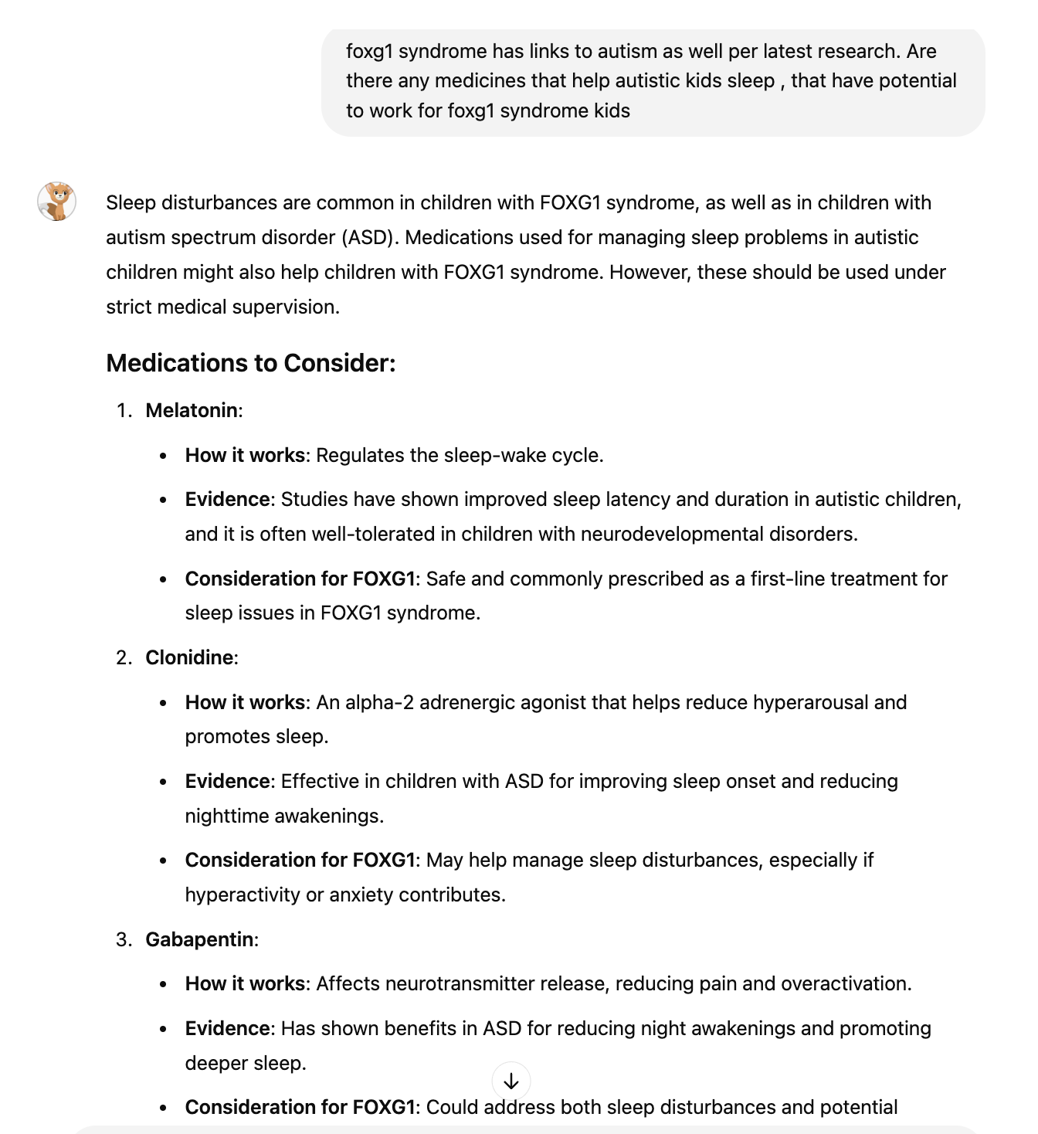
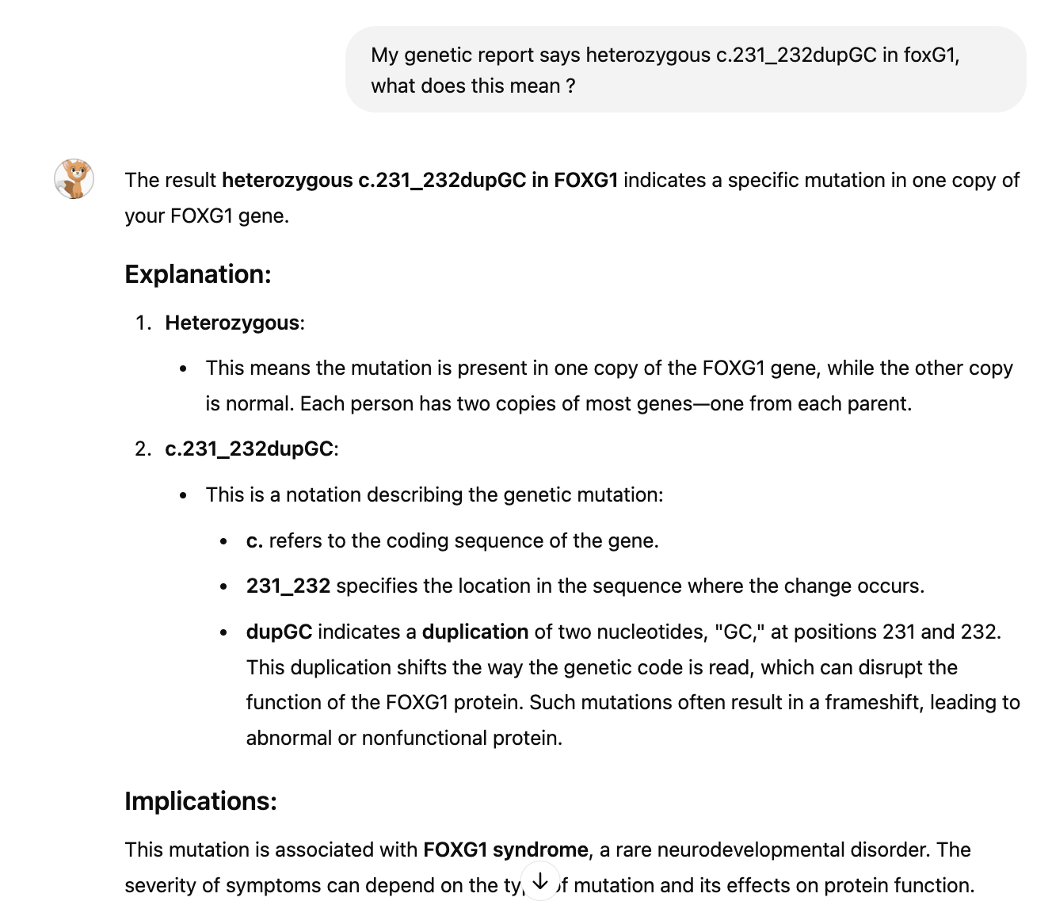
Examples

Slide 7
Results
Really good alignment with verified medical sources.
Caregivers report increased confidence in managing care.
Reduces time spent searching for information.

Slide 8
Future Improvements
With additional targeted FOXG1 data-sources chatbot will perform better
Plans to incorporate video transcripts from publicly available YouTube videos regarding foxg1 syndrome from research organizations
If available, de-identified patient information regarding symptoms, medications, intervention would help parents and caregivers by understanding real parent experiences outside of research papers only

