Slide 1
“ROAD SIGN CLASSIFICATION USING CNN”
Mini Project - IV
NIKHIL DWIVEDI 1NH17EC729
RITWIK SHOME 1NH17EC738
SAHIB ARORA 1NH17EC742
PRATHAMESH KADAM 1NH17EC420
Guided By
ISHANI MISHRA
Assistant Professor
Dept. of ECE
NHCE, Bengaluru

Slide 2
Contents
Introduction
Literature Review
Aim and Objective of Project
Top Level Block Diagram
Project Description
Progress Description
Progress Work
Milestones/Schedule
Outcome of Project
References

Slide 3
Introduction
In order to solve the concerns over road and transportation safety, automatic Road Sign Classification system has been introduced.
An RSC system can detect and recognize traffic signs from and within images captured by cameras or imaging sensors. In adverse traffic conditions, the driver may not notice traffic signs, which may cause accidents. In such scenarios, the RSC system comes into action.
The main objective of the research on RSC is to improve the robustness and efficiency of the system. To develop an automatic RSC system is a tedious job given the continuous changes in the environment and lighting conditions. Among the other issues that also need to be addressed are partial obscuring, multiple traffic signs appearing at a single time, and blurring and fading of traffic signs, which can also create problem for the detection purpose.
For applying the RSC system in real-time environment, a fast algorithm is needed. As well as dealing with these issues, a recognition system should also avoid erroneous recognition of non signs.

Slide 4
Literature Review
Title of the paper | Author | Year
Traffic Sign Detection and Recognition Based on Convolutional Neural Network | Ying Sun, Pingshu Ge and Dequan Liu Dalian Minzu University, College of Mechanical and Eletronic Engineering, Dalian, China | 2019
Application of Vision Models to Traffic Sign Recognition | X.W. Gao, L. Podladchikova, and D. Shaposhnikov School of Computing Science, Middlesex University, Bounds Green, London N11 2NQ, UK. | 2003
Efficient Feature Points for Myanmar Traffic Sign Recognition | Kay Thinzar Phu, Lwin Lwin Oo University of Computer StudiesMandalayMyanma | 2018
Hierarchical Traffic Sign Recognition | Yanyun Qu, Siying Yang, Weiwei Wu, Li Lin Computer Science DepartmentXiamen UniversityXiamenChina | 2016

Slide 5
Problem Statement & Objectives
Problem Statement:
To build a Road Sign Classification System using Convolutional Neural Networks (CNN) on Python 3.7.6 with 95% accuracy.
Objectives:
In this Python project example, we will build a deep neural network model that can classify traffic signs present in the image into different categories. With this model, we are able to read and understand traffic signs which are a very important task for all autonomous vehicles.

Slide 6
Proposed System
In this Python project example, we will build a deep neural network model that can classify traffic signs present in the image into different categories. With this model, we are able to read and understand traffic signs which are a very important task for all autonomous vehicles.
The ability to recognize an image by the computer was the main goal by this project. As we know that the computer does not understand images therefore these images are taken in the form of pixels or matrices. After this these images are fed into the neural network. The neural network is broken into layers. The first layer in the neural network is termed as input layer where the images from the dataset are taken. The second layers or the forth coming layers or the layers between are termed as hidden layers. The last layer is the output layer. The output layer decides whether the input image entered from the dataset in correctly recognized by the machine or not.

Slide 7
Proposed System
Our approach to building this traffic sign classification model is discussed in four steps:
Explore the dataset
Build a CNN model
Train and validate the model
Test the model with test dataset

Slide 8
Dataset
For this project, we are using the public dataset available at Kaggle: Traffic Signs Dataset
The dataset contains more than 50,000 images of different traffic signs. It is further classified into 43 different classes. The dataset is quite varying, some of the classes have many images while some classes have few images. The size of the dataset is around 300 MB. The dataset has a train folder which contains images inside each class and a test folder which we will use for testing our model.

Slide 9
Python Libraries
Keras
Tensorflow
OpenCV
Matplotlib
Scikit-learn
Pandas
Python Image Classification
Tkinter
Numpy

Slide 10
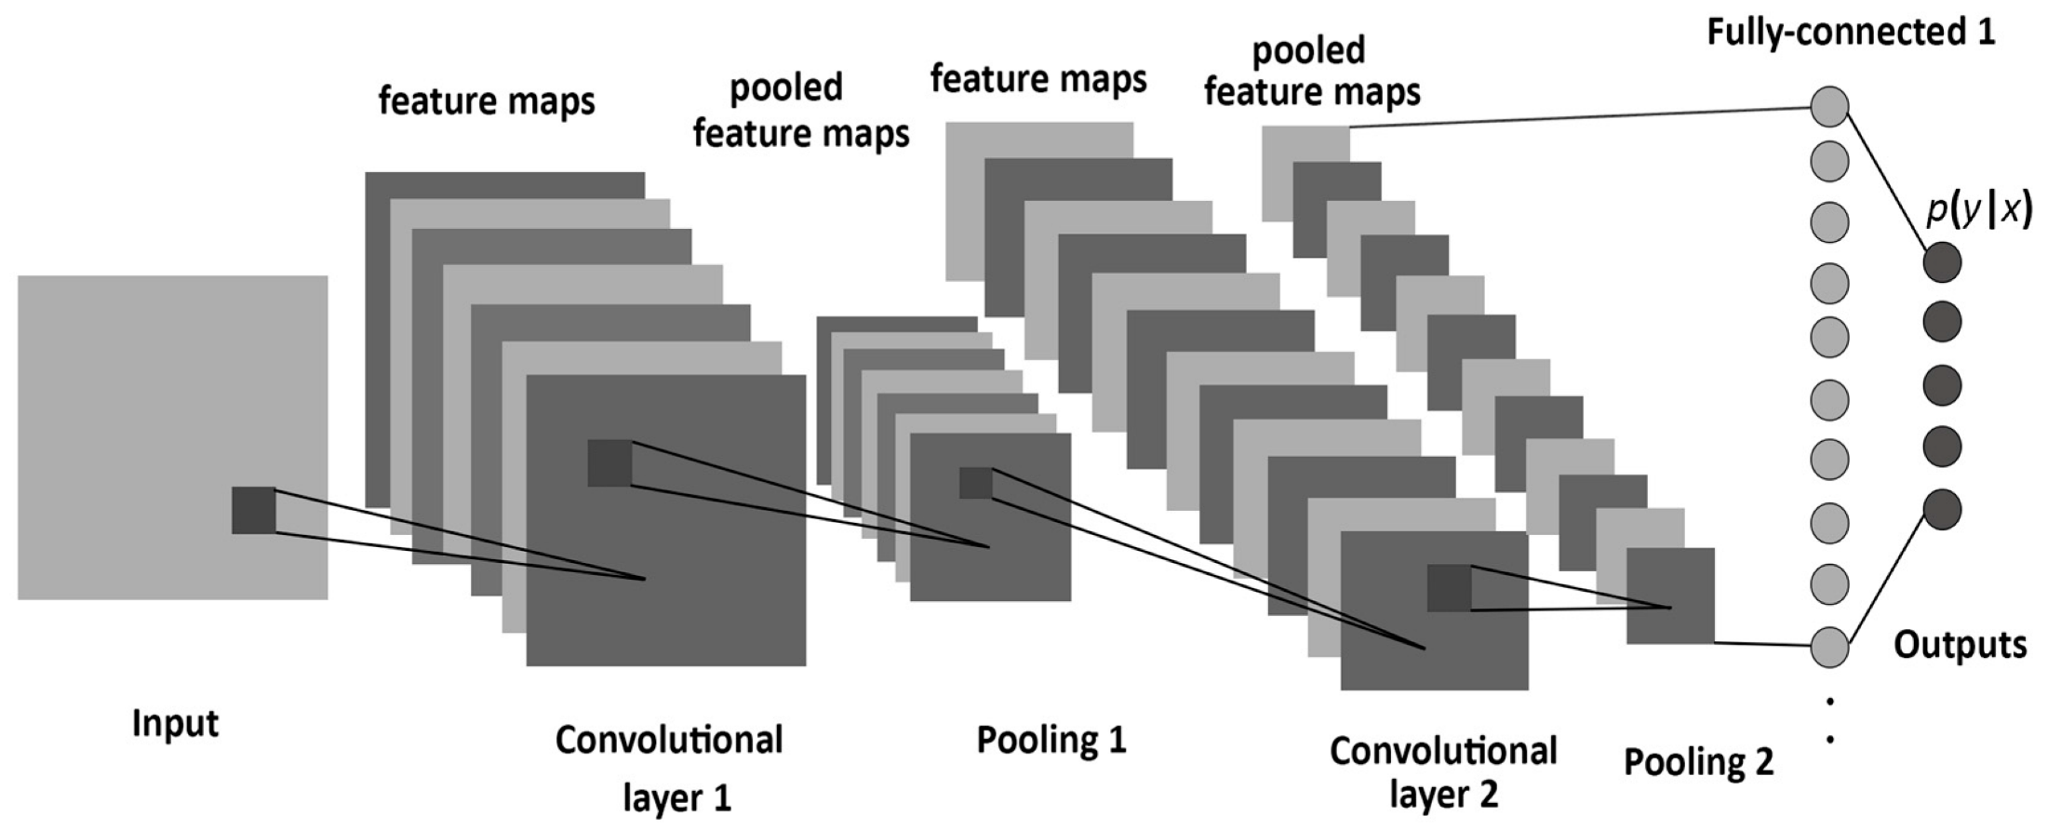
Circuit Diagram & Working

Slide 11
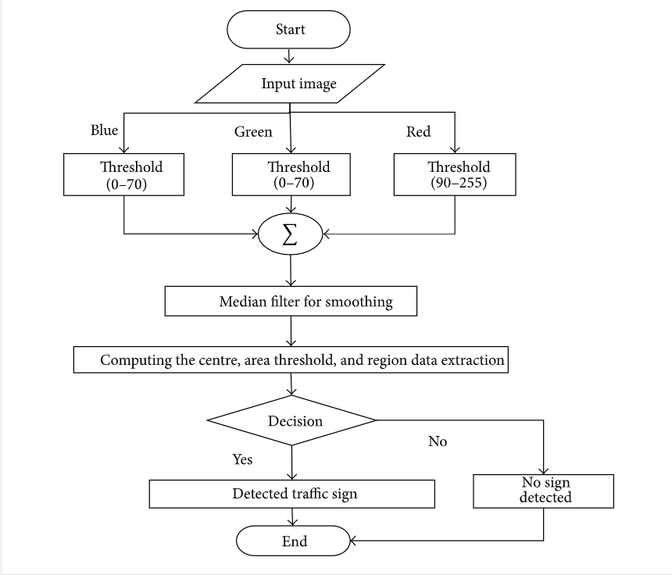

Slide 12
Algorithm
Step 1: Capture the image.
Step 2: Break down the image to get 3 layers (Red, Green, Blue).
Step 3: Select a suitable size(5x5,3x3) and number (32,64) of function blocks.
Step 4: Select a suitable stride (number of pixels the function block moves after each iteration value).
Step 5: Run the function block through the image to identify small pixels.
Step 6: Repeat step 5 for all function blocks till all the pixels in the image are covered
Step 7: Increase the size of function block and check whether the function blocks are forming and particular pattern.
Step 8: Repeat step 8 until the whole picture is covered.
Step 9: Make the decision based on result of step 8.

Slide 13
Results & Discussion
We covered how deep learning can be used to classify traffic signs with high accuracy, employing a variety of pre-processing and regularization techniques (e.g. dropout), and trying different model architectures. We built highly configurable code and developed a flexible way of evaluating multiple architectures. Our model reached close to close to 94% accuracy on the test set, achieving 95% on the validation set.

Slide 14
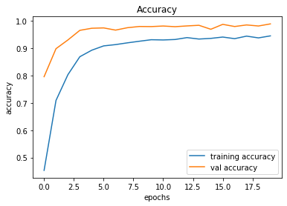
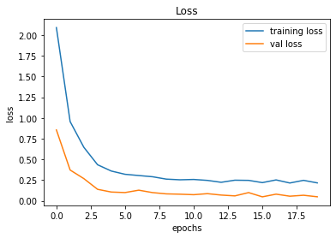

Slide 15
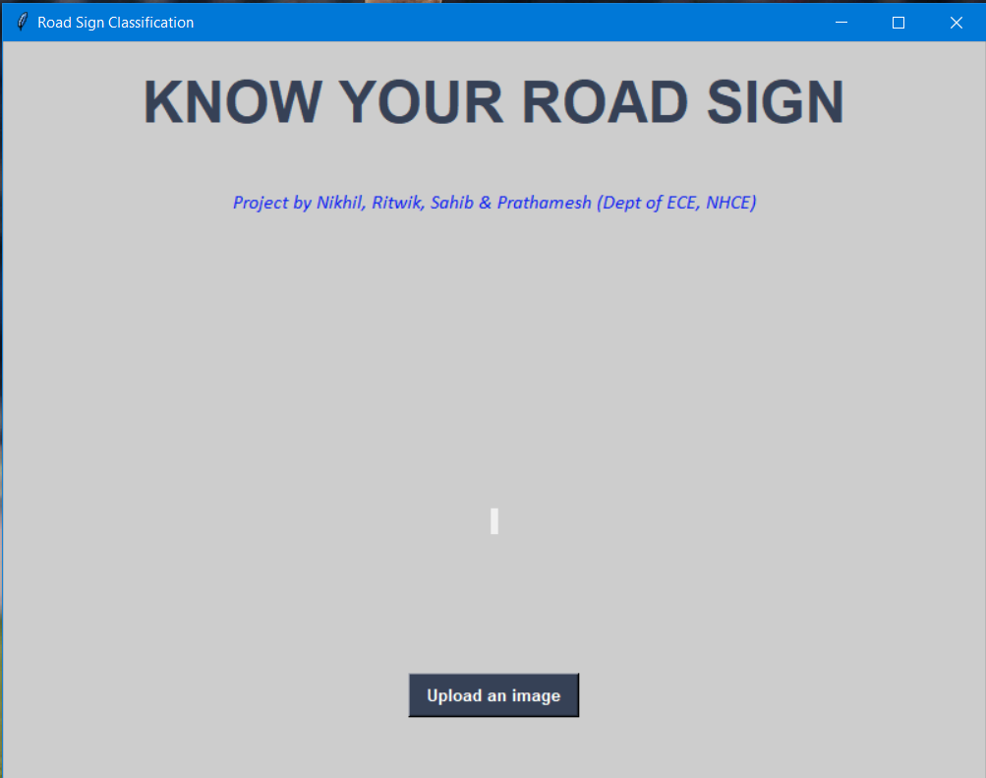
Output

Slide 16
We built a road sign recognition system which recognizes and classifies the road sign from an input image into the 43 categories. We were able to achieve 94% accuracy on the training set and 95% on the validation set which is pretty good for a simple CNN based model. We visualized how our accuracy and loss changes with time and also visualized the accuracy and loss on the training and validation data.
Conclusion

Slide 17
Advantages
The model we developed using the Convolutional Neural Network achieved accuracy up to 95% which means that our model is highly reliable compared to many other Road Classification model.
Although the model takes more time to train (due to system specifications), it can classify the images within 1-2 seconds, which is very good for a CNN model.
The Graphical User Interface built for using the project is very basic and minimalist and can be operated by anyone, even with people having very basic computer knowledge.
Once the model is trained it can be used in any system to test and implement which means the system requirement for running the project is very low.

Slide 18
Future Scope
This project can be used with a better UI which enables the use of a camera and processes the images/videos picked up by the camera to interpret traffic signs in real time and improve the quality and safety of self driven cars.
The time taken for the model to train once (1 epoch) takes more than 60 seconds and thus running 15 epochs took around 20 minutes. We can further develop the model and improve its time.
The training and validation losses has decreased significantly as the no of epochs has increased. The losses can further be reduced.
The GUI developed for this project is quite basic and it can be made much more Interactive and user friendly.

Slide 19
Application
The Road Sign Classification project is very useful for the autonomous vehicles which are going to be very common in the near future. It is very important for the autonomous vehicles to capture and identify in real time and this entire process should be very quick for proper functioning of the autonomous vehicles.
Many big companies like Tesla, Uber, Google-Waymo, Mercedes-Benz, Toyota, Ford, Audi etc. are working on autonomous vehicles and self-driving cars in fact Tesla has already implemented the self-driving mode in some of its models.
This image classification model can be used for many other applications if the proper dataset is available like Language Detection, Hand Sign recognition etc.

Slide 20
References
[1] https://www.kaggle.com/fab711/gtsrb-traffic-signs-classification-with-cnn
[2] https://analyticsindiamag.com/8-uses-cases-of-image-recognition-that-we-see-in-our-daily-lives/
[3] https://docs.python.org/3.7/
[4]https://scholar.google.co.in/scholar?q=traffic+sign+recognition&hl=en&as_sdt=0&as
[5] https://en.wikipedia.org/wiki/Traffic-sign_recognition
[6] http://benchmark.ini.rub.de/?section=gtsrb&subsection=news

Slide 21
Milestones/Schedule
Milestone | Baseline Date | Target Date | Achievement
Collecting the data set | 5/02/2020 | 15/02/2020 | Achieved
Data pre processing i.e. reading the pictures to matrices, converting categorical datab splitting to training and testing stes etc | 15/02/2020 | 3/03/2020 | Achieved
Building the model i.e the logic the software uses to recognise thee pictures | 03/03/2020 | 15/03/2020 | Achieved
Building the UI on python | 15/03/2020 | 16/04/2020 | Achieved

Slide 22
Thank You

