Slide 1
“Travelling Salesman Problem using Greedy’s Algorithm ”
By
MINI-PROJECT
PRESENTATION
ON
Nikhil Dwivedi 1NH17EC729
Ritwik Shome 1NH17EC738
Sahib Arora 1NH17EC742
Guided By
Dr. Sanjeev Sharma
Professor & HoD
Dept. of ECE
New Horizon College Of Engineering

Slide 2
INDEX
Introduction
Literature Survey
Aim and Objectives of Project
Top Level Block Diagram
Project Description
Outcome of Project
Advantages & Disadvantages
Applications
Progress Work
Milestones/Schedule
References

Slide 3
INTRODUCTION
The travelling salesman problem is a classic mathematical problem. It is used for optimization in the field of computer science and operational research.
The problem statement is: given a list of cities and the distance between every pair, find the shortest path that visit each and every city and return to the origin. The problem is best represented by using graphs, where every node is city and the edge between them is the distance between the cities.

Slide 4
Place a General Picture about the Project

Slide 5
LITERATURE REVIEW
Paper No | Title | Author & Year of Publication | Outcome | Limitation
1. | An Ant Colony Optimization Method for Prize-collecting Traveling Salesman Problem with Time Windows | Xiaohu Shi ; Liupu Wang ; You Zhou ; Yanchun Liang 2008 | Numerical results show that the proposed method is effective for the PCTSPTW problem.
2. | Artificial Bee Colony Algorithm and Its Application in Traveling Salesman Problems | Xutong LI ; Yan ZHENG 2019 | Artificial bee colony algorithm can be applied to settle the problems of traveling salesman and is much reliable in effectiveness, usability and research ability.
3. | Distributed hybrid method to solve multiple traveling salesman problems | Abdul Hadi M. Alaidi ; Ausif Mahmood 2018 | A comparison is made between the hybrid method and other methods found that the hybrid method provides a reduction in cost.
4. | Solving the Railway Traveling Salesman Problem via a Transformation into the Classical Traveling Salesman Problem | Bin Hu ; Günther R. Raidl 2008 | This transformation is efficient and, thus, is highly competitive compared to so far existing approaches for solving the RTSP directly.

Slide 6
AIM and OBJECTIVE
AIM: Given a list of cities and the distances between them, to find the shortest possible route that visit each city and return to the origin city.
Objective:
The objective of the project is to demonstrate an algorithm to solve the traveling salesman problem. The console application focuses on one of the purest applications of the problem and solves it using a working algorithm which in our case is using Greedy’s algorithm.

Slide 7
There have been several types of approaches taken to solving the TSP. They include:
Heuristic approaches
Memetic algorithms
Ant colony optimizations
Simulated annealing
Genetic algorithms
Neural networks
Nearest Neighbour

Slide 8
WHAT IS A 'GREEDY ALGORITHM’?
A greedy algorithm, as the name suggests, always makes the choice that seems to be the best at that moment. This means that it makes a locally-optimal choice in the hope that this choice will lead to a globally-optimal solution.
How do you decide which choice is optimal?
Assume that you have an objective function that needs to be optimized (either maximized or minimized) at a given point. A Greedy algorithm makes greedy choices at each step to ensure that the objective function is optimized. The Greedy algorithm has only one shot to compute the optimal solution so that it never goes back and reverses the decision.

Slide 9
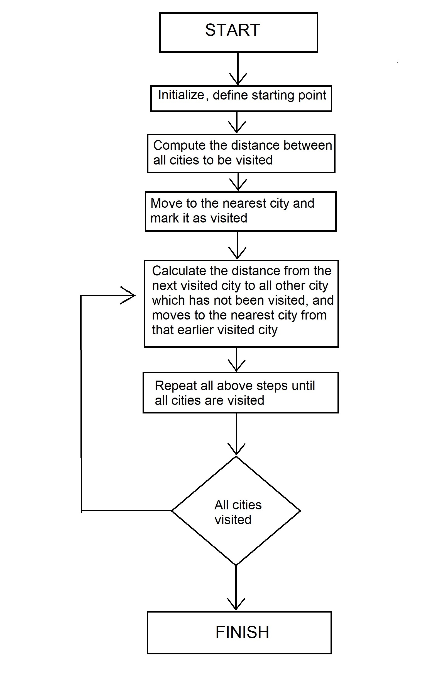
TOP LEVEL BLOCK DIAGRAM

Slide 10
FUNCTION FLOW
main()
input()
calc(int city)
least_city(int i)
storage()

Slide 11
ALGORITHM
Step 1: Enter the number of cities, places, etc.
Step 2: Prompt the user to enter the distance between each and every city.
Step 3: Prompt the user to enter the starting city.
Step 4: Repeat step 2, until all cities are done.
Step 5: Print the cost matrix, which is a graphical representation of all cities with their distances in a matrix.
Step 6: Find the path with the lowest cost or distance, this is an indirect way of calculating the (n-1)! path.
Step 7: Go to the starting city and print it, then mark that city as done.
Step 8: Find the minimum valued element in the row corresponding to the city number.
Step 9: Print the corresponding city name of that element and mark that city as done.
Step 10: Go to the next city, after recording the distance travelled or the cost.
Step 11: Go to step 7, until all the rows (cities) are marked as done.
Step 12: After printing the path, print the distance travelled or the total cost of the given path.

Slide 12
Following are the variables we have used
PROJECT DESCRIPTION
City names[50][50]: This 2D array is used to store the name of all the cities in string (character array).
Arr[10][10]: This 2D array is used to store the array representation of the graph, which is in turn used to represent the travelling salesman problem, where the cities are nodes and the edges are the distances between the nodes.
Done[10]: This 1D array is used to mark the city that have been visited and won’t have to visited again.
Result[10]: This 1D array is used to store the path city in order.

Slide 13
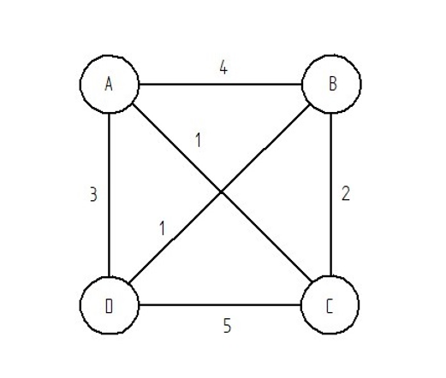
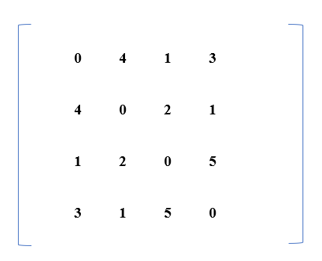
Consider the following graph and its matrix representation.

Slide 14

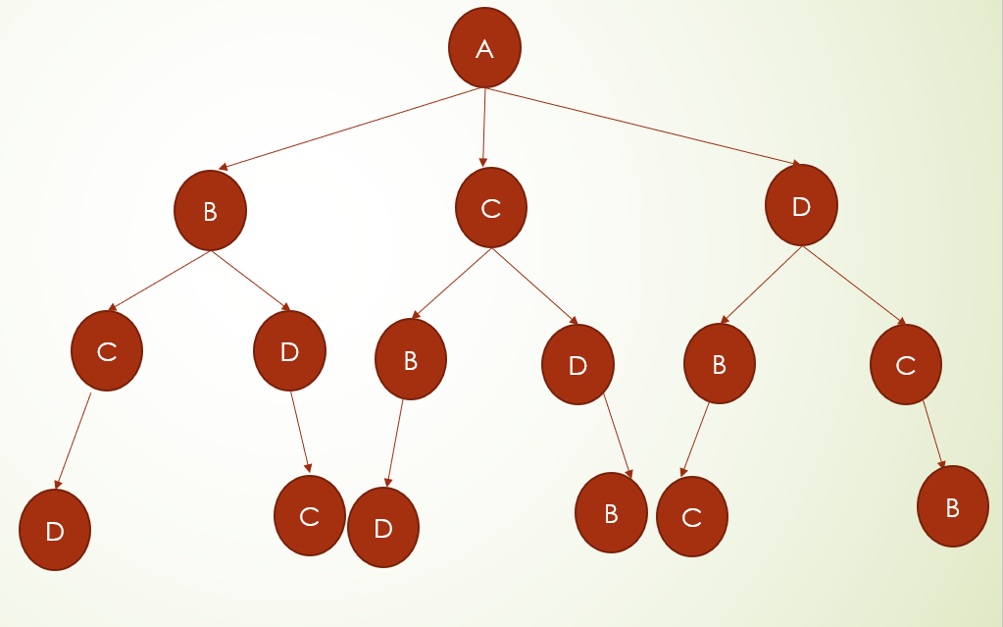
Possible paths for the example taken

Slide 15
The above graph has the following path:
A > B > C > D > A
A > B > D > C > A
A > C > B > D > A
A > C > D > B > A
A > D > B > C > A
A > D > C > B > A
Now there is a tree like structure in the path, which means that when the program is in node A, its looks for the nearest node and keeps on doing that until it reaches the starting node (A).
So, the algorithm calculates the distances from node A to B, C or D, which is represented by the weight of the edges. It them moves to the least weighted node and repeats the process until it reaches the starting node.

Slide 16
OUTCOME OF PROJECT
The outcome of this project is that the shortest path between N cities having the same start and end points was achieved. Concepts of array, trees and linked list with deletion and incretion learnt.

Slide 17
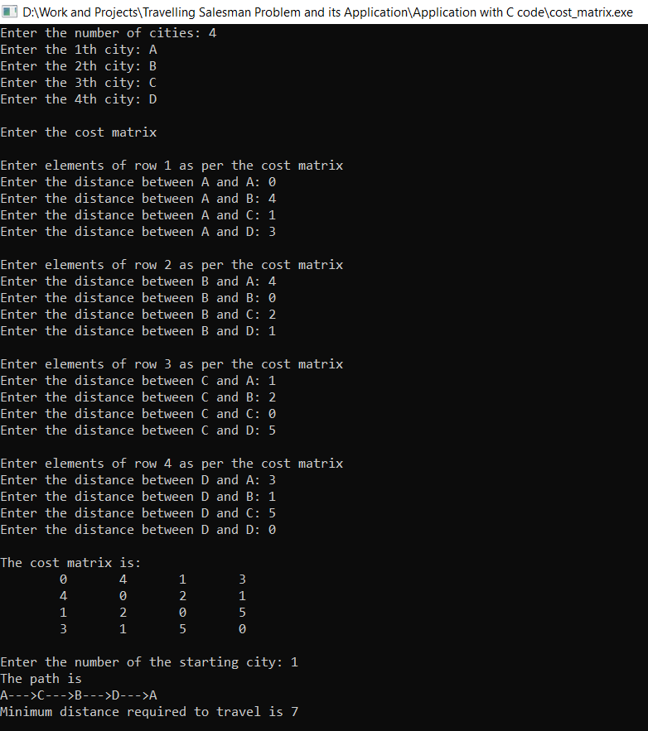
SAMPLE OUTPUT

Slide 18
Advantages & Disadvantages of Greedy’s Algorithm
Advantages | Disadvantages
Simple and Intuitive algorithm | Fail to find the globally optimal solution because they do not consider all the data
Analyzing the run time for greedy algorithms will generally be much easier than for other techniques. | The choice made by a greedy algorithm may depend on choices it has made so far, but it is not aware of future choices it could make

Slide 19
Applications of the TSP include:
APPLICATIONS
Fulfilling orders by logistic companies.
Drilling.
Astronomy.
School bus scheduling.
GPS satellite systems.
Designing and building printed circuit boards.
Analyzing an X-Ray.

Slide 20
REFERENCES
WIKIPEDIA https://en.wikipedia.org/wiki/Travelling_salesman_problem
GEEKSFORGEEKS https://www.geeksforgeeks.org/travelling-salesman-problem-set-1/
NEW MEXICO STATE UNIVERSITY
https://www.cs.nmsu.edu/~dcook/thesis/paper2.html
HACKEREARTH
https://www.hackerearth.com/practice/algorithms/greedy/basics-of-greedy-algorithms/tutorial/
IEEE Xplore Digital Library

Slide 21


