Slide 1


Active Contour Modeling for Brain Tumor Detection

Slide 2

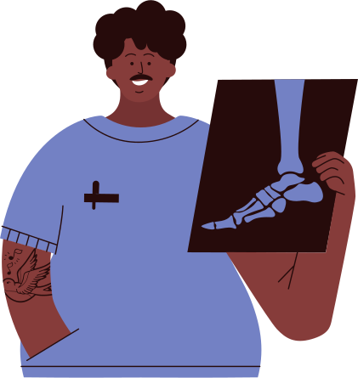
Automated Brain Tumor Detection using Active Contours
Brain tumors are among the most challenging medical conditions, requiring precise and timely detection for effective treatment. Manual interpretation of medical images like MRI scans can be time-consuming and prone to error, making automated methods essential for accurate tumor identification.
The objective of this project is to implement an active contour model, also known as a "snake," using OpenCV in Python. This advanced image segmentation technique can automatically detect and delineate brain tumors from MRI images, overcoming the limitations of traditional approaches like thresholding and edge detection.

Slide 3

Active Contour Models (Snakes)
Active contour models, also known as "snakes," are a powerful tool in computer vision for detecting and segmenting objects of interest within an image. They work by iteratively deforming an initial contour to minimize an energy function that takes into account both the image characteristics (e.g., edges, texture) and the contour's own properties (e.g., smoothness, curvature).
The key advantage of active contour models is their ability to accurately adapt to the target object's boundaries, making them well-suited for medical image analysis tasks like brain tumor detection. By balancing internal forces that maintain the contour's smoothness with external forces that attract it to image edges, the snake can evolve to fit the tumor's shape and size.
In this project, we will implement an active contour model using OpenCV in Python to automatically segment and detect brain tumors from MRI images, overcoming the limitations of manual interpretation and traditional image processing techniques.

Slide 4


Algorithm Overview
The active contour algorithm for brain tumor detection involves the following key steps:
Initialization: Define an initial contour, often a simple shape like a circle or polygon, that is placed near the suspected tumor region.
Energy Computation: Calculate the internal and external energy terms that will drive the contour's deformation:
Internal Energy: Enforces the smoothness and continuity of the contour, with terms for elasticity (stretching) and bending (curvature).
External Energy: Attracts the contour towards image features like edges and high-intensity regions, using line and edge energy terms.
Energy Minimization: Iteratively adjust the contour's control points to minimize the total energy, which is the sum of the internal and external energy terms.
Convergence: Continue the iterative deformation process until the contour has converged to the tumor's boundary, satisfying the energy minimization criteria.
By carefully balancing the internal and external energy terms, the active contour algorithm can accurately segment the tumor from the surrounding brain tissue, providing a powerful tool for automated brain tumor detection.

Slide 5
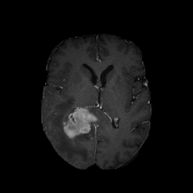
Preprocessing
01.
The input medical images (e.g., MRI, CT scans) are first preprocessed to enhance the contrast and reduce noise, ensuring the tumor boundaries are clearly visible.
Image Processing Steps :
Initialization
02.
An initial contour, typically a circle, is placed around the suspected tumor region. This initial contour will evolve to fit the tumor boundary.
Gradient Calculation
03.
A Sobel filter is applied to the image to compute the image gradient, which highlights the edges within the image. These edges are crucial for the snake's external energy.
Contour Evolution
04.
The contour moves by minimizing its total energy, adjusting its shape to adhere to the edges of the tumor. Over several iterations, the contour "snaps" to the tumor boundary.

Slide 6



CODE IMPLEMENTATION
The active contour algorithm can be implemented using various programming languages and libraries, such as OpenCV, Matlab, or Python. Key aspects of the implementation include:
InternalEnergy: This function calculates the internal energy of the snake based on its current shape, enforcing smoothness and continuity of the contour.
ExternalEnergy: This function computes the external energy by considering pixel intensity and the image gradient, which attracts the contour towards image features like edges and high-intensity regions.
ActiveContour: This function runs the active contour algorithm, iteratively updating the snake's position to minimize the total energy, which is the sum of the internal and external energy terms.
The implementation also relies on the following libraries:
OpenCV
For image processing operations, such as gradient calculation and contour manipulation.
NumPy
For numerical computations, especially with arrays, which are used to represent the snake's control points.
Copy
For deep copying the snake during the iterative optimization process, ensuring the contour's evolution is properly tracked.
Advanced techniques, such as the use of gradient vector flow or region-based energy terms, can further improve the algorithm's performance and robustness

Slide 7
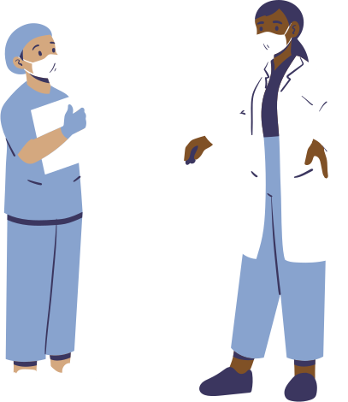
Accuracy
Active contour models have demonstrated high accuracy in brain tumor segmentation, with reported Dice similarity coefficients often exceeding 0.85 when compared to manual expert delineations. This makes them a valuable tool for computer-aided diagnosis and treatment planning.
RESULTS
Clinical Applications
Active contour models have been successfully applied to a variety of brain tumor types, including gliomas, meningiomas, and metastases. They can provide valuable information for treatment planning, response monitoring, and even automated tumor volume quantification.
Robustness
The algorithm's ability to adapt to complex tumor shapes and low-contrast boundaries makes it more robust than traditional segmentation techniques. This is particularly important in cases of infiltrative or irregularly shaped tumors, which are challenging to detect with other methods.

Slide 8
BONE FRACTURE DETECTION WITH ROVREN

Slide 9
Advanced Bone Fracture Detection: Integrating Image Processing and CNNs
A broken bone or bone fracture occurs when a force exerted against a bone is stronger than the bone can bear. This disturbs the structure and strength of the bone, and leads to pain, loss of function and sometimes bleeding and injury around the site. Finding fractures in X-ray pictures can be a difficult and time-consuming process that is frequently caused by human mistake. For this reason, the desire for computerized testing tools is expanding.
The objective of this project is to use image processing techniques in rovren to create a reliable fracture detecting system. This system is capable of automatically identifying and highlighting bone fractures from X-ray pictures by using sophisticated algorithms including image processing techniques found in OpenCV. By guaranteeing fast and accurate treatment, this not only increases the specificity and precision of fracture assessment but also greatly improves patient care.

Slide 10
Image Processing Models (ROVREN)
A powerful image processing software called ROVREN was created to improve and accelerate analysis of images for a variety of uses, which include as scientific studies, commercial assessment, and healthcare imaging. With its sophisticated features, which include noise reduction, edge detection, and picture segmentation, users can clearly recognize and define objects or areas of interest in photos.
These abilities are especially useful in industries like healthcare, where detecting diseases like tumors or fractures requires precise visual interpretation. When combined with its potent image enhancement techniques, ROVREN's automatic object detection and labeling capabilities greatly increase the level of clarity and complexity of images, guaranteeing more consistent outcomes.
In order to overcome the limits of human interpretation and conventional image processing approaches, we will create an image processing model in this project utilizing in OpenCv that will segment and identify fractures from X-Ray images.

Slide 11
Algorithm Overview
The image processing algorithm for Bone Fracture detection involves the following key steps:
Pre-processing: The first step in bone fracture detection using OpenCV is converting the RGB (Red, Green, Blue) image to a grayscale image. This step is crucial because grayscale images simplify the processing without losing essential structural information.
Threshold: Thresholding is a key image processing technique used in detecting bone fractures from X-ray images. By converting grayscale images into binary form, thresholding helps to isolate and enhance bone structures, making it easier to identify fractures.
Edge detection- canny: Canny edge detection is a popular edge detection algorithm used in image processing to identify the boundaries of objects within an image.
Structuring Element : A key component in these operations is the structuring element, which defines the shape and size of the neighborhood used to process the image.
Morphological Closing: The morphological closing operation, which applies the structuring element, helps to fill in gaps and remove noise from the edge-detected image

Slide 12
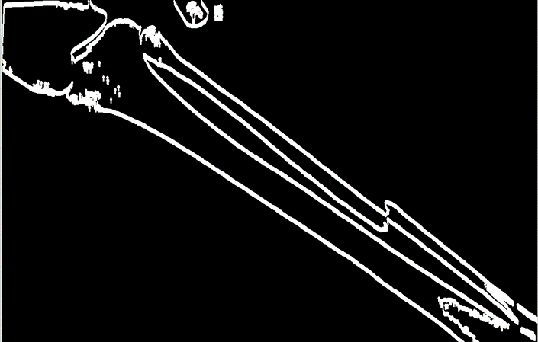
Preprocessing
01.
The first step in bone fracture detection using OpenCV is converting the RGB (Red, Green, Blue) image to a grayscale image
Image Processing Steps :
Threshold
02.
converting grayscale images into binary form, thresholding helps to isolate and enhance bone structures, making it easier to identify fractures
Edge detection
03.
Canny edge detection is a popular edge detection algorithm used in image processing to identify the boundaries of objects within an image.
Morphological Closing:
04.
The morphological closing operation, which applies the structuring element, helps to fill in gaps and remove noise from the edge-detected image

Slide 13
Future Enhancement
Machine Learning and Deep Learning
Purpose: Enhance detection accuracy by leveraging advanced learning techniques.
Techniques: CNNs for Bone Fracture Detection
Overview: Convolutional Neural Networks (CNNs) are deep learning models used to automatically detect and classify features in images. They are particularly effective for identifying bone fractures in X-ray images.
How It Works:
Convolutional Layers: Extract local features such as edges and textures.
Pooling Layers: Reduce image size while retaining essential information.
Fully Connected Layers: Classify the presence or absence of fractures.
Benefits:
Automatic Feature Extraction: Eliminates the need for manual feature selection.
High Accuracy: Detects subtle fracture details effectively.
Adaptability: Trained on diverse data to recognize various fracture types.
Process:
Data Collection: Collect and label X-ray images.
Model Training: Train CNN on these images.
Evaluation: Test and validate model performance.
Advanced Techniques:
Transfer Learning: Utilize pre-trained models to enhance performance.
Ensemble Methods: Combine models to improve detection accuracy.

Slide 14
Improved Fracture Visibility
Pre-processing techniques like grayscale conversion, thresholding, and edge detection enhance the clarity of X-ray images, making fractures easier to spot.
RESULTS
Promising Diagnostic Tools
The combination of traditional image processing and CNNs offers reliable tools for timely and accurate fracture diagnosis.
Accurate Automatic Detection
CNNs effectively identify fractures without manual feature selection, leading to higher accuracy.

Slide 15

Conclusion
Active contour models, or "snakes," are a powerful tool for the detection and segmentation of brain tumors in medical imaging. By leveraging the image's characteristics and the contour's own properties, these algorithms can accurately delineate tumor boundaries, even in complex cases. The implementation details and the handling of various challenges are crucial for achieving robust and reliable results. As the field of computer-aided diagnosis continues to evolve, active contour models will likely play an increasingly important role in the early detection and management of brain tumors.
Advanced bone fracture detection in healthcare is being revolutionized by cutting-edge image processing techniques. By employing methods such as grayscale conversion, thresholding, and edge detection, the clarity of X-ray images is dramatically enhanced, allowing for precise identification of fractures. When integrated with the power of Convolutional Neural Networks (CNNs), these innovations transform the accuracy and efficiency of fracture detection, reducing human error and ensuring that no fracture goes unnoticed. This synergy of advanced technology and medical expertise is paving the way for a new era in healthcare, where timely and accurate diagnoses lead to faster, more effective treatments and significantly improved patient outcomes.
4o

Slide 16
References
Kass, M., Witkin, A., & Terzopoulos, D. (1988). Snakes: Active contour models. International journal of computer vision, 1(4), 321-331.
Xu, C., & Prince, J. L. (1998). Snakes, shapes, and gradient vector flow. IEEE Transactions on image processing, 7(3), 359-369.
Gibbs, P., Buckley, D. L., Blackband, S. J., & Horsman, A. (1996). Tumour volume determination from MR images by morphological segmentation. Physics in Medicine & Biology, 41(11), 2437.
Zhao, F., & Xie, X. (2013). An overview of interactive medical image segmentation. Annals of the BMVA, 2013(7), 1-22.
Detection of bone fracture based on machine learning techniques.Authors:Kosrat Dlshad Ahmed, Roojwan Hawezi

Slide 17



Thank you!
Fauget Doctors

