Slide 1
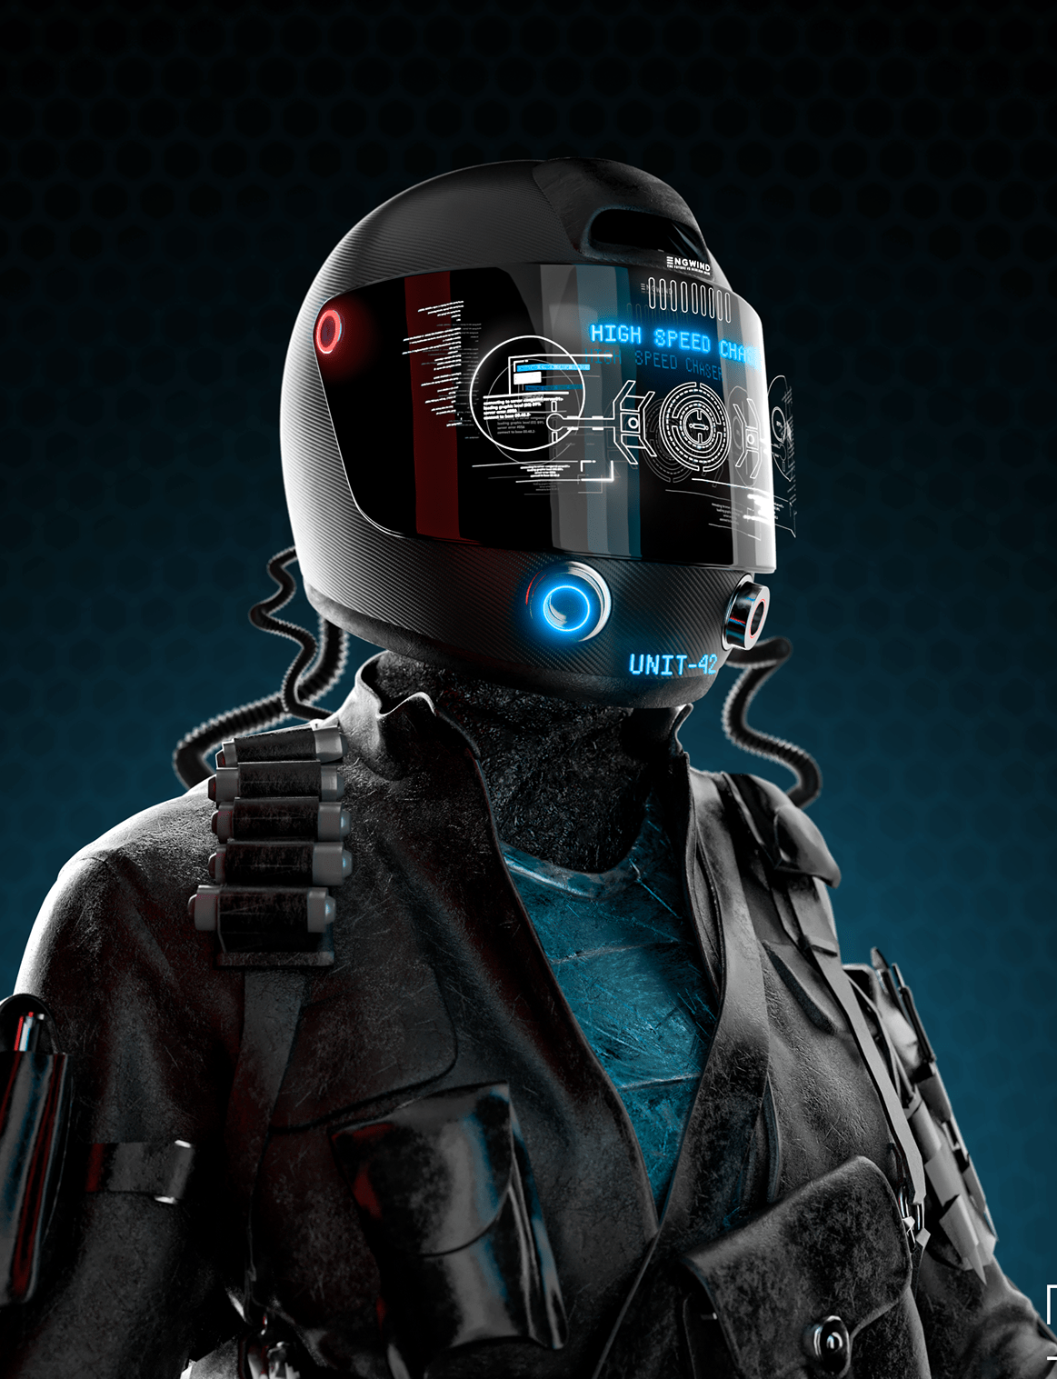

Revolutionizing road safety with Smart Helmets
Introducing the world to our innovative Smart Helmets. Our company is dedicated to bringing cutting-edge technology to improve the safety of riders all over the world.
by Nikhil Gupta

Slide 2

About Us
Our Mission
purpose
Our mission is to make roads safer for everyone. We believe that Smart Helmets are the key to achieving this goal, and we're committed to bringing this technology to as many people as possible.
purpose of the product is to provide safety by providing the information of surroundings by using the technology and allow the user to access his/her phone functionalities by his/her voice.

Slide 3
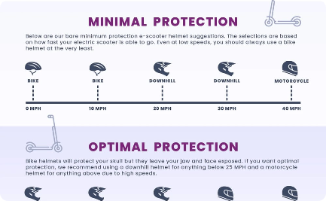

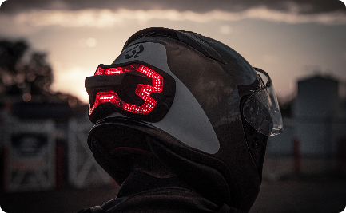
Product Overview - Smart Helmets
The Ultimate Safety Gadget
Comfortable Design
Enhanced Visibility
Our helmets are incredibly lightweight and have been designed to fit comfortably on the head, ensuring that the rider always feels at ease while wearing them.
Our helmets come with built-in LED lights that provide enhanced visibility, making it easier for other drivers and riders to see the rider wearing them.
Our Smart Helmets are equipped with a range of high-tech features, including Bluetooth, GPS, and motion sensors, making them the ultimate safety gadget for riders.

Slide 4

Why Smart Helmets are Unique
1
Intuitive Tech
2
Customizable Settings
Our Smart Helmets use technology that is intuitive and easy to use, making the rider's journey more enjoyable and safe.
Riders can customize the settings on their Smart Helmets to suit their preferences, making the helmets work exactly the way they want them to.
3
Integrated Technology
Our helmets integrate a range of technologies, including Bluetooth, GPS, and motion sensors, making them the ultimate safety gadget for riders.

Slide 5
The Design Thinking Process
Ideate
Test
We brainstorm creative ideas and concepts, exploring every possible option to ensure that we come up with the best possible solution.
We conduct extensive testing on our products, ensuring that they meet all regulatory requirements and are safe for our customers to use.
1
2
3
4
Empathy
Prototype
We take the time to understand our customers' needs, ensuring that we create products that are truly tailored to their requirements.
We develop prototypes of our products, testing them in real-world scenarios to ensure that they meet our standards of quality and safety.

Slide 6
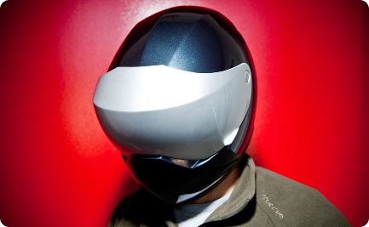
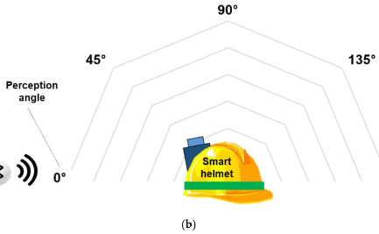
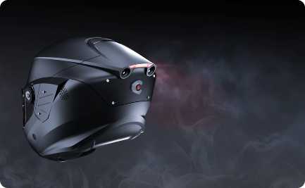
Design Thinking Implementation on Smart Helmets
Prototyping
Testing
Ideation
We developed multiple prototypes of our Smart Helmets, testing them extensively to ensure that they meet our high standards of quality and safety.
We conducted extensive testing on our Smart Helmets, ensuring that they meet all regulatory requirements and are safe for riders to use.
We brainstormed creative ideas and concepts to ensure that our Smart Helmets were truly innovative and unique.

Slide 7
Market Size and Government Initiatives
Market Size
Estimated to reach $1.2 billion by 2026 (Source: ZionMarketResearch)
Government Initiatives
Many governments around the world are promoting the use of Smart Helmets to improve road safety and reduce the number of accidents.
Government grants
Governments provide grants for research and
development, production, and exportation of
motor accessories. This helps entrepreneurs and
businesses to reduce financial risks and increase
innovation.

Slide 8
Official Documentation Needed
Patents
Regulatory Approvals
We filed multiple patents for the technology used in our Smart Helmets to protect our innovative designs and ensure that our products remain unique in the market.
We obtained all necessary regulatory approvals for our Smart Helmets, ensuring that they meet all safety standards and can be sold in markets around the world.

Slide 9
Conclusion
In conclusion, Smart Helmets are a promising technology that can revolutionize the motorcycle industry and
enhance the riding experience. Through design thinking, we were able to empathize with the user, define the
problem, generate creative ideas, develop and test prototypes, and collect feedback. The next steps would be to
refine the design further, develop a scalable business model, and ensure regulatory compliance.
The Future
We're excited about the future of our company and the impact that our Smart Helmets will have on the world. We're committed to innovation and will continue to develop products that make a difference in people's lives.

