Slide 1

MACHINE VISION BASED FRUIT GRADING SYSTEM
Jyothy Institute of Technology Tataguni, Bengaluru-560082 Department of Information Science and Engineering Accredited by NBA, New Delhi 2018-2019
Team Members:
Nikhil J (1JT15IS023)
Paavana G(1JT14IS031)
Puttamarigowda M S (1JT15IS026)
Tejamallik K S (1JT15IS048)
Under the guidance of:
Dr.Harshvardhan Tiwari
Assoc.prof. & Head
Dept. of ISE,JIT.

Slide 2
Introduction
Grading is sorting of vegetables and fruits into different grades according to size ,shape,color and volume.
It is essential process for post harvest management .
It depends on the physical characteristics.
The manual Grading is difficult for farmers.

Slide 3
Objectives
To Automate the grading System for Smart Farming.
To overcome shortcomings of manual grading of fruits.
To include all the physical characteristics as basis for sort the fruits quickly.
To apply best segmentation technique to extract all the required features from the images.
To explore the feasibility and applicability of such system in Agriculture oriented states like Karnataka.
To analysis the image parameters that is appropriate for the fruits classification problem.
To increase the shelf life of the fruits.

Slide 4
Problem Statement
The post harvesting operations like grading and sorting is the prime source of delay.
These processes are repetitive , labour intensive and time Consuming.
These processes are carried out by humans through visual Inspection causes problems of consistency and uniformity in grading.

Slide 5
Literature Review
[1] Song Yuhengi, Yan Haoi in “Image Segmentaion Alogrithms Overview ” have exhibit different segmentation for different applications.
[2] Payman Moallem, Alireza Serajoddin, Hossein Pourghassem in “Computer vision-based apple grading for golden delicious apples based on surface features” aim to remove background from the image and perform respective segmentation to remove calyx regions and to reduce Noise in the dataset.
[3] Devrim Unay and Bernard Gosselin in “Thresholding -based Segmentation and Apple Grading By Machine Vision ” have exhibited to classify fruits into healthy and defected by using classifier algorithms

Slide 6
Proposed System/Methodology
Capture the Images of fruit using Optical Colour Camera
Background removal.
Detect and remove the stem.
Detect and refine calyx region
Detect primary Defect in fruit.
Feature Extraction
Classification

Slide 7
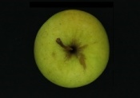
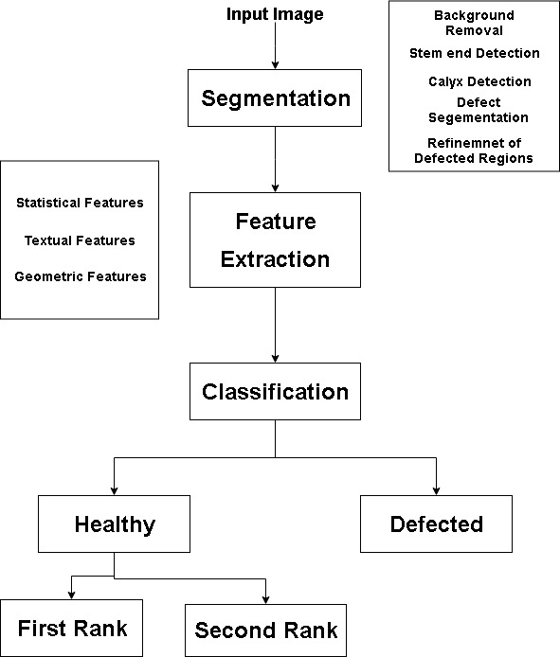
Fig.1.1:Overview of Proposed System

Slide 8
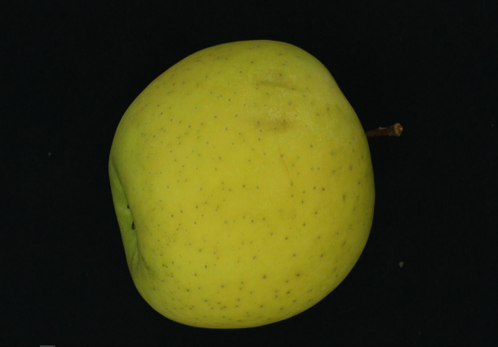
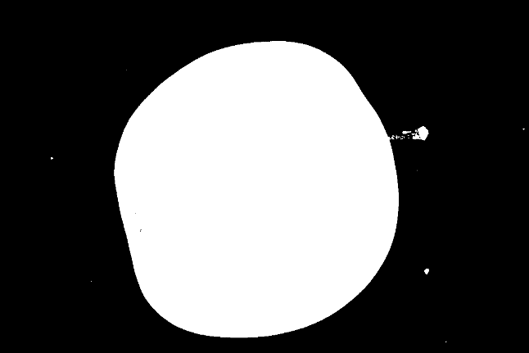
Results
Background Removal

Slide 9
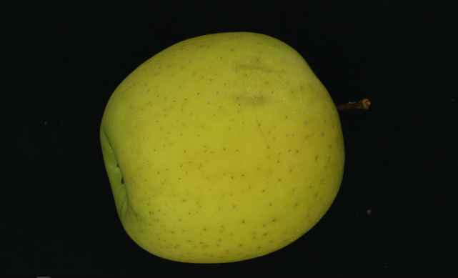
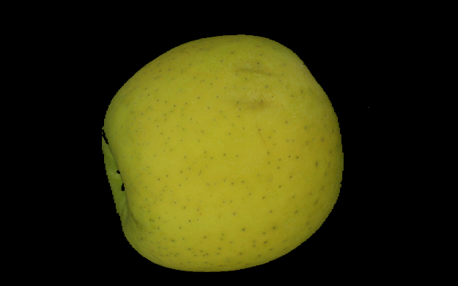
Removal of Stem end inside the fruit

Slide 10
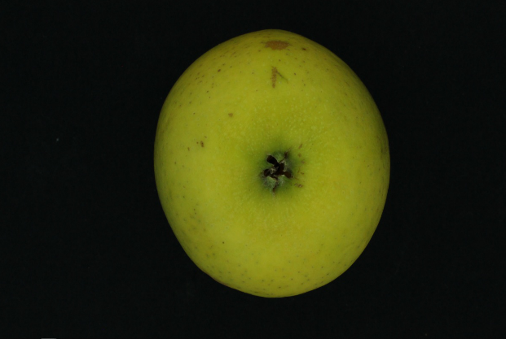
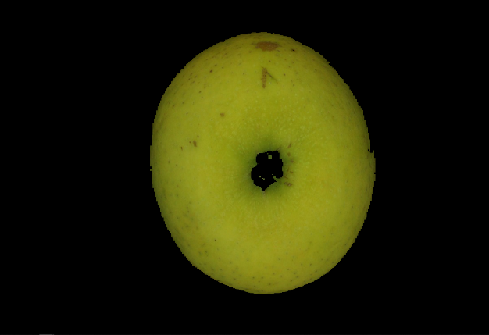
Removal of Calyx and Stem end inside the fruit

Slide 11
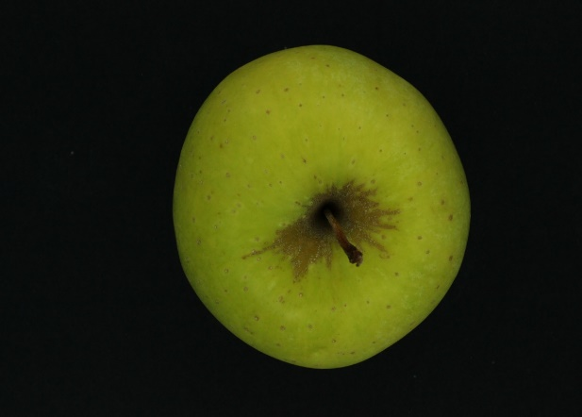

Primary Defect Segmentation

Slide 12


Refinement of defect region
The system is tested with different shapes and size of fruit from the dataset , the results has 85% accuracy in classification of fruits based on the features of the fruit.

Slide 13
References
[1]. Computer vision-based apple grading for golden delicious apples based on surface features, Payman Moallem, Alireza Serajoddin, Hossein Pourghassem journal in information processing in Agriculture.
[2].Thresholding -based Segmentation and Apple Grading By Machine Vision by Devrim Unay and Bernard Gosselin published in TCTS Labs.
[3].Image Segmentaion Alogrithms Overview , Song Yuhengi, Yan Haoi published paper in SiChaun University.

Slide 14
Thank you

