Slide 1

MODIFIED SPI PROTOCOL IMPLEMENTATION USING VERILOG HDL
Mini-Project
by
Rahul V | 221039020
Nikhilkumar Agasar | 221039026
Under the guidance of
Dr. Mohan Kumar Jayasubramanian (Associate Professor)
Manipal School of Information Science

Slide 2
Presentation Outline
Introduction
Objectives
Literature Review
Block Diagram
Schematic Diagram
Methodology
Results
Conclusion
References

Slide 3
1. Introduction
Communication between electronic devices is very much essential in today’s scenario.
It needs different devices to interact and is required to transmit data from device to device.
Both sides need to speak the same language. In electronics, these languages are called communication protocols.
In our project we are using SPI protocol which is synchronous and full duplex type. SPI is a serial communication bus developed by Motorola.
It is a full-duplex protocol that functions on a master-slave paradigm that is ideally suited to data stream applications.

Slide 4
1. Introduction
SPI PROTOCOL
The Serial Peripheral Interface (SPI) is a synchronous interface that allows several SPI microcontrollers to be interconnected.
In SPI, separate wires are required for data and clock lines and it is full duplex.
Also the clock is not included in the data stream and must be furnished as a separate signal. The SPI may be configured either as a master or as a slave.
The four basic SPI signals (MISO, MOSI, SCK, and SS).
The SPI can have an unlimited number of slaves. The data communication is configured in SPI registers.
The SPI can deliver up to 10Mbps of speed and is ideal for high-speed data communication.

Slide 5
1. Introduction
There are two types of configurations in which the SPI devices can be connected in an SPI bus. They are Independent Slave Configuration and Daisy Chain Configuration.

Slide 6
2. Objectives
To study and understand the SPI protocol and the controller aspects
To design modified SPI for reducing the chip selection pins for Slaves
To simulate the waveforms of the Modified SPI protocol and show its working.

Slide 7
3. Literature Review
Authors | Year | Title | Key Findings
Shumit Saha, Md. Ashikur Rahman, Amit Thakur | 2014 | Design and Implementation of SPI Bus Protocol with Built-In-Self-Test Capability over FPGA | The comparator used to verify the bit format using some value which gave us idea about using comparator. The waveforms which are given in the paper made us to understand the working of different modules and we could figure out the nature of the waveform in what way we should get that

Slide 8
3. Literature Review
Authors | Year | Title | Key Findings
T. Durga Prasad, B. Ramesh Babu | 2014 | Design and Simulation of SPI Master / Slave Using Verilog HDL | They talks about the master mode operation and slave mode operation by using master control bit. This paper gives the total structure about Master and Slave verification of Testing and Design along with functional verification.

Slide 9
3. Literature Review
Authors | Year | Title | Key Findings
Dvijen Trivedi, Aniruddha Khade, Kashish Jain, Ruchira Jadhav | 2018 | SPI to I2C Protocol Conversion Using Verilog. | This gives an extract about how to design an SPI FSM for the simulation purpose a top-level design SPI to I2C was implemented

Slide 10
3. Literature Review
Authors | Year | Title | Key Findings
Anand N, George Joseph, Suwin Sam Oommen, and R Dhanabal | 2014 | Design and Implementation of High-Speed Serial Peripheral Interface | It gives an idea about the implementation of the high-speed serial peripheral interface which is having a control register to implement the work of Master mode or slave mode. The control register can be programmed by the user to initiate the data transfer between the master and the slaves.

Slide 11
3. Literature Review
Authors | Year | Title | Key Findings
Frédéric Leens | 2009 | An Introduction to I2C and SPI Protocols | This paper has helped us in implementing the block diagrams for our project and understanding the entire protocols in the detailed manner. It also gives brief comparison between I2c and SPI with frame formats and timing diagrams respectively.

Slide 12
4. Block Diagram
SCK
MOSI
MASTER
MISO
SLAVES
SS
MOSI: Master Out Slave In
MISO: Master In Slave Out
SCL: Clock Signal
SS/CS: Chip Select

Slide 13
4. Block Diagram
SCK
MOSI
MISO
SLAVE 1
MASTER
SS 1
SS 2
SLAVE 2
SLAVE 3
SS 3

Slide 14
4. Block Diagram
SCK
MOSI
MISO
SLAVE 1
MASTER
SS
1 : 16
DEMUX
.
.
.
.
.
SLAVE 2
.
.
.
.
.
SLAVE 16

Slide 15
5. Methodology
CDIV
CLK
D_OUT
D_IN
MLB
SPI
MASTER
SCK
RSTB
SS
START
T_DATA

Slide 16
5. Methodology
CDIV: It is used to store a divisor for use in the generation of the SCK signal, based on the external clock signal (CLK). As part of the SPI Clock Generation Unit, an internal counter is used to count up to the value written to the CDIV. The next edge of SCK will only be generated when the internal counter reaches this divisor value.
CLK: Clock signal. Controlled by the master device. A new data bit is shifted out with each clock cycle.
D_IN: This is the MISO signal that is coming from the slave which is abbreviated as data in.
MLB: This is used to select the endianness of data whether the data is to be stored from LSB or MSB. If MLB=0, the reading and storing sequence pattern is from LSB. If MLB=1, the reading and storing sequence pattern is from MSB.

Slide 17
5. Methodology
RSTB: This is the reset bit of the master, this will reset the circuit, if rstb=0, then the state is finish that leads to idle state.
START: This signal starts the data transmission.
T_DATA: This signal is input helps in storing data from the system which in turn to be sent to slave.
D_OUT: This is the MOSI signal which is to be sent to slave, the data is to be sent to slave data out.
R_DATA: Received data signal which is a output which holds the data from master and to send it to tdata in slave.
SCK: Serial Clock, this signal manages clock signal between master and slave.
SS: This signal is used to select the slave for communication.

Slide 18
5. Methodology
MLB
RSTB
SCK
SD_IN
SPI
SLAVE
SD_OUT
SS
T_DATA
TEN

Slide 19
5. Methodology
MLB: This is used to select the endianness of a data whether the data to be stored from LSB or MSB. If MLB=0, the reading and storing sequence pattern is from LSB. If MLB=1, the reading and storing sequence pattern is from MSB.
RSTB: This is the reset bit of the master, this will reset the circuit, if rstb=0, then the state is finish that leads to idle state.
SCK: Serial Clock, this signal manages clock signal between master and slave.
SS: This signal is used to select the slave for communication.
T_DATA: This signal is input helps in storing data from the master rdata which in turn to be sent to master.

Slide 20
5. Methodology
SD_IN: This signal is MOSI which is used to take serial data from master.
T_EN: Transmission enable signal which is used to enable the transmission back to master from slave.
SD_OUT: This signal is used to transfer data from slave to din of master.
R_DATA: Received data signal which is a output which holds the data received.
Done: This signal indicates the end of transmission of data from master to slave and vice versa.

Slide 21
5. Methodology
In typical SPI communication protocol if the number of slaves increases then the number of slaves select signals should be increased. by increasing the slave select signals in the master it increases the space complexity of the protocol.
By analyzing these scenarios, we approached a modified SPI protocol by adding the extra block of demux in between the master and the slaves.
In our project, we used 16 slaves and 1 master for communication.

Slide 22
5. Methodology
We feed an active low slave selection line into the input of demux, on the basis of slave address particular slave is selected for the communication by channelizing the output of the demux to the respective slaves.
Hence, the communication between the master and slave/s is fulfilled.

Slide 23
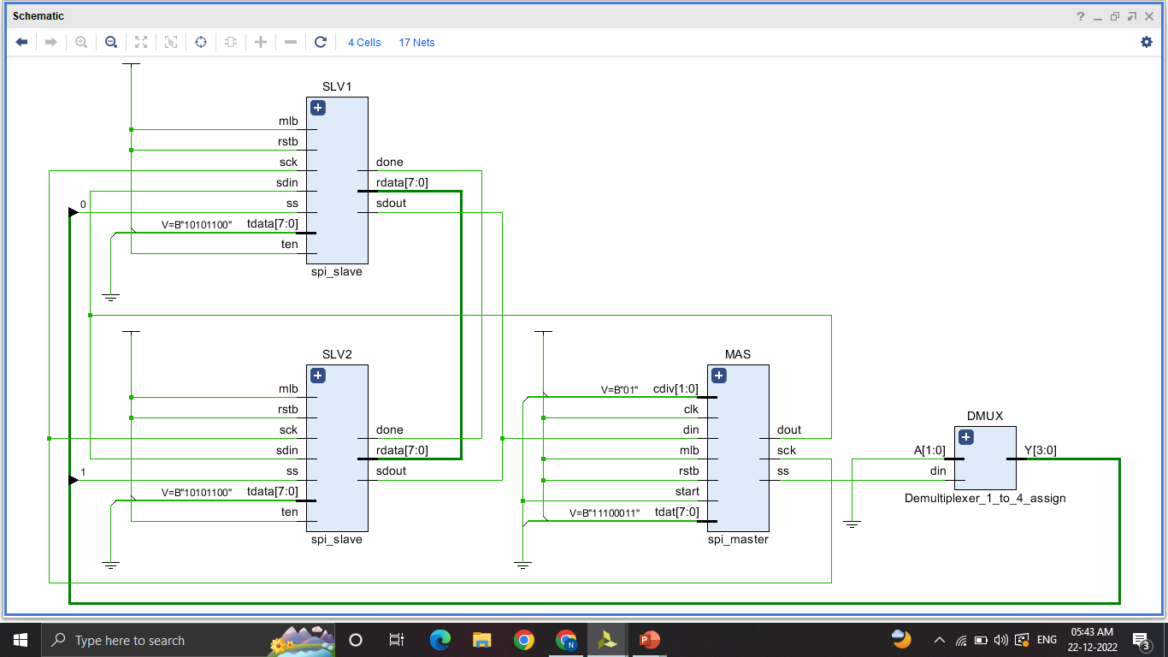
6. Schematic Diagram

Slide 24
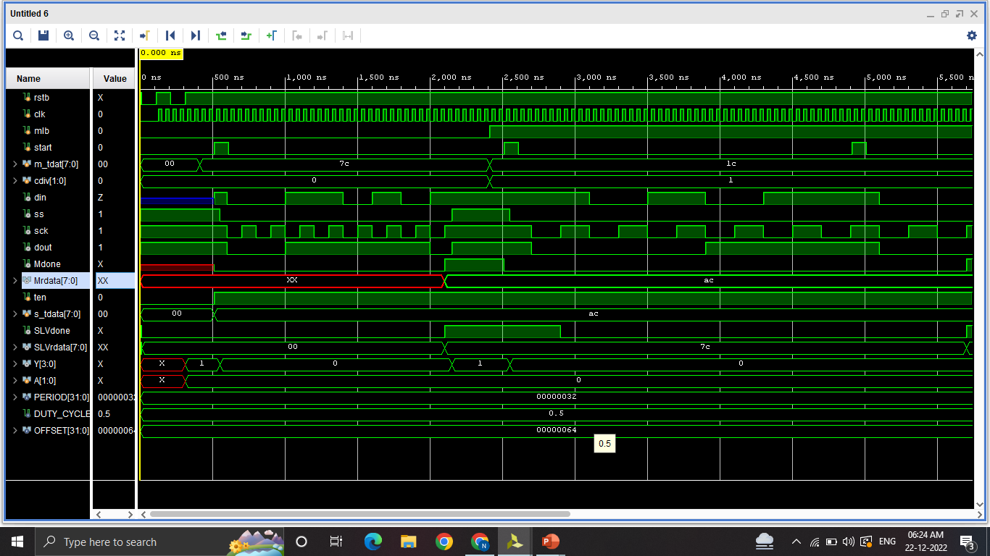
7. Results

Slide 25
7. Results
The result analysis of SPI protocol is obtained when the data which is given at the Master is transferred to Slave and vice versa is fulfilled.
In the part of Modified SPI, the slaves are called with their particular address and the data is transferred from master to particular mentioned slave.
The address of a slave to which data has to be transferred is mentioned in Testbench.

Slide 26
7. Results
Case 1:
The Data which we have given is 7C = 01111100 which is to be transferred from master to slave, from fig. 5.1.1 we can note that the at start the data is present at m_tdat[7:0] which is transferred to SLVrdata[7:0] after 8 SCK clock signals each SCK signal is of 2 units and the slave address given is A=0001
Case 2:
The Data which we have given is AC = 10101100 which is to be transferred from slave to master, from fig. 5.1.1 we can note that the at start the data is present at s_tdat[7:0] which is transferred to Mrdata[7:0] after 8 SCK clock signals each SCK signal is of 2 units and the slave address given is A=0001

Slide 27
7. Results
Hence, from the above-given cases, we can verify that the data is transferred from Master to Slave and as well as Slave to Master which will fulfil our aim to transfer the data as SPI is a full duplex.

Slide 28
8. Conclusion
From the given result analysis, we can sum up that, understanding and implementing SPI controller aspects using Verilog HDL is achieved. Designing and implementing Modified SPI using Verilog HDL and data transfer is verified using Demux.
Simulation of waveforms of Modified SPI using Verilog HDL is achieved and verified.
After analyzing the waveforms of the SPI protocol of multiple slaves in typical form and comparing them with Modified SPI, the Modified SPI reduces the complexity by space and time.

Slide 29
8. Conclusion
The modified SPI protocol has some advantages over the typical SPI protocol.
This design saves space and makes adding and removing slaves easy.
Modified SPI can reduce the area and hardware components that are used in designing.

Slide 30
References
S. Saha, M. A. Rahman and A. Thakur, "Design and implementation of SPI bus protocol with Built-in-self-test capability over FPGA," 2014 International Conference on Electrical Engineering and Information & Communication Technology, 2014, pp. 1-6, doi: 10.1109/ICEEICT.2014.6919076.
Prasad, Tadi Durga and B. Ramesh Babu. “Design and Simulation of SPI Master / Slave Using Verilog HDL.” (2014). Paper ID: 02015624 International Journal of Science and Research (IJSR) ISSN (Online)
D. Trivedi, A. Khade, K. Jain and R. Jadhav, "SPI to I2C Protocol Conversion Using Verilog," 2018 Fourth International Conference on Computing Communication Control and Automation (ICCUBEA), 2018, pp. 1-4, doi: 10.1109/ICCUBEA.2018.8697415.
Anand N, G. Joseph, S. S. Oommen and R. Dhanabal, "Design and implementation of a high speed Serial Peripheral Interface," 2014 International Conference on Advances in Electrical Engineering (ICAEE), 2014, pp. 1-3, doi: 10.1109/ICAEE.2014.6838431.
F. Leens, "An introduction to I2C and SPI protocols," in IEEE Instrumentation & Measurement Magazine, vol. 12, no. 1, pp. 8-13, February 2009, doi: 10.1109/MIM.2009.4762946.

Slide 31
Queries
&
Suggestions

Slide 32
THANK YOU…

