Slide 1

DESIGN AND SIMULATION OF SPI CONTROLLER USING VERILOG
Mid mini-Project
by
Rahul V | 221039020
Nikhilkumar Agasar | 221039026
Under the guidance of
Dr. Mohan Kumar Jayasubramanian (Associate Professor)
Manipal School of Information Science

Slide 2
Presentation Outline
Introduction
Literature Review
Block Diagram
Schematic Diagram
Objective
Methodology
Inference
8. References

Slide 3
1. Introduction
COMMUNICATION
Communication between electronic devices is very much essential in today’s scenario as it needs different devices to interact and required to transmit data from device to device. Both sides need to speak the same language. In electronics, these languages are called communication protocols.
There are two types of communication when we refer to embedded systems and microcontrollers.
They are Serial Communication and Parallel Communication.
In serial communication the data bits are transmitted serially one by one i.e., bit by bit on single communication line, It requires only one communication line rather than n lines to transmit data from sender to receiver.

Slide 4
1. Introduction
PARALLEL COMMUNICATION
all the bits of data are transmitted simultaneously on separate communication lines. In order to transmit n bit, n wires or lines are used.
Examples of Parallel Communication Protocols are ISA, ATA, SCSI, PCI and IEEE-488.
SERIAL COMMUNICATION
In serial communication the data bits are transmitted serially one by one i.e., bit by bit on single communication line, It requires only one communication line rather than n lines to transmit data from sender to receiver.
Serial communication uses two methods: Asynchronous and Synchronous. Asynchronous, this type transfers single byte at a time, it does not need of clock signal.

Slide 5
1. Introduction
Examples of Serial Communication Protocols such as CAN, ETHERNET, I2C, SPI, RS232, USB, 1-Wire, and SATA etc.
Serial communication is the most widely used approach to transfer information between data processing peripherals.
Every electronics device whether it is Personal Computer (PC) or Mobile runs on serial communication.
serial communication data is sent in the form of bits i.e. binary pulses and it is well known that, binary one represents the logic HIGH and zero represents the logic LOW.
There are several types of serial communication depending on the type of transmission mode and data transfer.
The transmission modes are classified as Simplex, Half Duplex and Full Duplex.

Slide 6
1. Introduction
SPI PROTOCOL
The Serial Peripheral Interface (SPI) is a synchronous interface which allows several SPI microcontrollers to be interconnected.
In SPI, separate wires are required for data and clock line.
Also the clock is not included in the data stream and must be furnished as a separate signal. The SPI may be configured either as master or as a slave.
The four basic SPI signals (MISO, MOSI, SCK and SS), Vcc and Ground are the part of data communication.
the SPI can have unlimited number of slaves. The data communication is configured in SPI registers.
The SPI can deliver up to 10Mbps of speed and is ideal for high speed data communication.

Slide 7
1. Introduction
There are two types of configurations in which the SPI devices can be connected in an SPI bus. They are Independent Slave Configuration and Daisy Chain Configuration.

Slide 8
2. Literature Review
Authors | Year | Title | Key Findings
Shumit Saha, Md. Ashikur Rahman, Amit Thakur | 2014 | Design and Implementation of SPI Bus Protocol with Built-In-Self-Test Capability over FPGA | The comparator used to verify the bit format using some value which gave us idea about using comparator. The waveforms which are given in the paper made us to understand the working of different modules and we could figure out the nature of the waveform in what way we should get that

Slide 9
2. Literature Review
Authors | Year | Title | Key Findings
T. Durga Prasad, B. Ramesh Babu | 2014 | Design and Simulation of SPI Master / Slave Using Verilog HDL | They talks about the master mode operation and slave mode operation by using master control bit. This paper gives the total structure about Master and Slave verification of Testing and Design along with functional verification.

Slide 10
2. Literature Review
Authors | Year | Title | Key Findings
Dvijen Trivedi, Aniruddha Khade, Kashish Jain, Ruchira Jadhav | 2018 | SPI to I2C Protocol Conversion Using Verilog. | This gives an extract about how to design an SPI FSM for the simulation purpose a top-level design SPI to I2C was implemented

Slide 11
2. Literature Review
Authors | Year | Title | Key Findings
Anand N, George Joseph, Suwin Sam Oommen, and R Dhanabal | 2014 | Design and Implementation of High-Speed Serial Peripheral Interface | It gives an idea about the implementation of the high-speed serial peripheral interface which is having a control register to implement the work of Master mode or slave mode. The control register can be programmed by the user to initiate the data transfer between the master and the slaves.

Slide 12
2. Literature Review
Authors | Year | Title | Key Findings
Frédéric Leens | 2009 | An Introduction to I2C and SPI Protocols | This paper has helped us in implementing the block diagrams for our project and understanding the entire protocols in the detailed manner. It also gives brief comparison between I2c and SPI with frame formats and timing diagrams respectively.

Slide 13
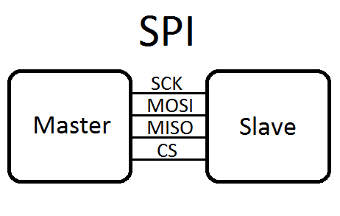
3. Block Diagram
MOSI: Master Out Slave In
MISO: Master In Slave Out
SCL: Clock Signal
SS/CS: Chip Select

Slide 14
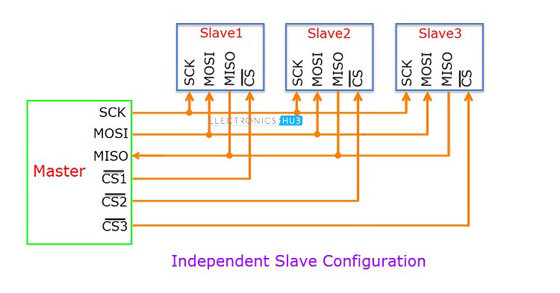
3. Block Diagram

Slide 15
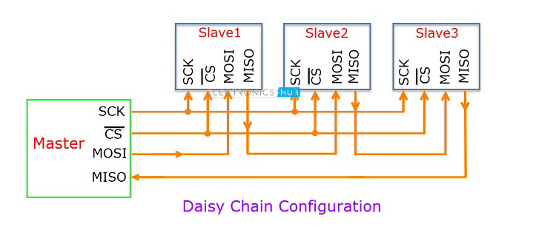
3. Block Diagram

Slide 16
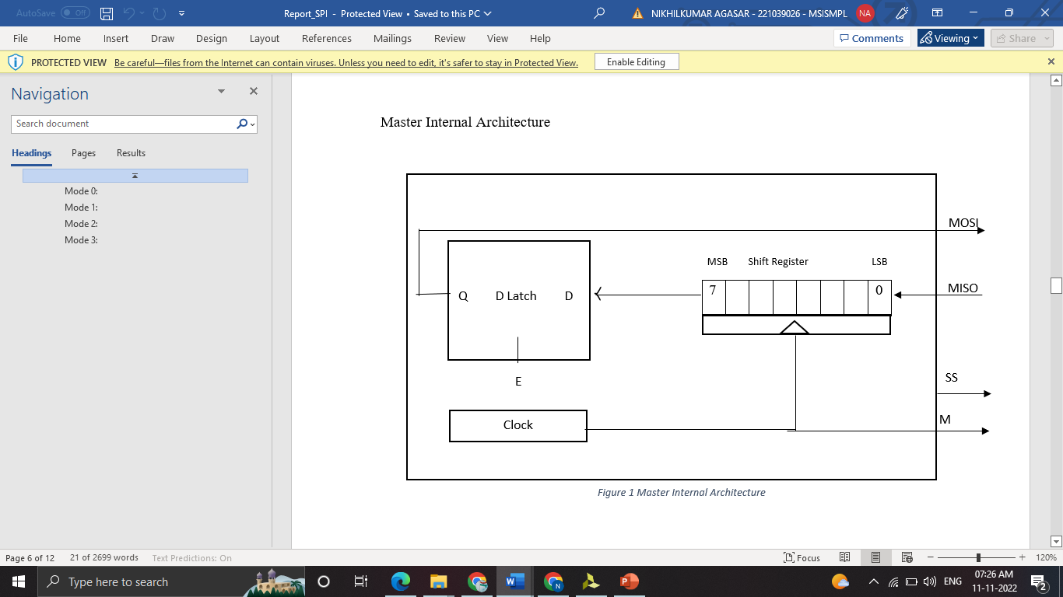
4. Schematic Diagram

Slide 17
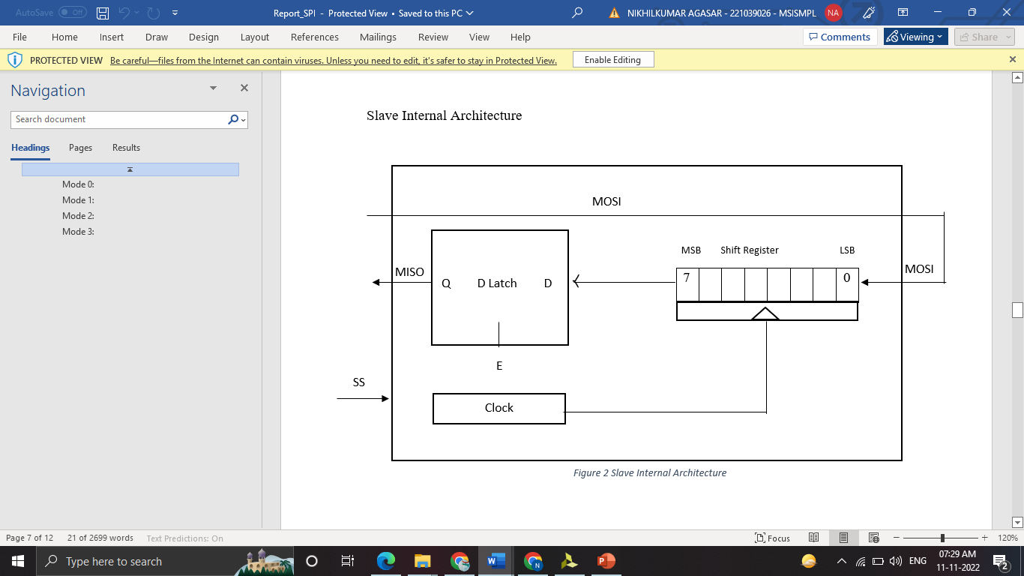
4. Schematic Diagram

Slide 18
5. Objectives
To study and understand the SPI protocol and the controller aspects.
To design SPI protocol using Verilog HDL.
To simulate the waveforms of the SPI protocol and show its working.

Slide 19
6. Methodology
MLB
dout
din
T_dat[7:0]
sck
MASTER
R_data[7:0]
CDIV[1:0]
CLK
done
rstb
SS
start

Slide 20
6. Methodology
Working of SPI Protocol
Master – Out / Slave – In or MOSI, as the name suggests, is the data generated by the Master and received by the Slave. Hence, MOSI pins on both the master and slave are connected together. Master – In / Slave – Out or MISO is the data generated by Slave and must be transmitted to Master.
MISO pins on both the master and slave are ties together. Even though the Signal in MISO is produced by the Slave, the line is controlled by the Master. The Master generates a clock signal at SCLK and is supplied to the clock input of the slave. Chip Select (CS) or Slave Select (SS) is used to select a particular slave by the master.

Slide 21
6. Methodology
Since the clock is generated by the Master, the flow of data is controlled by the master. For every clock cycle, one bit of data is transmitted from master to slave and one bit of data is transmitted from slave to master.
This process happen simultaneously and after 8 clock cycles, a byte of data is transmitted in both directions and hence, SPI is a full – duplex communication.
If the data has to be transmitted by only one device, then the other device has to send something (even garbage or junk data) and it is up to the device whether the transmitted data is actual data or not.

Slide 22
6. Methodology
This means that for every bit transmitted by one device, the other device has to send one bit data i.e. the Master simultaneously transmits data on MOSI line and receive data from slave on MISO line.
If the slave wants to transmit the data, the master has to generate the clock signal accordingly by knowing when the slave wants to send the data in advance.
In the daisy chain SPI protocol makes use of only 1 slave select line but the configuration is different. All slaves act as a cooperative device instead of individual devices. Only the first slave device gets data from the master device directly, all other slave devices receive data on their input pin from the subsequent slave device.

Slide 23
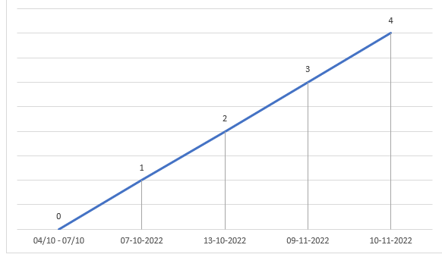
Timeline
(0) 04/10/22 - Meeting with guide
(1) 07/10/22 – Synopsis submission
(2) 13/10/22 – Guide meeting for getting inputs regarding SPI
(3) 09/11/22- Guide meeting for the slight difference in the project
(4) 10/11/22– Guide meeting and analysing code of SPI master in Verilog of opencores

Slide 24
7. Inference
Analysing and implementing SPI controller aspects using Verilog HDL.
Analysing of SPI using Verilog HDL code for Master and Slave separately.

Slide 25
References
S. Saha, M. A. Rahman and A. Thakur, "Design and implementation of SPI bus protocol with Built-in-self-test capability over FPGA," 2014 International Conference on Electrical Engineering and Information & Communication Technology, 2014, pp. 1-6, doi: 10.1109/ICEEICT.2014.6919076.
Prasad, Tadi Durga and B. Ramesh Babu. “Design and Simulation of SPI Master / Slave Using Verilog HDL.” (2014). Paper ID: 02015624 International Journal of Science and Research (IJSR) ISSN (Online)
D. Trivedi, A. Khade, K. Jain and R. Jadhav, "SPI to I2C Protocol Conversion Using Verilog," 2018 Fourth International Conference on Computing Communication Control and Automation (ICCUBEA), 2018, pp. 1-4, doi: 10.1109/ICCUBEA.2018.8697415.
Anand N, G. Joseph, S. S. Oommen and R. Dhanabal, "Design and implementation of a high speed Serial Peripheral Interface," 2014 International Conference on Advances in Electrical Engineering (ICAEE), 2014, pp. 1-3, doi: 10.1109/ICAEE.2014.6838431.
F. Leens, "An introduction to I2C and SPI protocols," in IEEE Instrumentation & Measurement Magazine, vol. 12, no. 1, pp. 8-13, February 2009, doi: 10.1109/MIM.2009.4762946.

Slide 26
Queries
&
Suggestions

Slide 27
THANK YOU…

