Slide 1
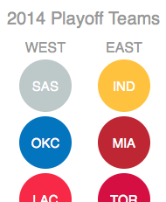
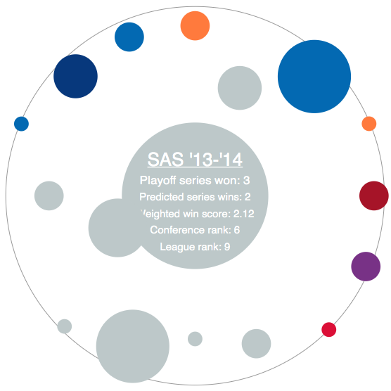
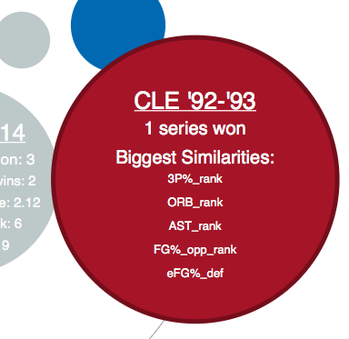
Select a team to reveal its orbit
Colored dots are past playoff teams most similar to the chosen team (in the center)
The bigger the dot, the more successful that team was in the playoffs
And the closer a dot is to the center, the more similar it is to the chosen team
Click on a data point to see more info
Link to even more info
Num. playoff series won
Most similar team stats to chosen team

