Slide 1
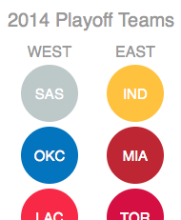
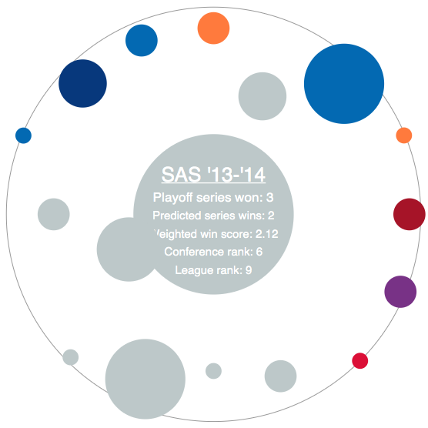
Select a team to reveal its orbit
Colored dots are past playoff teams most similar to the chosen team (in the center)
Click on a data point to see more info
The bigger the dot, the more successful that team was in the playoffs
Click on player name or season for even more info on basketball-reference.com
And the closer a dot is to the center, the more similar it is to the chosen team

