Slide 1
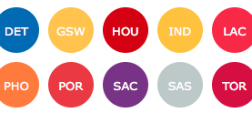
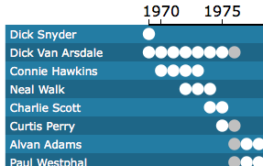
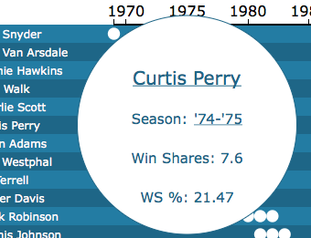
Select a team to reveal its timeline
Click on a data point to see more info
Click on player name or season for even more info on basketball-reference.com

