Slide 1
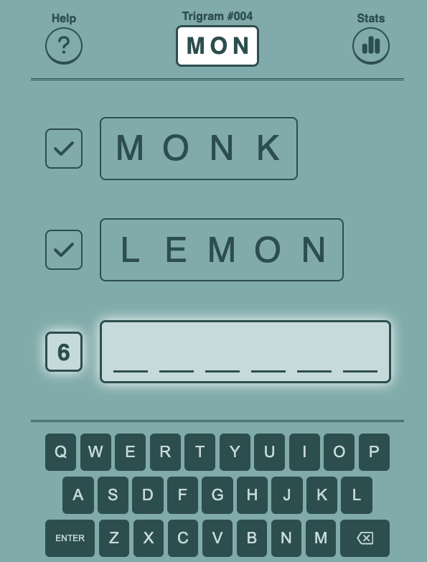
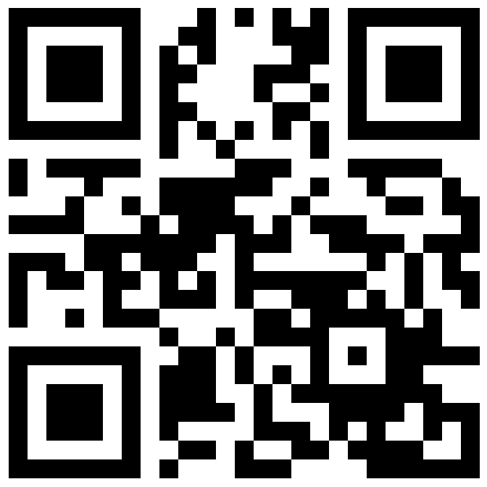
Trigram
a word game
made here in Chelmsford
Play for free here:
http://trigram.netlify.app

Slide 2
Trigram
a word game
made here in Chelmsford
Play for free here:
http://trigram.netlify.app

Slide 3

Trigram
a word game
made here in Chelmsford
Play for free here:
http://trigram.netlify.app

Slide 4
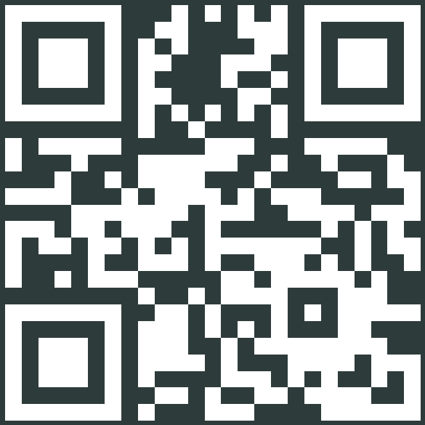
Trigram
a word game
made here in Chelmsford
Play for free here:
http://trigram.netlify.app

Slide 5
Trigram
a word game
made here in Chelmsford
Play for free here:
http://trigram.netlify.app

Slide 6
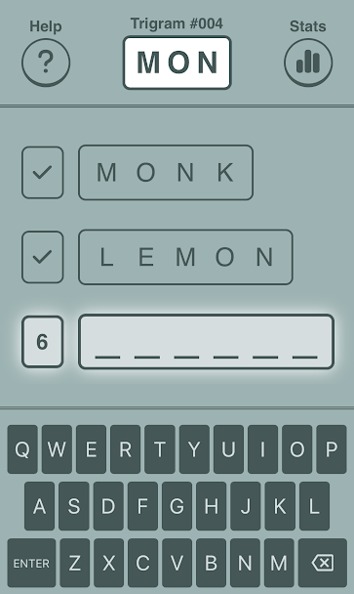
Trigram
a word game
made here in Chelmsford
Play for free here:
http://trigram.netlify.app

Slide 7
Trigram
a word game
made here in Chelmsford
Play for free here:
http://trigram.netlify.app

