Slide 1
TEAM REVIEW • CURRENT CHECKS AND PROPOSED IMPROVEMENTS
AI Inventory validation: 173 records
Use the findings to correct records and improve the checks.
173
28 OCT 2026
20–30 MIN
Source records
Saved validation snapshot
Team discussion
One source row is one record. No rows were removed.
Rules 5.4; current results stay separate from proposed checks.
Checks to retain, corrections to target, and improvements to agree.
Krisp_data.xlsx → second tab: AI Inventory data → AI Inventory data.csv
AI Inventory columns: LLM Count • ML/DL Models Count • Vendor Owner • Source of AI System • Deployment Status
01
Notes:
AI Inventory validation: 173 records
Suggested timing: 45 seconds
WHY THIS MATTERS
The goal is to make the inventory reliable enough to interpret and maintain, starting with evidence from the app.
PRESENTER NOTES
This deck focuses on validation and the records behind the findings. Existing checks, source corrections, reporting gaps and proposed semantic follow-ups are labeled separately. One source row remains one record even when an ID is repeated or a registration looks test-like. The source CSV matches the saved review byte-for-byte. This is a 24–25 minute core discussion; the three appendix slides support questions.
AI INVENTORY COLUMNS
LLM Count; ML/DL Models Count; Vendor Owner; Source of AI System; Deployment Status
DISCUSSION QUESTION
Which validation changes would make the next inventory review easier to resolve?
EVIDENCE
Input SHA-256: fcc16d891b2a69ee8b88f0e2ddd0fa4584439ae1f96855b757d5decf9046dd36
BASELINE
173 source rows = 173 records. All displayed percentages use 173 unless explicitly stated otherwise. Distinct record counts are deduplicated within each cohort; overlapping cohorts are not additive.
Source: AI Inventory data.csv, exported from Krisp_data.xlsx, second tab AI Inventory data. Saved validation review 28b09c1d-4ee4-4a51-a408-0caf7fb82915; rules 5.4; validated as of 28 October 2026. Findings and screenshots are the saved outcomes; proposed checks are not new validation results.

Slide 2
OBSERVED • RECORD-LEVEL BASELINE
Model-count checks affect most records with findings
121 · 69.9%
100 · 57.8%
52 · 30.1%
Records with findings
Records with count findings
Records passing today
183 finding instances across these 121 records.
A record is counted once, even if both count fields fail.
Passing describes current configured checks.
The count fields cause most findings. Give owners specific correction steps.
AI Inventory columns: LLM Count • ML/DL Models Count • Vendor Owner • State • LOB
02
Notes:
Model-count checks affect most records with findings
Suggested timing: 90 seconds
WHY THIS MATTERS
Focus the team on the kind of information that is failing, rather than treating every finding as an empty form field.
PRESENTER NOTES
The 173-record snapshot has 52 Passed records and 121 Errors records, with 183 finding instances. The count-rule union affects 100 records. A finding can involve more than one field and a record can have several findings, so finding instances and records are different units. The screenshot is the actual saved app summary. Basic date/contact/source-detail issues remain important but are smaller, more specific queues.
AI INVENTORY COLUMNS
LLM Count; ML/DL Models Count; Vendor Owner; State; LOB
DISCUSSION QUESTION
Are correction requests explaining what the owner must establish, or only repeating the error message?
EVIDENCE
errors: 121 records (69.9% of 173); source rows 3, 4, 5, 6, 10, 11, 13, 14, 19, 21, 22, 23, 26, 27, 28, 29, 30, 31, 32, 33, 35, 36, 37, 38, 39, 40, 41, 43, 44, 45, 46, 47, 48, 49, 50, 51, 52, 53, 55, 57, 58, 60, 61, 62, 63, 64, 65, 66, 67, 68, 69, 70, 71, 72, 74, 77, 78, 81, 85, 86, 87, 88, 89, 90, 91, 92, 93, 94, 95, 97, 98, 99, 100, 101, 102, 103, 104, 105, 106, 108, 112, 115, 116, 117, 118, 119, 121, 123, 125, 126, 127, 129, 130, 133, 134, 135, 136, 137, 138, 139, 140, 142, 143, 145, 146, 147, 150, 151, 154, 155, 156, 159, 161, 162, 163, 164, 166, 168, 170, 171, 172.
passed: 52 records (30.1% of 173); source rows 2, 7, 8, 9, 12, 15, 16, 17, 18, 20, 24, 25, 34, 42, 54, 56, 59, 73, 75, 76, 79, 80, 82, 83, 84, 96, 107, 109, 110, 111, 113, 114, 120, 122, 124, 128, 131, 132, 141, 144, 148, 149, 152, 153, 157, 158, 160, 165, 167, 169, 173, 174.
count_any: 100 records (57.8% of 173); source rows 3, 4, 6, 10, 11, 13, 19, 21, 22, 26, 29, 30, 31, 32, 35, 37, 38, 39, 40, 41, 43, 45, 46, 47, 48, 49, 50, 51, 52, 53, 57, 58, 64, 66, 67, 68, 69, 70, 71, 72, 74, 77, 78, 85, 86, 87, 88, 89, 90, 91, 92, 93, 94, 95, 97, 98, 99, 100, 101, 102, 103, 104, 105, 108, 115, 116, 117, 118, 119, 121, 123, 125, 126, 127, 129, 130, 133, 134, 136, 137, 138, 140, 142, 143, 145, 146, 147, 150, 151, 154, 155, 156, 159, 161, 163, 166, 168, 170, 171, 172.
BASELINE
173 source rows = 173 records. All displayed percentages use 173 unless explicitly stated otherwise. Distinct record counts are deduplicated within each cohort; overlapping cohorts are not additive.
Source: AI Inventory data.csv, exported from Krisp_data.xlsx, second tab AI Inventory data. Saved validation review 28b09c1d-4ee4-4a51-a408-0caf7fb82915; rules 5.4; validated as of 28 October 2026. Findings and screenshots are the saved outcomes; proposed checks are not new validation results.

Slide 3
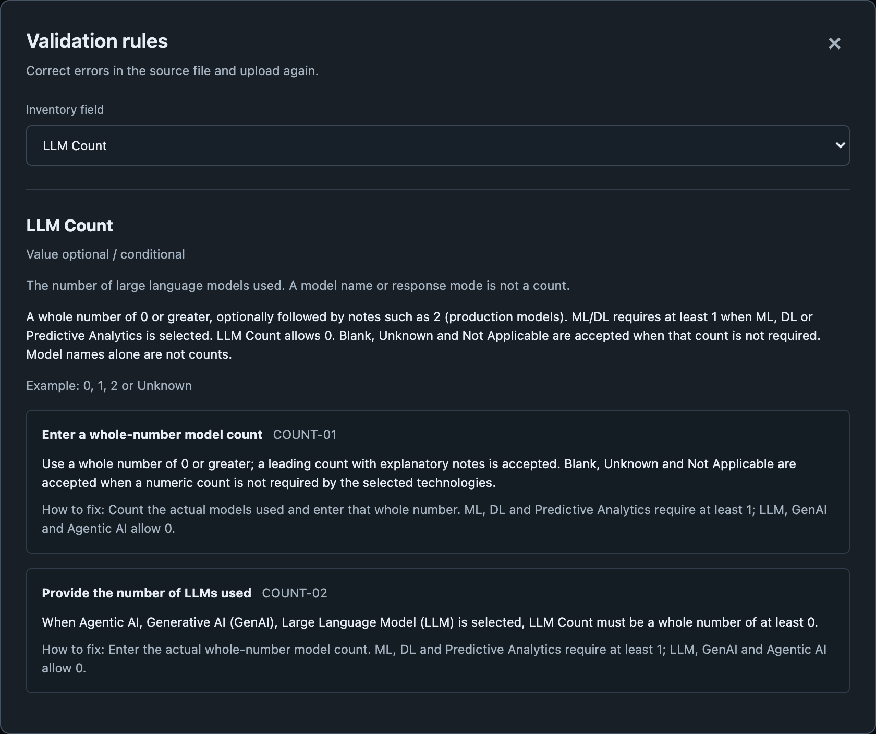
CURRENT VALIDATION • EXECUTABLE CHECKS
Show each condition and the required response
Type(s) of AI Used → model counts
LLM / GenAI / Agentic: LLM Count ≥ 0.
ML / DL / Predictive: ML/DL Models Count ≥ 1.
Source of AI System → Vendor Owner
Vendor-related acquisition requires a contact.
Deployment Status → Go-Live Date
Active requires a valid date; future dates are accepted.
Business Owner / Technical Owner
A name or valid email from any domain is accepted.
AI Inventory columns: Type(s) of AI Used • LLM Count • ML/DL Models Count • Source of AI System • Vendor Owner • Deployment Status • Go-Live Date • Business Owner • Technical Owner
03
Notes:
Show each condition and the required response
Suggested timing: 120 seconds
WHY THIS MATTERS
An error is easier to resolve when the owner can see the triggering column and the required response together.
PRESENTER NOTES
These are current implemented rules, not new proposals. Counts may be blank or Unknown when not required by the selected technology. The required LLM minimum is zero, not one. A vendor-related source requires a contact; a platform name alone does not establish vendor involvement. Future go-live dates remain accepted under the confirmed app behavior. Business and technical owners can be names or any syntactically valid email domain, including mhplan.com; the app does not verify identity or delivery. The screenshot comes from the app’s current rule catalogue, which reflects executable rules rather than older wording in the reference file.
AI INVENTORY COLUMNS
Type(s) of AI Used; LLM Count; ML/DL Models Count; Source of AI System; Vendor Owner; Deployment Status; Go-Live Date; Business Owner; Technical Owner
DISCUSSION QUESTION
Can an owner understand why a field became required from the error shown?
EVIDENCE
Current rule IDs: COUNT-01/02/03, VENDOR-01, DATE-02, REQ-02, EMAIL-01.
BASELINE
173 source rows = 173 records. All displayed percentages use 173 unless explicitly stated otherwise. Distinct record counts are deduplicated within each cohort; overlapping cohorts are not additive.
Source: AI Inventory data.csv, exported from Krisp_data.xlsx, second tab AI Inventory data. Saved validation review 28b09c1d-4ee4-4a51-a408-0caf7fb82915; rules 5.4; validated as of 28 October 2026. Findings and screenshots are the saved outcomes; proposed checks are not new validation results.

Slide 4
OBSERVED • OVERLAPPING COUNT FINDINGS
Both model-count fields have findings in 33 records
LLM Count findings
84 records
48.6% of all 173
ML/DL Models Count findings
49 records
28.3% of all 173
Both count fields
33 records
19.1% of all 173
84 + 49 − 33 = 100 distinct records with a model-count finding
AI Inventory columns: Type(s) of AI Used • LLM Count • ML/DL Models Count
04
Notes:
Both model-count fields have findings in 33 records
Suggested timing: 90 seconds
WHY THIS MATTERS
A correction plan should count records once while recognizing that the same owner may need to resolve both count fields.
PRESENTER NOTES
84 records have at least one finding involving LLM Count, 49 involve ML/DL Models Count, and 33 appear in both. Their union is 100 records. This is field-level affected-record accounting, not a sum of repeated messages. COUNT-01 alone has 112 finding instances across 79 records; COUNT-02 and COUNT-03 add conditional requirements. The exact technology selections matter when deciding whether a numeric response is required.
AI INVENTORY COLUMNS
Type(s) of AI Used; LLM Count; ML/DL Models Count
DISCUSSION QUESTION
Can both count questions be resolved in the same owner conversation?
EVIDENCE
field_llm_count: 84 records (48.6% of 173); source rows 4, 6, 10, 13, 19, 21, 22, 26, 29, 31, 32, 37, 38, 39, 40, 41, 45, 46, 47, 48, 49, 50, 51, 52, 53, 57, 58, 64, 66, 67, 68, 69, 70, 71, 74, 77, 78, 85, 86, 87, 90, 91, 92, 93, 94, 95, 97, 98, 99, 100, 101, 102, 103, 104, 105, 108, 116, 117, 118, 119, 123, 126, 127, 129, 130, 133, 134, 136, 137, 138, 140, 142, 145, 146, 150, 151, 154, 155, 156, 159, 161, 163, 168, 170.
field_ml_dl_count: 49 records (28.3% of 173); source rows 3, 6, 10, 11, 19, 21, 22, 26, 29, 30, 35, 43, 68, 72, 77, 88, 89, 94, 97, 98, 99, 100, 101, 104, 115, 116, 119, 121, 125, 127, 130, 134, 136, 137, 138, 140, 142, 143, 146, 147, 150, 154, 155, 161, 163, 166, 168, 171, 172.
both_count_fields: 33 records (19.1% of 173); source rows 6, 10, 19, 21, 22, 26, 29, 68, 77, 94, 97, 98, 99, 100, 101, 104, 116, 119, 127, 130, 134, 136, 137, 138, 140, 142, 146, 150, 154, 155, 161, 163, 168.
count_any: 100 records (57.8% of 173); source rows 3, 4, 6, 10, 11, 13, 19, 21, 22, 26, 29, 30, 31, 32, 35, 37, 38, 39, 40, 41, 43, 45, 46, 47, 48, 49, 50, 51, 52, 53, 57, 58, 64, 66, 67, 68, 69, 70, 71, 72, 74, 77, 78, 85, 86, 87, 88, 89, 90, 91, 92, 93, 94, 95, 97, 98, 99, 100, 101, 102, 103, 104, 105, 108, 115, 116, 117, 118, 119, 121, 123, 125, 126, 127, 129, 130, 133, 134, 136, 137, 138, 140, 142, 143, 145, 146, 147, 150, 151, 154, 155, 156, 159, 161, 163, 166, 168, 170, 171, 172.
BASELINE
173 source rows = 173 records. All displayed percentages use 173 unless explicitly stated otherwise. Distinct record counts are deduplicated within each cohort; overlapping cohorts are not additive.
Source: AI Inventory data.csv, exported from Krisp_data.xlsx, second tab AI Inventory data. Saved validation review 28b09c1d-4ee4-4a51-a408-0caf7fb82915; rules 5.4; validated as of 28 October 2026. Findings and screenshots are the saved outcomes; proposed checks are not new validation results.

Slide 5
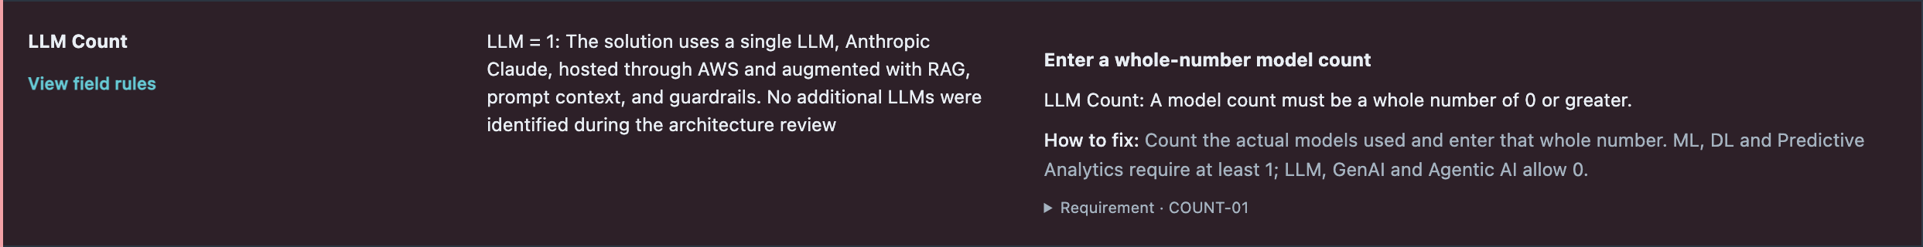
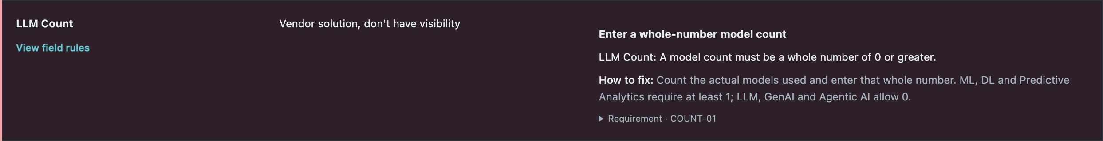
OBSERVED • SAME FINDING FAMILY, DIFFERENT CAUSES
Use different actions for known and unknown counts
KNOWN FACT, DIFFERENT FORMAT
“LLM = 1”
FACT REQUIRES CONFIRMATION
“Vendor solution, don’t have visibility”
AI Inventory columns: LLM Count • ML/DL Models Count • Type(s) of AI Used
05
Notes:
Use different actions for known and unknown counts
Suggested timing: 120 seconds
WHY THIS MATTERS
Resolve whether the owner knows the count before asking them to reformat the source response.
PRESENTER NOTES
The upper screenshot is source row161, Principles Prince AI: LLM Count explicitly says LLM = 1, but fails the current format. Row126 also describes two models in prose. The lower screenshot is row98, H1/Veda: the answer explicitly states the owner lacks vendor visibility; it cannot be fixed responsibly by merely choosing a number. Six reviewed vendor Pilot/Active examples across both model-count fields are rows10,29,88,98,121,127; these are reviewed examples, not an exhaustive automatically inferred cohort. Do not invent a count or enter zero just to clear a finding. Proposed improvement: provide a clearer numeric response convention and a route for obtaining unresolved information.
AI INVENTORY COLUMNS
LLM Count; ML/DL Models Count; Type(s) of AI Used
DISCUSSION QUESTION
Is this a formatting correction or a request for information the owner does not yet have?
EVIDENCE
Source rows161 and98 shown. Row126 offers another explicit-count narrative; no source values were corrected.
BASELINE
173 source rows = 173 records. All displayed percentages use 173 unless explicitly stated otherwise. Distinct record counts are deduplicated within each cohort; overlapping cohorts are not additive.
Source: AI Inventory data.csv, exported from Krisp_data.xlsx, second tab AI Inventory data. Saved validation review 28b09c1d-4ee4-4a51-a408-0caf7fb82915; rules 5.4; validated as of 28 October 2026. Findings and screenshots are the saved outcomes; proposed checks are not new validation results.

Slide 6
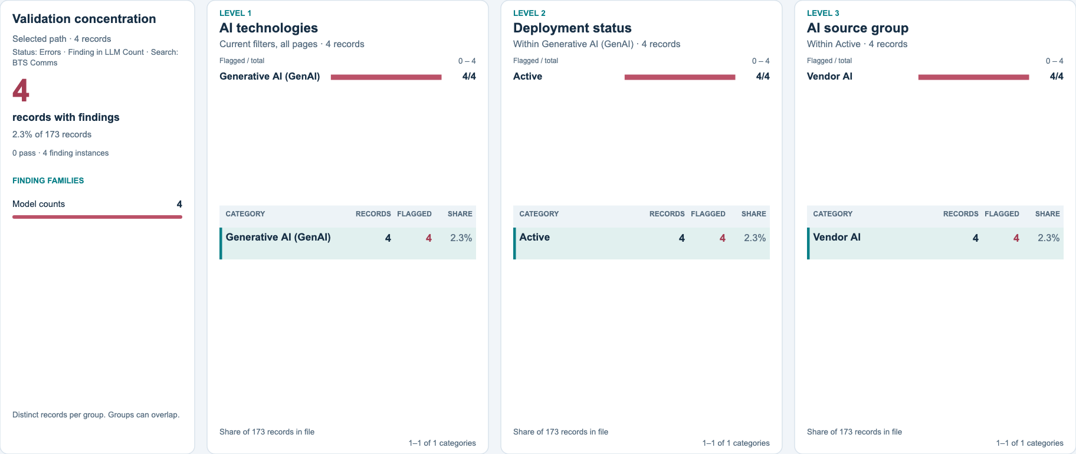
OBSERVED • REPEATED CONDITIONAL-COUNT PATTERN
Four records need the same count clarification
All four GenAI records answer N/A for LLM Count. Ask the platform owner to confirm each count.
Red: records with findings. Teal: records with no findings. Share: % of all 173 records.
AI Inventory columns: Type(s) of AI Used • LLM Count • Deployment Status • Source of AI System
06
Notes:
Four records need the same count clarification
Suggested timing: 75 seconds
WHY THIS MATTERS
Repeated patterns can reveal a shared interpretation problem in the intake guidance.
PRESENTER NOTES
Four Active BTS Communications Copilot records select Generative AI and answer N/A for LLM Count. Each has only COUNT-02. Their source is Hybrid, grouped as Vendor AI in the screenshot. Ask the platform and record owners how the underlying models should be counted for each record. The inventory does not prove that the four records share the same model, nor that they are duplicate registrations. Keep them as four records. Proposed improvement: add a worked GenAI/Copilot example to the field help and have the owner confirm each count.
AI INVENTORY COLUMNS
Type(s) of AI Used; LLM Count; Deployment Status; Source of AI System
DISCUSSION QUESTION
What example would prevent the same interpretation problem across this family?
EVIDENCE
bts_count_family: 4 records (2.3% of 173); source rows 32, 37, 38, 39.
The app PNG includes validation concentration and total/flagged record counts. Flagged means at least one saved finding. Red bars show flagged records; teal bars show records with no findings. The sidebar uses the scope printed in the image. Its family counts are distinct records and can overlap. These are the same data in the app and its PNG export.
BASELINE
173 source rows = 173 records. All displayed percentages use 173 unless explicitly stated otherwise. Distinct record counts are deduplicated within each cohort; overlapping cohorts are not additive.
Source: AI Inventory data.csv, exported from Krisp_data.xlsx, second tab AI Inventory data. Saved validation review 28b09c1d-4ee4-4a51-a408-0caf7fb82915; rules 5.4; validated as of 28 October 2026. Findings and screenshots are the saved outcomes; proposed checks are not new validation results.

Slide 7
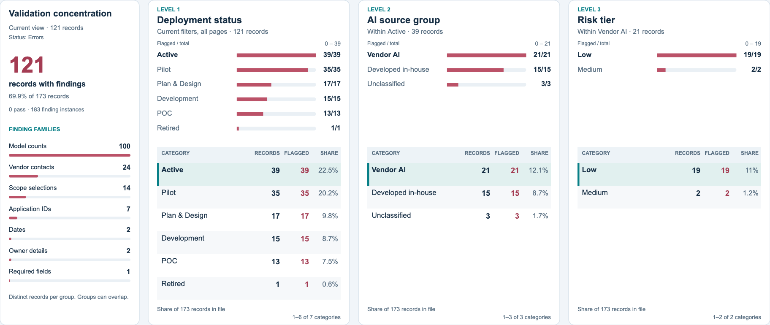
OBSERVED • ERRORS × DEPLOYMENT STATUS × SOURCE
74 Pilot or Active records have validation findings
46 records need count corrections only. Ask owners to review all findings in the other 28.
Image: all 121 flagged records. The highlighted 19-record path is one example.
Red: records with findings. Teal: records with no findings. Share: % of all 173 records.
AI Inventory columns: Deployment Status • Source of AI System • Risk Tier • LLM Count • ML/DL Models Count
07
Notes:
74 Pilot or Active records have validation findings
Suggested timing: 90 seconds
WHY THIS MATTERS
An operational status does not establish that the inventory record is complete.
PRESENTER NOTES
The saved review has 39 Active and 35 Pilot records with findings: 74 distinct records, 42.8% of all173. Of this combined group,46 have only model-count findings and28 have at least one non-count finding. These are mutually exclusive routing groups and sum to74. The visible caption gives the work split:46 count-only records and28 with other findings. The screenshot is explicitly labeled as all121 flagged records, with one19-record example path highlighted. It uses Status Errors, Current filters and the full173-record percentage denominator. It shows deployment, source and risk together; the displayed highlighted path is one subset, not the total74. These outcomes are inventory-validation findings, not evidence that the systems are unsafe or noncompliant.
AI INVENTORY COLUMNS
Deployment Status; Source of AI System; Risk Tier; LLM Count; ML/DL Models Count
DISCUSSION QUESTION
Can the correction queue be split by who can supply the missing fact?
EVIDENCE
errors_Active: 39 records (22.5% of 173); source rows 3, 22, 23, 26, 28, 32, 37, 38, 39, 41, 45, 46, 48, 49, 50, 51, 52, 55, 57, 60, 61, 62, 63, 65, 72, 74, 77, 81, 89, 95, 98, 112, 117, 139, 154, 155, 163, 171, 172.
errors_Pilot: 35 records (20.2% of 173); source rows 4, 10, 14, 19, 29, 30, 31, 36, 43, 44, 53, 64, 66, 67, 68, 71, 78, 88, 94, 101, 106, 116, 121, 123, 126, 127, 129, 133, 136, 145, 146, 150, 159, 161, 162.
errors_later: 74 records (42.8% of 173); source rows 3, 4, 10, 14, 19, 22, 23, 26, 28, 29, 30, 31, 32, 36, 37, 38, 39, 41, 43, 44, 45, 46, 48, 49, 50, 51, 52, 53, 55, 57, 60, 61, 62, 63, 64, 65, 66, 67, 68, 71, 72, 74, 77, 78, 81, 88, 89, 94, 95, 98, 101, 106, 112, 116, 117, 121, 123, 126, 127, 129, 133, 136, 139, 145, 146, 150, 154, 155, 159, 161, 162, 163, 171, 172.
count_only_later: 46 records (26.6% of 173); source rows 3, 10, 26, 29, 30, 31, 32, 37, 38, 39, 43, 45, 46, 50, 51, 52, 53, 64, 66, 67, 68, 71, 72, 74, 77, 88, 89, 94, 101, 116, 117, 121, 123, 126, 127, 129, 133, 145, 146, 150, 154, 155, 161, 163, 171, 172.
non_count_later: 28 records (16.2% of 173); source rows 4, 14, 19, 22, 23, 28, 36, 41, 44, 48, 49, 55, 57, 60, 61, 62, 63, 65, 78, 81, 95, 98, 106, 112, 136, 139, 159, 162.
The app PNG includes validation concentration and total/flagged record counts. Flagged means at least one saved finding. Red bars show flagged records; teal bars show records with no findings. The sidebar uses the scope printed in the image. Its family counts are distinct records and can overlap. These are the same data in the app and its PNG export.
BASELINE
173 source rows = 173 records. All displayed percentages use 173 unless explicitly stated otherwise. Distinct record counts are deduplicated within each cohort; overlapping cohorts are not additive.
Source: AI Inventory data.csv, exported from Krisp_data.xlsx, second tab AI Inventory data. Saved validation review 28b09c1d-4ee4-4a51-a408-0caf7fb82915; rules 5.4; validated as of 28 October 2026. Findings and screenshots are the saved outcomes; proposed checks are not new validation results.

Slide 8
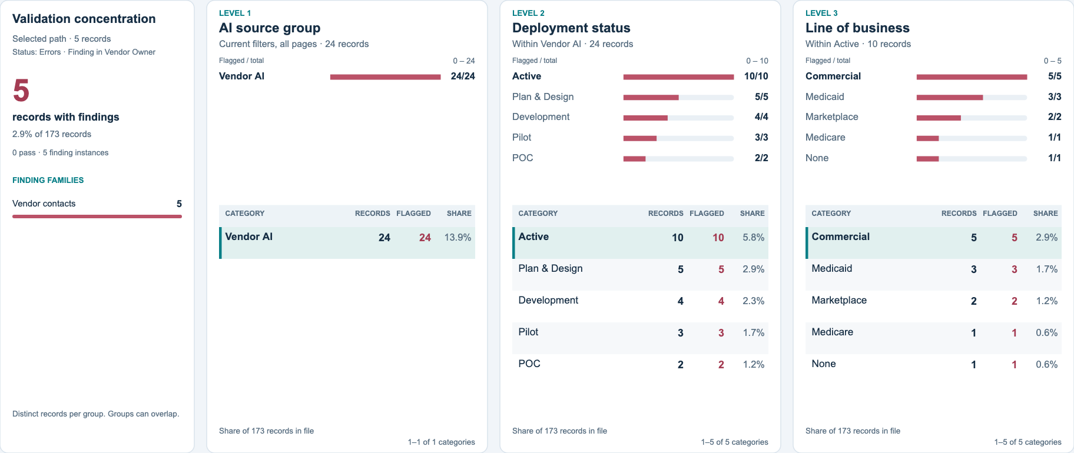
OBSERVED • VENDOR-CONTACT ERRORS × STAGE × LOB
Five Jira records need a vendor contact
These five Active Commercial Jira records share owners. Ask them to confirm each vendor contact.
Red: records with findings. Teal: records with no findings. Share: % of all 173 records.
AI Inventory columns: Vendor Owner • Source of AI System • Deployment Status • LOB • Business Owner • Technical Owner
08
Notes:
Five Jira records need a vendor contact
Suggested timing: 90 seconds
WHY THIS MATTERS
Grouping related records by workflow and owner gives a concrete starting point for correction.
PRESENTER NOTES
24 records have VENDOR-01, including13 in Pilot/Active and10 Active. Five Active Commercial records form the highlighted path in the screenshot. They are Jira workflow helpers with the same business/technical-owner pair and only vendor-contact findings: backlog themes, work-item surfacing, estimation, security classification and release checks. This is five records, not evidence of five vendors, one contract or duplicated systems. A common owner discussion may help, while the correct escalation contact still needs confirmation for each record.
AI INVENTORY COLUMNS
Vendor Owner; Source of AI System; Deployment Status; LOB; Business Owner; Technical Owner
DISCUSSION QUESTION
Who can confirm the appropriate escalation contact for these five records?
EVIDENCE
rule_VENDOR-01: 24 records (13.9% of 173); source rows 5, 14, 33, 35, 36, 41, 48, 49, 55, 57, 60, 61, 62, 63, 81, 87, 102, 103, 108, 135, 136, 143, 156, 164.
VENDOR-01_later: 13 records (7.5% of 173); source rows 14, 36, 41, 48, 49, 55, 57, 60, 61, 62, 63, 81, 136.
vendor_active_commercial: 5 records (2.9% of 173); source rows 55, 60, 61, 62, 63.
jira_vendor_contact_family: 5 records (2.9% of 173); source rows 55, 60, 61, 62, 63.
The app PNG includes validation concentration and total/flagged record counts. Flagged means at least one saved finding. Red bars show flagged records; teal bars show records with no findings. The sidebar uses the scope printed in the image. Its family counts are distinct records and can overlap. These are the same data in the app and its PNG export.
BASELINE
173 source rows = 173 records. All displayed percentages use 173 unless explicitly stated otherwise. Distinct record counts are deduplicated within each cohort; overlapping cohorts are not additive.
Source: AI Inventory data.csv, exported from Krisp_data.xlsx, second tab AI Inventory data. Saved validation review 28b09c1d-4ee4-4a51-a408-0caf7fb82915; rules 5.4; validated as of 28 October 2026. Findings and screenshots are the saved outcomes; proposed checks are not new validation results.

Slide 9
INTERPRETATION • CONDITIONAL RULES CHANGE THE FINDING MIX
Compare the checks before you compare the finding totals
Pilot/Active records
In-house
Vendor AI
Records in each sourcing group
48 · 27.7%
48 · 27.7%
Any non-count finding
8 · 4.6%
16 · 9.2%
Non-count findings except VENDOR-01
8 · 4.6%
6 · 3.5%
Vendor records have an additional contact check. Compare the requirements before you compare the totals.
AI Inventory columns: Source of AI System • Vendor Owner • Deployment Status
09
Notes:
Compare the checks before you compare the finding totals
Suggested timing: 90 seconds
WHY THIS MATTERS
Compare the applicability of checks before interpreting a higher finding count as a quality difference.
PRESENTER NOTES
In-house and Vendor AI each contain48 Pilot/Active records. Vendor AI has16 with non-count findings versus8 in-house.13 vendor records trigger VENDOR-01. If the question is limited to non-count findings other than that contact rule, the counts are6 vendor versus8 in-house. Records may trigger both vendor and another rule, so16−13 is not the correct residual. Every displayed percentage still uses173, not48. This is descriptive segmentation of the current rules; it does not measure vendor performance or validate the adequacy of any control.
AI INVENTORY COLUMNS
Source of AI System; Vendor Owner; Deployment Status
DISCUSSION QUESTION
Are we comparing the same requirements across the sourcing groups?
EVIDENCE
Developed in-house_later: 48 records (27.7% of 173); source rows 3, 7, 8, 9, 22, 23, 24, 25, 26, 28, 30, 31, 34, 43, 44, 45, 46, 51, 52, 53, 54, 59, 64, 65, 66, 67, 71, 73, 74, 75, 76, 77, 78, 80, 84, 94, 96, 106, 122, 126, 133, 148, 153, 154, 155, 159, 160, 172.
Vendor AI_later: 48 records (27.7% of 173); source rows 2, 10, 14, 15, 17, 18, 19, 20, 29, 32, 36, 37, 38, 39, 41, 48, 49, 55, 57, 60, 61, 62, 63, 68, 72, 79, 81, 82, 88, 89, 98, 109, 112, 116, 117, 121, 123, 127, 132, 136, 144, 145, 146, 152, 161, 163, 165, 171.
Developed in-house_non_count_later: 8 records (4.6% of 173); source rows 22, 23, 28, 44, 65, 78, 106, 159.
Vendor AI_non_count_later: 16 records (9.2% of 173); source rows 14, 19, 36, 41, 48, 49, 55, 57, 60, 61, 62, 63, 81, 98, 112, 136.
Developed in-house_non_count_except_vendor_later: 8 records (4.6% of 173); source rows 22, 23, 28, 44, 65, 78, 106, 159.
Vendor AI_non_count_except_vendor_later: 6 records (3.5% of 173); source rows 14, 19, 36, 57, 98, 112.
BASELINE
173 source rows = 173 records. All displayed percentages use 173 unless explicitly stated otherwise. Distinct record counts are deduplicated within each cohort; overlapping cohorts are not additive.
Source: AI Inventory data.csv, exported from Krisp_data.xlsx, second tab AI Inventory data. Saved validation review 28b09c1d-4ee4-4a51-a408-0caf7fb82915; rules 5.4; validated as of 28 October 2026. Findings and screenshots are the saved outcomes; proposed checks are not new validation results.

Slide 10
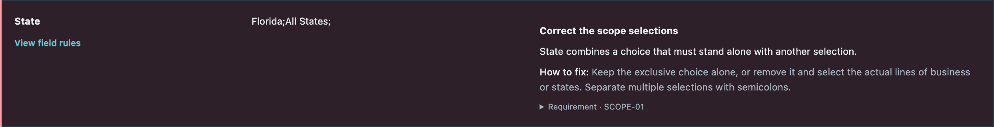
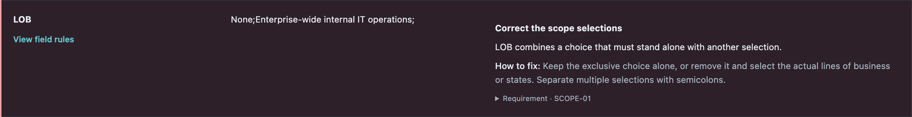
CURRENT CHECK • MUTUALLY EXCLUSIVE SCOPE SELECTIONS
Confirm the intended scope before you remove selections
14 · 8.1%
9 State / 5 LOB
9 · 5.2%
Records with scope findings
Separate field cohorts
Also Pilot or Active
AI Inventory columns: State • LOB • Deployment Status
10
Notes:
Confirm the intended scope before you remove selections
Suggested timing: 75 seconds
WHY THIS MATTERS
The contradiction is about the intended usage scope, so correction should preserve meaning rather than delete a token mechanically.
PRESENTER NOTES
Current SCOPE-01 flags14 records: nine in State and five in LOB, with no overlap between these field cohorts. Nine are Pilot/Active. The upper screenshot is row4, which combines Florida and All States; the lower is row35, which combines None with a specific internal scope response. None must stand alone; All States must stand alone. Six of the State-error records are later-stage; the remaining later-stage scope cases are in LOB. Proposed improvement: make exclusive choices clearer in intake guidance or the source form, then ask owners to retain the correct selection.
AI INVENTORY COLUMNS
State; LOB; Deployment Status
DISCUSSION QUESTION
Which selection represents the actual intended scope?
EVIDENCE
rule_SCOPE-01: 14 records (8.1% of 173); source rows 4, 14, 19, 21, 22, 23, 27, 28, 35, 36, 65, 95, 135, 138.
field_states: 9 records (5.2% of 173); source rows 4, 14, 19, 21, 22, 23, 27, 28, 138.
field_lines_of_business: 5 records (2.9% of 173); source rows 35, 36, 65, 95, 135.
SCOPE-01_later: 9 records (5.2% of 173); source rows 4, 14, 19, 22, 23, 28, 36, 65, 95.
BASELINE
173 source rows = 173 records. All displayed percentages use 173 unless explicitly stated otherwise. Distinct record counts are deduplicated within each cohort; overlapping cohorts are not additive.
Source: AI Inventory data.csv, exported from Krisp_data.xlsx, second tab AI Inventory data. Saved validation review 28b09c1d-4ee4-4a51-a408-0caf7fb82915; rules 5.4; validated as of 28 October 2026. Findings and screenshots are the saved outcomes; proposed checks are not new validation results.

Slide 11
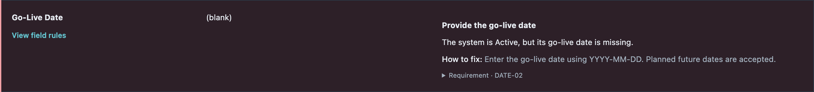
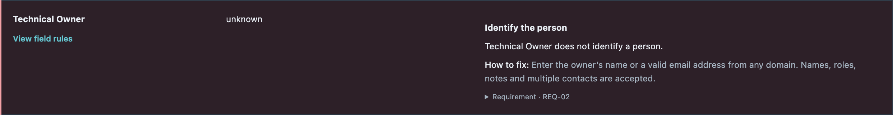
CURRENT CHECKS • DATES, OWNERSHIP AND COMPLETENESS
Correct the dates, owners and source details in five records
2 · 1.2%
2 · 1.2%
1 · 0.6%
Active, no go-live date
Owner details need correction
Blank Data Environment
Rows 98 and 139.
One malformed email; one Unknown owner.
A required source detail is absent.
AI Inventory columns: Deployment Status • Go-Live Date • Business Owner • Technical Owner • Data Environment
11
Notes:
Correct the dates, owners and source details in five records
Suggested timing: 75 seconds
WHY THIS MATTERS
These findings have direct source-field corrections and can be routed to the responsible record owner.
PRESENTER NOTES
The five distinct source rows are58,97,98,139,162. Active records98 and139 lack Go-Live Date. Row97 has a space after the @ in Business Owner email text; this is a syntax issue, not a restriction to Centene domains. Row162 says Unknown for Technical Owner. Row58 leaves Data Environment blank. Names and any valid email domain remain accepted; no directory or delivery verification is performed. Future go-live dates remain allowed. These examples do not imply that all other fields were independently verified as true.
AI INVENTORY COLUMNS
Deployment Status; Go-Live Date; Business Owner; Technical Owner; Data Environment
DISCUSSION QUESTION
Can each request name the exact missing or malformed source value?
EVIDENCE
small_specific_fixes: 5 records (2.9% of 173); source rows 58, 97, 98, 139, 162.
rule_DATE-02: 2 records (1.2% of 173); source rows 98, 139.
rule_EMAIL-01: 1 records (0.6% of 173); source rows 97.
rule_REQ-02: 1 records (0.6% of 173); source rows 162.
rule_REQ-01: 1 records (0.6% of 173); source rows 58.
BASELINE
173 source rows = 173 records. All displayed percentages use 173 unless explicitly stated otherwise. Distinct record counts are deduplicated within each cohort; overlapping cohorts are not additive.
Source: AI Inventory data.csv, exported from Krisp_data.xlsx, second tab AI Inventory data. Saved validation review 28b09c1d-4ee4-4a51-a408-0caf7fb82915; rules 5.4; validated as of 28 October 2026. Findings and screenshots are the saved outcomes; proposed checks are not new validation results.

Slide 12
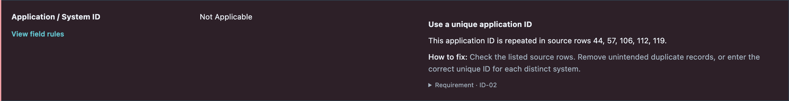
CURRENT FINDINGS • PROPOSED PLACEHOLDER ALIGNMENT
Check the ID meaning before you merge records
5 · 2.9%
2 · 1.2%
Repeated “Not Applicable” IDs
Same normalized identifier
Align placeholder handling with the intended unavailable-ID allowance.
Rows 78 and 159 share variants of “TruCare Cloud”.
AI Inventory columns: Application / System ID • AI System / Solution Name
12
Notes:
Check the ID meaning before you merge records
Suggested timing: 90 seconds
WHY THIS MATTERS
A repeated identifier can be an unavailable-ID placeholder or a shared identifier; neither automatically proves duplicate records.
PRESENTER NOTES
The saved ID-02 findings affect seven records. Five use Not Applicable: rows44,57,106,112,119. The current placeholder grouping does not exempt that exact phrase even though the rule’s intent allows unavailable-ID placeholders. The two other records are78, WFM_BCT_AI_CHATBOT, and159, Care Lens, with Trucare Cloud/TruCare Cloud IDs after case normalization. Ask owners whether these are distinct systems sharing a platform identifier or registrations needing correction. Proposed improvement: align the placeholder list and ID help, and review actual collisions. Keep the173-record baseline; do not merge or drop rows automatically.
AI INVENTORY COLUMNS
Application / System ID; AI System / Solution Name
DISCUSSION QUESTION
Does the ID identify this record’s system, a shared platform or an unavailable value?
EVIDENCE
rule_ID-02: 7 records (4.0% of 173); source rows 44, 57, 78, 106, 112, 119, 159.
Placeholder rows44,57,106,112,119; other normalized-ID pair78,159.
BASELINE
173 source rows = 173 records. All displayed percentages use 173 unless explicitly stated otherwise. Distinct record counts are deduplicated within each cohort; overlapping cohorts are not additive.
Source: AI Inventory data.csv, exported from Krisp_data.xlsx, second tab AI Inventory data. Saved validation review 28b09c1d-4ee4-4a51-a408-0caf7fb82915; rules 5.4; validated as of 28 October 2026. Findings and screenshots are the saved outcomes; proposed checks are not new validation results.

Slide 13
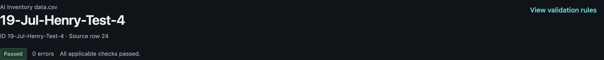
PROPOSED CHECKS • PARSER PRECISION AND SEMANTIC REVIEW
A passing check does not confirm the operating status
5 · 2.9%
2 · 1.2%
19
Active, test-like registrations
Pass current checks
Parsed as the model count
AI Inventory columns: AI System / Solution Name • Business Purpose / Intended Use • Deployment Status • Risk Tier • LLM Count • ML/DL Models Count • Date Submitted
13
Notes:
A passing check does not confirm the operating status
Suggested timing: 120 seconds
WHY THIS MATTERS
These records show two distinct questions: whether a number was parsed correctly and whether the registration describes an operating system.
PRESENTER NOTES
Rows22–26 are five manually reviewed candidates with test-like names and repeated test wording in their purposes. All are Active, in-house, Agentic and Unknown risk, with the same19 July2026 submission and go-live date. Rows24 and25 pass. In row24 both count fields contain 19-Jul-Henry-Test-4, which the leading-number-with-notes parser accepts as19. Proposed parser check: reject date-like or identifier-like strings as counts. Proposed semantic follow-up: ask owners to confirm the registration and status. These are not confirmed test data and are not excluded. A broad search for test also finds a legitimate test-case-generator use case (row41), so a keyword-only rejection would be too blunt.
AI INVENTORY COLUMNS
AI System / Solution Name; Business Purpose / Intended Use; Deployment Status; Risk Tier; LLM Count; ML/DL Models Count; Date Submitted
DISCUSSION QUESTION
What should be rejected as an invalid count, and what should go to owner review?
EVIDENCE
candidate_test_active: 5 records (2.9% of 173); source rows 22, 23, 24, 25, 26.
candidate_test_pass: 2 records (1.2% of 173); source rows 24, 25.
Row24 current normalized llm_count=19 and ml_dl_count=19; source values unchanged.
BASELINE
173 source rows = 173 records. All displayed percentages use 173 unless explicitly stated otherwise. Distinct record counts are deduplicated within each cohort; overlapping cohorts are not additive.
Source: AI Inventory data.csv, exported from Krisp_data.xlsx, second tab AI Inventory data. Saved validation review 28b09c1d-4ee4-4a51-a408-0caf7fb82915; rules 5.4; validated as of 28 October 2026. Findings and screenshots are the saved outcomes; proposed checks are not new validation results.

Slide 14
REPORTING IMPROVEMENT • PRESERVE DISCLOSED SELECTIONS
Unmapped text can hide PHI or PII in the charts
18 · 10.4%
9 · 5.2%
14
Explicit PHI/PII, hidden in charts
Also Pilot or Active
Also say Business Confidential Data
Keep each recognized selection. Report the unmapped text separately. Do not treat a detailed answer as an empty answer.
AI Inventory columns: Data Input to or Processed by AI Tool • Deployment Status
14
Notes:
Unmapped text can hide PHI or PII in the charts
Suggested timing: 90 seconds
WHY THIS MATTERS
The chart catalogue can lose recognized information when a multi-select response also contains a term it cannot map.
PRESENTER NOTES
18 records explicitly select Contains PHI or Contains PII and are charted as Unclassified. Nine are Pilot/Active. Business Confidential Data appears with14 of the18. Exact PHI selection appears on33 records versus19 charted; PII appears on36 versus18 charted. The PHI and PII groups overlap. The app currently treats an entire multi-select answer as Unclassified if any term is unmapped. The screenshot is row160, a Passed record that explicitly includes Contains PII alongside Business Confidential Data and Employee Data. Proposed reporting improvement: preserve each recognized selection and retain the unmapped terms for review. Do not hard-fail detailed free-text answers solely because of chart taxonomy coverage.
AI INVENTORY COLUMNS
Data Input to or Processed by AI Tool; Deployment Status
DISCUSSION QUESTION
Can reporting retain known sensitive-data selections while showing what still needs mapping?
EVIDENCE
hidden_phi_pii: 18 records (10.4% of 173); source rows 4, 10, 12, 15, 33, 35, 90, 94, 104, 120, 121, 127, 132, 134, 160, 162, 166, 173.
hidden_phi_pii_later: 9 records (5.2% of 173); source rows 4, 10, 15, 94, 121, 127, 132, 160, 162.
Raw and charted exact PHI:33/19; PII:36/18. Hidden-sensitive records with Business Confidential Data=14.
BASELINE
173 source rows = 173 records. All displayed percentages use 173 unless explicitly stated otherwise. Distinct record counts are deduplicated within each cohort; overlapping cohorts are not additive.
Source: AI Inventory data.csv, exported from Krisp_data.xlsx, second tab AI Inventory data. Saved validation review 28b09c1d-4ee4-4a51-a408-0caf7fb82915; rules 5.4; validated as of 28 October 2026. Findings and screenshots are the saved outcomes; proposed checks are not new validation results.

Slide 15
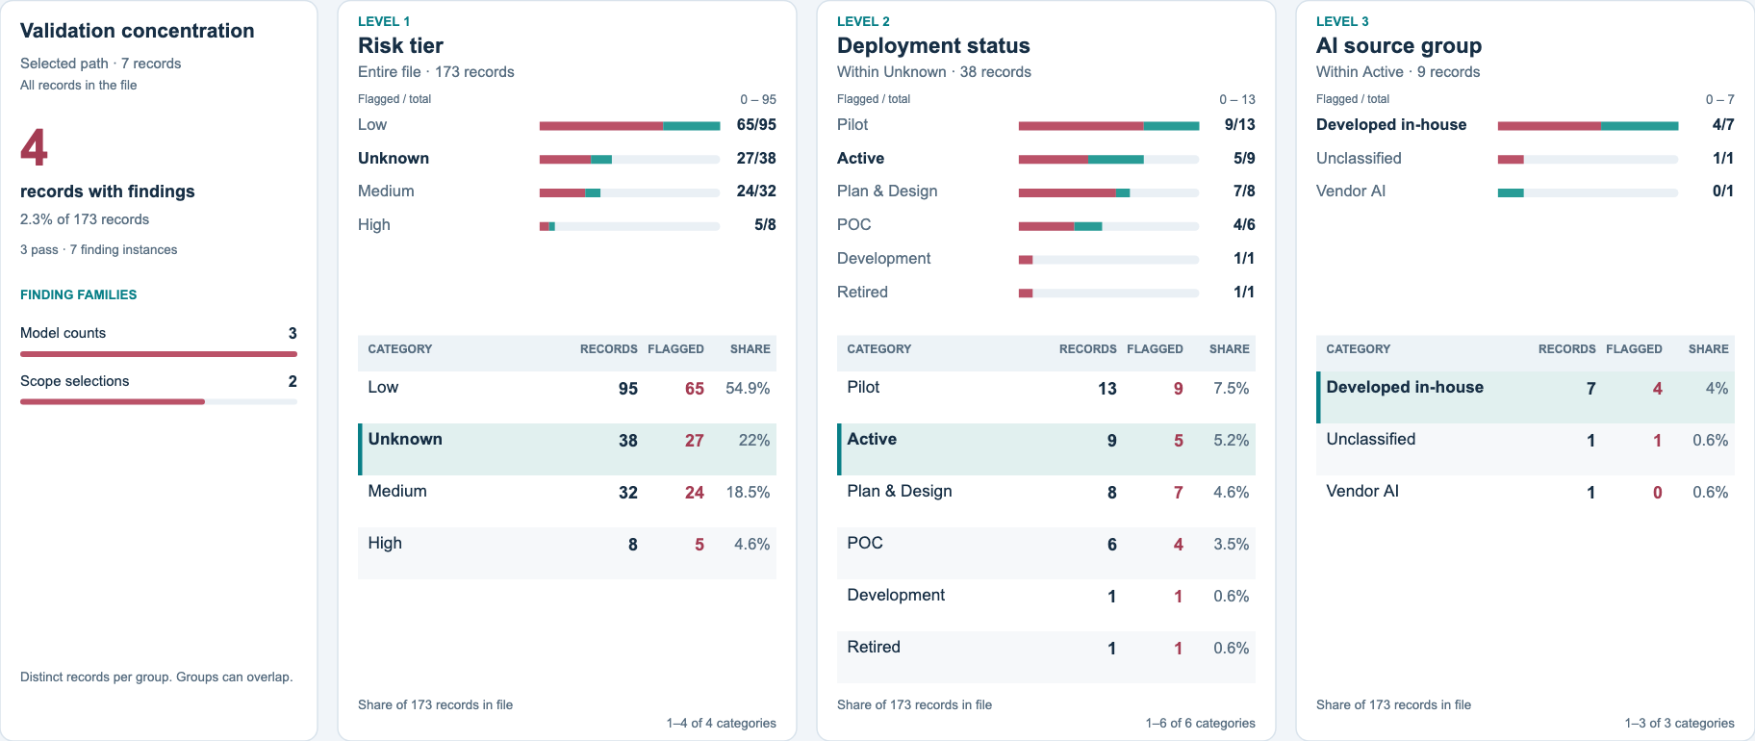
PROPOSED FOLLOW-UP • UNKNOWN RISK TIER × STAGE × SOURCE
Ask owners to review Unknown risk tiers
Unknown needs owner review. Red bars show findings from other checks.
Red: records with findings. Teal: records with no findings. Share: % of all 173 records.
AI Inventory columns: Risk Tier • Deployment Status • Source of AI System • AI System / Solution Name • Business Purpose / Intended Use
15
Notes:
Ask owners to review Unknown risk tiers
Suggested timing: 90 seconds
WHY THIS MATTERS
Unknown and High answer different questions; owner clarification is more appropriate than substituting one for the other.
PRESENTER NOTES
22 records are Pilot/Active with Unknown risk:13 Pilot and9 Active. The highlighted app path is Unknown→Active→Developed in-house, containing seven records. Five are the test-like candidates on the earlier slide; two others are separate use cases. Keep all173 records and ask owners to confirm classification and operating context. This is a proposed follow-up queue. Unknown is accepted by the current rules and does not mean High risk. Within the seven-record path, four records have current findings: three involve model counts and two involve scope; those groups overlap. The red bars show these other findings, not an Unknown-risk validation error.
AI INVENTORY COLUMNS
Risk Tier; Deployment Status; Source of AI System; AI System / Solution Name; Business Purpose / Intended Use
DISCUSSION QUESTION
Is the missing fact the risk assessment, the operating context or the status of the registration?
EVIDENCE
unknown_risk_later: 22 records (12.7% of 173); source rows 4, 15, 17, 18, 22, 23, 24, 25, 26, 29, 51, 75, 78, 82, 84, 95, 106, 116, 127, 145, 150, 162.
unknown_risk_active: 9 records (5.2% of 173); source rows 22, 23, 24, 25, 26, 51, 82, 84, 95.
risk_unknown_active_inhouse: 7 records (4.0% of 173); source rows 22, 23, 24, 25, 26, 51, 84.
candidate_test_active: 5 records (2.9% of 173); source rows 22, 23, 24, 25, 26.
The app PNG includes validation concentration and total/flagged record counts. Flagged means at least one saved finding. Red bars show flagged records; teal bars show records with no findings. The sidebar uses the scope printed in the image. Its family counts are distinct records and can overlap. These are the same data in the app and its PNG export.
BASELINE
173 source rows = 173 records. All displayed percentages use 173 unless explicitly stated otherwise. Distinct record counts are deduplicated within each cohort; overlapping cohorts are not additive.
Source: AI Inventory data.csv, exported from Krisp_data.xlsx, second tab AI Inventory data. Saved validation review 28b09c1d-4ee4-4a51-a408-0caf7fb82915; rules 5.4; validated as of 28 October 2026. Findings and screenshots are the saved outcomes; proposed checks are not new validation results.

Slide 16
TEAM DECISIONS • CORRECTION PRIORITIES AND RULE IMPROVEMENTS
Agree the checks. Then validate the corrected source.
RECORD / PLATFORM OWNERS
Confirm missing facts. Correct source values.
Review the counts and contacts for each record.
INVENTORY TEAM
Clarify count guidance and ID meaning.
Agree the review steps for Unknown and test-like records.
APP TEAM
Reject date-like counts. Align ID placeholders.
Keep recognized data selections in the charts.
Upload the corrected source. Confirm the same 173 records. Compare the findings.
If all 76 count-only records pass after correction, the passing count could rise from 52 to 128 (74.0%).
AI Inventory columns: LLM Count • ML/DL Models Count • Vendor Owner • Application / System ID • Data Input to or Processed by AI Tool • Risk Tier • Deployment Status
16
Notes:
Agree the checks. Then validate the corrected source.
Suggested timing: 120 seconds
WHY THIS MATTERS
Use the current evidence to agree a small set of correction and precision improvements, then measure the result through revalidation.
PRESENTER NOTES
76 records have count findings and no other current finding family. Resolving them without introducing other findings would conditionally raise passing records from52 to128, or74.0% of173. This is a scenario, not a new validation result.24 other records have both count and non-count findings, while21 have only non-count findings. Keep source correction, validation-code precision and reporting improvements distinct in delivery. The visible cards separate responsibilities. Record and platform owners confirm facts and correct source values. The inventory team clarifies guidance and review expectations. The app team addresses parsing, placeholder handling and chart mapping. These are proposed responsibilities, not assigned commitments or policy changes. After correction, upload the source again, confirm the same 173 records, and compare findings. The final review should confirm field wording and expected behavior before applying new checks to the inventory.
AI INVENTORY COLUMNS
LLM Count; ML/DL Models Count; Vendor Owner; Application / System ID; Data Input to or Processed by AI Tool; Risk Tier; Deployment Status
DISCUSSION QUESTION
Which proposed checks should be implemented first, and how will owners verify the corrections?
EVIDENCE
count_only: 76 records (43.9% of 173); source rows 3, 6, 10, 11, 13, 26, 29, 30, 31, 32, 37, 38, 39, 40, 43, 45, 46, 47, 50, 51, 52, 53, 64, 66, 67, 68, 69, 70, 71, 72, 74, 77, 85, 86, 88, 89, 90, 91, 92, 93, 94, 99, 100, 101, 104, 105, 115, 116, 117, 118, 121, 123, 125, 126, 127, 129, 130, 133, 134, 137, 140, 142, 145, 146, 147, 150, 151, 154, 155, 161, 163, 166, 168, 170, 171, 172.
countplusother: 24 records (13.9% of 173); source rows 4, 19, 21, 22, 35, 41, 48, 49, 57, 58, 78, 87, 95, 97, 98, 102, 103, 108, 119, 136, 138, 143, 156, 159.
otheronly: 21 records (12.1% of 173); source rows 5, 14, 23, 27, 28, 33, 36, 44, 55, 60, 61, 62, 63, 65, 81, 106, 112, 135, 139, 162, 164.
passed: 52 records (30.1% of 173); source rows 2, 7, 8, 9, 12, 15, 16, 17, 18, 20, 24, 25, 34, 42, 54, 56, 59, 73, 75, 76, 79, 80, 82, 83, 84, 96, 107, 109, 110, 111, 113, 114, 120, 122, 124, 128, 131, 132, 141, 144, 148, 149, 152, 153, 157, 158, 160, 165, 167, 169, 173, 174.
BASELINE
173 source rows = 173 records. All displayed percentages use 173 unless explicitly stated otherwise. Distinct record counts are deduplicated within each cohort; overlapping cohorts are not additive.
Source: AI Inventory data.csv, exported from Krisp_data.xlsx, second tab AI Inventory data. Saved validation review 28b09c1d-4ee4-4a51-a408-0caf7fb82915; rules 5.4; validated as of 28 October 2026. Findings and screenshots are the saved outcomes; proposed checks are not new validation results.

Slide 17
APPENDIX A • CURRENT RULE OUTCOMES
Records with findings, by rule and column
Rule
Columns with current findings
Meaning
Records / % of 173
COUNT-01
LLM Count; ML/DL Models Count
Whole-number format
79 · 45.7%
COUNT-02
Type(s) of AI Used; LLM Count
Required LLM count ≥ 0
15 · 8.7%
COUNT-03
Type(s) of AI Used; ML/DL Models Count
Required ML/DL count ≥ 1
6 · 3.5%
VENDOR-01
Source of AI System; Vendor Owner
Vendor contact unavailable
24 · 13.9%
SCOPE-01
LOB; State
Exclusive choices combined
14 · 8.1%
ID-02
Application / System ID
Repeated normalized ID
7 · 4.0%
DATE-02
Deployment Status; Go-Live Date
Active without a date
2 · 1.2%
REQ-01
Data Environment
Required value missing
1 · 0.6%
REQ-02
Technical Owner
Owner not identified
1 · 0.6%
EMAIL-01
Business Owner
Email syntax invalid
1 · 0.6%
AI Inventory columns: LLM Count • ML/DL Models Count • Vendor Owner • State • LOB • Application / System ID • Go-Live Date • Business Owner • Technical Owner • Data Environment
17
Notes:
Records with findings, by rule and column
Appendix reference
WHY THIS MATTERS
The table counts a record once per rule, even if that rule creates more than one finding on the record.
PRESENTER NOTES
Rule rows overlap. COUNT-01 has112 instances but79 affected records; the table uses79. The other current rule definitions may have zero findings in this saved dataset and remain configured. REQ-01 and the owner rules apply more broadly than the one currently affected field listed here. The full field contract and conditions are on the next appendix slide. These are saved outcomes under rules5.4.
AI INVENTORY COLUMNS
LLM Count; ML/DL Models Count; Vendor Owner; State; LOB; Application / System ID; Go-Live Date; Business Owner; Technical Owner; Data Environment
EVIDENCE
rule_COUNT-01: 79 records (45.7% of 173); source rows 3, 6, 10, 11, 13, 19, 21, 22, 26, 29, 31, 40, 41, 45, 46, 47, 48, 49, 50, 51, 52, 53, 57, 58, 64, 66, 67, 68, 69, 70, 71, 72, 74, 77, 78, 85, 86, 88, 90, 94, 97, 98, 99, 100, 101, 104, 108, 116, 117, 118, 119, 121, 125, 126, 127, 129, 130, 134, 136, 137, 138, 140, 142, 145, 146, 147, 150, 151, 154, 155, 156, 159, 161, 163, 166, 168, 170, 171, 172.
rule_COUNT-02: 15 records (8.7% of 173); source rows 4, 32, 37, 38, 39, 87, 91, 92, 93, 95, 102, 103, 105, 123, 133.
rule_COUNT-03: 6 records (3.5% of 173); source rows 30, 35, 43, 89, 115, 143.
rule_VENDOR-01: 24 records (13.9% of 173); source rows 5, 14, 33, 35, 36, 41, 48, 49, 55, 57, 60, 61, 62, 63, 81, 87, 102, 103, 108, 135, 136, 143, 156, 164.
rule_SCOPE-01: 14 records (8.1% of 173); source rows 4, 14, 19, 21, 22, 23, 27, 28, 35, 36, 65, 95, 135, 138.
rule_ID-02: 7 records (4.0% of 173); source rows 44, 57, 78, 106, 112, 119, 159.
rule_DATE-02: 2 records (1.2% of 173); source rows 98, 139.
rule_REQ-01: 1 records (0.6% of 173); source rows 58.
rule_REQ-02: 1 records (0.6% of 173); source rows 162.
rule_EMAIL-01: 1 records (0.6% of 173); source rows 97.
BASELINE
173 source rows = 173 records. All displayed percentages use 173 unless explicitly stated otherwise. Distinct record counts are deduplicated within each cohort; overlapping cohorts are not additive.
Source: AI Inventory data.csv, exported from Krisp_data.xlsx, second tab AI Inventory data. Saved validation review 28b09c1d-4ee4-4a51-a408-0caf7fb82915; rules 5.4; validated as of 28 October 2026. Findings and screenshots are the saved outcomes; proposed checks are not new validation results.

Slide 18
APPENDIX B • ALL 23 SOURCE COLUMNS
Checks that apply to each inventory column
01
Application / System ID
Required; normalized ID uniqueness
13
Data Input to or Processed by AI Tool
At least one selection; mapping separate
02
AI System / Solution Name
Required
14
Data Environment
At least one selection
03
Business Purpose / Intended Use
Required
15
Deployment Environment
Required
04
Business Function
At least one selection
16
Deployment Status
One current status; triggers date
05
Impact from AI (Patient/Member, Regulatory, Financial)
Nonblank impact response
17
Go-Live Date
Valid date; required if Active
06
Business Owner
Name or valid-domain email
18
LOB
Selection; None stands alone
07
Technical Owner
Name or valid-domain email
19
State
Selection; All/None stand alone
08
Vendor Owner
Conditional contact; email syntax
20
Risk Tier
Required; Unknown accepted
09
Source of AI System
Required; triggers vendor contact
21
Human-in-the-Loop
Required; No/Partial accepted
10
Type(s) of AI Used
Required; triggers count conditions
22
Submitter Name
Required
11
ML/DL Models Count
Whole count; ≥1 when ML/DL/Predictive
23
Date Submitted
Required real date; not future
12
LLM Count
Whole count; ≥0 when LLM/GenAI/Agentic
AI Inventory columns: all 23 exact source names are listed above; the optional Lifecycle field is not validated.
18
Notes:
Checks that apply to each inventory column
Appendix reference
WHY THIS MATTERS
Every substantive validation claim in the deck names the source columns that drive it.
PRESENTER NOTES
The fixed template has23 columns. Cell requirements can be conditional even though all headers must exist. Counts, Vendor Owner and Go-Live Date have optional or conditional behavior; the other19 fields require values. Dates accept the documented supported date formats. Selections outside the example catalogue can remain valid source responses and appear Unclassified in charts. Human oversight No/Partially and Risk Tier Unknown are accepted; the deck’s follow-up proposals do not redefine them as current errors. The optional Lifecycle column is retained without validation.
AI INVENTORY COLUMNS
Application / System ID; AI System / Solution Name; Business Purpose / Intended Use; Business Function; Impact from AI (Patient/Member, Regulatory, Financial); Business Owner; Technical Owner; Vendor Owner; Source of AI System; Type(s) of AI Used; ML/DL Models Count; LLM Count; Data Input to or Processed by AI Tool; Data Environment; Deployment Environment; Deployment Status; Go-Live Date; LOB; State; Risk Tier; Human-in-the-Loop; Submitter Name; Date Submitted
EVIDENCE
Column order may vary; exact supported header sets are checked before record validation.
BASELINE
173 source rows = 173 records. All displayed percentages use 173 unless explicitly stated otherwise. Distinct record counts are deduplicated within each cohort; overlapping cohorts are not additive.
Source: AI Inventory data.csv, exported from Krisp_data.xlsx, second tab AI Inventory data. Saved validation review 28b09c1d-4ee4-4a51-a408-0caf7fb82915; rules 5.4; validated as of 28 October 2026. Findings and screenshots are the saved outcomes; proposed checks are not new validation results.

Slide 19
APPENDIX C • COUNTING, PROVENANCE AND REPRODUCIBILITY
Use one record count and a fixed denominator
Interpretation
Basis
Population
173 logical source rows; one row is one record.
Percentages
Every headline share divides by 173; screenshots use the same whole-file basis.
Findings vs records
183 findings affect 121 records; rule and field cohorts overlap.
Snapshot
Saved review 28 October 2026, rules 5.4; source CSV byte-hash verified.
Screenshots
App PNG exports and record captures; exact source rows are listed in the notes.
Proposed improvements
Discussion items only; no source values, validation rules or saved outcomes changed.
Correct the source → upload again → compare the record results.
AI Inventory columns: AI System / Solution Name • Application / System ID • LLM Count • ML/DL Models Count • Deployment Status • Source of AI System
19
Notes:
Use one record count and a fixed denominator
Appendix reference
WHY THIS MATTERS
The deck is evidence for a team discussion, with enough detail in the notes to reproduce each cohort.
PRESENTER NOTES
Use the root AI Inventory data.csv and saved review ID noted below. The source-row references use logical CSV records, including the header as row1; multiline cells mean physical line numbers differ. Screenshots were captured from the app after aligning visible terminology to records. Drill-down screenshots show the exact selected path and may show a category page; the wider source cohort is described in the notes and headline. All quantitative claims are recomputed from the same saved snapshot using the app’s category rules. Existing validation results remain frozen. The old portfolio deck is preserved separately.
AI INVENTORY COLUMNS
AI System / Solution Name; Application / System ID; LLM Count; ML/DL Models Count; Deployment Status; Source of AI System
EVIDENCE
SHA-256: fcc16d891b2a69ee8b88f0e2ddd0fa4584439ae1f96855b757d5decf9046dd36; screenshot manifest and calculation scripts kept in temporary working storage; evidence row lists embedded in each slide’s notes.
BASELINE
173 source rows = 173 records. All displayed percentages use 173 unless explicitly stated otherwise. Distinct record counts are deduplicated within each cohort; overlapping cohorts are not additive.
Source: AI Inventory data.csv, exported from Krisp_data.xlsx, second tab AI Inventory data. Saved validation review 28b09c1d-4ee4-4a51-a408-0caf7fb82915; rules 5.4; validated as of 28 October 2026. Findings and screenshots are the saved outcomes; proposed checks are not new validation results.
WRITING STYLE
ASD-STE100 principles guide most authored slide text. Use short sentences, active voice, direct verbs and one point per sentence. Retain exact technical column names, rule IDs and source quotations. Apply this approach approximately, as requested. Reference: https://www.asd-ste100.org/assets/files/ASD-STE100_ISSUE9.pdf

