Slide 1
Eagle’s view
Agentic × In-house × Pilot/Active
Vendor AI × Vendor cloud × Pilot/Active
30 products
29 products
17.3% of all 173 products
16.8% of all 173 products
Unknown risk × Pilot/Active
Model-count error × Pilot/Active
22 products
58 products
12.7% of all 173 products
33.5% of all 173 products
01
Notes:
Eagle’s view
Suggested timing: 90 seconds
WHY THIS MATTERS
The useful story is how products fit into the business: shared capabilities across business lines, internal workflow tools, vendor dependencies and the quality of the disclosures behind them. These four cards are starting points; the later slides explain the products inside each group.
DISCUSSION
Use the cards to introduce the discussion, then move to examples. Product counts show the size of a footprint; they do not measure spend, delivered value, incidents or control effectiveness. All percentages use the same 173 source products. A product appears once within each combination, but can appear in several combinations. Pilot and Active are kept distinct in the underlying data, even when combined for a follow-up list.
QUESTION TO OPEN THE DISCUSSION
Which shared products and recurring owner questions deserve coordinated attention?
EVIDENCE
Source: AI Inventory data.csv,173 products; saved review 28b09c1d-4ee4-4a51-a408-0caf7fb82915; rules 5.4; validated 28 October 2026. One source row per product; all percentages /173. Source rows use logical records including the header.

Slide 2
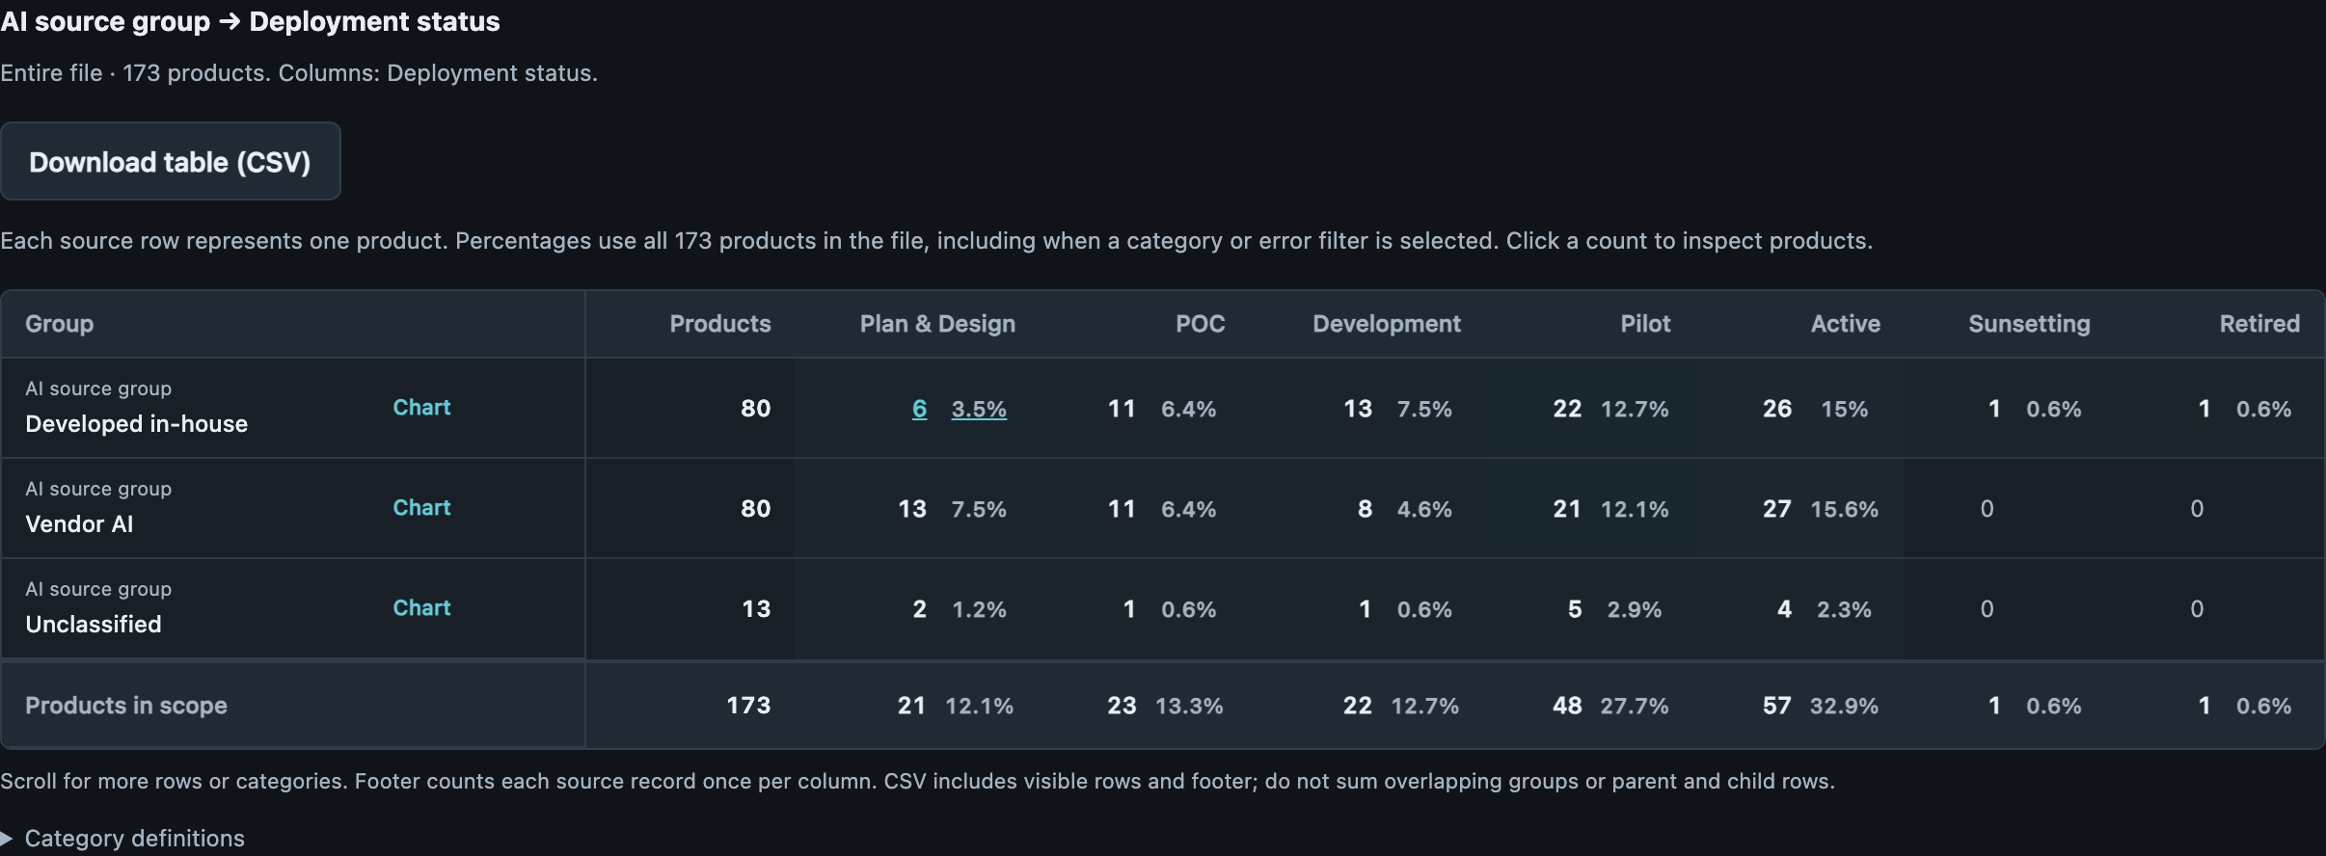
SOURCE × DEPLOYMENT
Build and buy both need ongoing ownership
48 · 27.7%
In-house + Pilot/Active
Match support to each sourcing path.
48 · 27.7%
Vendor AI + Pilot/Active
Read counts alongside cost, value and dependencies.
02
Notes:
Build and buy both need ongoing ownership
Suggested timing: 75 seconds
WHY THIS MATTERS
Build and buy have equally large Pilot/Active footprints, so both need ongoing ownership. The practical question is how responsibilities are shared across internal teams and suppliers.
DISCUSSION
There are 48 in-house and 48 vendor-related products in Pilot/Active. The equal counts are descriptive; the inventory has no comparable cost, usage or outcome measures from which to declare either approach more successful. Nine additional Pilot/Active products have Unclassified sources. Vendor AI is the app’s grouping of licensed, purchased, custom-built vendor and hybrid sources; it is not a count of vendors.
QUESTION TO OPEN THE DISCUSSION
Who owns maintenance, changes, incident handling and vendor escalation for each sourcing path?
EVIDENCE
Developed in-house_later: 48 products (27.7% of 173); source rows 3, 7, 8, 9, 22, 23, 24, 25, 26, 28, 30, 31, 34, 43, 44, 45, 46, 51, 52, 53, 54, 59, 64, 65, 66, 67, 71, 73, 74, 75, 76, 77, 78, 80, 84, 94, 96, 106, 122, 126, 133, 148, 153, 154, 155, 159, 160, 172.
Vendor AI_later: 48 products (27.7% of 173); source rows 2, 10, 14, 15, 17, 18, 19, 20, 29, 32, 36, 37, 38, 39, 41, 48, 49, 55, 57, 60, 61, 62, 63, 68, 72, 79, 81, 82, 88, 89, 98, 109, 112, 116, 117, 121, 123, 127, 132, 136, 144, 145, 146, 152, 161, 163, 165, 171.
Source: AI Inventory data.csv,173 products; saved review 28b09c1d-4ee4-4a51-a408-0caf7fb82915; rules 5.4; validated 28 October 2026. One source row per product; all percentages /173. Source rows use logical records including the header.

Slide 3
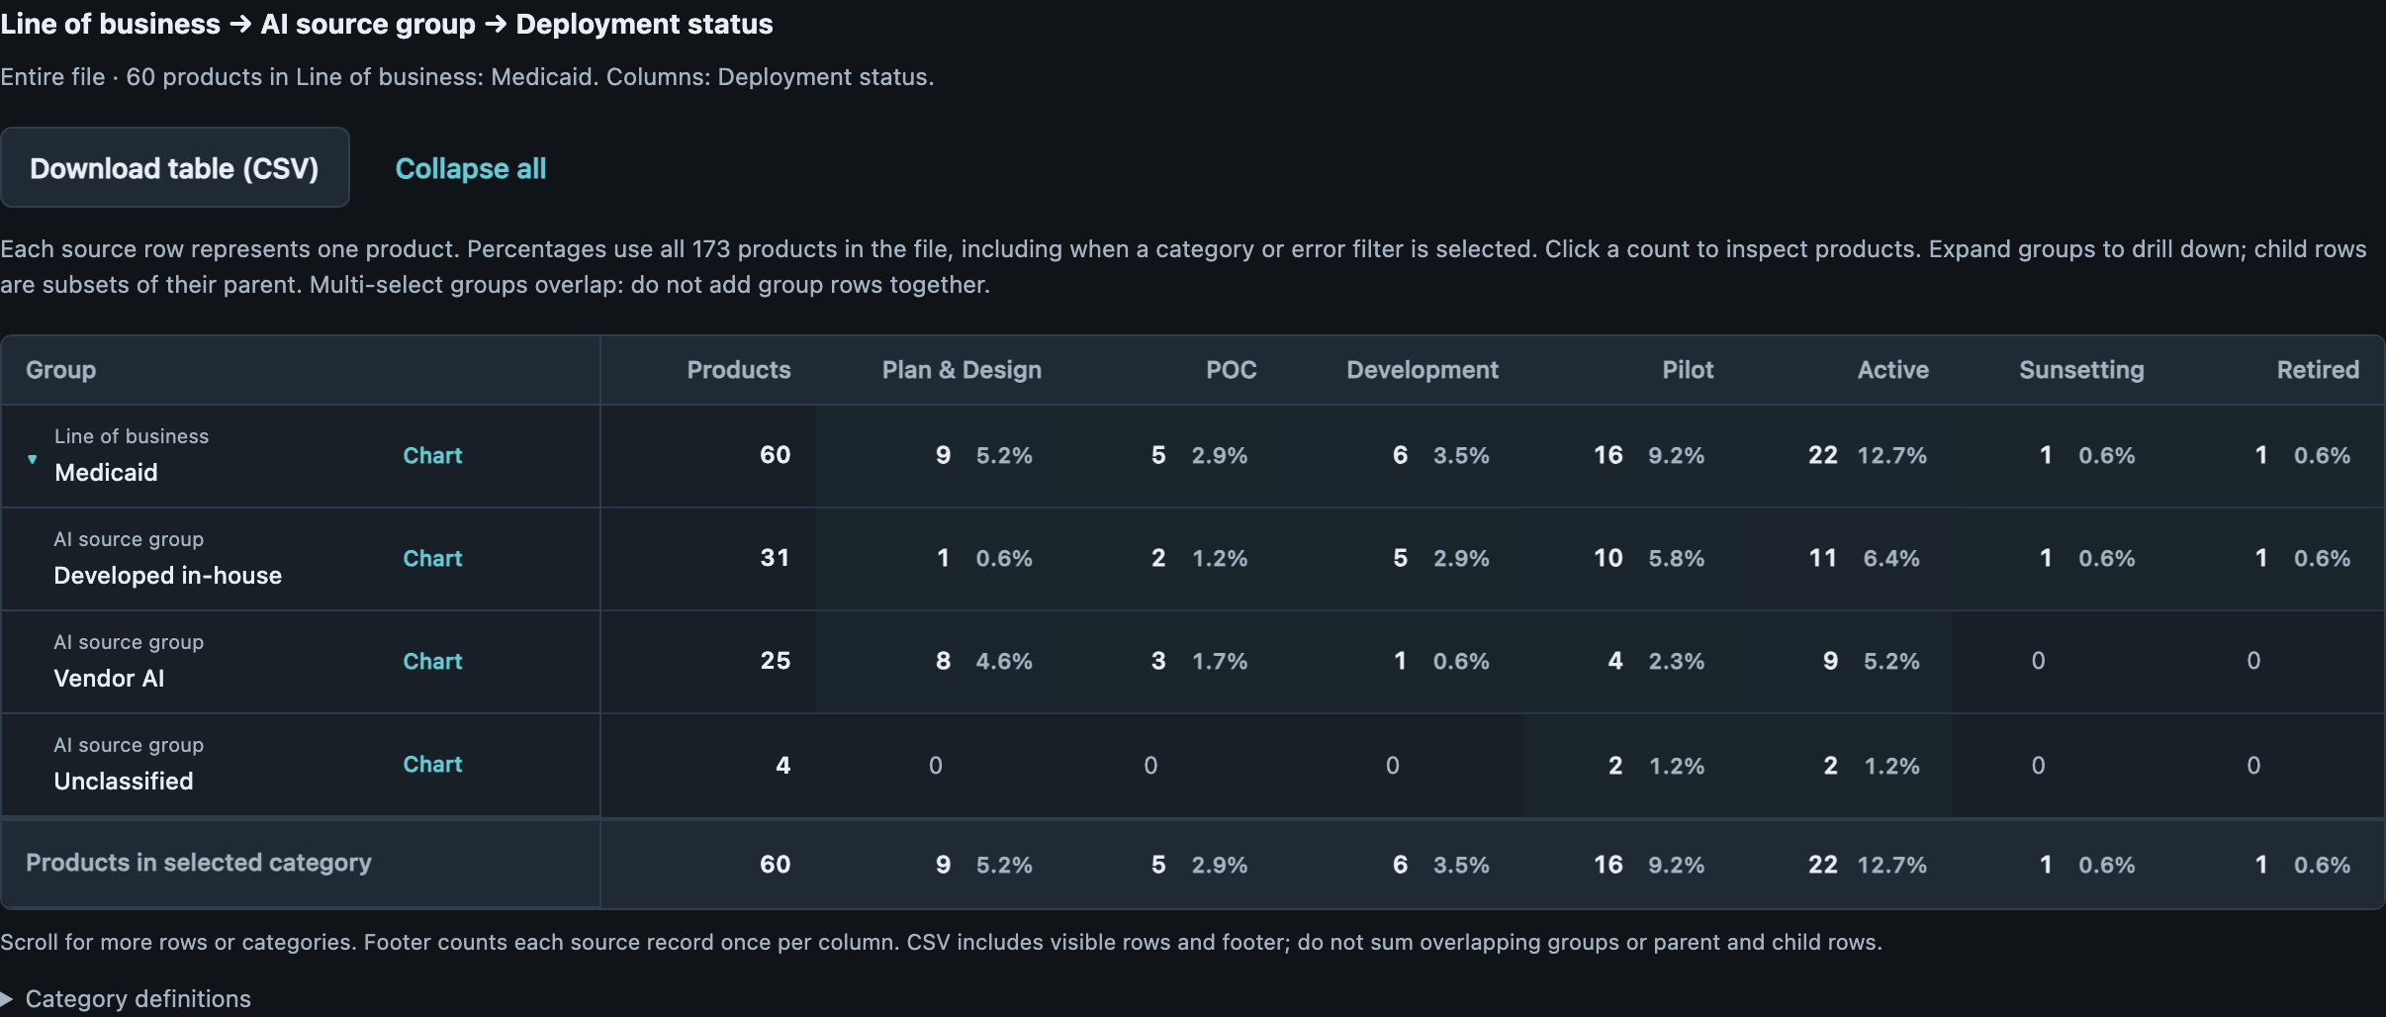
BUSINESS LINE × SOURCE × DEPLOYMENT
Business lines share products as well as sourcing choices
21 · 12.1%
Medicaid / in-house /
Pilot–Active
Some products also serve Medicare and Marketplace.
13 · 7.5%
Medicaid / vendor / Pilot–Active
Shared tools create opportunities for coordinated investment.
03
Notes:
Business lines share products as well as sourcing choices
Suggested timing: 105 seconds
WHY THIS MATTERS
Several business lines depend on the same products. A shared improvement in outreach, translation or prior-authorization support could benefit more than one business, so the sourcing charts should prompt coordination across business-line owners.
DISCUSSION
26 products simultaneously support Medicaid, Medicare and Marketplace and are Pilot/Active: 14 Active and 12 Pilot. The group includes HuMaN outreach, CADA prior-authorization support, Krisp translation, SIU lead generation and provider-directory cleansing. The Medicaid and Commercial Pilot/Active slices also share 14 products. These are shared product records, not separately counted deployments for each business line; potential reuse is an implication, not measured ROI.
QUESTION TO OPEN THE DISCUSSION
Which shared capabilities should have joint investment and maintenance ownership?
EVIDENCE
shared_three_lob: 26 products (15.0% of 173); source rows 3, 4, 28, 30, 42, 44, 49, 51, 66, 67, 80, 84, 89, 96, 98, 109, 123, 126, 132, 139, 144, 145, 148, 162, 171, 172.
medicaid_commercial_overlap: 14 products (8.1% of 173); source rows 22, 23, 30, 51, 66, 89, 96, 98, 109, 123, 132, 144, 148, 162.
Source: AI Inventory data.csv,173 products; saved review 28b09c1d-4ee4-4a51-a408-0caf7fb82915; rules 5.4; validated 28 October 2026. One source row per product; all percentages /173. Source rows use logical records including the header.

Slide 4
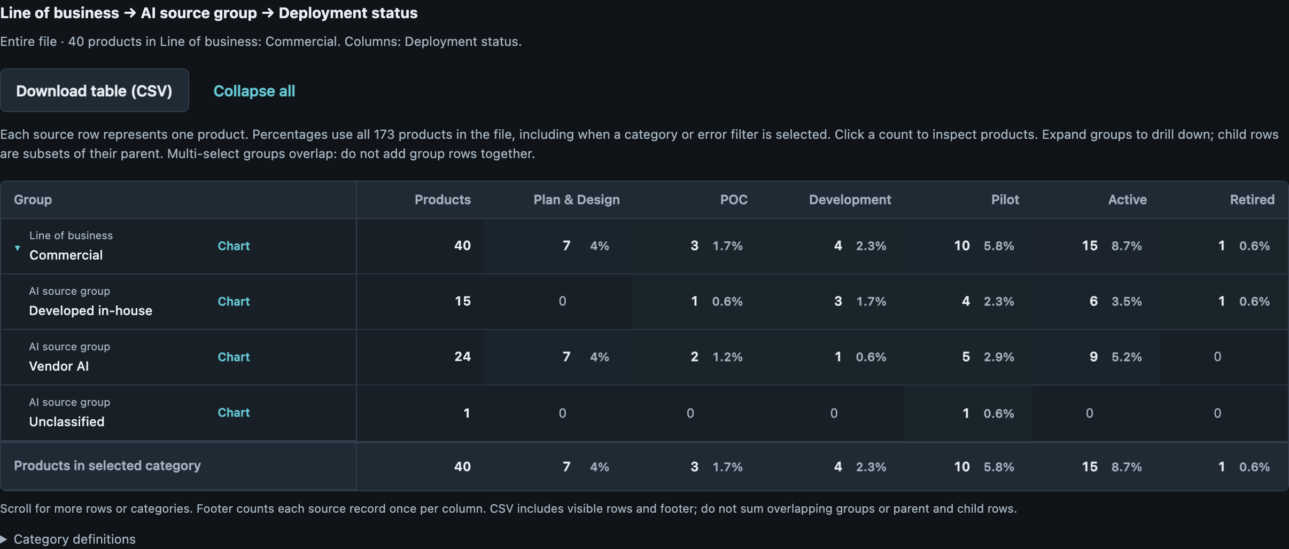
BUSINESS LINE × SOURCE × DEPLOYMENT
Commercial’s vendor footprint includes related workflow tools
14 · 8.1%
Commercial / vendor /
Pilot–Active
Five are Active Jira helpers with shared owners.
10 · 5.8%
Commercial / in-house /
Pilot–Active
Verify test-like entries before interpreting this total.
04
Notes:
Commercial’s vendor footprint includes related workflow tools
Suggested timing: 105 seconds
WHY THIS MATTERS
Part of Commercial’s vendor footprint comes from several assistants embedded in the same delivery workflow. Looking at the common workflow and owner gives a more practical explanation than treating every product as a separate supplier decision.
DISCUSSION
Five of the 14 Commercial Vendor AI products in Pilot/Active are Active Jira helpers with the same business/technical owner pair. Their purposes cover backlog grouping, work-item surfacing, estimation, security classification and release checks. They remain five products; the data does not establish five vendors, a single contract or duplicate products. All five have a vendor-contact finding. Separately, the 10 Commercial in-house later-stage products include five test-like entries that need owner confirmation; the original totals remain intact.
QUESTION TO OPEN THE DISCUSSION
Could one coordinated owner review resolve shared dependencies and contact details across these Jira tools?
EVIDENCE
jira_commercial_active: 5 products (2.9% of 173); source rows 55, 60, 61, 62, 63.
test_named_active_unknown_agentic: 5 products (2.9% of 173); source rows 22, 23, 24, 25, 26.
Source: AI Inventory data.csv,173 products; saved review 28b09c1d-4ee4-4a51-a408-0caf7fb82915; rules 5.4; validated 28 October 2026. One source row per product; all percentages /173. Source rows use logical records including the header.

Slide 5
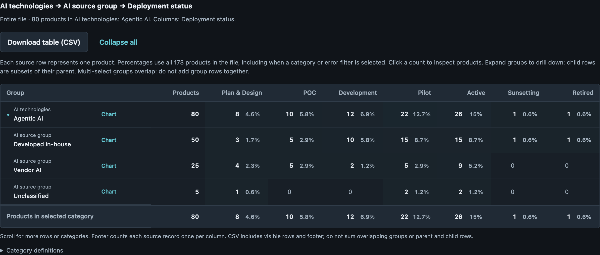
TECHNOLOGY × SOURCE × DEPLOYMENT
In-house Agentic AI includes everyday staff workflows
30 · 17.3%
Agentic / in-house / Pilot–Active
21 report no member impact; examples include staff support.
14 · 8.1%
Agentic / vendor / Pilot–Active
Review actual actions and opportunities for reuse.
05
Notes:
In-house Agentic AI includes everyday staff workflows
Suggested timing: 90 seconds
WHY THIS MATTERS
The in-house Agentic footprint includes ordinary staff workflows such as policy guidance, reporting, estimation, scheduling and file checks. This opens a reuse and support discussion alongside the question of what each tool is allowed to do.
DISCUSSION
21 products combine Agentic AI, in-house source, Pilot/Active and reported No member impact. Examples include ITSM policy help, PDF/JSON validation, demand estimation and Power Platform support. This is a subset of the 30 in-house Agentic Pilot/Active products. Reported No member impact does not prove no indirect impact, and an Agentic tag does not tell us whether a product can take actions autonomously. Five of the 30 have test-like registrations; retain them until the owners confirm their status.
QUESTION TO OPEN THE DISCUSSION
Which useful staff tools can be reused, and who will maintain them as recurring work depends on them?
EVIDENCE
agentic_inhouse_later_no_member: 21 products (12.1% of 173); source rows 7, 8, 30, 34, 44, 54, 59, 64, 66, 73, 74, 75, 76, 77, 78, 126, 133, 153, 154, 155, 160.
agentic_inhouse_later: 30 products (17.3% of 173); source rows 7, 8, 22, 23, 24, 25, 26, 30, 34, 43, 44, 54, 59, 64, 66, 73, 74, 75, 76, 77, 78, 94, 96, 122, 126, 133, 153, 154, 155, 160.
test_named_active_unknown_agentic: 5 products (2.9% of 173); source rows 22, 23, 24, 25, 26.
Source: AI Inventory data.csv,173 products; saved review 28b09c1d-4ee4-4a51-a408-0caf7fb82915; rules 5.4; validated 28 October 2026. One source row per product; all percentages /173. Source rows use logical records including the header.

Slide 6
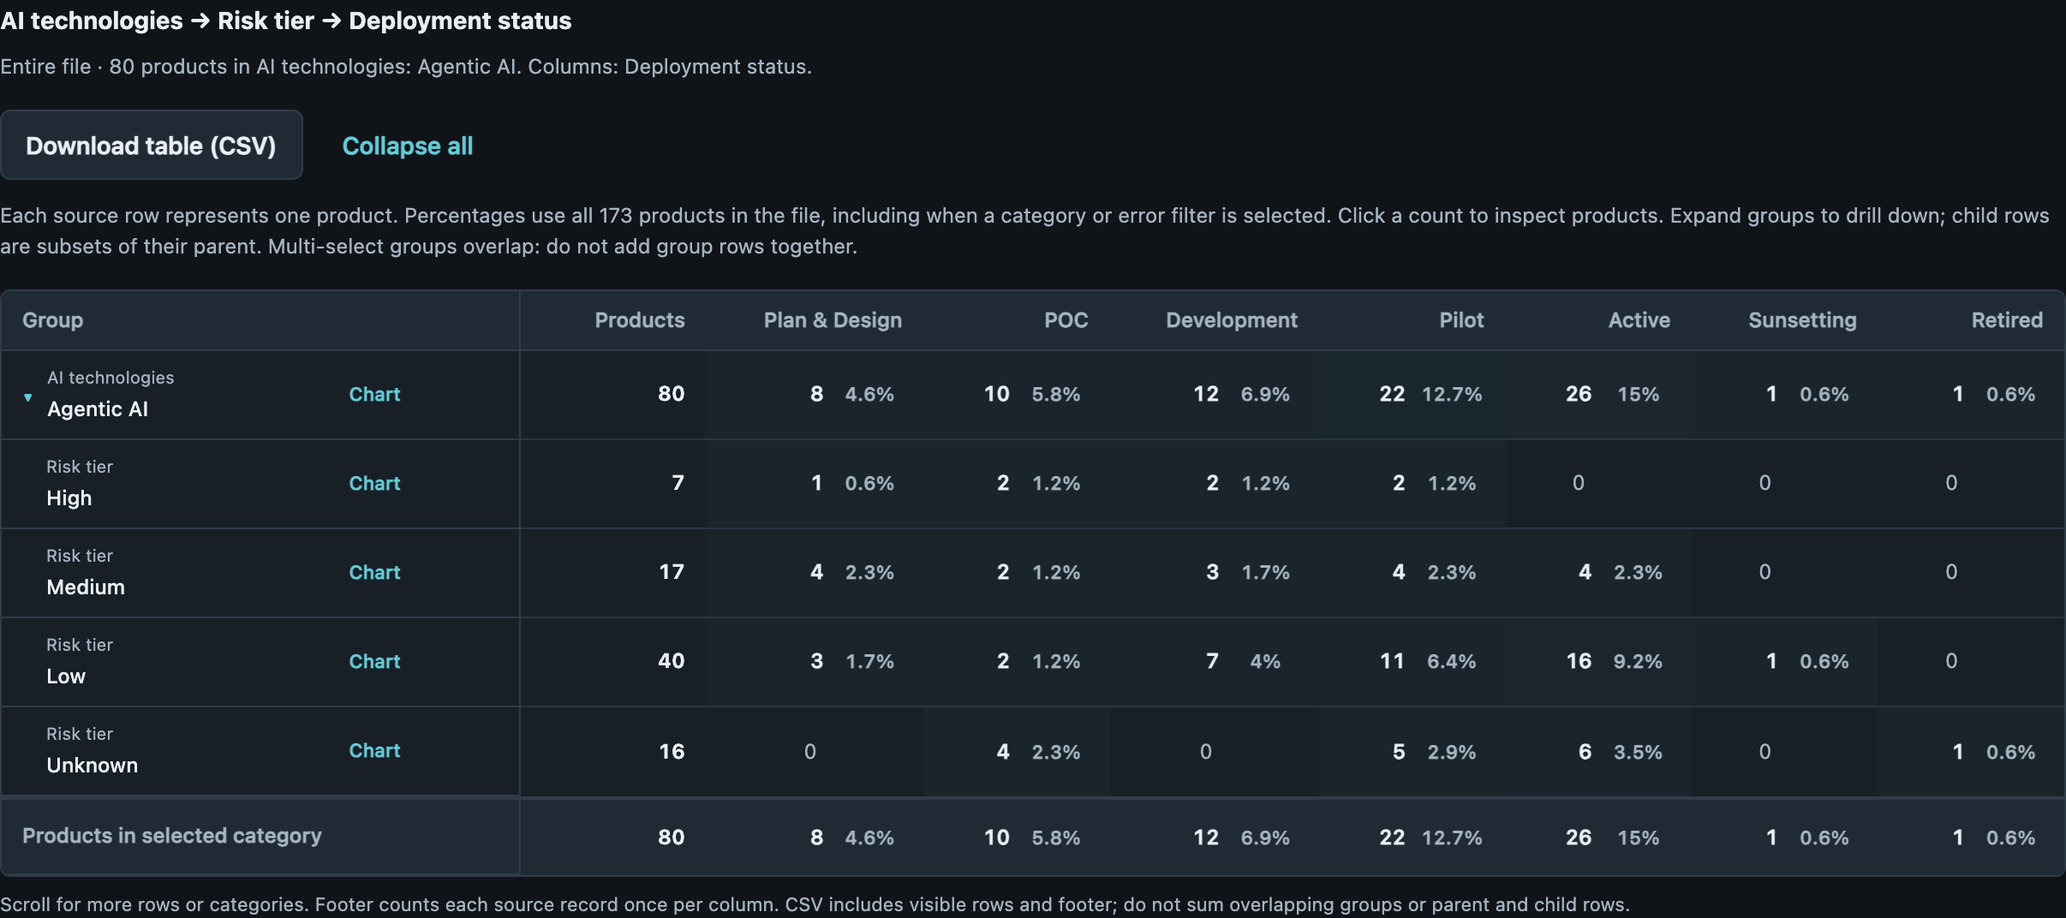
TECHNOLOGY × RISK × DEPLOYMENT
Risk labels point to different follow-up questions
10 · 5.8%
Agentic / Medium–High /
Pilot–Active
Confirm how the declared risk was assessed.
11 · 6.4%
Agentic / Unknown risk /
Pilot–Active
Five Active entries have test-like names and purposes.
06
Notes:
Risk labels point to different follow-up questions
Suggested timing: 75 seconds
WHY THIS MATTERS
A declared Medium or High tier prompts a discussion about the assessment and controls. An Unknown tier first needs classification and, for some records here, confirmation of the registration itself.
DISCUSSION
The existing cards show 10 Agentic Medium/High Pilot/Active products and 11 Agentic Unknown-risk Pilot/Active products. Five of the Unknown group are the same Active products with test-like names and purposes discussed later. They are signals for owner review, not confirmed test data. Keep the baseline unchanged and avoid interpreting Unknown as High.
QUESTION TO OPEN THE DISCUSSION
Is the missing information the assessment, the product context, or the registration’s operating status?
EVIDENCE
test_named_active_unknown_agentic: 5 products (2.9% of 173); source rows 22, 23, 24, 25, 26.
Existing card cohorts: Agentic + Medium/High + Pilot/Active =10; Agentic + Unknown + Pilot/Active =11.
Source: AI Inventory data.csv,173 products; saved review 28b09c1d-4ee4-4a51-a408-0caf7fb82915; rules 5.4; validated 28 October 2026. One source row per product; all percentages /173. Source rows use logical records including the header.

Slide 7
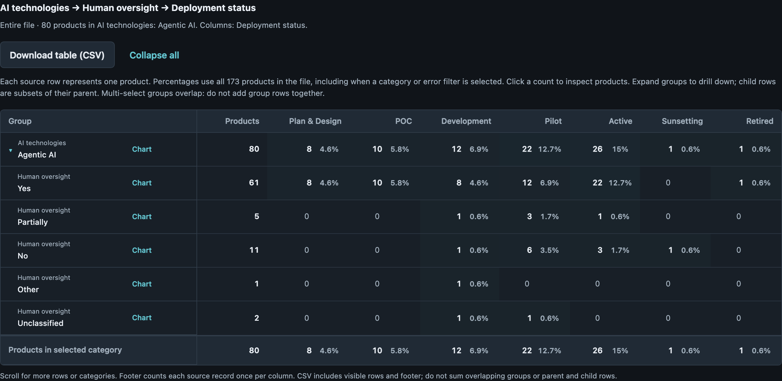
TECHNOLOGY × OVERSIGHT × DEPLOYMENT
Oversight needs to be understood in the workflow
9 · 5.2%
Agentic / No oversight /
Pilot–Active
Includes file checks, policy help and email recall.
4 · 2.3%
Agentic / Partial oversight /
Pilot–Active
Clarify where people review outputs or approve actions.
07
Notes:
Oversight needs to be understood in the workflow
Suggested timing: 90 seconds
WHY THIS MATTERS
This group includes tools that validate files, answer policy questions and recall conversations. The key distinction is where a person makes the downstream decision after the tool produces its output.
DISCUSSION
Nine Agentic Pilot/Active products report No oversight. Eight declare Low risk; eight report No member impact; these are different eight-product subsets. Examples include a Medicare enrollment PDF validator, ITSM policy assistance and email recall. The inventory does not establish whether a user still approves a consequential action, so the No label needs workflow-specific follow-up. Four other Agentic Pilot/Active products report Partial oversight.
QUESTION TO OPEN THE DISCUSSION
Does the tool only inform a user, or can it act on a member, transaction or system without approval?
EVIDENCE
agentic_no_later: 9 products (5.2% of 173); source rows 42, 43, 44, 54, 59, 64, 66, 73, 78.
Source: AI Inventory data.csv,173 products; saved review 28b09c1d-4ee4-4a51-a408-0caf7fb82915; rules 5.4; validated 28 October 2026. One source row per product; all percentages /173. Source rows use logical records including the header.

Slide 8
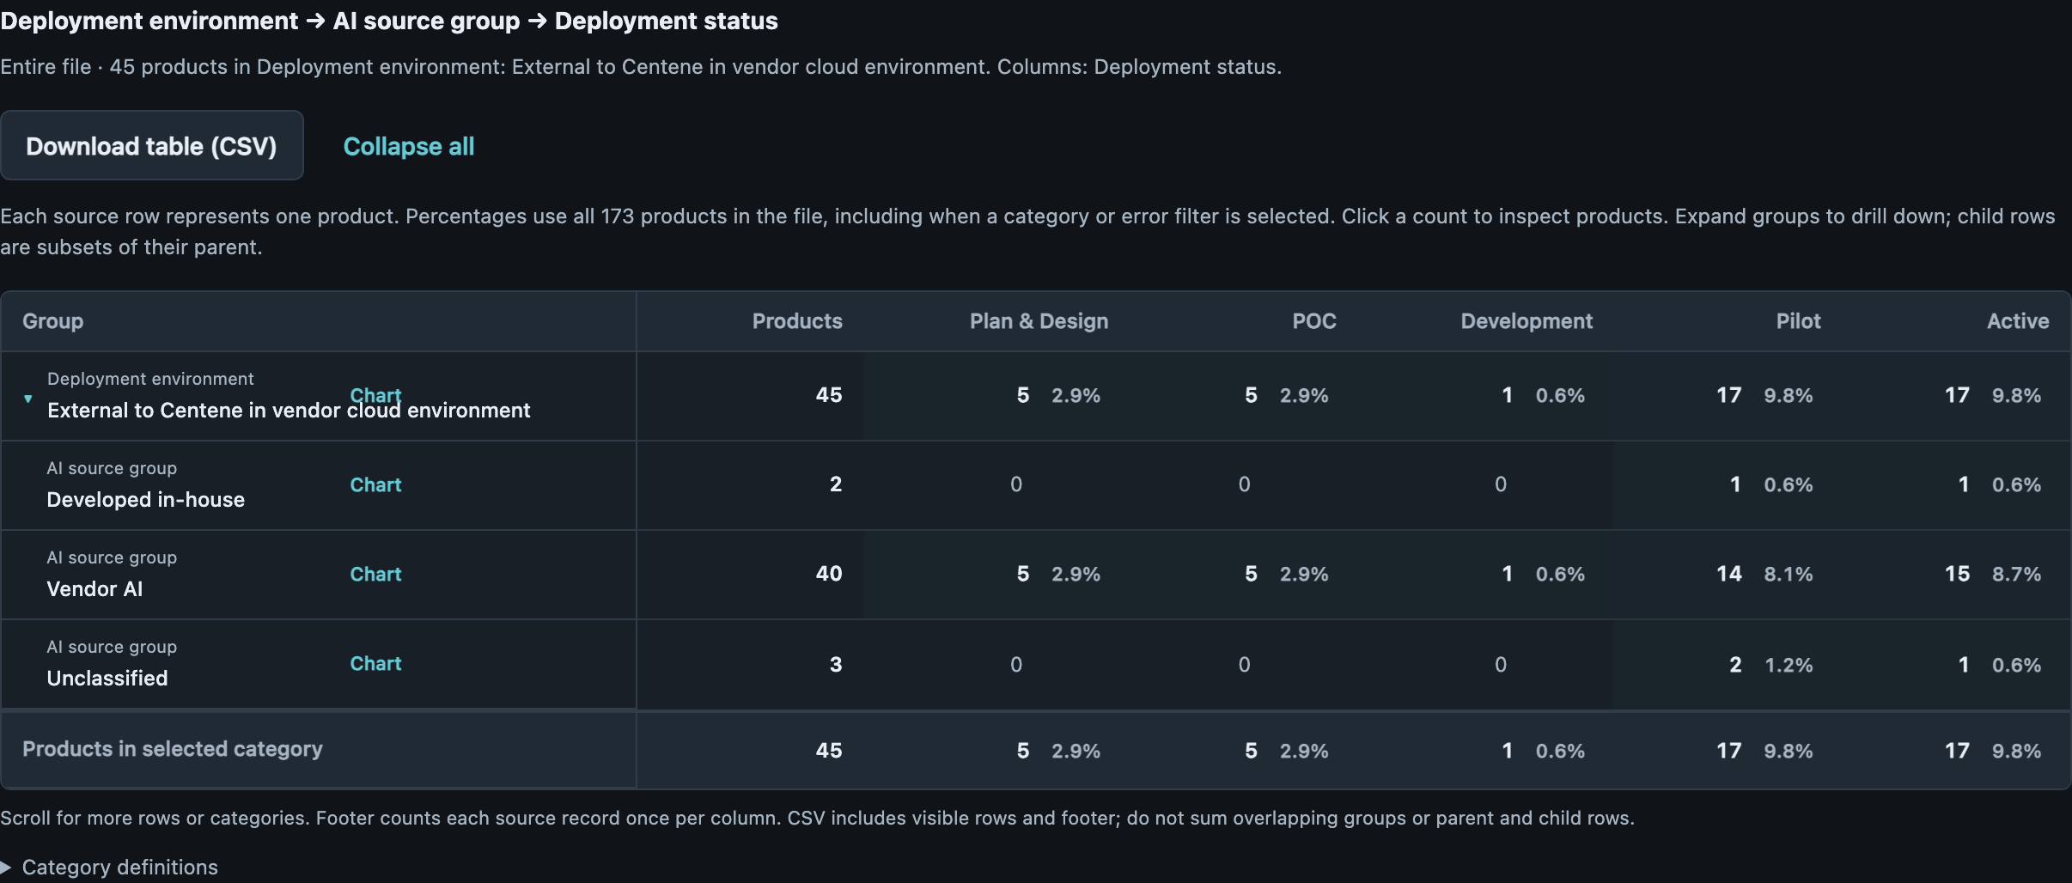
HOSTING × SOURCE × DEPLOYMENT
Hosting points to different support responsibilities
ACTUAL APP CAPTURE
29 · 16.8%
Vendor cloud / Vendor AI /
Pilot–Active
Clarify external support and escalation ownership.
8 · 4.6%
Laptop / in-house / Pilot–Active
Check whether “laptop” means access or actual hosting.
08
Notes:
Hosting points to different support responsibilities
Suggested timing: 75 seconds
WHY THIS MATTERS
The hosting field helps identify who should support a product and where escalation may depend on another party. It also needs a consistent meaning: an employee laptop may describe the user’s access point rather than the place inference runs.
DISCUSSION
29 products combine Vendor AI, external vendor cloud and Pilot/Active. Eight combine in-house, Employee laptop and Pilot/Active; five are Active, six are Agentic and all eight report No member impact. The laptop products include mapping, clause extraction, reporting and conversation-recall tools. Their descriptions support a maintenance and continuity question; they do not establish local-only data processing, shadow IT or a security finding.
QUESTION TO OPEN THE DISCUSSION
Which tools now support recurring work, and who provides durable maintenance and escalation?
EVIDENCE
Employee laptop + in-house + Pilot/Active source rows:7,8,31,45,64,66,77,153. Vendor cloud + Vendor AI + Pilot/Active =29.
Source: AI Inventory data.csv,173 products; saved review 28b09c1d-4ee4-4a51-a408-0caf7fb82915; rules 5.4; validated 28 October 2026. One source row per product; all percentages /173. Source rows use logical records including the header.

Slide 9
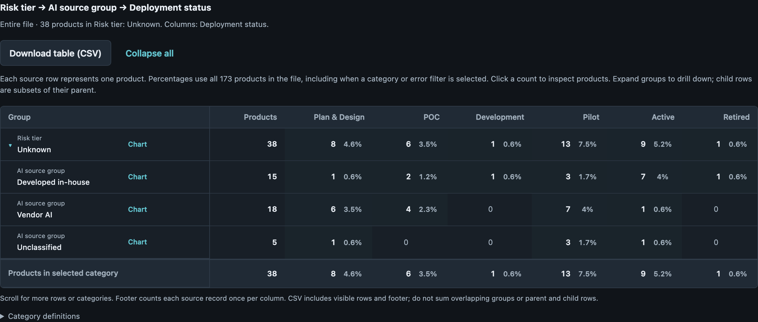
RISK × SOURCE × DEPLOYMENT
Unknown risk needs a registration check as well as assessment
ACTUAL APP CAPTURE
10 · 5.8%
Unknown risk / in-house /
Pilot–Active
Five Active entries have test-like names and purposes.
8 · 4.6%
Unknown risk / vendor /
Pilot–Active
Confirm the classification with the product owner.
09
Notes:
Unknown risk needs a registration check as well as assessment
Suggested timing: 105 seconds
WHY THIS MATTERS
The Unknown-risk group includes a registration-quality question as well as a risk-assessment question. Five Active products have test-like names and purposes and share the same submission and go-live date.
DISCUSSION
The five source rows 22–26 are in-house, Agentic and Unknown risk; both dates are 19 July 2026. They sit within the 22 Unknown-risk Pilot/Active products and the nine Unknown-risk Active products. Two of the five pass all current validation rules. That shows the limit of a clean form: it does not confirm that the registration describes an operating product. Ask owners to verify them; no records were removed, no classifications were changed, and all percentages still use 173.
QUESTION TO OPEN THE DISCUSSION
Are these operating products, demonstration registrations or entries whose status needs correction?
EVIDENCE
unknown_later: 22 products (12.7% of 173); source rows 4, 15, 17, 18, 22, 23, 24, 25, 26, 29, 51, 75, 78, 82, 84, 95, 106, 116, 127, 145, 150, 162.
unknown_active: 9 products (5.2% of 173); source rows 22, 23, 24, 25, 26, 51, 82, 84, 95.
test_named_active_unknown_agentic: 5 products (2.9% of 173); source rows 22, 23, 24, 25, 26.
test_named_passing: 2 products (1.2% of 173); source rows 24, 25.
Source: AI Inventory data.csv,173 products; saved review 28b09c1d-4ee4-4a51-a408-0caf7fb82915; rules 5.4; validated 28 October 2026. One source row per product; all percentages /173. Source rows use logical records including the header.

Slide 10
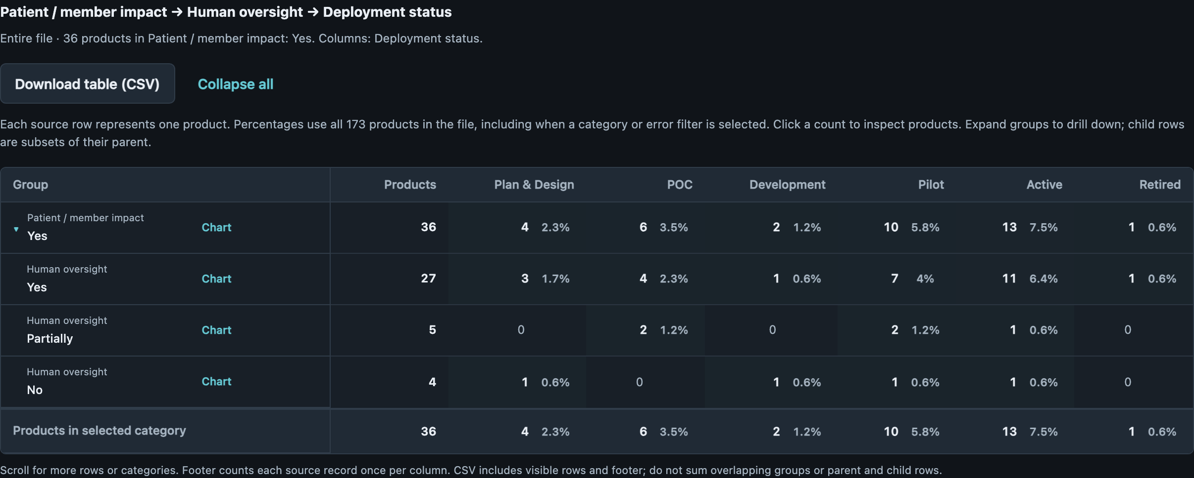
MEMBER IMPACT × OVERSIGHT × DEPLOYMENT
The live oversight questions extend beyond Agentic AI
ACTUAL APP CAPTURE
3 · 1.7%
Member impact / Partial /
Pilot–Active
Includes an Active prior-authorization review product.
2 · 1.2%
Member impact / No /
Pilot–Active
Includes an Active provider-directory cleansing product.
10
Notes:
The live oversight questions extend beyond Agentic AI
Suggested timing: 90 seconds
WHY THIS MATTERS
The two Active products in this limited-oversight, member-impact group use ML for prior-authorization review and provider-directory accuracy. The three Agentic products in the same group are in Pilot, so the workflow and affected person provide useful context beyond the technology label.
DISCUSSION
CADA (row 80) is Active, ML and Partial oversight, with a stated purpose of prior-authorization clinical-review automation. H1/Veda (row 98) is Active, ML and No oversight, with a provider-directory cleansing purpose. Neither has an Agentic tag. The three Pilot Agentic products are rows 10,15,43; their purposes include outreach and enrollment validation. The on-slide cards retain the Partial/No split shown in the screenshot; this Active/Pilot and technology split is a further cross-column analysis of the same five products. The data does not establish harm or control effectiveness.
QUESTION TO OPEN THE DISCUSSION
Where could an incorrect output affect a member’s authorization, routing or provider information, and who can intervene?
EVIDENCE
member_limited_later: 5 products (2.9% of 173); source rows 10, 15, 43, 80, 98.
member_limited_active_ml: 2 products (1.2% of 173); source rows 80, 98.
member_limited_pilot_agentic: 3 products (1.7% of 173); source rows 10, 15, 43.
Source: AI Inventory data.csv,173 products; saved review 28b09c1d-4ee4-4a51-a408-0caf7fb82915; rules 5.4; validated 28 October 2026. One source row per product; all percentages /173. Source rows use logical records including the header.

Slide 11
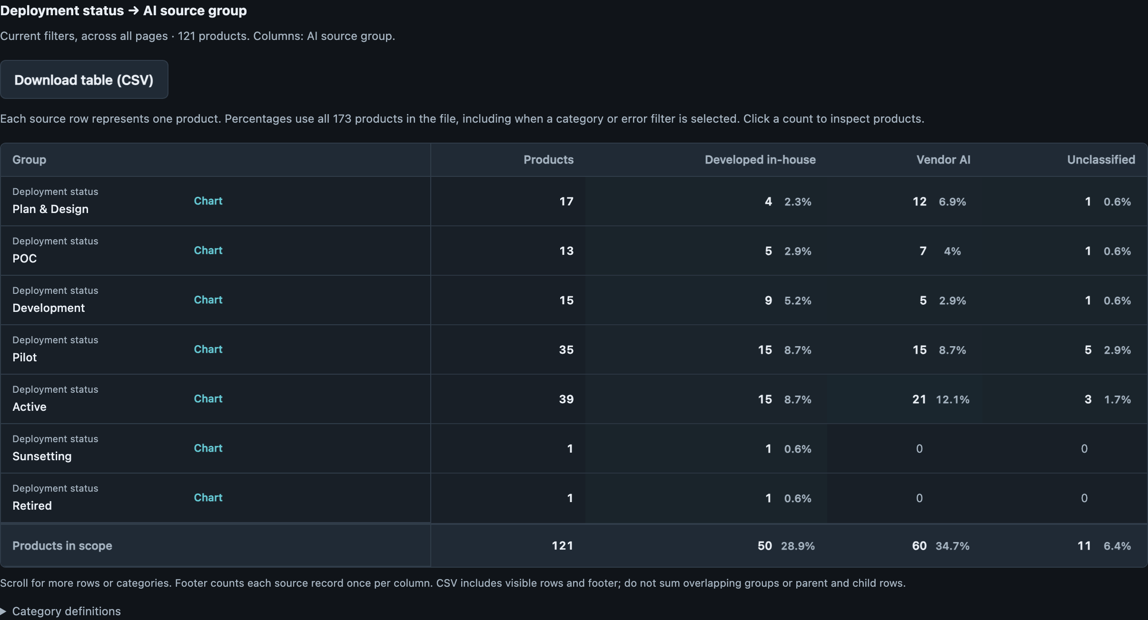
VALIDATION STATUS × DEPLOYMENT × SOURCE
Later-stage errors call for two kinds of follow-up
ACTUAL APP CAPTURE
39 · 22.5%
Active products with errors
Operational status does not guarantee complete disclosures.
35 · 20.2%
Pilot products with errors
Use the pilot to resolve missing product details.
11
Notes:
Later-stage errors call for two kinds of follow-up
Suggested timing: 90 seconds
WHY THIS MATTERS
The later-stage cleanup list contains two kinds of work. Some products need model-count clarification; others also need contact, scope, identity or other disclosures resolved.
DISCUSSION
Across the 74 Pilot/Active products with findings, 46 have only count findings and 28 have at least one non-count finding. Those groups are mutually exclusive and sum to 74. The on-slide cards show the same overall group split by Active (39) and Pilot (35). Count-only does not mean an easy formatting repair: some owners still need another party to confirm the answer. These are inventory-validation outcomes, not evidence that a product is unsafe or noncompliant.
QUESTION TO OPEN THE DISCUSSION
Can the correction work be routed by what is missing and who can supply it?
EVIDENCE
errors_later: 74 products (42.8% of 173); source rows 3, 4, 10, 14, 19, 22, 23, 26, 28, 29, 30, 31, 32, 36, 37, 38, 39, 41, 43, 44, 45, 46, 48, 49, 50, 51, 52, 53, 55, 57, 60, 61, 62, 63, 64, 65, 66, 67, 68, 71, 72, 74, 77, 78, 81, 88, 89, 94, 95, 98, 101, 106, 112, 116, 117, 121, 123, 126, 127, 129, 133, 136, 139, 145, 146, 150, 154, 155, 159, 161, 162, 163, 171, 172.
count_only_later: 46 products (26.6% of 173); source rows 3, 10, 26, 29, 30, 31, 32, 37, 38, 39, 43, 45, 46, 50, 51, 52, 53, 64, 66, 67, 68, 71, 72, 74, 77, 88, 89, 94, 101, 116, 117, 121, 123, 126, 127, 129, 133, 145, 146, 150, 154, 155, 161, 163, 171, 172.
non_count_later: 28 products (16.2% of 173); source rows 4, 14, 19, 22, 23, 28, 36, 41, 44, 48, 49, 55, 57, 60, 61, 62, 63, 65, 78, 81, 95, 98, 106, 112, 136, 139, 159, 162.
Source: AI Inventory data.csv,173 products; saved review 28b09c1d-4ee4-4a51-a408-0caf7fb82915; rules 5.4; validated 28 October 2026. One source row per product; all percentages /173. Source rows use logical records including the header.

Slide 12
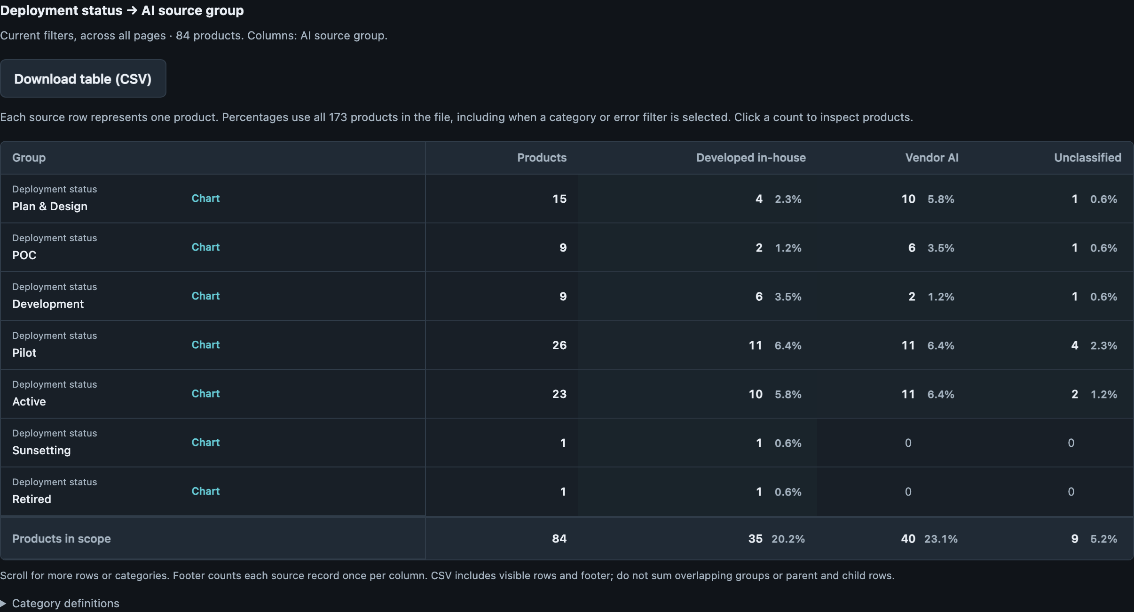
COUNT ERRORS × DEPLOYMENT × SOURCE
A model-count error can mean two different problems
ACTUAL APP CAPTURE
84 · 48.6%
Products with LLM-count errors
Some responses give a count in prose.
49 · 28.3%
LLM-count error + Pilot/Active
Others require the vendor to confirm the count.
12
Notes:
A model-count error can mean two different problems
Suggested timing: 105 seconds
WHY THIS MATTERS
Some owners supplied a count in prose; others still need the vendor to confirm it. Sending the same correction request to both groups would miss the underlying reason the field failed.
DISCUSSION
ServiceNow Estimator Assistant (row 126) describes two models in a response beginning “2.”, and Principles Prince AI (row 161) explicitly writes “LLM = 1”; these fail the current format. Across both model-count fields, six reviewed vendor Pilot/Active examples (rows 10,29,88,98,121,127) explicitly defer counts or indicate limited vendor visibility; rows 88 and121 concern ML/DL counts rather than the LLM-count cohort on this slide. Those six are reviewed examples, not an exhaustive automated classification. Ask owners to confirm model definitions and facts before rewriting a response. No source values or validation rules were changed.
QUESTION TO OPEN THE DISCUSSION
Is the fix a clearer way to enter a known count, or a request for information the product owner does not yet have?
EVIDENCE
llm_errors_later: 49 products (28.3% of 173); source rows 4, 10, 19, 22, 26, 29, 31, 32, 37, 38, 39, 41, 45, 46, 48, 49, 50, 51, 52, 53, 57, 64, 66, 67, 68, 71, 74, 77, 78, 94, 95, 98, 101, 116, 117, 123, 126, 127, 129, 133, 136, 145, 146, 150, 154, 155, 159, 161, 163.
Reviewed explicit-count examples: rows 126,161. Reviewed vendor-dependent examples across both count fields: rows 10,29,88,98,121,127. LLM-count-specific examples: rows 10,29,98,127.
Source: AI Inventory data.csv,173 products; saved review 28b09c1d-4ee4-4a51-a408-0caf7fb82915; rules 5.4; validated 28 October 2026. One source row per product; all percentages /173. Source rows use logical records including the header.

Slide 13
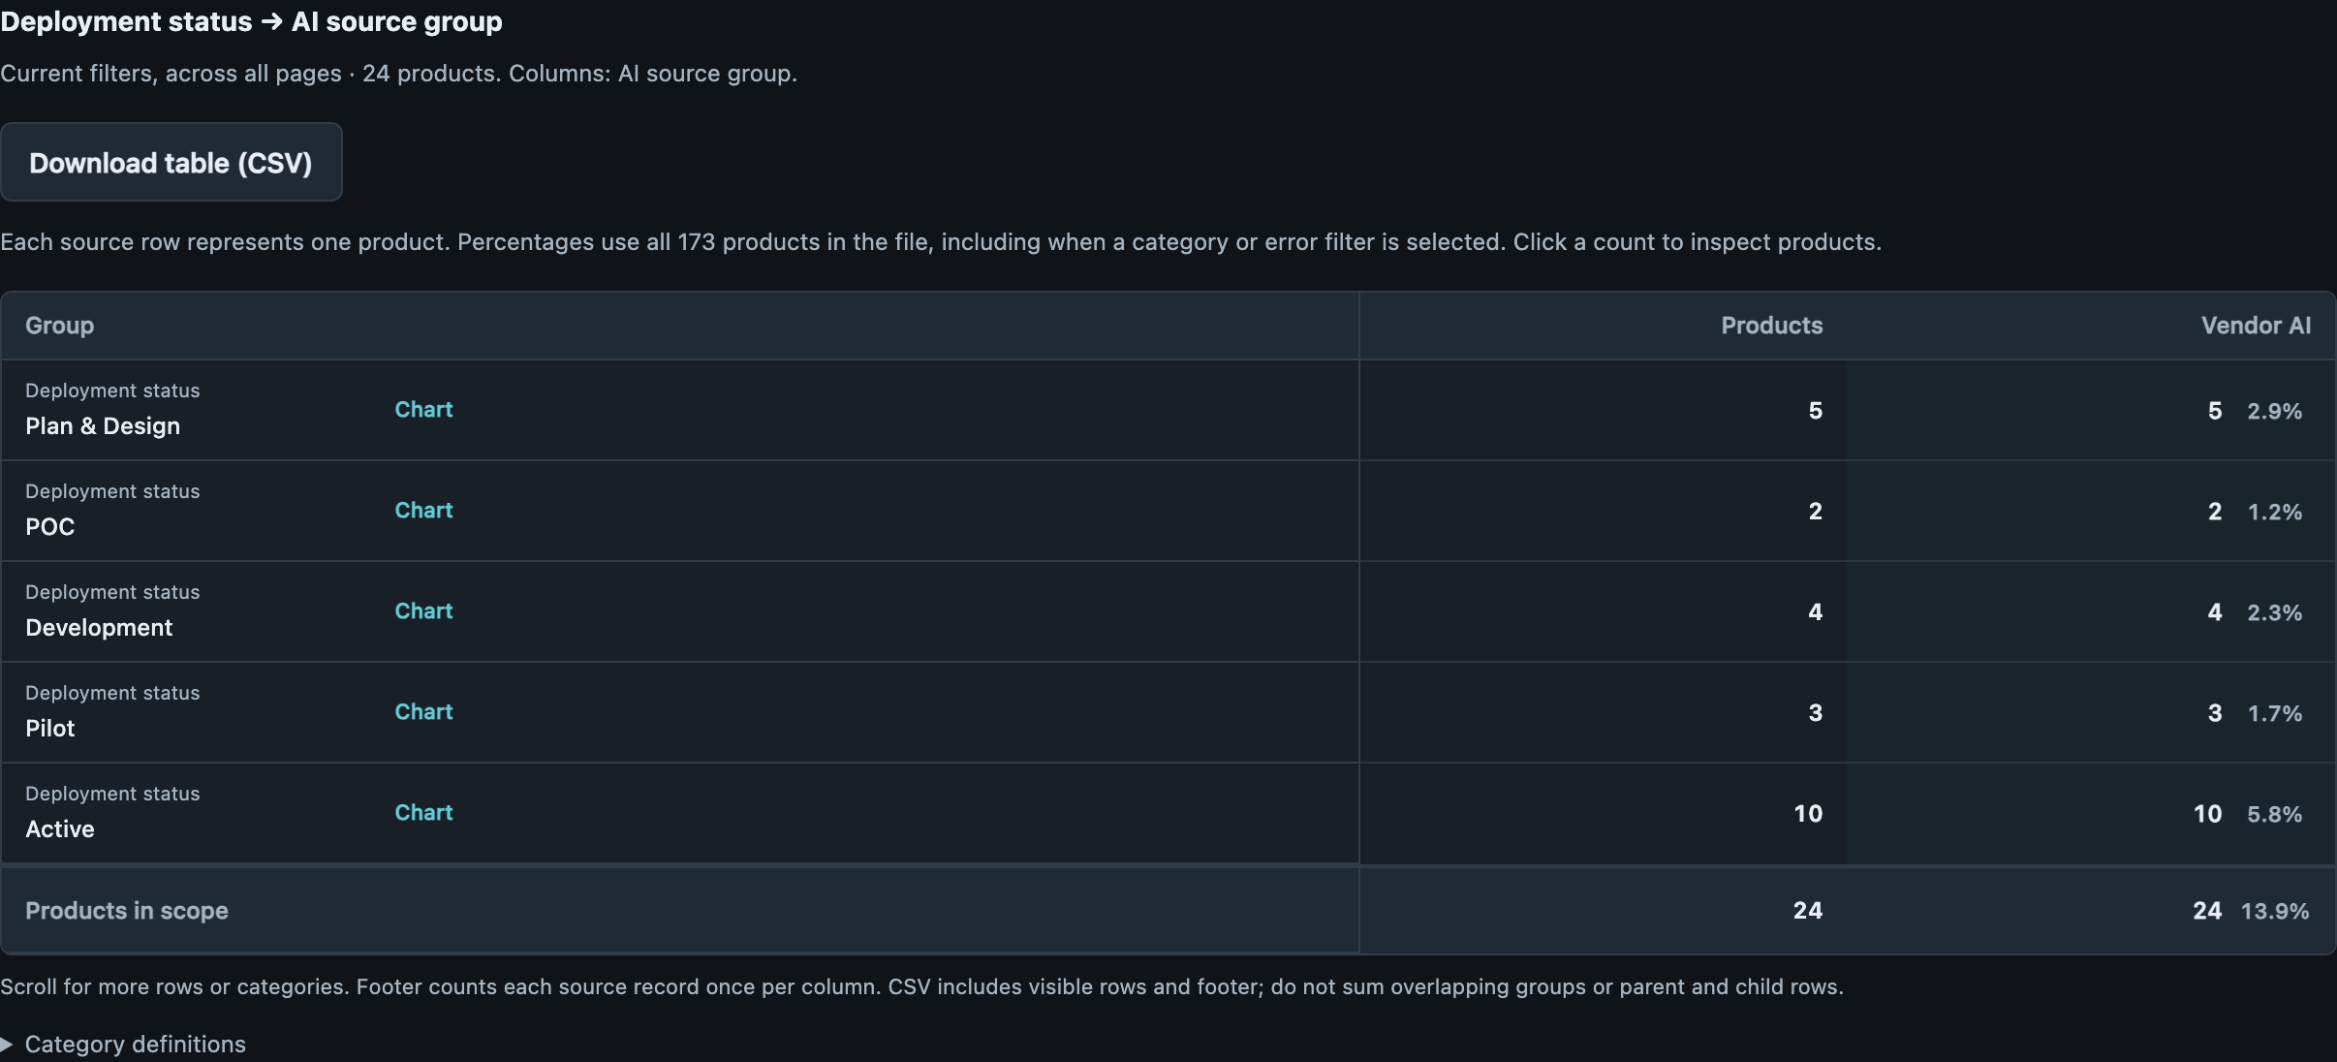
VENDOR CONTACT × DEPLOYMENT × SOURCE
Shared owners offer a starting point for vendor follow-up
ACTUAL APP CAPTURE
13 · 7.5%
Vendor contact gap +
Pilot/Active
Group related products for one owner-led review.
10 · 5.8%
Vendor contact gap + Active
Five are Jira helpers with the same owner pair.
13
Notes:
Shared owners offer a starting point for vendor follow-up
Suggested timing: 90 seconds
WHY THIS MATTERS
A common owner can be a useful starting point for repeated contact gaps. Five Active Jira helpers have the same owner pair and all lack the required vendor contact, so one coordinated discussion could address five product records.
DISCUSSION
The later-stage vendor-contact group contains 13 products, including 10 Active; the five Jira products are rows 55,60,61,62,63. The source comparison also needs care: vendor products face this additional disclosure requirement. In Pilot/Active, 16 vendor and eight in-house products have non-count findings; considering non-count findings other than VENDOR-01 leaves six vendor and eight in-house products. That does not establish worse vendor-product quality. Confirm the appropriate contact for each product even if ownership is shared.
QUESTION TO OPEN THE DISCUSSION
Who can confirm the right escalation contact for this related group of tools?
EVIDENCE
vendor_gap_later: 13 products (7.5% of 173); source rows 14, 36, 41, 48, 49, 55, 57, 60, 61, 62, 63, 81, 136.
jira_commercial_active: 5 products (2.9% of 173); source rows 55, 60, 61, 62, 63.
Vendor AI_non_count: 16 products (9.2% of 173); source rows 14, 19, 36, 41, 48, 49, 55, 57, 60, 61, 62, 63, 81, 98, 112, 136.
Developed in-house_non_count: 8 products (4.6% of 173); source rows 22, 23, 28, 44, 65, 78, 106, 159.
Vendor AI_non_count_excluding_vendor: 6 products (3.5% of 173); source rows 14, 19, 36, 57, 98, 112.
Developed in-house_non_count_excluding_vendor: 8 products (4.6% of 173); source rows 22, 23, 28, 44, 65, 78, 106, 159.
Source: AI Inventory data.csv,173 products; saved review 28b09c1d-4ee4-4a51-a408-0caf7fb82915; rules 5.4; validated 28 October 2026. One source row per product; all percentages /173. Source rows use logical records including the header.

Slide 14
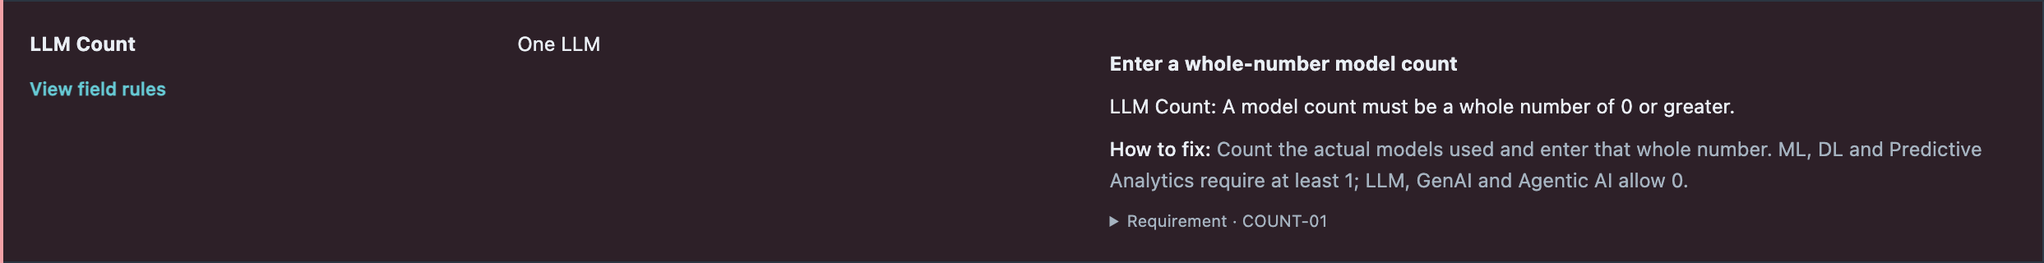
ERROR MIX × PRODUCT OUTCOME
Count-only findings create a focused cleanup opportunity
CURRENTLY PASSING
COUNT-ONLY COHORT
CONDITIONAL SCENARIO
52 · 30.1%
76 · 43.9%
128 · 74.0%
Validation passes still need business context.
Separate format corrections from unresolved model details.
After owner confirmation and successful revalidation.
ACTUAL APP CAPTURE
14
Notes:
Count-only findings create a focused cleanup opportunity
Suggested timing: 90 seconds
WHY THIS MATTERS
The count-only group is a focused opportunity because no other finding family currently prevents a validation pass. The next step is to distinguish formatting from unresolved facts and then revalidate the confirmed answers.
DISCUSSION
76 products have only COUNT findings, including 46 in Pilot/Active. Four Active BTS Communications Copilot products (rows 32,37,38,39) all select GenAI, answer N/A for LLM Count and receive only COUNT-02. A common platform-owner clarification may help all four; the inventory does not prove they share a model. The 128 passing-product scenario is conditional on all 76 resolving cleanly with no other findings introduced. It is not a completed revalidation or permission to invent counts.
QUESTION TO OPEN THE DISCUSSION
Which repeated questions can a product or platform owner answer once, with confirmation for each affected product?
EVIDENCE
count_only_all: 76 products (43.9% of 173); source rows 3, 6, 10, 11, 13, 26, 29, 30, 31, 32, 37, 38, 39, 40, 43, 45, 46, 47, 50, 51, 52, 53, 64, 66, 67, 68, 69, 70, 71, 72, 74, 77, 85, 86, 88, 89, 90, 91, 92, 93, 94, 99, 100, 101, 104, 105, 115, 116, 117, 118, 121, 123, 125, 126, 127, 129, 130, 133, 134, 137, 140, 142, 145, 146, 147, 150, 151, 154, 155, 161, 163, 166, 168, 170, 171, 172.
count_only_later: 46 products (26.6% of 173); source rows 3, 10, 26, 29, 30, 31, 32, 37, 38, 39, 43, 45, 46, 50, 51, 52, 53, 64, 66, 67, 68, 71, 72, 74, 77, 88, 89, 94, 101, 116, 117, 121, 123, 126, 127, 129, 133, 145, 146, 150, 154, 155, 161, 163, 171, 172.
bts_communications: 4 products (2.3% of 173); source rows 32, 37, 38, 39.
Source: AI Inventory data.csv,173 products; saved review 28b09c1d-4ee4-4a51-a408-0caf7fb82915; rules 5.4; validated 28 October 2026. One source row per product; all percentages /173. Source rows use logical records including the header.

Slide 15
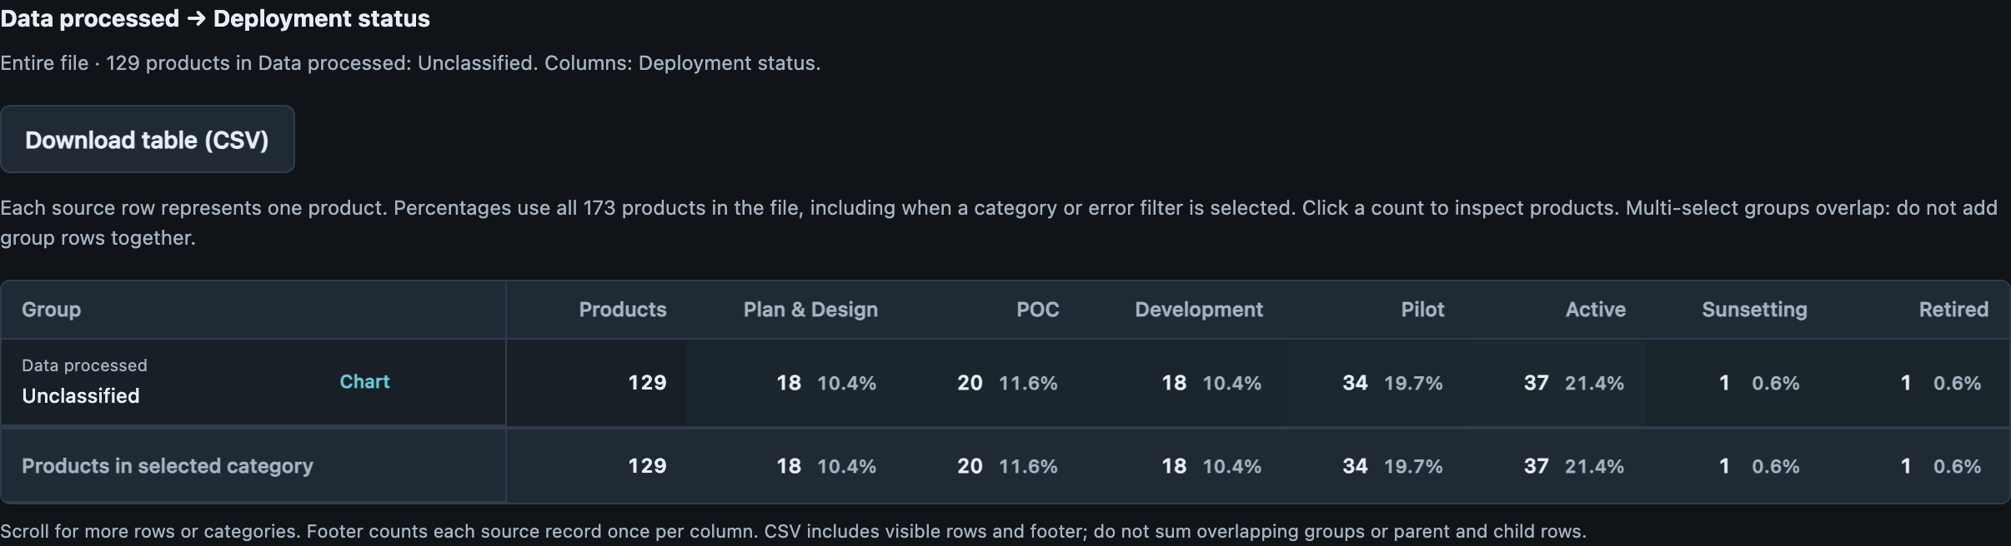
TAXONOMY COVERAGE × DEPLOYMENT
Unclassified can hide sensitive-data disclosures
71 · 41.0%
Data type Unclassified +
Pilot/Active
Nine explicitly select PHI/PII alongside unmapped terms.
26 · 15.0%
Environment Unclassified +
Pilot/Active
Clarify hosting before drawing infrastructure conclusions.
15
Notes:
Unclassified can hide sensitive-data disclosures
Suggested timing: 105 seconds
WHY THIS MATTERS
Some products disclose PHI or PII but disappear from those chart categories when another selected term is unmapped. The immediate reporting improvement is to preserve known selections while still showing the unmapped wording for review.
DISCUSSION
18 products explicitly select Contains PHI or Contains PII and are charted as Unclassified because the multi-select response also contains an unmapped term; nine are Pilot/Active. Business Confidential Data accompanies 14 of the 18. Exact raw PHI selection appears on 33 products versus 19 charted; PII appears on 36 versus 18 charted. These PHI and PII groups overlap. This is a mapping blind spot in disclosed data, not proof of additional data use or a missing answer. The on-slide 71-product Unclassified data cohort includes the nine later-stage products; environment mapping is a separate issue.
QUESTION TO OPEN THE DISCUSSION
Can the reporting preserve recognized sensitive-data selections without losing the owner’s more detailed description?
EVIDENCE
hidden_sensitive: 18 products (10.4% of 173); source rows 4, 10, 12, 15, 33, 35, 90, 94, 104, 120, 121, 127, 132, 134, 160, 162, 166, 173.
hidden_sensitive_later: 9 products (5.2% of 173); source rows 4, 10, 15, 94, 121, 127, 132, 160, 162.
Exact Contains PHI source selection=33, app chart category=19. Exact Contains PII selection=36, app chart category=18. Business Confidential Data in hidden-sensitive cohort=14.
Source: AI Inventory data.csv,173 products; saved review 28b09c1d-4ee4-4a51-a408-0caf7fb82915; rules 5.4; validated 28 October 2026. One source row per product; all percentages /173. Source rows use logical records including the header.

Slide 16
PROPOSED NEXT STEPS
Turn the patterns into coordinated owner reviews
CORRECT INPUTS
CLARIFY CONTEXT
IMPROVE REPORTING
Clarify model counts with owners
Verify five Active test-like entries
Preserve recognized PHI/PII selections
Resolve Jira vendor contacts together
Locate the human decision points
Align hosting and business terminology
Revalidate corrected products
Prioritize member-impacting workflows
Coordinate shared business-line products
16
Notes:
Turn the patterns into coordinated owner reviews
Suggested timing: 120 seconds
WHY THIS MATTERS
Organize follow-up around related products and the people who can resolve the question. The aim is fewer repeated requests and a clearer distinction between correcting a form, confirming a product and improving the reporting.
DISCUSSION
Start with shared Jira contacts, recurring model-count questions and verification of the five Active test-like entries. For oversight, use the actual decision and member impact to choose the follow-up. For reporting, retain explicit PHI/PII selections and agree what hosting and business-line labels mean. Shared business-line products create an opportunity for coordinated maintenance and investment. These are proposals for discussion, not assigned owners or approved commitments; the product lists overlap and should be deduplicated before planning workload.
QUESTION TO OPEN THE DISCUSSION
Which owner groups can resolve the most repeated questions, and what evidence will show that each product record is ready?
EVIDENCE
jira_commercial_active: 5 products (2.9% of 173); source rows 55, 60, 61, 62, 63.
bts_communications: 4 products (2.3% of 173); source rows 32, 37, 38, 39.
test_named_active_unknown_agentic: 5 products (2.9% of 173); source rows 22, 23, 24, 25, 26.
hidden_sensitive_later: 9 products (5.2% of 173); source rows 4, 10, 15, 94, 121, 127, 132, 160, 162.
shared_three_lob: 26 products (15.0% of 173); source rows 3, 4, 28, 30, 42, 44, 49, 51, 66, 67, 80, 84, 89, 96, 98, 109, 123, 126, 132, 139, 144, 145, 148, 162, 171, 172.
Source: AI Inventory data.csv,173 products; saved review 28b09c1d-4ee4-4a51-a408-0caf7fb82915; rules 5.4; validated 28 October 2026. One source row per product; all percentages /173. Source rows use logical records including the header.

Slide 17
APPENDIX A • PRODUCT COUNTS BY RULE
Count affected products—not repeated findings
Rule
Meaning
Products
% of all 173
COUNT-01
Invalid model-count format
79
45.7%
COUNT-02
Required LLM count
15
8.7%
COUNT-03
Required ML/DL count
6
3.5%
VENDOR-01
Vendor contact unavailable
24
13.9%
SCOPE-01
Exclusive scope selections
14
8.1%
ID-02
Repeated ID flag
7
4.0%
DATE-02
Active without go-live date
2
1.2%
REQ-01
Required value missing
1
0.6%
REQ-02
Owner not identified
1
0.6%
EMAIL-01
Owner email text invalid
1
0.6%
17
Notes:
Count affected products—not repeated findings
Appendix reference
WHY THIS MATTERS
Each rule counts affected products once, even when it produces more than one finding for a product. A product may appear under several rules, so these rows cannot be added to calculate total affected products.
DISCUSSION
COUNT-01 has 112 finding instances across 79 products. The union across count rules is 100 products; the union across all current rules is 121. All percentages divide affected products by 173. These are results from the saved rules 5.4 review, not a measure of business risk or product effectiveness.
QUESTION TO OPEN THE DISCUSSION
Use this table to answer questions about what the validation checks actually flagged.
EVIDENCE
Saved findings deduplicated on source_row by rule_id. Original screenshot-based card counts are retained.
Source: AI Inventory data.csv,173 products; saved review 28b09c1d-4ee4-4a51-a408-0caf7fb82915; rules 5.4; validated 28 October 2026. One source row per product; all percentages /173. Source rows use logical records including the header.

Slide 18
APPENDIX B • INTERSECTIONS IN ONE VIEW
Deeper combinations on the same 173-product base
Combination
Products
% of all 173
Medicaid + Medicare + Marketplace + Pilot/Active
26
15.0%
Commercial + Vendor AI + Active + Jira helpers
5
2.9%
Agentic + In-house + Pilot/Active + No member impact
21
12.1%
Member impact + Limited oversight + Active + ML
2
1.2%
Count-only findings + Pilot/Active
46
26.6%
PHI/PII selected + Unclassified data + Pilot/Active
9
5.2%
Test-like name + Active + Agentic + Unknown risk
5
2.9%
Active + BTS Comms Copilot + Required LLM-count finding
4
2.3%
LLM Count error + Pilot/Active
49
28.3%
Vendor contact gap + Pilot/Active
13
7.5%
18
Notes:
Deeper combinations on the same 173-product base
Appendix reference
WHY THIS MATTERS
These combinations make the new explanations reproducible on one common product baseline. The source-specific and raw-answer checks supplement the app’s standard grouped views.
DISCUSSION
Every number is a distinct source-product count divided by 173. Limited oversight means Partially or No. Test-like is an explicit review of the names and purposes on rows 22–26 and is not a confirmed exclusion. The PHI/PII intersection uses exact source selections plus the app’s Unclassified category; it should not be read as a category already visible in the chart. The BTS family uses the shared product-name prefix and the saved COUNT-02 outcome. The groups overlap.
QUESTION TO OPEN THE DISCUSSION
Use the source-row lists below to inspect the actual products behind a combination.
EVIDENCE
shared_three_lob: 26 products (15.0% of 173); source rows 3, 4, 28, 30, 42, 44, 49, 51, 66, 67, 80, 84, 89, 96, 98, 109, 123, 126, 132, 139, 144, 145, 148, 162, 171, 172.
jira_commercial_active: 5 products (2.9% of 173); source rows 55, 60, 61, 62, 63.
agentic_inhouse_later_no_member: 21 products (12.1% of 173); source rows 7, 8, 30, 34, 44, 54, 59, 64, 66, 73, 74, 75, 76, 77, 78, 126, 133, 153, 154, 155, 160.
member_limited_active_ml: 2 products (1.2% of 173); source rows 80, 98.
count_only_later: 46 products (26.6% of 173); source rows 3, 10, 26, 29, 30, 31, 32, 37, 38, 39, 43, 45, 46, 50, 51, 52, 53, 64, 66, 67, 68, 71, 72, 74, 77, 88, 89, 94, 101, 116, 117, 121, 123, 126, 127, 129, 133, 145, 146, 150, 154, 155, 161, 163, 171, 172.
hidden_sensitive_later: 9 products (5.2% of 173); source rows 4, 10, 15, 94, 121, 127, 132, 160, 162.
test_named_active_unknown_agentic: 5 products (2.9% of 173); source rows 22, 23, 24, 25, 26.
bts_communications: 4 products (2.3% of 173); source rows 32, 37, 38, 39.
llm_errors_later: 49 products (28.3% of 173); source rows 4, 10, 19, 22, 26, 29, 31, 32, 37, 38, 39, 41, 45, 46, 48, 49, 50, 51, 52, 53, 57, 64, 66, 67, 68, 71, 74, 77, 78, 94, 95, 98, 101, 116, 117, 123, 126, 127, 129, 133, 136, 145, 146, 150, 154, 155, 159, 161, 163.
vendor_gap_later: 13 products (7.5% of 173); source rows 14, 36, 41, 48, 49, 55, 57, 60, 61, 62, 63, 81, 136.
Source: AI Inventory data.csv,173 products; saved review 28b09c1d-4ee4-4a51-a408-0caf7fb82915; rules 5.4; validated 28 October 2026. One source row per product; all percentages /173. Source rows use logical records including the header.

Slide 19
APPENDIX C • BUSINESS LINE AND SOURCE
Business-line source counts as shares of all products
Business line
Products
In-house
Vendor AI
Unclassified
Medicaid
60
31 (17.9%)
25 (14.5%)
4 (2.3%)
Medicare
68
32 (18.5%)
32 (18.5%)
4 (2.3%)
Marketplace
50
24 (13.9%)
22 (12.7%)
4 (2.3%)
Commercial
40
15 (8.7%)
24 (13.9%)
1 (0.6%)
Employer Groups
15
6 (3.5%)
8 (4.6%)
1 (0.6%)
Pharmacy
13
4 (2.3%)
8 (4.6%)
1 (0.6%)
None
31
17 (9.8%)
11 (6.4%)
3 (1.7%)
Invalid
5
1 (0.6%)
3 (1.7%)
1 (0.6%)
Unclassified
36
13 (7.5%)
18 (10.4%)
5 (2.9%)
19
Notes:
Business-line source counts as shares of all products
Appendix reference
WHY THIS MATTERS
The business-line rows partly describe the same products. They are useful views of shared capability, but do not form separate product portfolios that can be added together.
DISCUSSION
26 Pilot/Active products support Medicaid, Medicare and Marketplace together. Medicaid and Commercial later-stage slices overlap on 14 products. Commercial’s vendor view also includes the five same-owner Jira helpers. These explanations make the source differences more useful for ownership discussions without claiming that sourcing preference or performance caused them. All displayed percentages remain shares of 173 products.
QUESTION TO OPEN THE DISCUSSION
Which decisions should be coordinated across the business lines that use the same product?
EVIDENCE
shared_three_lob: 26 products (15.0% of 173); source rows 3, 4, 28, 30, 42, 44, 49, 51, 66, 67, 80, 84, 89, 96, 98, 109, 123, 126, 132, 139, 144, 145, 148, 162, 171, 172.
medicaid_commercial_overlap: 14 products (8.1% of 173); source rows 22, 23, 30, 51, 66, 89, 96, 98, 109, 123, 132, 144, 148, 162.
jira_commercial_active: 5 products (2.9% of 173); source rows 55, 60, 61, 62, 63.
Source: AI Inventory data.csv,173 products; saved review 28b09c1d-4ee4-4a51-a408-0caf7fb82915; rules 5.4; validated 28 October 2026. One source row per product; all percentages /173. Source rows use logical records including the header.

Slide 20
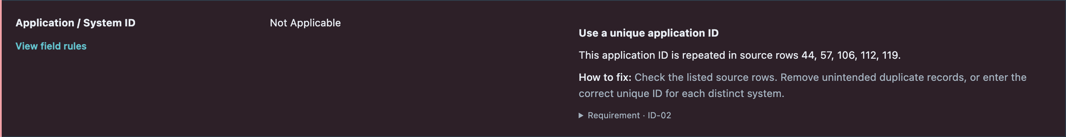
APPENDIX D • INTERPRETING DATA-QUALITY SIGNALS
A clean form still needs a credible product record
PLACEHOLDER ID FLAGS
OTHER REPEATED IDENTIFIER
5 · 2.9%
2 · 1.2%
Confirm placeholder meaning before merging products.
Reconcile IDs before assuming duplicate products.
ACTUAL APP CAPTURE
20
Notes:
A clean form still needs a credible product record
Appendix reference
WHY THIS MATTERS
Identity checks and clean field values cannot establish that a record describes a distinct operating product. Review the business meaning before merging records or presenting a registration as operational exposure.
DISCUSSION
The screenshot shows five repeated Not Applicable ID flags; two other products share an identifier after case normalization. Keep all 173 products while owners reconcile the identifiers. A separate semantic check found five Active test-like registrations, two of which pass the current checks. Row24 even has the test-like phrase “19-Jul-Henry-Test-4” in the count fields, accepted by the leading-number parser. This warrants rule and registration review; no identifiers, source data or saved outcomes were changed.
QUESTION TO OPEN THE DISCUSSION
Is this a legitimate product record, a placeholder or a registration needing correction?
EVIDENCE
test_named_active_unknown_agentic: 5 products (2.9% of 173); source rows 22, 23, 24, 25, 26.
test_named_passing: 2 products (1.2% of 173); source rows 24, 25.
Not Applicable ID-02 source rows 44,57,106,112,119. Other repeated identifier rows 78,159.
Source: AI Inventory data.csv,173 products; saved review 28b09c1d-4ee4-4a51-a408-0caf7fb82915; rules 5.4; validated 28 October 2026. One source row per product; all percentages /173. Source rows use logical records including the header.

Slide 21
APPENDIX E • EVIDENCE AND REPRODUCTION
Reproduce the product intersections in the app
View
Ordered fields
Category / filter
Business-line patterns
LOB → AI source group → Deployment status
Medicaid / Commercial
Agentic sourcing
AI technologies → AI source group → Deployment status
Agentic AI
Agentic classification
AI technologies → Risk tier → Deployment status
Agentic AI
Agentic oversight
AI technologies → Human oversight → Deployment status
Agentic AI
Hosting / sourcing
Deployment environment → AI source group → Deployment status
External vendor cloud
Unknown risk
Risk tier → AI source group → Deployment status
Unknown
Member impact
Member impact → Human oversight → Deployment status
Yes
Validation intersections
Deployment status → AI source group
Errors / selected field
21
Notes:
Reproduce the product intersections in the app
Appendix reference
WHY THIS MATTERS
Use the app for the grouped comparisons and individual product details for the source-response checks. The product lists embedded in these notes make the deeper combinations traceable without additional report files.
DISCUSSION
Input: AI Inventory data.csv in the repo root, exported from the second tab of Krisp_data.xlsx. Saved review: 28b09c1d-4ee4-4a51-a408-0caf7fb82915, rules 5.4, validated 28 October 2026. Set Percentage basis to All products in the file. The existing screenshots remain genuine app captures. For shared business lines, intersect the selected business-line memberships; for Jira helpers, also inspect Data Environment and the owner pair. For PHI/PII mapping, inspect the original multi-select answer. Source-row references count logical product records with the header as row 1, not physical lines in the multiline CSV.
QUESTION TO OPEN THE DISCUSSION
Keep the 173-product population fixed until the business confirms any change.
EVIDENCE
Source: AI Inventory data.csv,173 products; saved review 28b09c1d-4ee4-4a51-a408-0caf7fb82915; rules 5.4; validated 28 October 2026. One source row per product; all percentages /173. Source rows use logical records including the header.

