Slide 1
AI Project
on
SMART SLIDE
Automatic Presentation Generator
Puvvula Nikhileswari
24AI06017

Slide 2
CONTENTS
Problem Statement
Objectives
Technologies Stack
Work Flow and Architecture
Results

Slide 3
Problem Statement
Creating a presentation can be a time-consuming task that requires both content organization and design skills. Individuals often spend hours structuring information, choosing layouts, and adjusting formatting to achieve a cohesive, visually appealing presentation.
This is particularly challenging for people with limited design experience or when facing tight deadlines. There is a need for a tool that can automatically generate well-organized, professional-looking PowerPoint presentations this project eradicates this challenge.
Objectives
Reducing presentation development time.
Improving presentation aesthetics.
Making it easier for users to generate presentations by automating content generation and layout design, requiring minimal input.

Slide 4
Technologies Stack
Flask Framework A lightweight web framework for Python that facilitates the creation of web applications. It handles routing, requests, and serves the Flask chat interface for user interaction.
Python programming language The primary language used for backend development, including integration with OpenAI APIs, generating content, and creating PowerPoint presentations using the Python-pptx library.
OpenAI APIs APIs provided by OpenAI to access the GPT-3.5 model, enabling natural language processing for content generation based on user prompts.
HTML, CSS, Java Script Technologies used for front-end development. HTML structures the web pages, CSS styles them for visual appeal, and JavaScript enhances interactivity in the Flask chat interface.

Slide 5
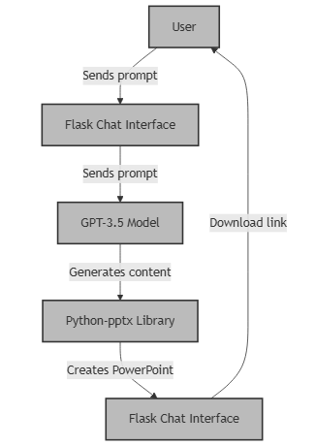
Work Flow And Architecture
Start running the web app it generates a link for Flask Interface
The user sends a prompt
The Flask chat interface will receive the prompt and send it to the GPT 3.5 model. The GPT 3.5 model generates content based on the prompt (for this we need OpenAI APIs).
The Python-pptx library converts the generated content into a PowerPoint presentation and then sends it back to the flask interface.
We can directly download the generated presentation from flask interface.

Slide 6
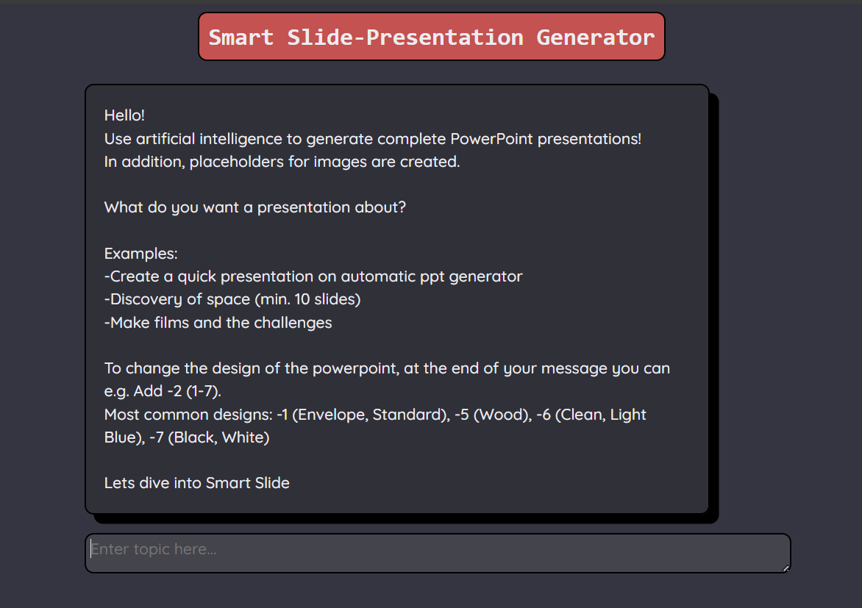
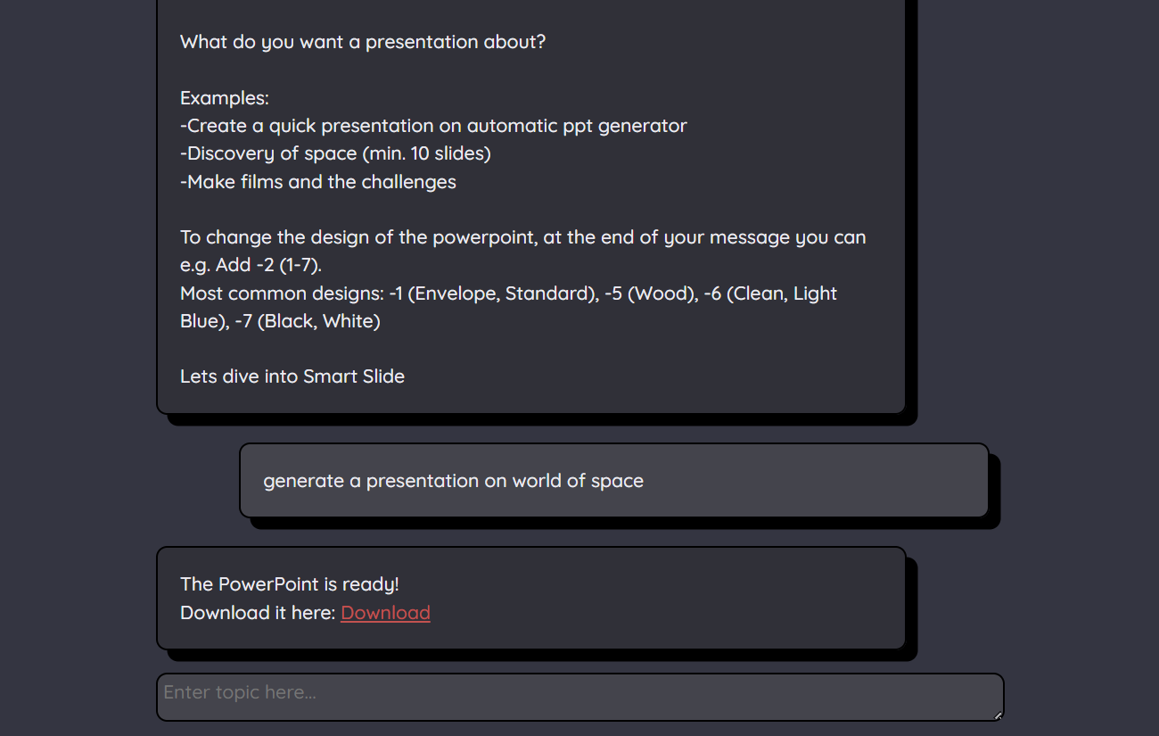
Results
Flask User interface
User prompts and results

Slide 7
THANK YOU

