Slide 1
NVIDIA AI GPU SUMMER INTERNSHIP PROGRAM · SUMMER 2026
SmartStay
An Explainable Rental Price Predictor — End-to-End Regression Pipeline
Nikhil D P Roll No: 20241ISE0014
Role: Model Architect
SmartStay · Nikhil D P · 20241ISE0014
1

Slide 2
THE PROBLEM
Nobody Knows If a Nightly Rate Is Fair
Hosts and guests on short-term rental platforms both face the same blind spot: is this price fair, or arbitrary?
🏠
🧳
❓
Hosts
Guests
Black-box tools
Struggle to price new listings competitively without under- or over-charging.
Can't tell if a quoted rate reflects genuine value or inflated demand.
Most pricing tools output a number with zero explanation of why.
SmartStay predicts a fair nightly price from listing details — location, room type, reviews, availability, host activity — and explains exactly why, so both sides can trust the number.
SmartStay · Nikhil D P · 20241ISE0014
2

Slide 3
OBJECTIVES
What SmartStay Sets Out to Do
1
Clean & engineer features from a real, messy tabular dataset — missing values, skewed price distribution, outliers.
2
Compare 3 regression models Linear Regression (baseline), Random Forest, and Gradient Boosting under fair 5-fold cross-validation.
3
Tune the winning model with GridSearchCV, avoiding data leakage via a single held-out test set.
4
Explain every prediction with global and local feature-importance — not just a bare number.
5
Deploy as a live tool a simple form where anyone enters listing details and gets an instant price + reasons.
SmartStay · Nikhil D P · 20241ISE0014
3

Slide 4
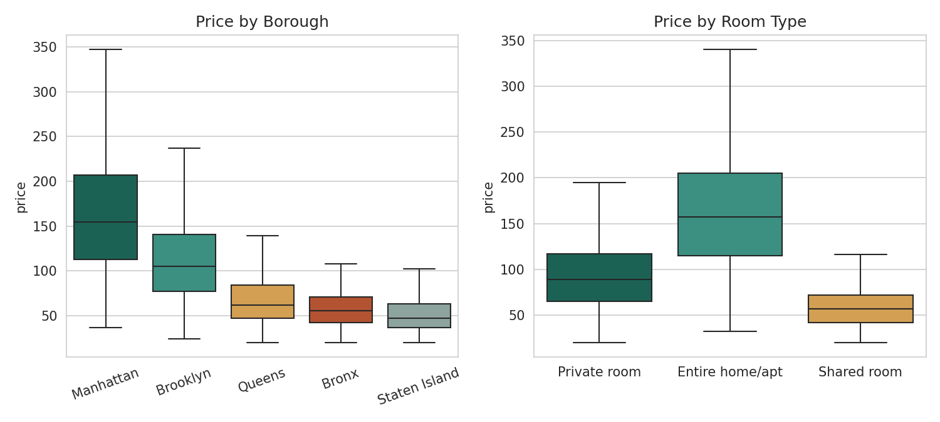
DATASET
NYC Airbnb-Style Listings
Structured after the public AB_NYC_2019 dataset — 5 boroughs, 3 room types, and the same real-world messiness: skewed prices, missing reviews, wide host-activity range.
8,500
16
5
3
listings
raw columns
boroughs
room types
KEY FEATURES USED
neighbourhood_group · room_type · minimum_nights · number_of_reviews · reviews_per_month · availability_365 · calculated_host_listings_count · latitude / longitude
Price by borough & room type — the two strongest raw price drivers.
SmartStay · Nikhil D P · 20241ISE0014
4

Slide 5
PIPELINE
Six-Stage End-to-End Architecture
1
Ingest & Clean
2
Feature Engineer
3
Model & Compare
Load CSV, fill missing reviews, cap price outliers, log-transform target
→
Distance-to-center, review activity score, host scale, availability ratio
→
Linear Regression, Random Forest, Gradient Boosting — 5-fold CV
4
Tune
5
Explain
6
Deploy
GridSearchCV over the winning model's hyperparameters
→
Global feature importance + top-3 reasons per prediction
→
Streamlit form — enter listing details, get price + explanation instantly
SmartStay · Nikhil D P · 20241ISE0014
5

Slide 6
TECH STACK
Tools Behind Every Stage
Data Handling
pandas · numpy
Modelling
scikit-learn (Linear Regression, Random Forest, Gradient Boosting)
Tuning
GridSearchCV · 5-fold KFold cross-validation
Explainability
feature_importances_ · matplotlib · seaborn
Deployment
Streamlit form (image-upload / structured input)
Persistence
joblib model serialization
SmartStay · Nikhil D P · 20241ISE0014
6

Slide 7
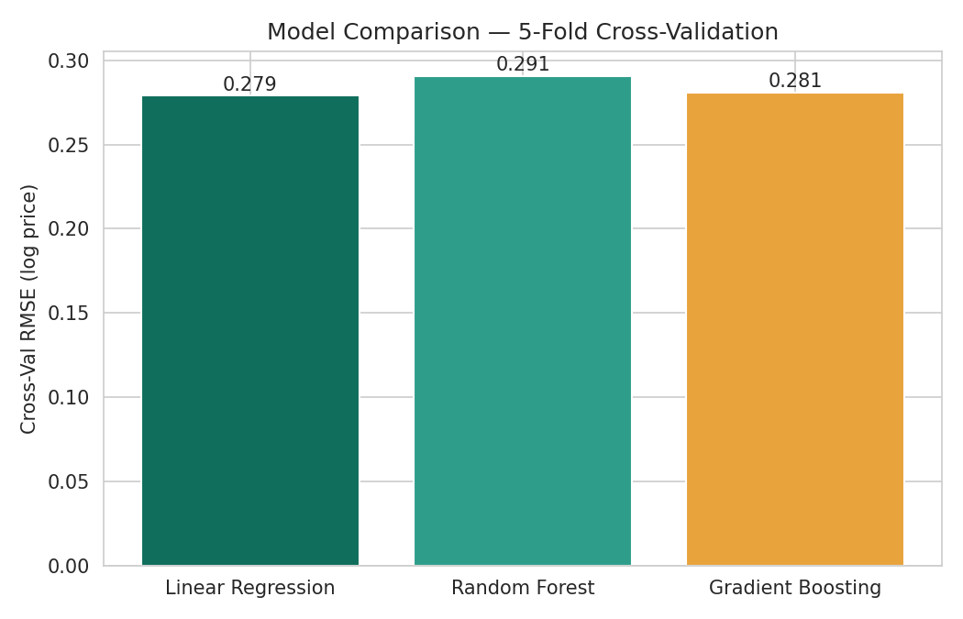
MODELLING
Three Models, One Fair Comparison
5-fold cross-validation, same preprocessing pipeline, same random seed — an apples-to-apples comparison, not cherry-picked numbers.
MODEL
CV RMSE
CV R²
Linear Regression
0.279
0.710
Gradient Boosting
0.281
0.705
Random Forest
0.291
0.685
Gradient Boosting is selected for tuning: near-identical accuracy to Linear Regression, but captures non-linear location/review effects and yields tree-based feature importances for explainability.
SmartStay · Nikhil D P · 20241ISE0014
7

Slide 8
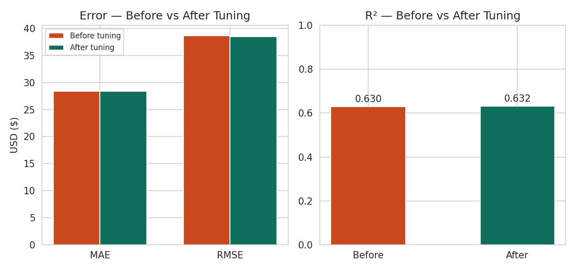
TUNING
GridSearchCV: Measurable Improvement
$28.36
MAE (test set)
$38.54
RMSE (test set)
0.632
R² (test set)
Best params: n_estimators=250, max_depth=2, learning_rate=0.05 — a shallow, regularized ensemble that resists overfitting on a modest-sized dataset.
SmartStay · Nikhil D P · 20241ISE0014
8

Slide 9
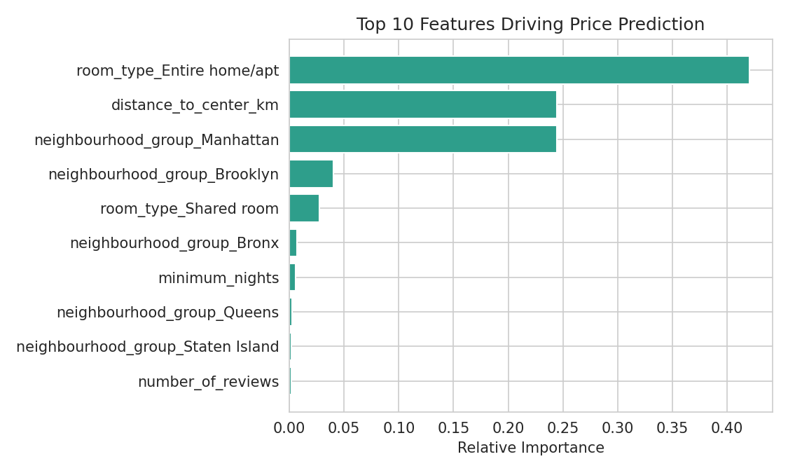
EXPLAINABILITY
Not Just a Number — A Reason
Room type and borough dominate the prediction, matching real-world intuition — an entire home in Manhattan commands a premium over a shared room in the Bronx.
Distance to city center and host activity score add fine-grained correction on top of the location/type baseline.
Every prediction ships with its top-3 contributing factors — shown directly in the deployed app.
SmartStay · Nikhil D P · 20241ISE0014
9

Slide 10
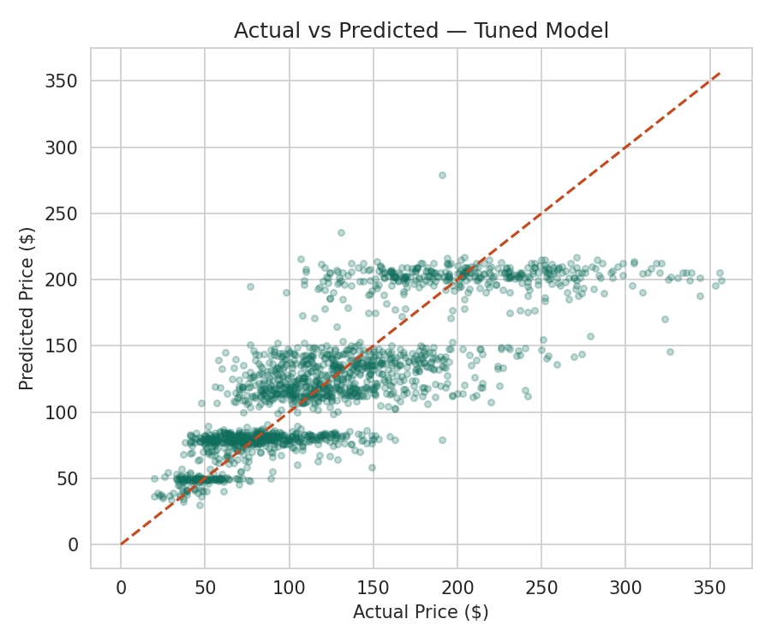
EVALUATION
Checking the Model Against Reality
Held-out test set — never seen during training or tuning.
Typical error: about $28
off the true nightly price
Points near the dashed line are accurate predictions; the spread widens at high prices, where luxury listings carry more unexplained variance.
SmartStay · Nikhil D P · 20241ISE0014
10

Slide 11
DEPLOYMENT
From Notebook to Usable Tool
The tuned pipeline is serialized with joblib and wrapped in a Streamlit form — anyone can enter listing details and get a live price estimate with reasons, no code required.
🏠 SmartStay — Fair Price Estimator
Neighbourhood group
Manhattan
Borough, room type & minimum nights inputs
Room type
Entire home/apt
Reviews & host-activity sliders
Minimum nights
2
Instant price estimate
Distance to center
3.4 km
Top-3 explanation factors shown live
Estimated fair price: $118 / night
SmartStay · Nikhil D P · 20241ISE0014
11

Slide 12
TEAM
Suggested Team Split
Data Engineer
ML Engineer
Cleaning, feature engineering, EDA
Model training, cross-validation, GridSearch tuning
Explainability & Reporting
App / Deployment Lead
Feature-importance analysis, charts, final report
Streamlit front-end, model packaging, live demo
SmartStay · Nikhil D P · 20241ISE0014
12

Slide 13
WHY THIS PROJECT WORKS
Low Risk, High Trust, Fully Deployed
Real, messy dataset — not a toy sklearn example
Three models compared fairly under identical cross-validation
Tuned with GridSearchCV — measurable, reported improvement
Every prediction is explainable, not a black box
Deployed end-to-end: a non-technical user can use it today
Thank you — Questions?
Nikhil D P · 20241ISE0014

