Slide 1

EASY LOAN’S WEBSITE
Subtitle

Slide 2
TEAM MEMBERS
BHARATHI M 3BR21CS024
D KAVYA 3BR21CS032
DEEKSHA G 3BR21CS034
NIKHILA E 3BR21CS042
ELUGU HARIPRIYA 3BR21CS043

Slide 3
TABLE OF CONTENTS
ABSTRACT
INTRODUCTION
PROBLEM STATEMENT
REQUIREMENTS
SYSTEM DESIGN
CONCLUSION

Slide 4
ABSTRACT
In the rapidly evolving digital era, quick and easy access to financial services is not a luxury, but a necessity. The Easy loan’s website will enable customers to access and apply loans from anywhere. This website will lead to a reliable, fast, user appealing solution and low interest loans robust enough to meet the requirements of the customer.

Slide 5
INTRODUCTION
Due to the rapid globalization and industrialization financial support is an important aspect to be concerned about. The best way of providing financial support can be achieved through loans. A loan is money that you borrow and promise to pay back with interest over a set period of time. The offline loan system, which typically involves face-to-face interactions is time consuming which is prone to human errors which leads to inconvenience. This can be overthrown with the help of digitalization of loans.

Slide 6
PROBLEM STATEMENT
To design and develop an online loan website to help the borrower to apply loan at ease.

Slide 7
REQUIREMENTS
Functional Requirements
Non-Functional Requirements

Slide 8
FUNCTIONAL REQUIREMENTS
The system shall allow users to navigate through options like about us, services, contact us, loan calculator and apply loan. It also asks the user to provide with necessary personal information.
The system shall provide a form for users to input required documents for the loan including amount, purpose, duration.
The system shall provide a loan calculator to estimate loan payments and interest rates.
The system shall provide the users with options for customer inquiries and support. The system also displays clear requirements and eligibility criteria related to loans.

Slide 9
NON-FUNCTIONAL REQUIREMENTS
Performance – The system should be responsive and ensure quick page load times, especially for application submission.
Usability – The system should have user-friendly interface which provides with visual appealing, easy navigation and clear instructions to guide users through the process.
Reliability – The system should ensure that website is dependable and doesn’t experience frequent crashes or errors.
Cost Efficiency – The system should optimize resource utilization to minimize optimal costs.

Slide 10
SYSTEM DESIGN
Context Diagram
Use-Case Diagram
Sequence Diagram
Class Diagram
Activity Diagram

Slide 11
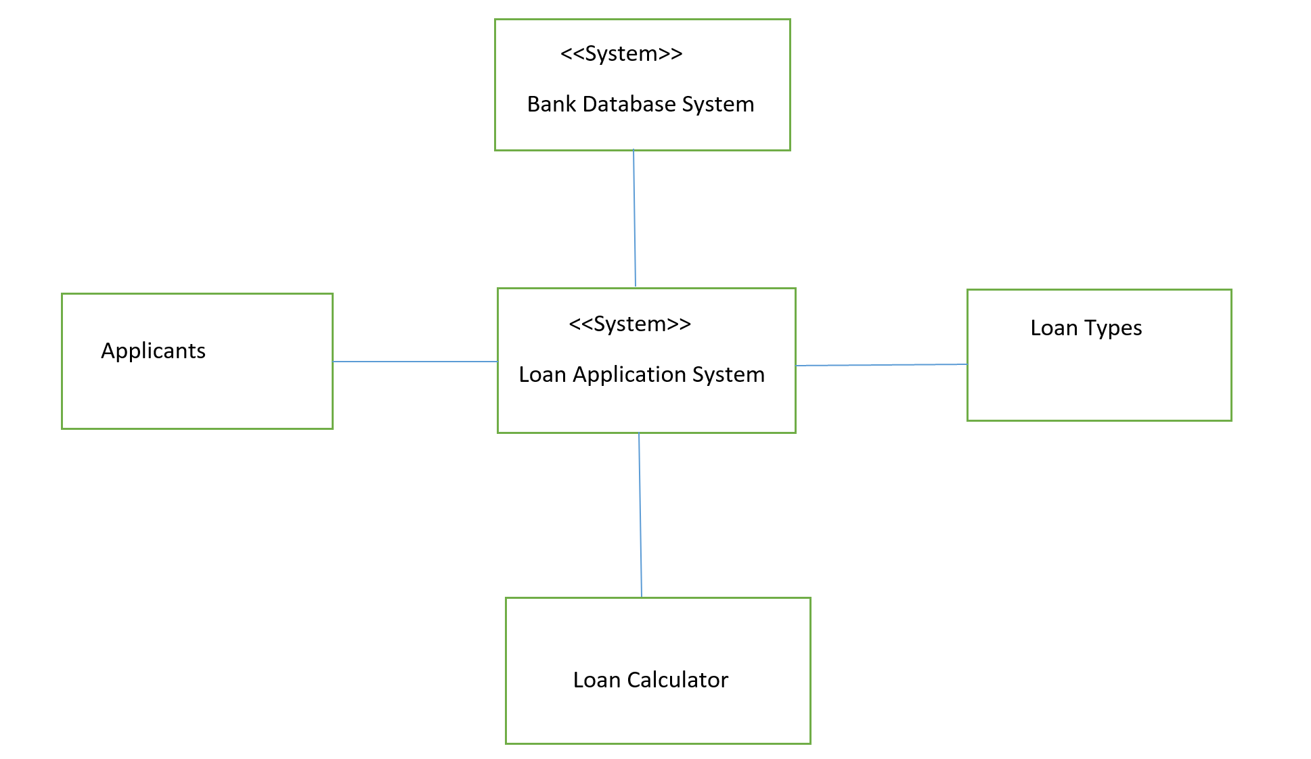
CONTEXT DIAGRAM

Slide 12
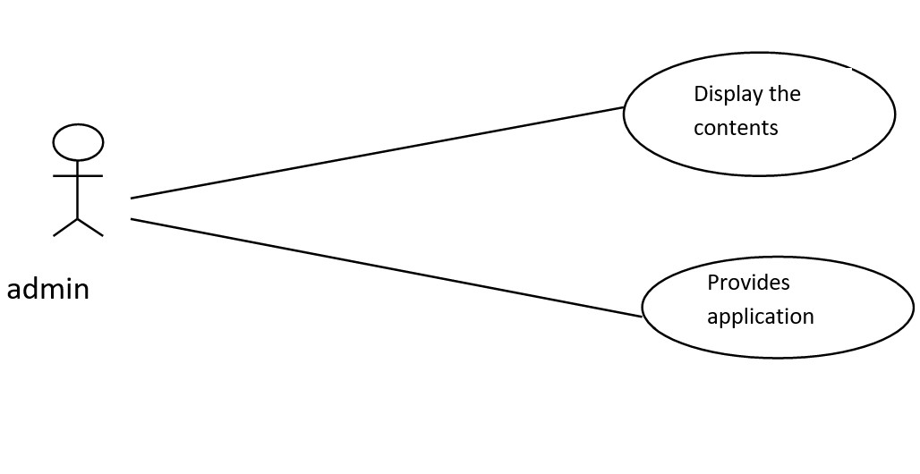
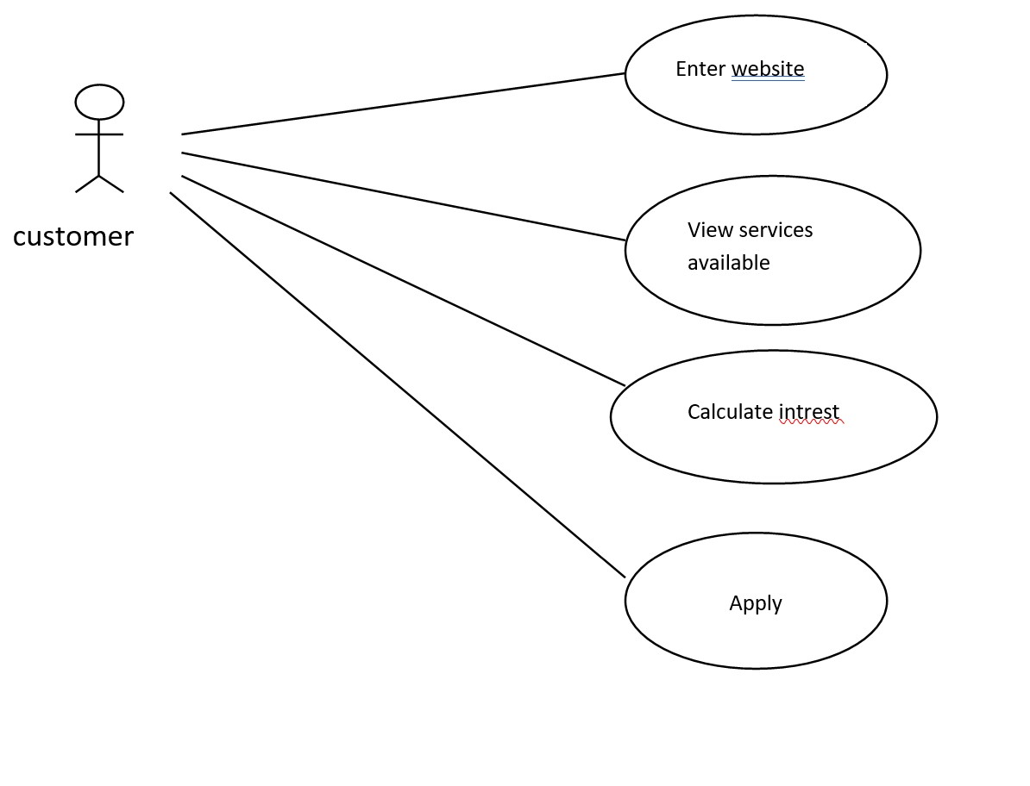
USE-CASE DIAGRAM

Slide 13
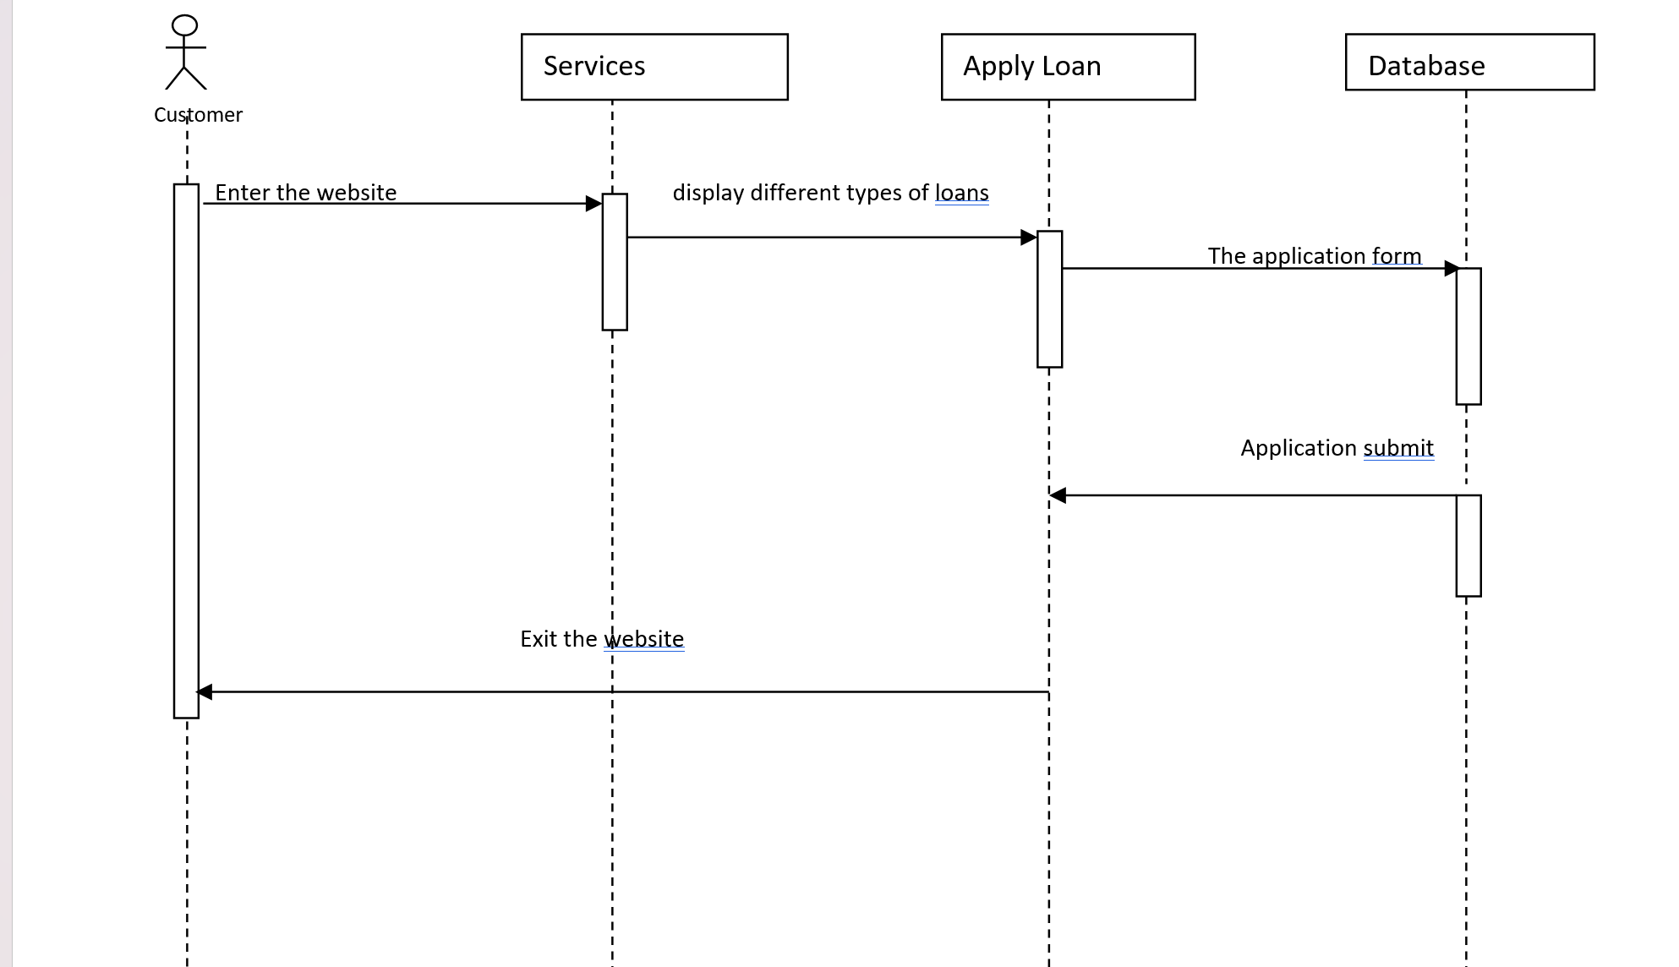
SEQUENCE DIAGRAM

Slide 14
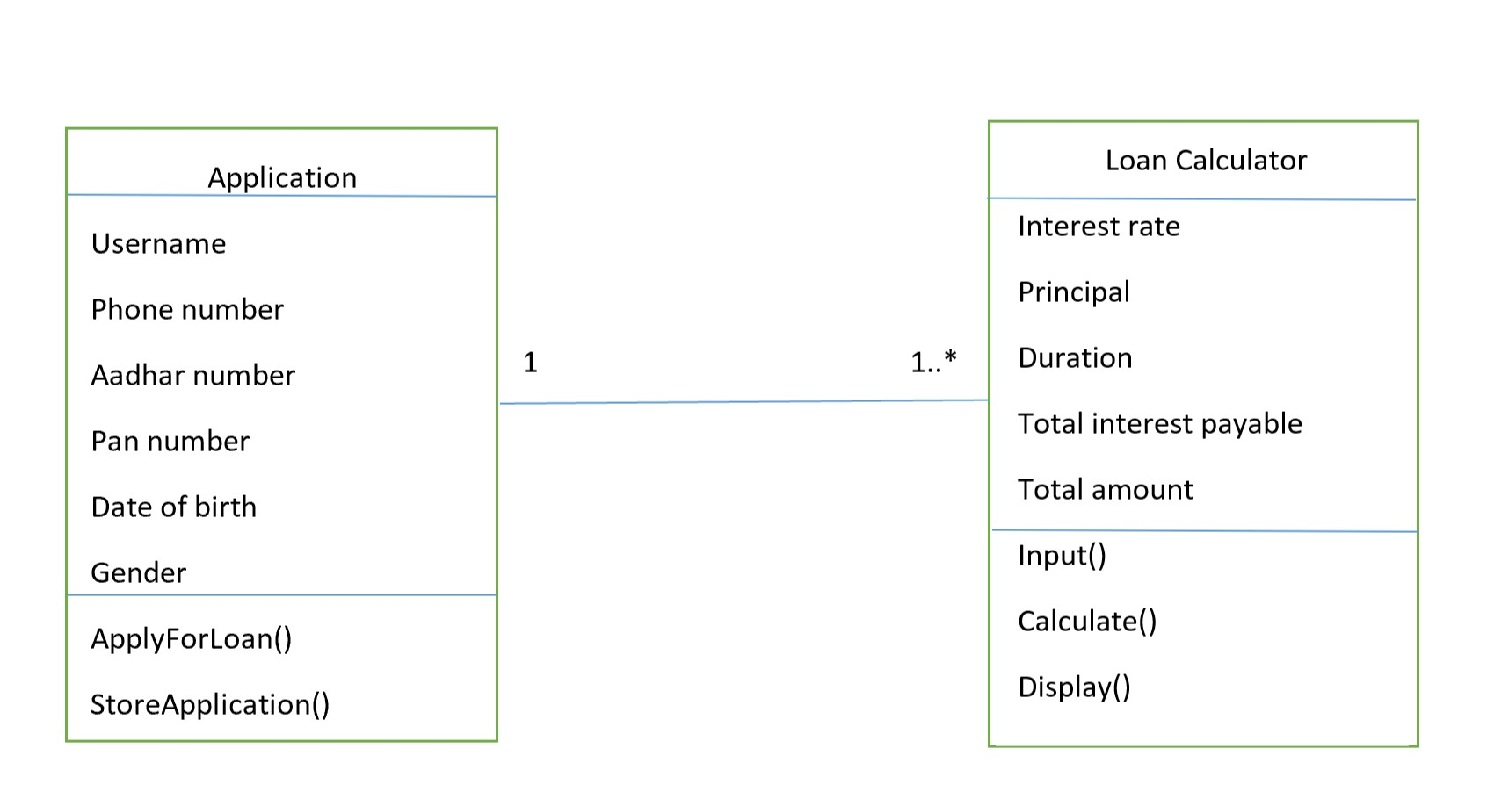
CLASS DIAGRAM

Slide 15
ACTIVITY DIAGRAM
Customer
Admin
Select the type of loan
Places Requirements & Eligibility Criteria
Fill the loan Application
Provides contacting option
Stores the Submitted Applications

Slide 16
CONCLUSION
We conclude that, a loan application system streamlines the process of evaluating and approving loans for both applicants and financial institutions. By integrating data analytics and automation, such systems can offer quicker decisions, reduce errors, and ensure a more consistent assessment criteria. It is essential for modern banking and financial sectors to stay competitive and enhance customer experience. However, the design and implementation of these systems must prioritize security and data privacy to foster trust and compliance.

Slide 17
Thank you !

