Slide 1
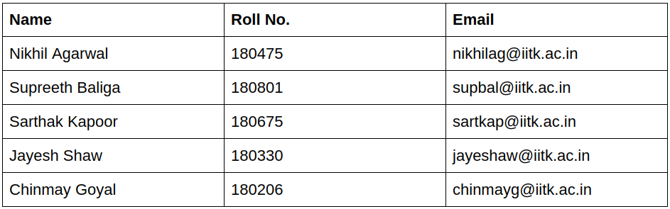
Analysis and Predictions of Air Quality Index in India
Group 2
CS685 Group Project

Slide 2
About the Data
Other Links
Extracted from CPCB website by using their application (link here)
Contains recordings of the concentrations of various pollutants at daily and hourly temporal frequencies
Analysing data from 1st January 2015 to 1st July 2021
Chose 25 cities spread over India for analysis
Link to Project Report
Codebase: https://github.com/nikhilag2711/Project_CS685

Slide 3
Insights & Trends

Slide 4
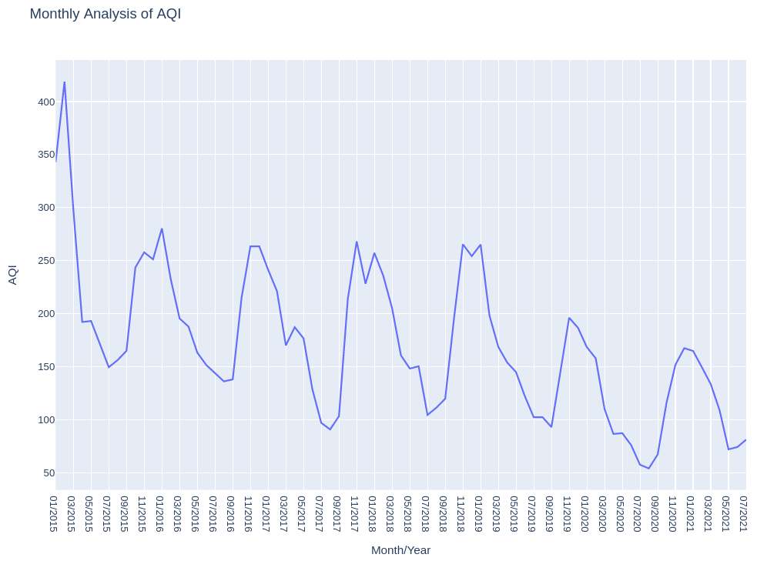
Does AQI show a seasonality trend?
Air quality is much better during summer as compared to winder
Factors: Density, Humidity, Diwali
Many of the individual cities show similar curves
Lower peaks in 2020 & 2021 due to pandemic
Implications:
Policy-makers can strategize to deal with higher air pollution during winter
Mandate the pollution throughput of industries based on the season

Slide 5
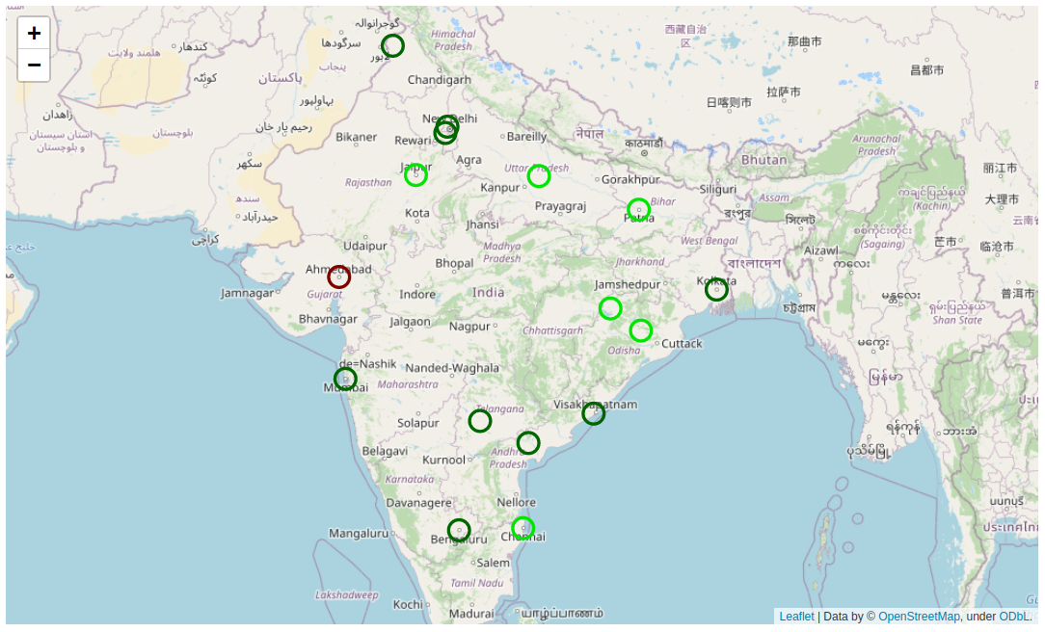
Spatial and temporal comparison of AQI across cities
1st July, 2018
High AQI for Ahmedabad since PM10 measured starting from 2019
Rest of the cities have relatively better quality of air

Slide 6
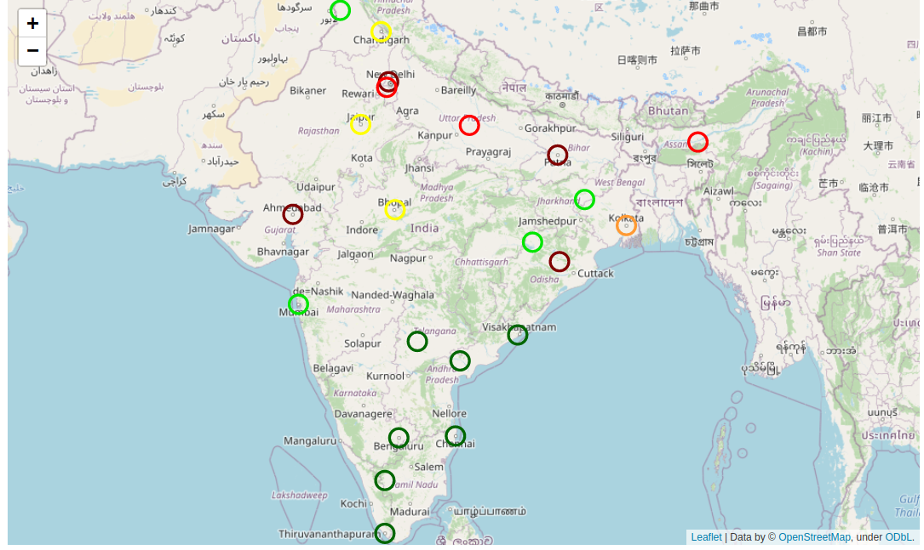
Spatial and temporal comparison of AQI across cities
31st Dec, 2019
1st July, 2018
Can see the drastic difference just in a span of 1.5 years
Poor quality of air in northern cities like Ahmedabad, Delhi, Patna, Lucknow etc.
Southern India has maintained a better AQI due to close vicinity to ocean
In general, poorer air quality at locations with high density of industries, as expected

Slide 7
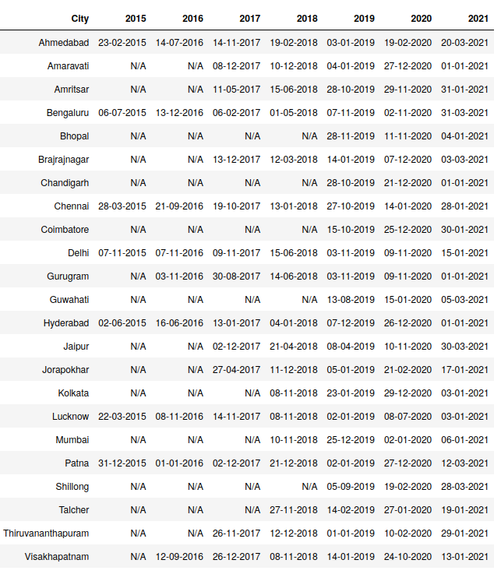
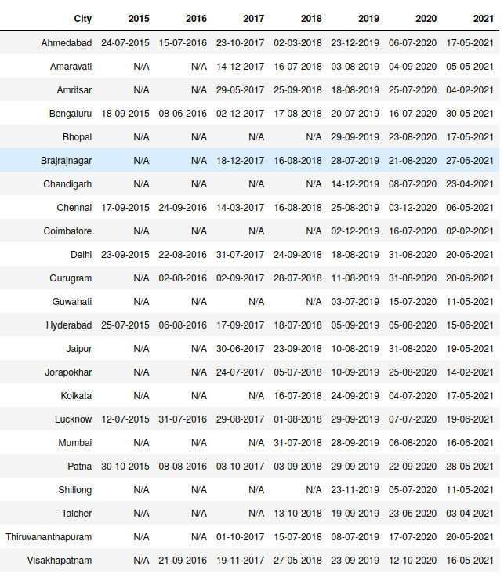
Dates on which cities show maximum & minimum AQI
Dates on which cities show maximum AQI
Dates on which cities show minimum AQI
No specific relation between the dates for two different cities
Reasoning would require extensive research of multiple factors for each city

Slide 8
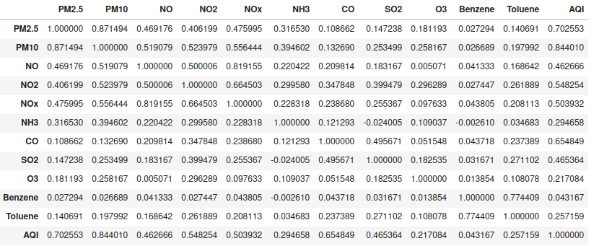
Correlation among particle concentrations
NOx has a very high correlation with NO and NO2, something which is expected, since NOx is a mixture of these two gases.
PM2.5 and PM10 have a high correlation. PM2. 5 is the subset of PM10 particles that have aerodynamic diameters less than or equal to 2.5 μm, thus such a result is very plausible.
Benzene and toluene also have a high correlation. This is due to the fact that both these chemicals are very similar physically and chemically and thus are expected to exist under similar conditions.
PM2.5, PM10, CO, SO₂, NO₂ have the most significant correlation with AQI while benzene, toluene, ozone and NH₃ have very little correlation with AQI.

Slide 9
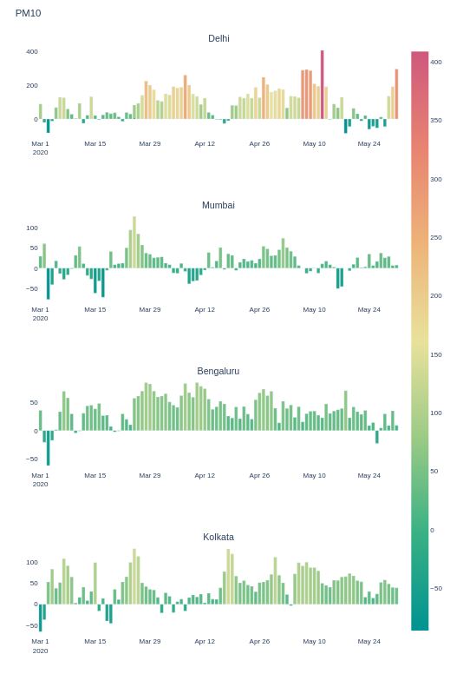
Effect of lockdown on AQI
Due to seasonality of AQI, we have taken difference of concentration of particle in month ‘x’ of 2020 from month ‘x’ in 2019.
Air quality was found to be much better during the lockdown months compared to same months of 2019.
Since vehicles are the major source of particles like PM10, PM2.5, NO₂ their concentration is significantly reduced.
For SO₂ the concentration remains almost same or slightly increases for all cities since its major source is coal plants.

Slide 10
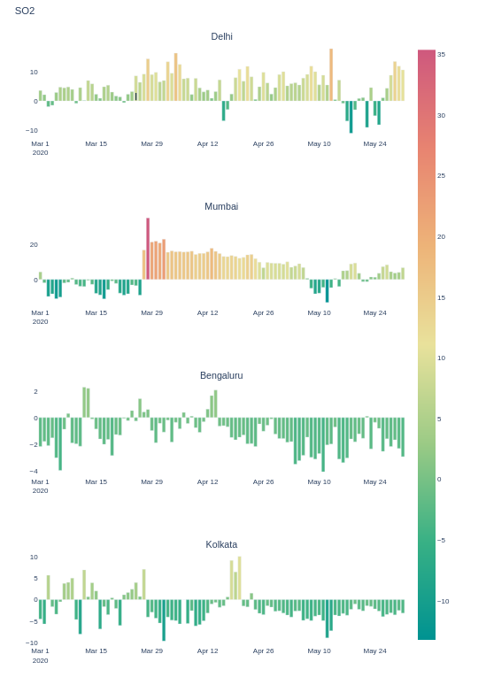
Effect of lockdown on AQI
The analysis has been done for both first wave (end March 2020 - May 2020) and second wave (April 2021 - June 2021).
Both the time periods followed very similar trends as mentioned above.
The same steps were followed for 4 major cities of India to ensure no outliers are present.
Implications:
The results show that policy makers should emphasize on curbing vehicle usage since its reduction for only a couple of months had miraculous effect on AQI.

Slide 11
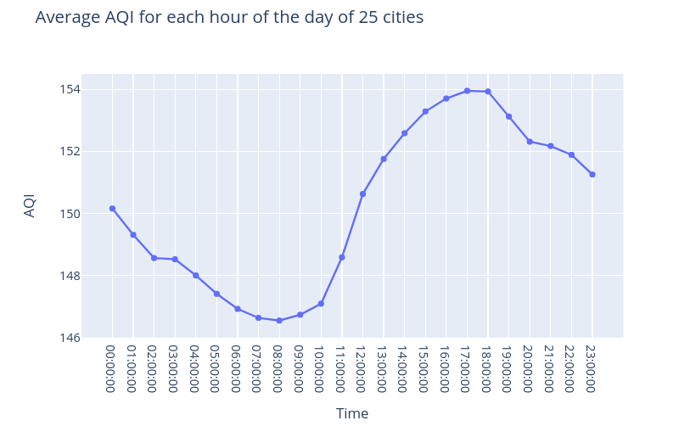
Is AQI high during daytime or night?
AQI of Ahmedabad is very high so need to remove it from the dataset for this insight
AQI is higher at daytime and evening
Many of the individual cities show similar curves
Lower AQI in night due to less vehicle count and industries operating at that time
Implications:
Policy-makers can control the number of vehicles during the daytime
Some of the industries can be operated in night rather than daytime to balance the air pollution

Slide 12
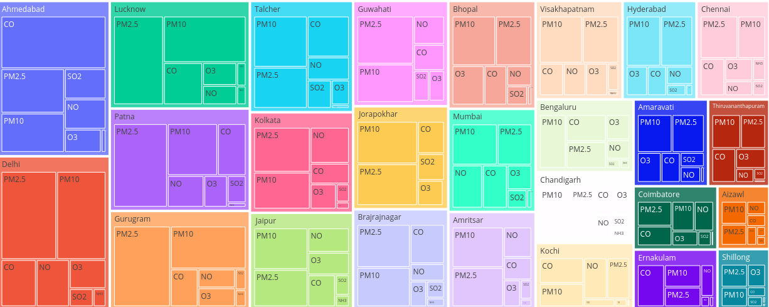
Particle with highest concentration in each city
31st Dec, 2019
1st July, 2018
Different particle’s concentrations cannot be compared directly due to different units and different level of variations for high pollution for each of them.
For most of the cities either PM2.5 or PM10 has the highest concentration.
Ahmedabad has highest CO concentration due to highest number of vehicles and power plants.

Slide 13
Predictive Model

Slide 14
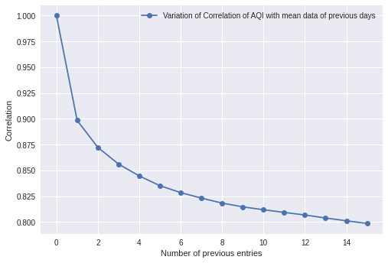
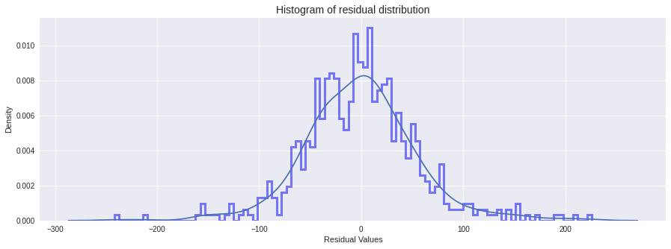
Linear Prediction Model
Features based on average of previous day data have a good correlation with the next day AQI which suggests the set of features
Plotting residuals shows that Linear Model can appropriately model the data

Slide 15
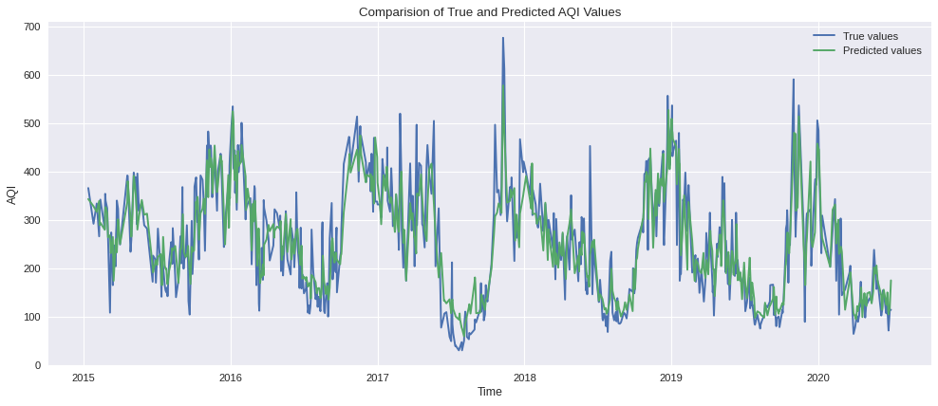
Comparison of Final Prediction

