Slide 1
Land Block
(Land Registration using Blockchain)
By – Aryan Dhaor(20103282),
Nikhil Agrawal(20103290),
Yash Kapoor(20103296)

Slide 2
Traditional land registration system
[1]In the traditional land registration system of India, if anyone wants to buy or sell the land, he/she has to contact a middlemen or broker. The broker establishes the link between the buyer and seller. All the documents with regards to an agreement as a proof of property will be created and assembled by the broker on behalf of buyer and seller. Broker will assure that all the land/property will be registered by an authorized government office where all the things are noted in the ledger and than the whole transaction takes place between them and the broker takes the money form of commission from them.
[1] https://ieeexplore.ieee.org/document/9299606
2

Slide 3
Limitations of traditional land registration
MIDDLEMEN
[2]When anyone wants to purchase the land, they are sometimes get harassed by these brokers. It is necessary to buy the land with the help of legal practitioners who have knowledge and can give right advice.
CENTRALIZATION
The land registry system involves a massive amount of registration documents to be stored on central databases that facilitate the transaction for the trading of land title.
TIME CONSUMING
The process to get the possession of land is very time
consuming as all the data are paper based.
SCAMS AND FAILURES
In the current system it is very difficult to detect frauds and scams as they are all paper work. Currently all data is centralized, so it is single point of failure and the possibility of data change is more.
NON TRANSPARENT
Most of the procedure in the system is not transparent as they are poorly secured and the property can be sold multiple times. As the thousands of records are preserved it is difficult to find the actual owner of property.
[2] https://direct.mit.edu/itgg/article/12/3-4/72/9852/A-Blockchain-Based-Land-Titling-Project-in-the

Slide 4
Solutions
DIRECT COMMUNICATION
[3]The system stores the information like Signatures, Seller’s id and Buyer’s id, Sell id of land, amount to be transferred and payment status in form of contract and secures and verifies using blockchain. This contract is sent to registry office to make the request.
DECENTRALIZATION
There is a decentralized control and record storage facility in blockchain that have the potential to increase the trust in public issues
TIME AND MONEY EFFICIENT
Blockchain is the best system to use time and money
properly for the land owners.
SECURITY
After the deployment the data in the blockchain it can only be changed by chain code. Data manipulation is not possible by any unauthorized person in blockchain.
TRANSPARENT
[4]The blockchain based contracts and ledger is the open ledger. Anyone can see the history and status of land without spending large amount of money. The land data is inspected by the land officer in the public ledger before the handover to new owner
[3] https://www.sciencedirect.com/science/article/pii/S1319157820304912 [4] https://www.sciencedirect.com/science/article/pii/S1319157820304912

Slide 5
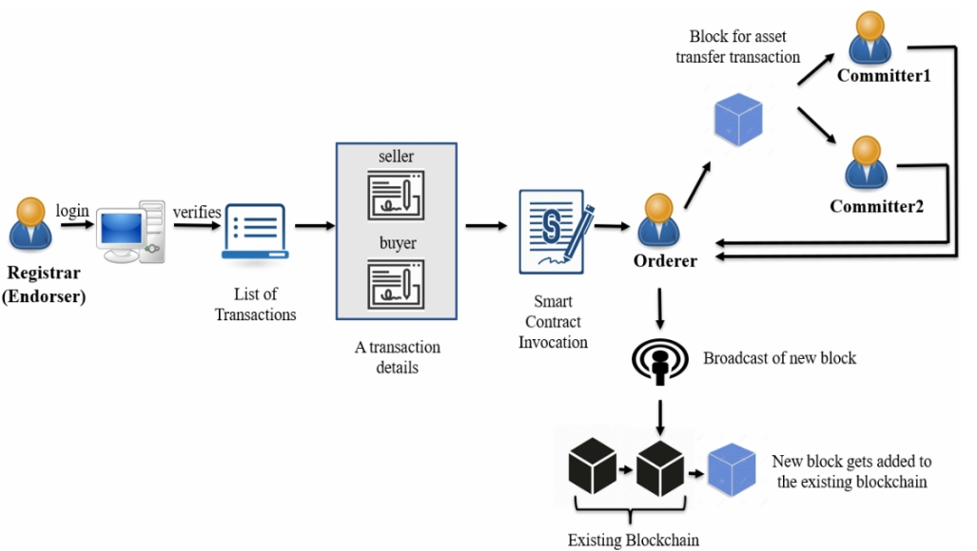
LAND REGISTRATION USING BLOCKCHAIN
[5]Blockchain land registration system allows user to sell and purchase the land from a web application. It is a simple process and is time and money efficient. The ledger of the land will be public and the buyer can see it by paying some amount of fees. No middlemen will be there and all the data will be verified by the land officer. The seller can sell the land easily without any interference. All the data will be decentralized so that there will be no loss of data. The platform will allow you to upload the title documentation to the blockchain network where signers can sign the document and other users can verify it when needed.
[5] Exploring Blockchain and Smart Contract Technology for Reliable and Secure Land Registration and Record Management | SpringerLink

Slide 6
Problem Statement
[6]The current system of land registration is a centrally managed database and provides the list of services that allow to connect via web interface. Despite the modernization by the government and doing e-Governance there are lot of flaws like corruption, transparency and many more. So, it is questionable to government as they manage all this and there is need to increase the security and transparency of all this. All this can be achieved by the block chain. Propose a blockchain based web application which allows the user to buy and sell land with the proper use of time and money. This application should be secured, efficient and transparent.
[6] https://koreascience.kr/article/JAKO202030161655507.page

Slide 7
What is Blockchain?
[7]A blockchain can be defined as a continuously growing list of records, called blocks, which are linked and secured using cryptography. Each block typically contains a cryptographic hash of the previous block, a timestamp and transaction data. By design, a blockchain is inherently resistant to modification of the data.
Just like a linked list, the Blockchain is a collection of blocks linked together, where each block will have the following fields.
Block: It is used to store the block value
Nonce: An arbitrary value used for finding a valid hash value.
Data: Store the data (transaction details)
Prev: Store the hash of the previous block
Hash: Hash value for the current block which can be used to refer this block.
[7] https://en.wikipedia.org/wiki/Blockchain

Slide 8
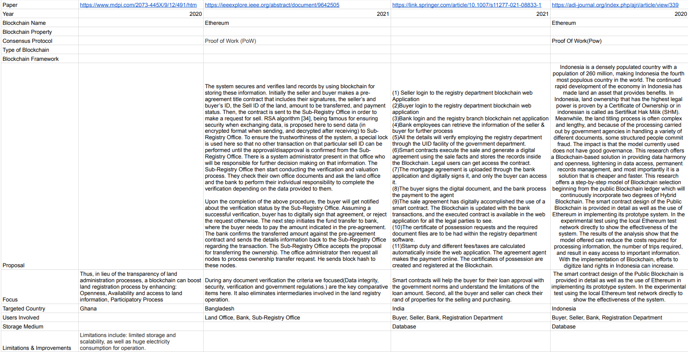
Related Work
8

Slide 9
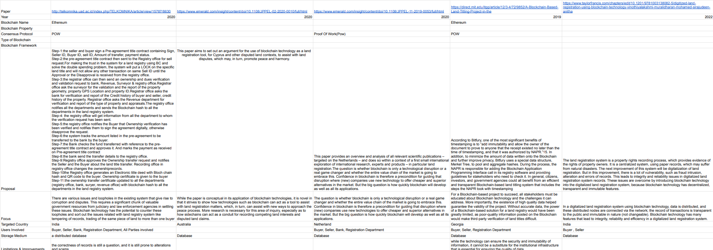
Related Work
9

Slide 10
Languages and Libraries Used
Languages
Libraries
Web2
HTML
CSS
Javascript
Web3
Solidity
Web2
Node.js
Express.js
Mern.js
Web3
Web3.js
Truffle
ganache-cli

Slide 11
Project Plan
Frontend
Firstly the user will sign in or register through mail and password.
After this, the user will enter his/her details if no details are there. Then the user can select the option of ‘Buy,’ ‘Sell’ and ‘Update’.
If ‘Buy’ is clicked, then the user can choose a plot and click on it. After that they can see the details of the chosen plot along with the information about any pending cases on the land.
If any case is there then the link to the information regarding that case will be provided for the user.
If ‘Sell’ is clicked then the user has to enter the details of their plot and upload it.
User can also choose to update their plot details.
HTML, CSS and React.js will be used for making all the frontend.
11

Slide 12
Project Plan ctd.
Blockchain
Solidity will be used to make the contracts. Contracts are user details, plot details(see), plot details(edit), case details(if any).
Ganache is used to test in the test net in local host.
Rinkyby test net is used for deploying the contracts.
Deployment is done with truffle and Web3.js
Remix ide is used for instant testing
JavaScript and its libraries like node.js, express.js, jquery are used for the functioning of webpage.
12

Slide 13
Timeline
Week 1 | Research on various topics like healthcare, banking, supply chain, finance.
Week 2 | Read papers on Google Scholars about land registration using Blockchain.
Week 3 | Design and planning of the outlook of the final project along with starting full stack development using JavaScript and learning solidity
Week 4 | Started working on the frontend of the project using HTML, CSS.

Slide 14
Future Plans on the project.
We will continue making our frontend using HTML, CSS, Bootstrap and React.js for all our webpages.
Then we will make our webpages functional using javascript and its libraries.
We will be making contracts using solidity for our blockchain. We will be using remix.ide for test runs of our contracts and VS code for the project.
We will use Mongodb for our database.

Slide 15
References
https://www.mdpi.com/2073-445X/9/12/491/htm
https://ieeexplore.ieee.org/abstract/document/9642505
https://link.springer.com/article/10.1007/s11277-021-08833-1
https://adi-journal.org/index.php/ajri/article/view/339
http://telkomnika.uad.ac.id/index.php/TELKOMNIKA/article/view/15787/8630
https://www.emerald.com/insight/content/doi/10.1108/JPPEL-02-2020-0010/full/html
https://www.emerald.com/insight/content/doi/10.1108/JPPEL-11-2019-0053/full/html
https://direct.mit.edu/itgg/article/12/3-4/72/9852/A-Blockchain-Based-Land-Titling-Project-in-the
https://www.taylorfrancis.com/chapters/edit/10.1201/9781003138082-5/digitized-land-registration-using-blockchain-technology-vinothiyalakshmi-muralidharan-mohamed-sirajudeen-anitha

