Slide 1

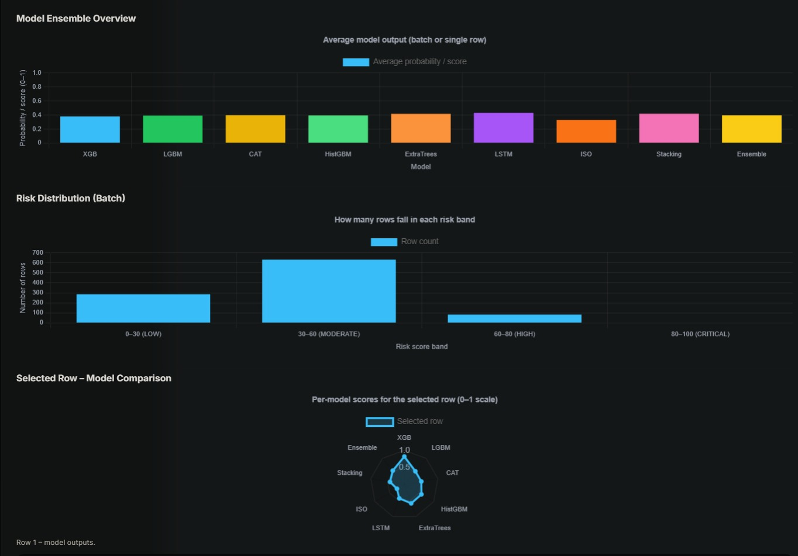
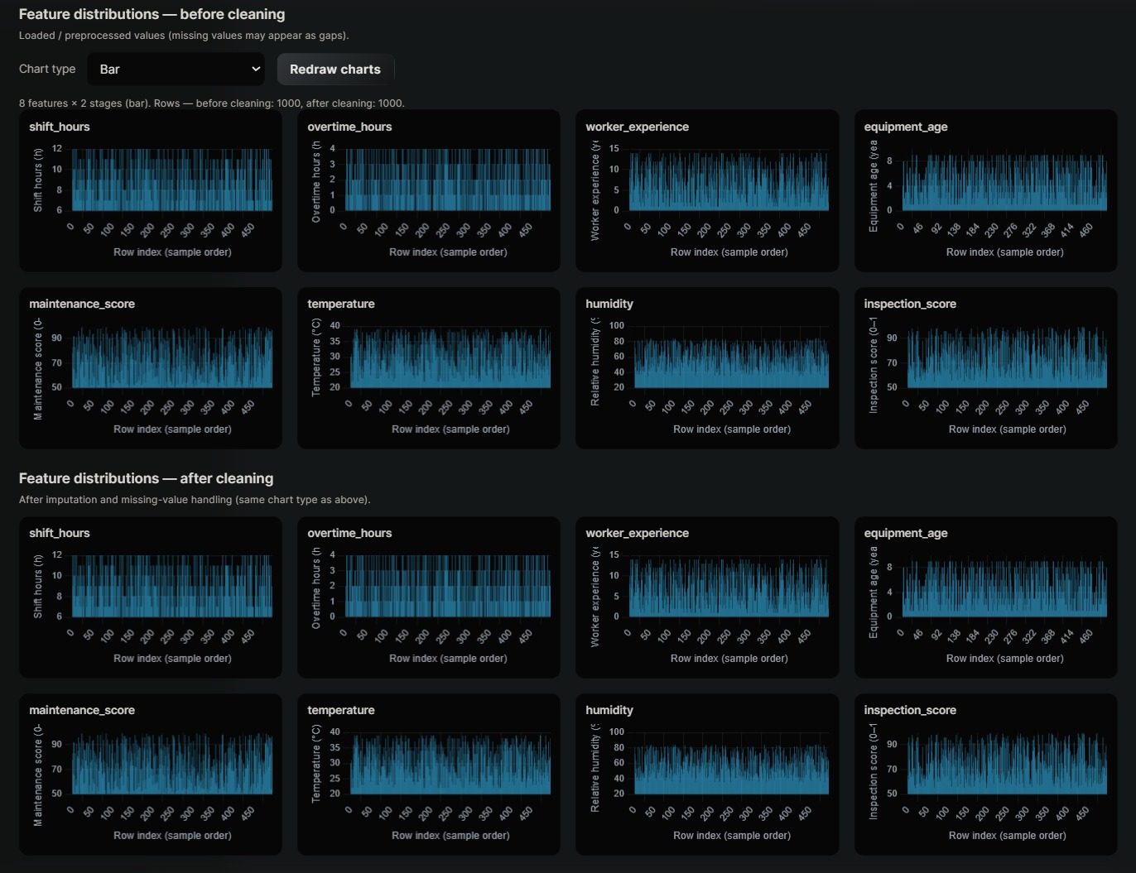
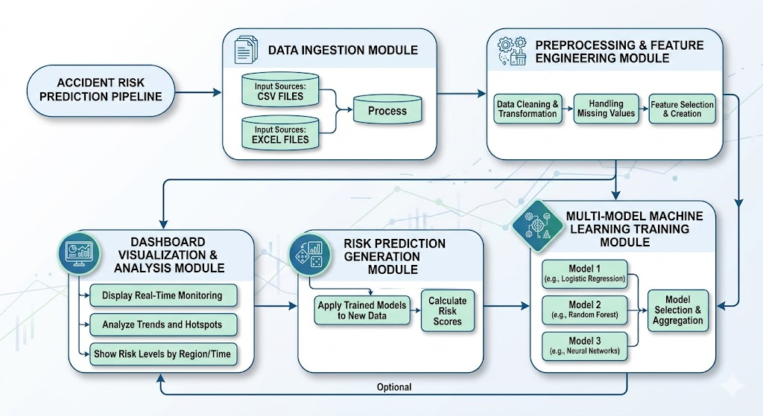
Accident zero AI - Intelligent Safety Risk Monitoring System
Ayush (24BCE1548) Aarsh Choudary (24BCE1635) Dhruv Mayur Vira (24BCE1664) Nikhil Anand(24BCE1674) Pushkar Santosh Regode (24BCE1691)
Prof. Pattabiraman V
School of Computer Science and Engineering
INTRODUCTION
Accident prevention in construction environments requires proactive identification of potential risks using historical safety data. Traditional monitoring approaches rely on manual inspections and reactive decision-making, which may not effectively analyze large datasets. A predictive, data-driven approach enables early identification of hidden risk patterns and improves safety compliance. Accident Zero AI is a machine learning–based accident risk prediction system that analyzes structured safety datasets to estimate risk levels and support decision-making.
• Predicts accident risk using structured safety data
•Applies machine learning for proactive safety monitoring
•Reduces dependency on manual safety inspections
•Supports data-driven decision-making in construction environments
Objectives
The objective of this project is to develop a data-driven system that predicts accident risks using structured datasets and machine learning techniques.
• Develop a machine learning–based accident risk prediction system
• Ingest structured datasets from CSV and Excel formats
• Perform preprocessing and feature engineering
• Train and evaluate multiple machine learning models
• Compare model performance using standard evaluation metrics
SCOPE of the project
The project focuses on predicting accident risks using structured safety datasets collected from construction environments. The system assists safety managers in identifying high-risk conditions and improving preventive measures
.• Supports structured dataset analysis
• Provides accident risk prediction outputs
• Enhances proactive safety management
• Reduces manual data analysis effort
Methodology
Preprocessing
The dataset is loaded from CSV and Excel files. Data cleaning is performed to handle missing values and inconsistencies. Numerical values are normalized and categorical variables are encoded to prepare the dataset for model training.
• Data cleaning and validation
• Handling missing values
• Feature normalization
• Encoding categorical variables
Feature Engineering
Relevant safety-related features are extracted and transformed to improve model performance. These features represent operational and safety indicators used for prediction.
• Feature selection
• Derived safety indicators
• Statistical transformations
• Model input preparation
Architecture
The system follows a modular pipeline for accident risk prediction. Data is ingested, preprocessed, and passed to multiple machine learning models. The predicted results are displayed through a dashboard for monitoring and analysis.
• Data ingestion from CSV and Excel files
• Preprocessing and feature engineering
• Multi-model machine learning training
• Risk prediction generation• Dashboard visualization
Results and discussion
The system was trained using multiple machine learning models and evaluated using performance metrics. Ensemble-based models demonstrated improved prediction accuracy. The dashboard provides a clear visualization of predicted risk levels for decision-making.
• Multiple model performance comparison
• Improved prediction accuracy
• Effective risk classification
• Visual representation of prediction results
Conclusion
Accident Zero AI provides a data-driven approach for predicting accident risks in construction environments. The use of machine learning models enables proactive identification of hazardous conditions. The system enhances safety planning and supports data-driven decision-making.
• Predicts accident risks using structured data
• Enhances proactive safety management
• Reduces manual monitoring effort
• Supports zero-accident objective
References
Hands-On Machine Learning with Scikit-Learn, Keras, and TensorFlow — O’Reilly Media, 2019.
• Pattern Recognition and Machine Learning — Springer, 2006.
• XGBoost Documentation — https://xgboost.readthedocs.io

