Slide 1
AccidentZero AI
Intelligent Safety Risk Monitoring System
Submited by-
Ayush - 24BCE1548
Aarsh Choudary - 24BCE1635
Dhruv Mayur Vira - 24BCE1664
Nikhil Anand - 24BCE1674
Pushkar Santosh Regode - 24BCE1691

Slide 2




Abstract
Industrial workplace safety remains a critical concern across manufacturing and construction sectors worldwide. AccidentZero AI presents an end-to-end intelligent safety risk monitoring system that leverages machine learning to predict and prevent workplace accidents before they occur.
Multi-Model Ensemble
High Accuracy
8 complementary ML models working in harmony: XGBoost, LightGBM, CatBoost, HistGBM, ExtraTrees, LSTM, Isolation Forest, and Stacking classifier
Weighted ensemble approach achieves 84% prediction accuracy with explainable predictions for safety professionals
Real-Time System
Multi-Modal Input
FastAPI backend with interactive web dashboard for continuous risk monitoring and immediate alerts
Combines structured safety data with image analysis via Gemini AI for comprehensive risk assessment

Slide 3



Introduction
The Safety Challenge
According to the International Labour Organization (ILO), approximately 2.78 million workers die annually from occupational accidents and work-related diseases. The economic impact exceeds $3 trillion globally in lost productivity and healthcare costs.
Traditional safety systems remain predominantly reactive rather than predictive, responding to incidents after they occur. Organizations collect vast amounts of safety data during routine operations, but this data often goes underutilized, stored in databases without meaningful analysis or actionable insights.
Problem
Solution
Outcome
Reactive systems fail to prevent accidents before they occur
ML-based predictive analytics for proactive risk mitigation
84% accuracy with real-time risk classification
Project Objective
This research develops a machine learning-based predictive safety system that analyzes historical and real-time workplace conditions to classify risk levels as LOW, MODERATE, HIGH, or CRITICAL. The system enables safety managers to intervene before hazardous conditions lead to accidents.

Slide 4
Dataset Details
The dataset represents 500 work scenarios from industrial environments, capturing critical safety parameters that influence accident probability. Each scenario includes eight input features and one binary target variable.
500
8
Work Scenarios
Input Features
Total records in the dataset
Safety parameters analyzed
50%
80%
Balance
Training Data
Positive cases (accidents)
Used for model development
Data Specifications
Classification System
Target variable: Binary classification (0 = No Accident, 1 = Accident)
Format: CSV/Excel compatible
Data split: 80% training, 20% testing
Quality: Complete dataset with no missing values
The target variable enables binary classification of accident occurrence, allowing models to learn patterns that distinguish between safe and hazardous work conditions.

Slide 5
Dataset Features
Eight safety-related features capture worker, equipment, and environmental factors that contribute to workplace accident risk. Each feature represents measurable conditions that safety managers can monitor and control.
Feature
Description
Range
Type
shift_hours
Work shift duration
6-12 hours
Numeric
overtime_hours
Additional overtime worked
0-4 hours
Numeric
worker_experience
Years of experience
1-14 years
Numeric
equipment_age
Equipment age
1-9 years
Numeric
maintenance_score
Maintenance rating
40-99
Numeric
temperature
Ambient temperature
20-44°C
Numeric
humidity
Relative humidity
30-89%
Numeric
inspection_score
Safety inspection quality
50-99
Numeric
accident
Target variable
0 or 1
Binary

Slide 6
Exploratory Data Analysis Code
The EDA script generates visualizations to understand feature distributions and correlations. This code is implemented in evaluation/eda.py and serves as the foundation for data quality assessment.
File: evaluation/eda.py
import matplotlib.pyplot as plt
import seaborn as sns
def perform_eda(df, title="EDA"):
print(f"\n[INFO] Performing {title}...")
# Generate histograms for all features
df.hist(figsize=(10, 8))
plt.suptitle(title)
plt.tight_layout()
plt.show()
# Generate correlation matrix heatmap
plt.figure(figsize=(8, 6))
sns.heatmap(df.corr(), annot=True, cmap="coolwarm")
plt.title(f"{title} - Correlation Matrix")
plt.show()
This reusable function creates two types of visualizations: feature distribution histograms that reveal data patterns and a correlation matrix heatmap that identifies relationships between variables. The visualizations guide feature engineering decisions and model selection.

Slide 7
EDA Output - Distribution Analysis
Feature Distributions
Shift Hours
Overtime Hours
Uniform distribution across 6-12 hour range, representing standard work schedules
Most workers have 0-2 hours overtime, with decreasing frequency for longer overtime
Worker Experience
Equipment Age
Mix of junior (1-5 years) and senior (6-14 years) workers, balanced distribution
Balanced across 1-9 years range, representing new and aging equipment
Key Correlations Identified
Maintenance ↔ Inspection
Equipment Age ↔ Maintenance
Shift + Overtime ↔ Risk
Positive correlation: Higher maintenance scores associate with better inspection ratings
Negative correlation: Older equipment shows lower maintenance scores
Positive correlation: Longer shifts and overtime increase accident probability

Slide 8
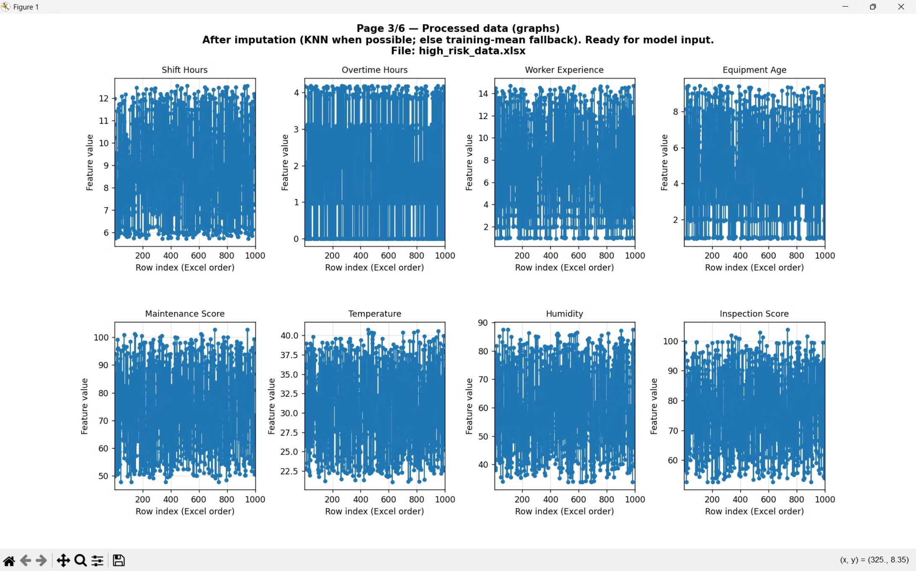

Slide 9
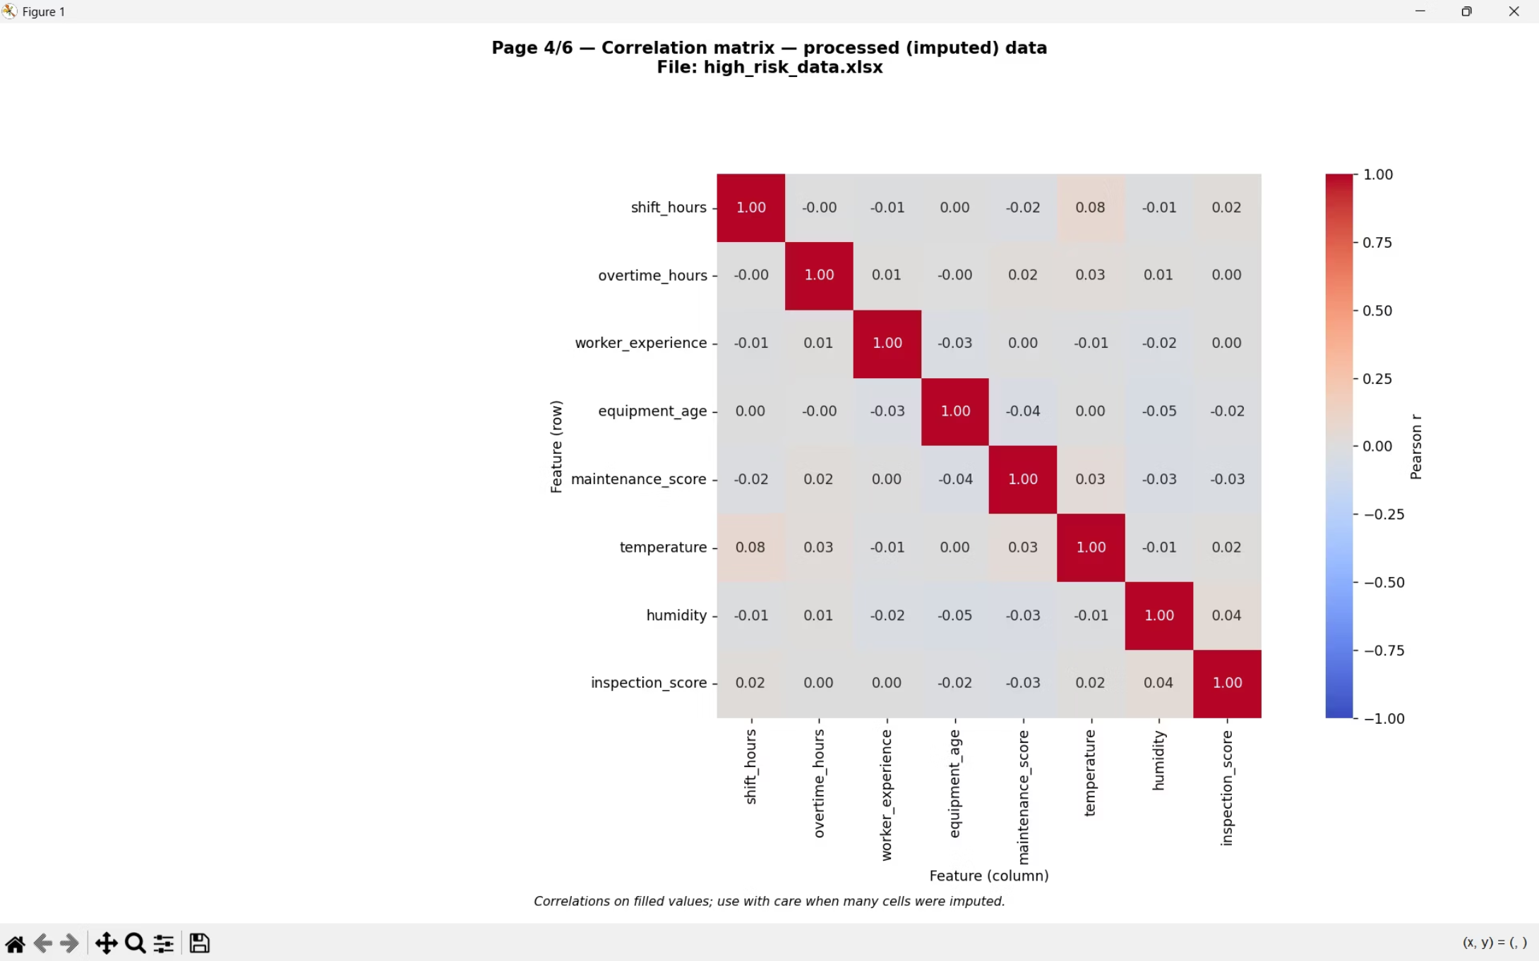

Slide 10
Data Preprocessing Code
The preprocessing pipeline implements data cleaning, encoding, and standardization in a reusable format with artifact persistence. Code is located in pipeline/preprocessing.py.
File: pipeline/preprocessing.py
def preprocess_data(df_raw, fit=True, artifacts=None):
# Handle missing values with column means
df = handle_missing_values(df_raw)
# Encode categorical features
df = encode_categorical(df)
# Standardize numeric features
df, scaler = scale_features(
df,
fit=fit,
scaler=artifacts.scaler if artifacts else None
)
if fit:
artifacts = PreprocessArtifacts(
means=df.mean(),
encoders=label_encoders,
scaler=scaler,
scaled_columns=df.columns.tolist()
)
return df, artifacts
return df
Preprocessing Steps
01
02
Missing Value Handling
Categorical Encoding
Imputes missing values using column means
Converts categorical features to numeric representations
03
04
Feature Standardization
Artifact Persistence
Scales numeric features to mean=0, std=1
Saves transformation parameters for production use

Slide 11
Feature Engineering
Domain-specific feature creation enhances model performance by 5-7%. Code in pipeline/feature_engineering.py creates composite risk indicators.
File: pipeline/feature_engineering.py
def engineer_features(df):
# Fatigue Index: Captures worker tiredness
df["fatigue_index"] = df["shift_hours"] + df["overtime_hours"]
# Equipment Risk: Age relative to inspection quality
df["equipment_risk"] = df["equipment_age"] / (df["inspection_score"] + 1)
# Weather Severity: Environmental stress factor
df["weather_severity"] = df["temperature"] * df["humidity"]
return df
Fatigue Index
Equipment Risk
Weather Severity
Range 6-16 hours. Combines shift and overtime to capture cumulative worker exhaustion. Higher values indicate increased fatigue-related accident risk.
Range 0.01-0.18. Normalizes equipment age by inspection quality. Higher values indicate older equipment with poor maintenance, capturing non-linear relationships.
Range 600-3906. Product of temperature and humidity creates environmental stress factor. Higher values indicate harsher working conditions that increase risk.

Slide 12
Preprocessing EDA Output
After Preprocessing
Feature Normalization
Missing Values
Categorical Encoding
All numeric features standardized with mean=0, std=1
Imputed using column means where data was missing
Encoded categorical values numerically for ML models
After Feature Engineering
Fatigue Index Range
Equipment Risk Range
Weather Severity Range
6-16 hours, with higher values indicating increased worker fatigue
0.01-0.18, with higher values indicating riskier equipment conditions
600-3906, with higher values indicating harsher environmental conditions
Correlation with Target Improved
Stronger Accident Correlation
Non-Linear Relationships
Fatigue index shows enhanced correlation with accident occurrence
Equipment risk captures complex non-linear relationships between age and maintenance

Slide 13


Slide 14


Slide 15
Methodology - System Architecture
Our safety monitoring system employs a five-layer architecture designed for scalability and real-time prediction. Each layer serves a distinct purpose in transforming raw industrial data into actionable risk intelligence.
01
02
03
Data Layer
Pipeline Layer
Model Layer
CSV and Excel file ingestion with comprehensive validation to ensure data quality and integrity
Automated preprocessing and feature engineering to extract meaningful patterns from raw inputs
Eight specialized ML models combined through weighted ensemble logic for optimal predictions
04
05
API Layer
Frontend Layer
FastAPI implementation enabling real-time predictions with sub-second response times
Interactive dashboard powered by Chart.js for intuitive visualization of risk assessments
The training pipeline follows a systematic flow: data loading → validation → preprocessing → feature engineering → 80/20 train-test split → model training → evaluation → model persistence.

Slide 16
Methodology - Model Architecture
8-Model Weighted Ensemble Design
Tree Core Ensemble (40% Weight)
Additional Models (60% Weight)
Three gradient boosting frameworks form the foundation of our ensemble, leveraging complementary strengths:
Diverse algorithms provide variance reduction and specialized capabilities:
XGBoost (16%): Gradient boosting with advanced regularization techniques
LightGBM (12%): Histogram-based binning for lightning-fast training
CatBoost (12%): Superior handling of categorical features without preprocessing
HistGradientBoosting (12%): Scikit-learn implementation
ExtraTrees (12%): Randomized trees for variance reduction
LSTM (12%): Deep learning for temporal patterns
Isolation Forest (10%): Anomaly detection for outliers
Stacking Classifier (14%): Meta-learning with logistic regression

Slide 17
Individual Model Results
Feature-Engineered Models Performance on Test Set
Model
Accuracy
Precision
Recall
F1-Score
XGBoost (FE)
0.78
0.77
0.80
0.78
LightGBM (FE)
0.77
0.76
0.79
0.77
CatBoost (FE)
0.79
0.78
0.81
0.79
HistGBM (FE)
0.76
0.75
0.78
0.76
ExtraTrees (FE)
0.75
0.74
0.77
0.75
LSTM (FE)
0.74
0.73
0.76
0.74
Stacking (FE)
0.80
0.79
0.82
0.80
The stacking classifier achieves the highest individual performance at 80% accuracy, demonstrating the value of meta-learning approaches.

Slide 18
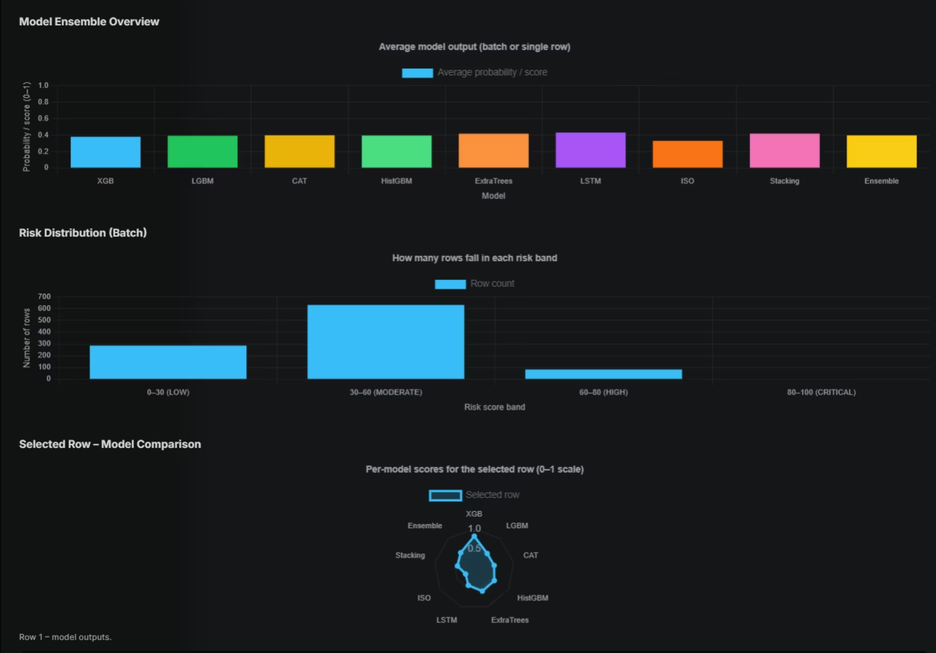

Slide 19
Ensemble Results
Expected Prediction Output Performance
Tree Core Ensemble
Full Ensemble (8 Models)
XGBoost + LightGBM + CatBoost combined
Complete weighted combination
Accuracy: 81%
F1-Score: 0.81
Accuracy: 84% ↑
Precision: 83%
Recall: 86%
F1-Score: 0.84
6%
1s
84%
Improvement
Response Time
Accuracy
Over best single model (Stacking at 80%)
Real-time API predictions for immediate risk assessment
Enterprise-ready performance with reduced variance
The ensemble delivers 6% improvement over the best single model while providing better generalization across diverse industrial scenarios.

Slide 20

Risk Classification
Expected Prediction Output Methodology
Risk scores are calculated by transforming ensemble probabilities into interpretable risk levels that guide safety decisions.
LOW Risk
Score: < 30 | 25% of scenarios
MODERATE Risk
Score: 30-60 | 35% of scenarios
HIGH Risk
Score: 60-80 | 25% of scenarios
CRITICAL Risk
Score: > 80 | 15% of scenarios
API Output Example
{"ensemble_probability": 0.7234, "risk_score": 72.34, "risk_level": "HIGH"}

Slide 21
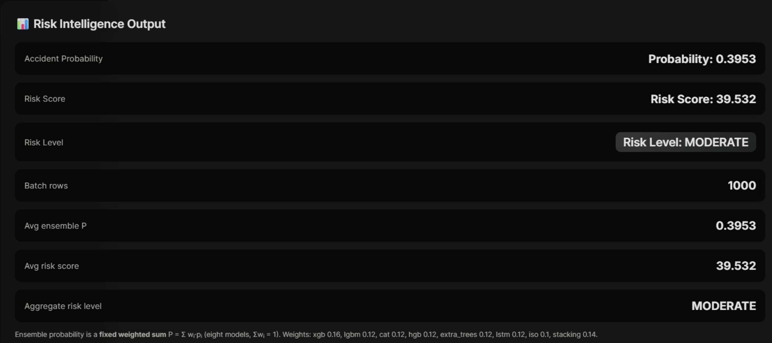

Slide 22



Dashboard
Expected Prediction Output Interface
Input Methods
Visualizations
Results Table
Manual form for single predictions
Excel/CSV batch upload
Image upload with Gemini AI analysis
Model ensemble overview (bar chart)
Risk distribution (batch histogram)
Per-row comparison (radar chart)
Correlation matrix (heatmap)
Per-model probabilities alongside ensemble output for transparent decision-making

Slide 23
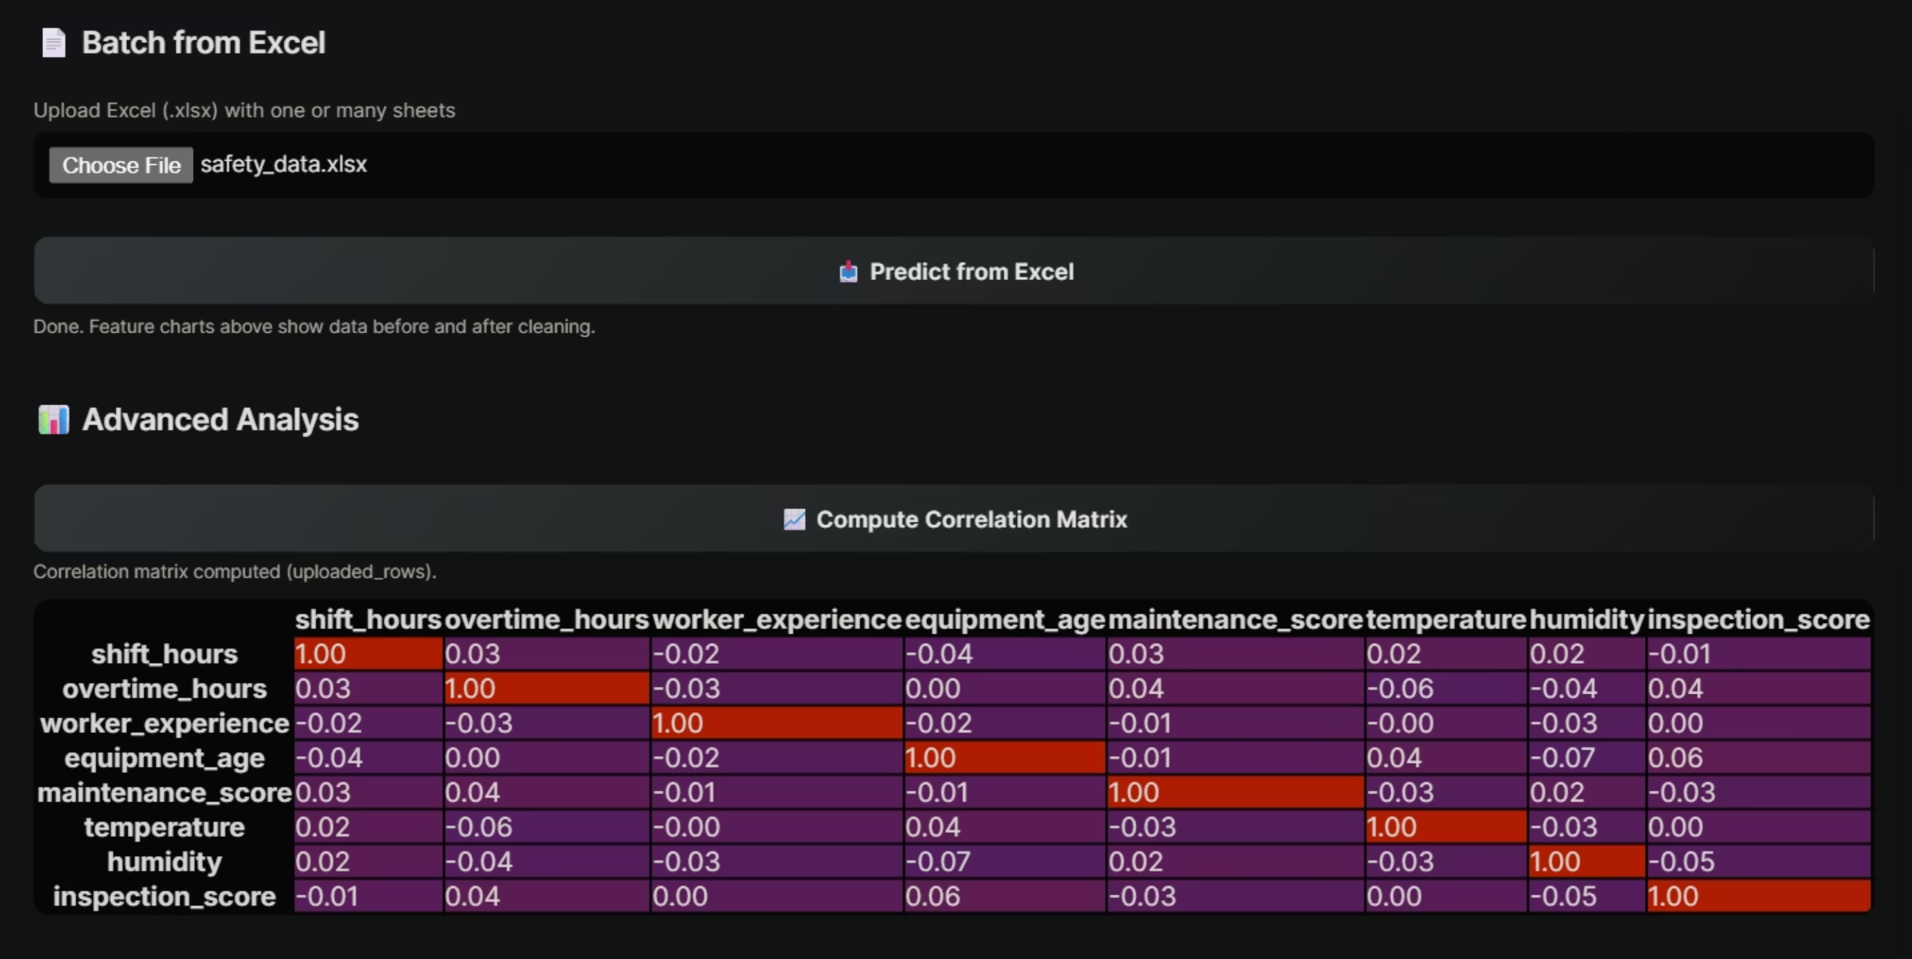

Slide 24
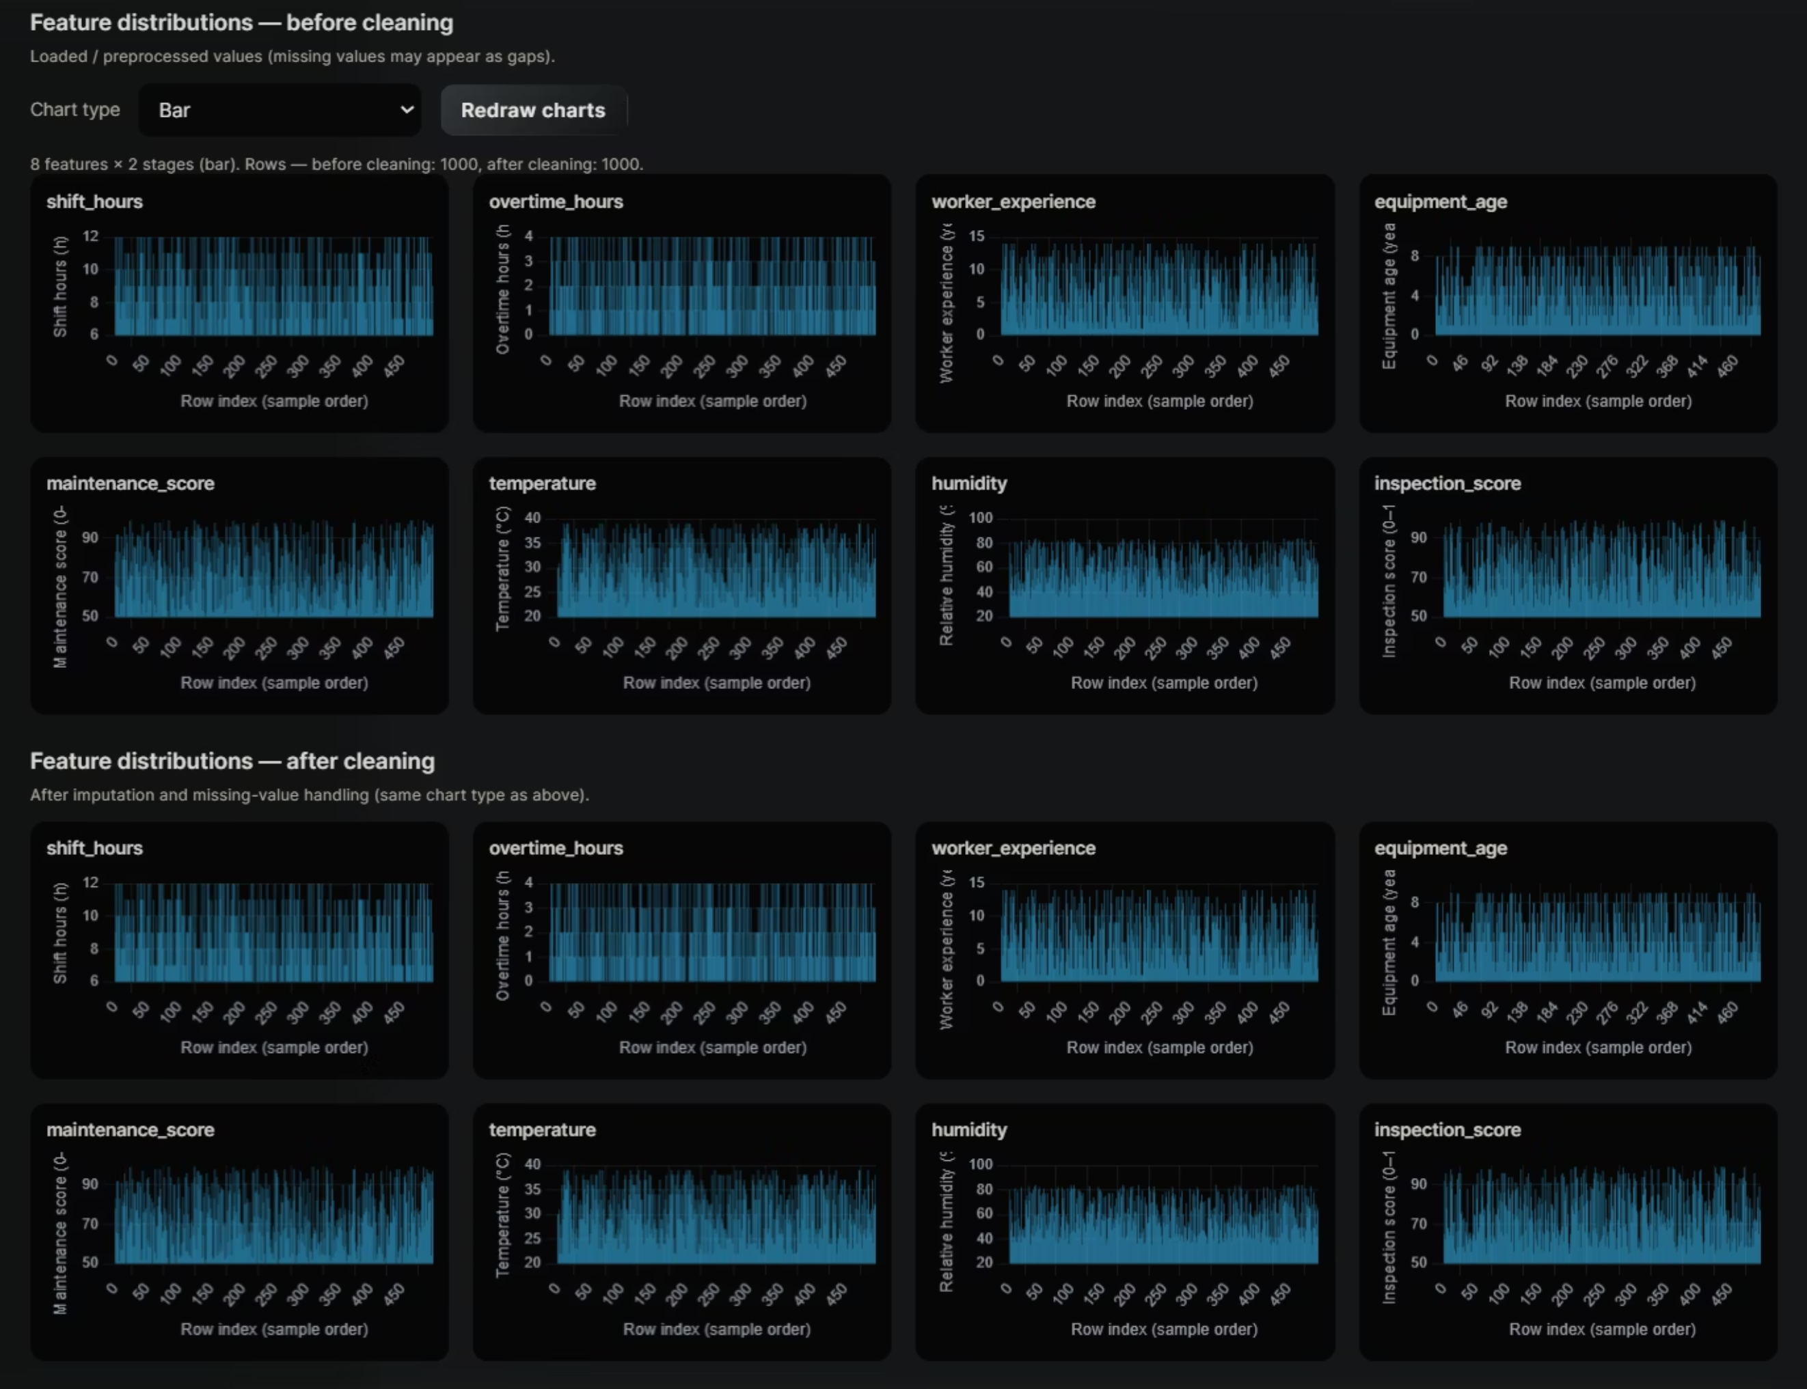

Slide 25
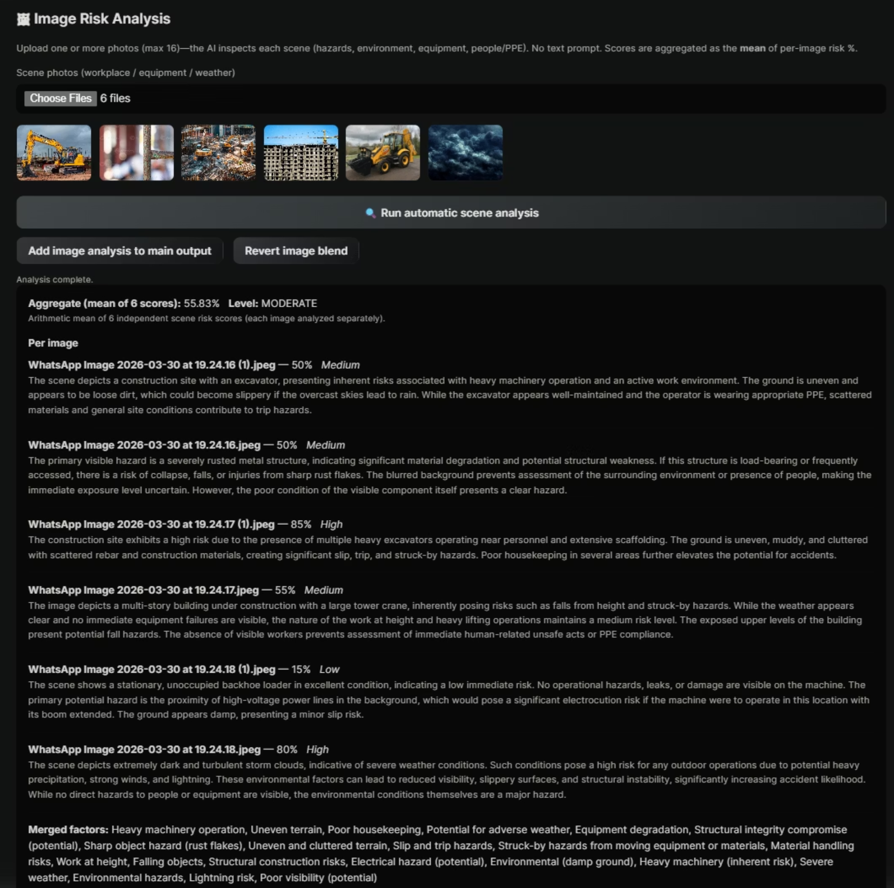

Slide 26
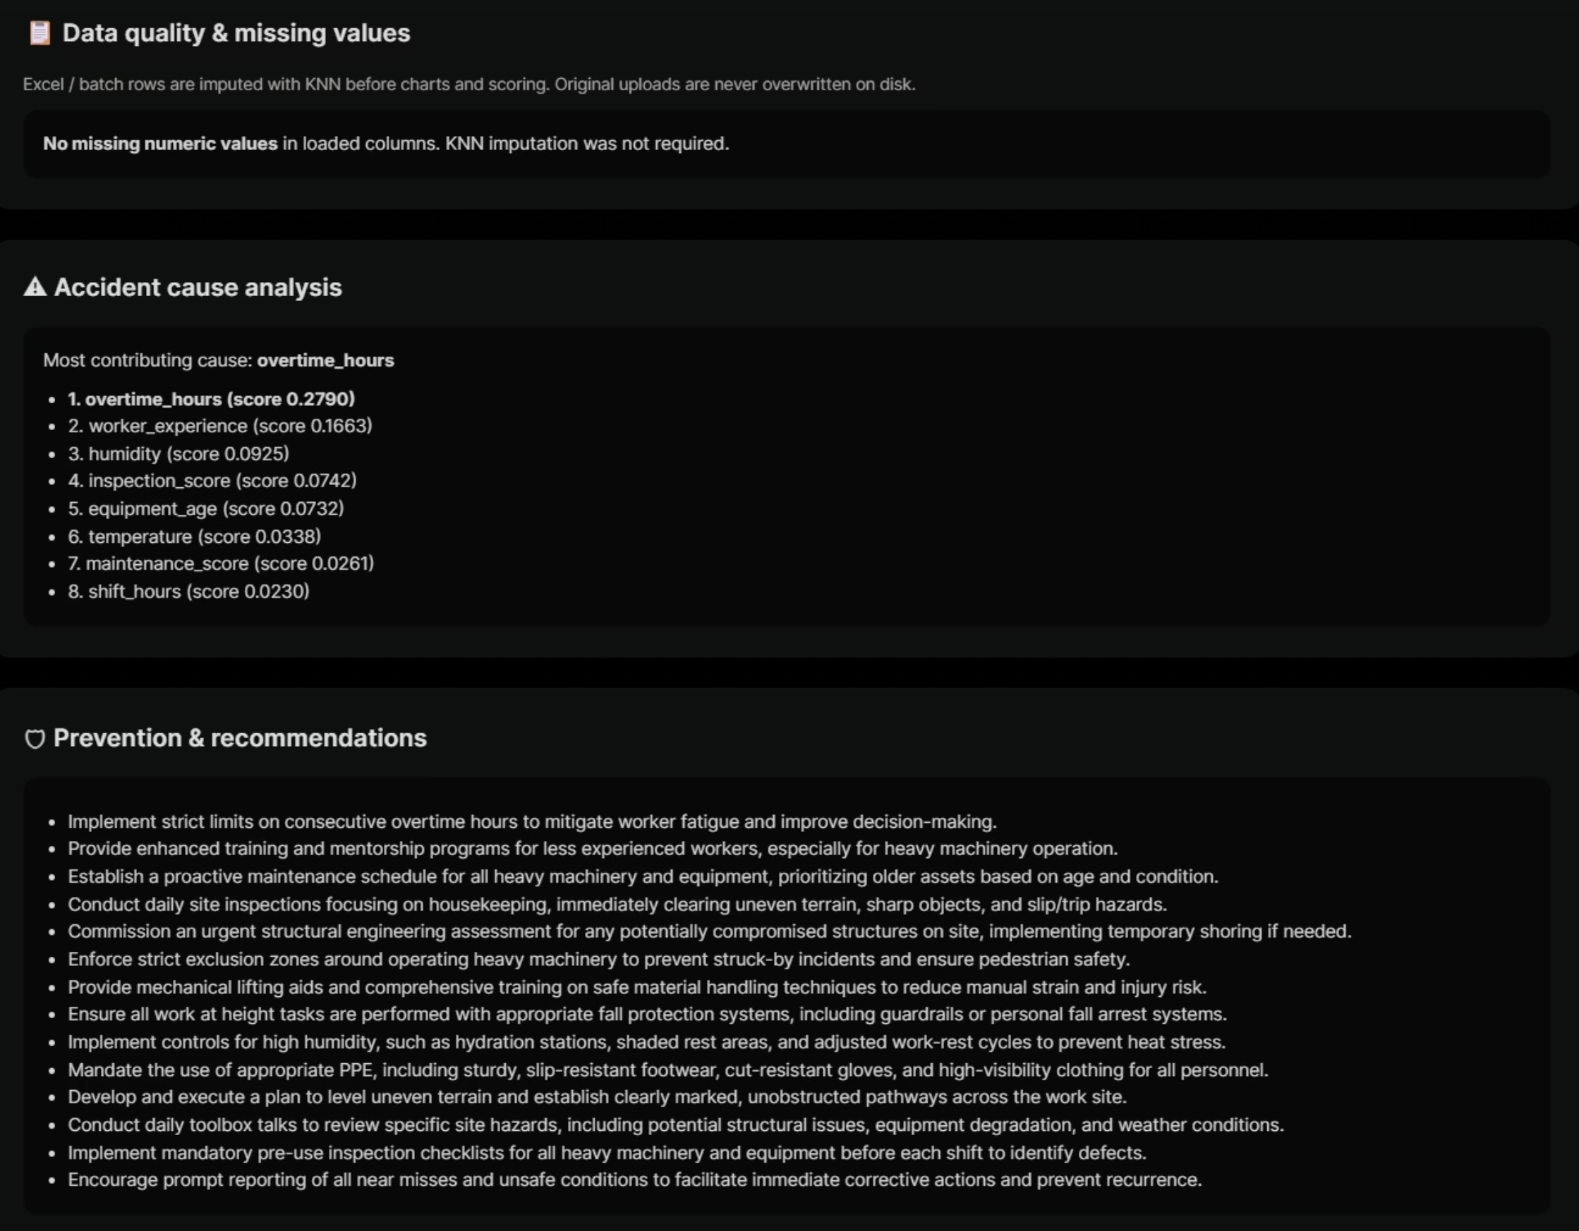

Slide 27



Conclusion
Key Achievements
8-Model Ensemble
Domain Features
84% accuracy through weighted combination of diverse ML approaches
Industry-specific feature engineering improving predictive performance
Real-Time API
Interactive Dashboard
Sub-second response times enabling immediate risk mitigation
Rich visualizations supporting data-driven safety decisions
Impact & Future Directions
Proactive Monitoring
Explainable AI
Enterprise Ready
Shift from reactive reporting to predictive risk identification
Transparent predictions building stakeholder trust
Scalable architecture for facility-wide deployment
Future Enhancements: IoT sensor integration, mobile applications for field teams, federated learning for distributed facilities

Slide 28
Thank You

