Slide 1
Modeling Geomagnetic Disturbances Using Computer-Based Simulations
Nikhil Nayak

Slide 2


What is a Geomagnetic Disturbance (GMD)?
Space Weather
But what does that actually mean?
A GMD is created from magnetic field emitted by the sun, causing Geomagnetic Induced Currents (GICs)
When the GICs collides with the Earth’s magnetic field, it can cause disturbances in electrical systems in the affected areas
These disturbances can include the fluctuation in the system’s voltage and current, which can overheat the system and cause power outages

Slide 3
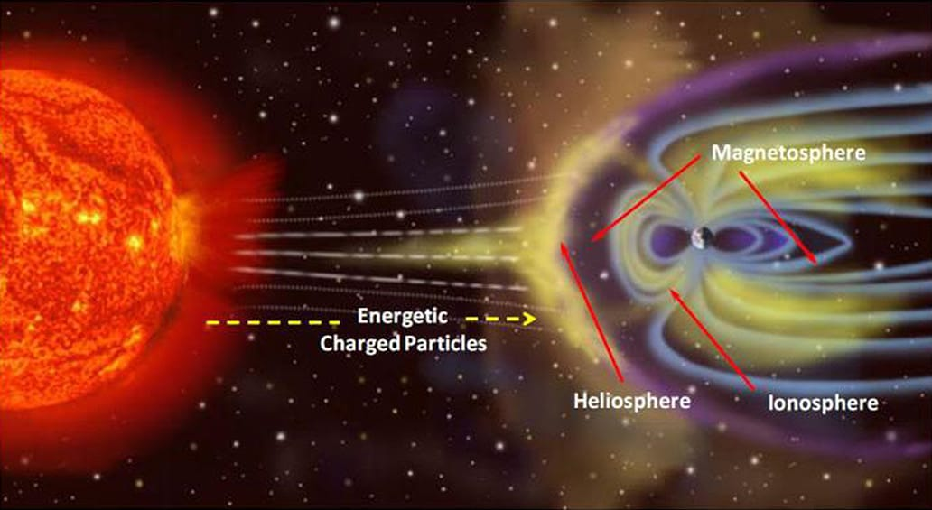
Diagram of GMDs

Slide 4
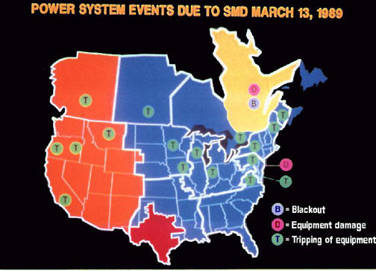
Why should you care about this?
This is a real issue, not just a theoretical problem. Take the Hydro-Quebec 1989 power outage, for example.
On March 12, 1989, voltage fluctuations were seen on the Hydro-Quebec power grid
One day later, the Earth’s magnetic field started violently fluctuating, causing a province-wide blackout in less than one minute
This was caused by a solar storm that astronomers witnessed on March 10, 1989, a storm that affected dozens of countries, from Canada to Europe

Slide 5
How can we solve this?
We need to take our geomagnetic field recordings and use them to determine the geoelectric fields at the Earth’s surface
To understand the system we’re looking at, we need to model it
In this case, we can use a set of mathematical equations to model the GMD system

Slide 6
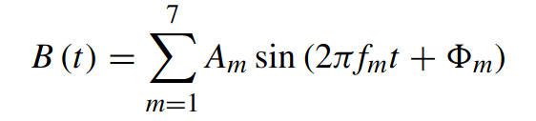
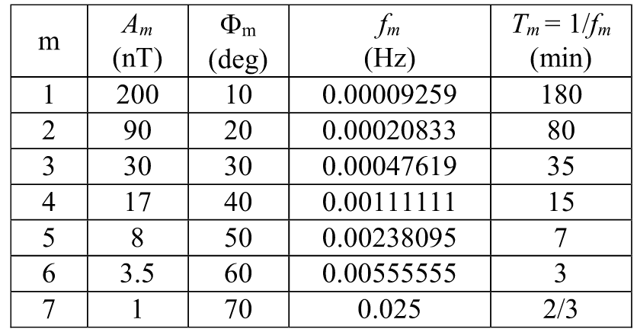
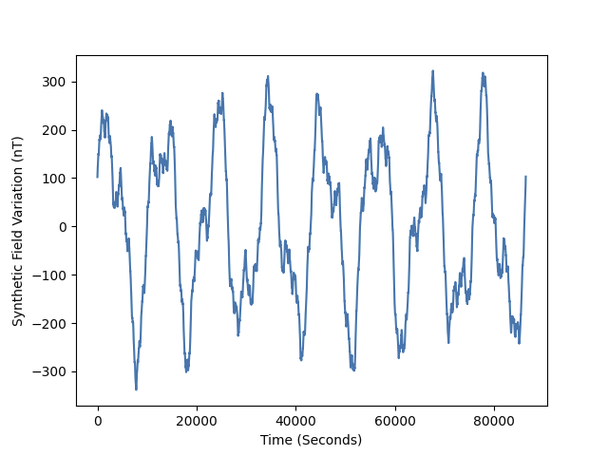
Simulating a GMD
Before we try to model a real dataset, we can start with a simulated base case. Our dataset can be defined by B(t):

Slide 7
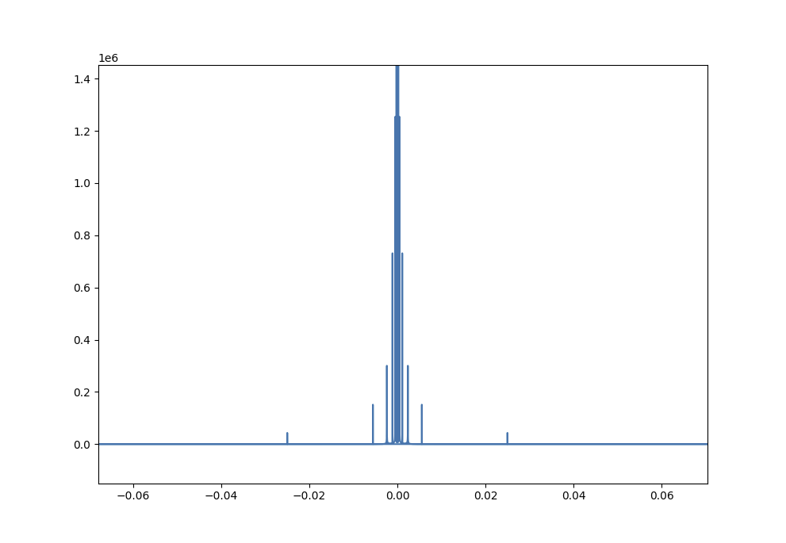
Discretization
Because we are implementing our model on a computer, we need to discretize the function into bins using a Fourier Transform

Slide 8
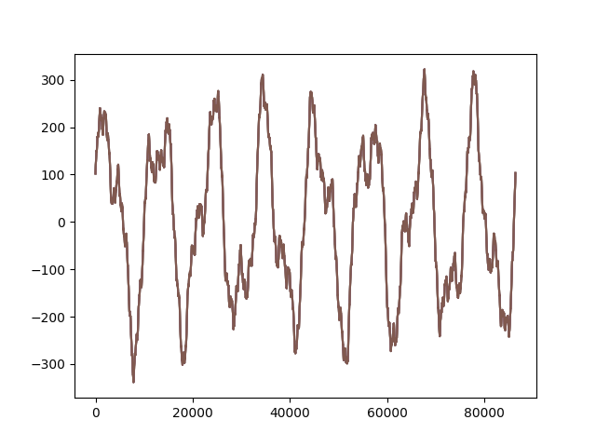
Discretization (Explained)
FFTs are representations of a function using just sin and cos
Each line of an FFT represents 1 function. When all the functions are added together, they resemble the original function
This converts our data from the time domain to the frequency domain, making it easier to process the signals
Inverse FFT
FFT

Slide 9

Complex Numbers in FFTs
To accurately represent a signal, you need to represent amplitude and phase
Complex numbers are inherently good at representing waves because of Euler’s formula:
Euler’s formula helps simplify the process of creating Fourier Transforms, making it possible to represent a wave using the sum of cos and sin functions
Each complex number is just a real and imaginary component, or a x and y. x and y can make up a point on a plane, meaning the point can have a distance from origin (amplitude) and rotation from a horizontal line (phase)

Slide 10

Modeling the System
How are we going to model a GMD system?
To model the GMD system, we are using a 5 layer model designed for the Hydro-Quebec incident. This model was created in the Boteler 2019 research paper. Here’s the model:
To understand what all those letters mean, we’re going to need some more info

Slide 11

Modeling the System (cont.)
K is a recursive function, defined by the base case on the right
The 5 layer model represents 5 layers of the Earth, from 15km to 200km
When we use layer “1”, the recursive function calls each layer until it hits the base case, returning the modeled data.

Slide 12
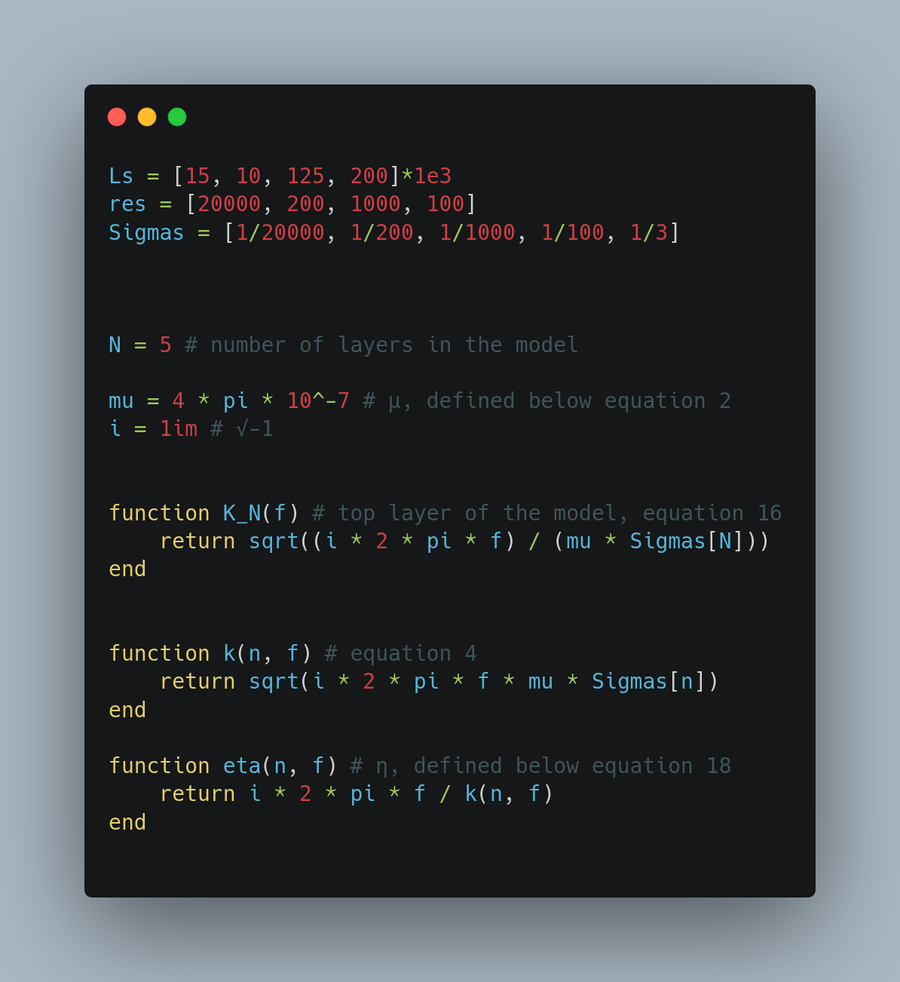
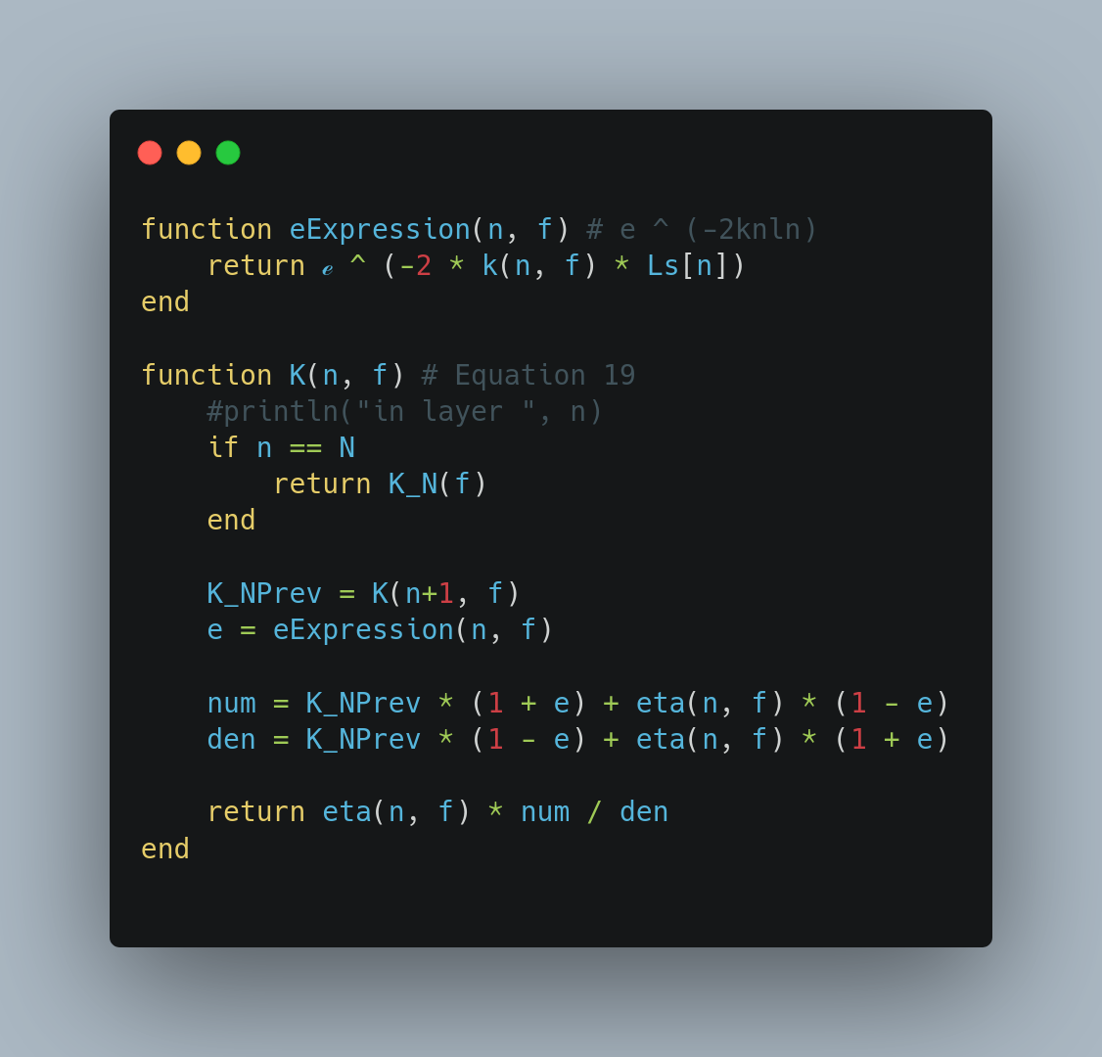
Relevant Model Code (Julia)

Slide 13
Benchmark
To benchmark our computer implementation of the Boteler 2019 model, we can run some test cases

Slide 14
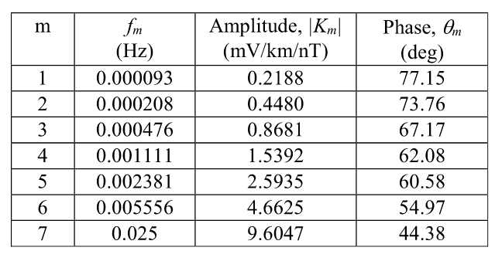
TABLE 3. Transfer function K(f) for the frequencies in the synthetic test magnetic field variation for a multi-layer Earth (5-layer Québec model).
Boteler 2019 Results
Computer Implemented Results
1 | 0.000093 | 0.219701 | 77.139393
2 | 0.000208 | 0.447422 | 73.771382
3 | 0.000476 | 0.867800 | 67.172638
4 | 0.001111 | 1.539096 | 62.080986
5 | 0.002381 | 2.593561 | 60.575656
6 | 0.005556 | 4.662704 | 54.969143
7 | 0.025000 | 9.604690 | 44.381495
m f_{m} Amplitude Phase

Slide 15
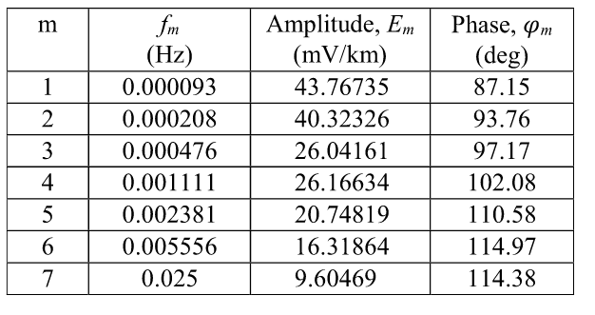
TABLE 7. Parameters of electric field waveform for a multi-layer Earth
(5-layer Québec model).
Boteler 2019 Results
1 | 0.000093 | 43.940296 | 87.139393
2 | 0.000208 | 40.267957 | 93.771382
3 | 0.000476 | 26.033997 | 97.172638
4 | 0.001111 | 26.164632 | 102.080986
5 | 0.002381 | 20.748486 | 110.575656
6 | 0.005556 | 16.319466 | 114.969143
7 | 0.025000 | 9.604690 | 114.381495
Computer Implemented Results
m f_{m} Amplitude Phase

Slide 16
TABLE 7. Parameters of electric field waveform for a multi-layer Earth
(5-layer Québec model).
Boteler 2019 Results
1 | 0.000093 | 43.940296 | 87.139393
2 | 0.000208 | 40.267957 | 93.771382
3 | 0.000476 | 26.033997 | 97.172638
4 | 0.001111 | 26.164632 | 102.080986
5 | 0.002381 | 20.748486 | 110.575656
6 | 0.005556 | 16.319466 | 114.969143
7 | 0.025000 | 9.604690 | 114.381495
Computer Implemented Results
m f_{m} Amplitude Phase

Slide 17
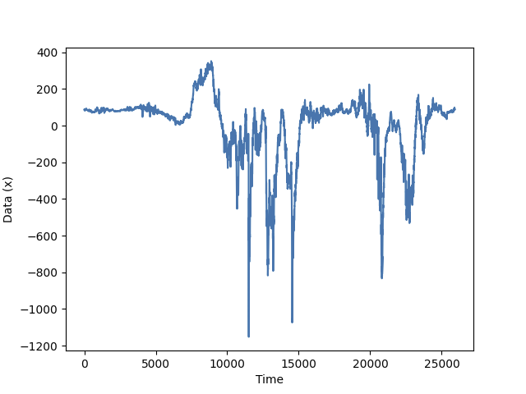
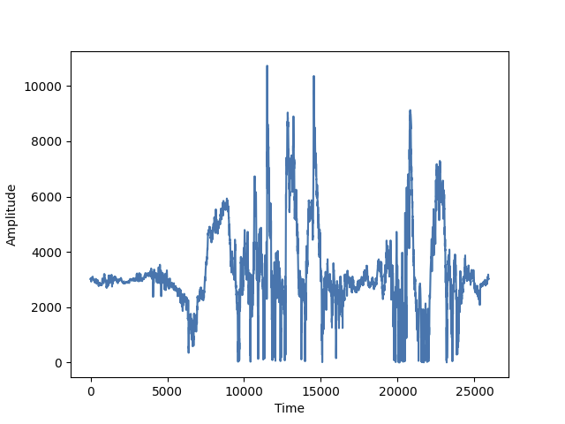
Real World Application
Data from Fort Simpson, Canada
Calculated Geoelectric fields for Fort Simpson dataset, mV/km/nT
K(f)

Slide 18
Conclusion
In this project, a computer implementation of the Quebec 5-layer model was created
Despite some challenges regarding creating a computer implementation of the simulation, I was able to create an accurate and efficient transfer function model
In the future, I want to take the output of the model and calculate the actual currents and voltages in the system
Additionally, I want to implement the 5 layer model in a performance-focused programming language; Julia had some issues with speed during development and testing due to its Just-In-Time compilation method

Slide 19
Bibliography
https://www.naes.com/news/what-is-a-geomagnetic-disturbance-and-how-can-it-affect-the-power-grid/
https://www.nasa.gov/mission_pages/sunearth/spaceweather/index.html
https://ieeexplore.ieee.org/abstract/document/8859181
https://towardsdatascience.com/fast-fourier-transform-937926e591cb#:~:text=As%20the%20name%20implies%2C%20the,)%20to%20O(NlogN)%20
http://www.librow.com/articles/article-10
https://wdc.bgs.ac.uk/catalog/format.html

Slide 20
Questions?

