Slide 1
New Orleans Police Department
Reducing violent crime through analytics
27th February, 2017

Slide 2
Agenda
Problem Statement
Logic Flow
Analysis
Next Steps

Slide 3
Problem Statement
Goal
To build a model that helps reduce violent crime by improving the responsiveness to emergency calls, by proactively identifying violent crime, and by improving the efficiency of stops and search, thus improving resource allocation.
1
2
Background and context
Stakeholders
The New Orleans Police Department (NOPD) has large amounts of Open Data on crime, quality of life issues, etc.
The NOPD currently does not have a framework in place that utilizes this Open Data to help reduce the occurrence of violent crime
New Orleans Police Department
Other city departments
Heinz College
3
4
Criteria for success
Potential challenges
To have a model in place that analyses existing Open Data to identify violent crimes and effectively allocate the department’s resources
Identify metrics that correlate Quality of life issues to violent crime in the city
Missing/insufficient data
Difficult to accurately quantify certain indicators
5
Data Analysis ( https://github.com/nikhilba/NOLA/ ):
All data, code, analysis and documents related to the project are available on GitHub
Links and additional information
Data Source ( https://data.nola.gov/ ):
Analysis of data from year 2012-2016
Specific to: Call for Service, Field Interview, Quality of life

Slide 4
Logic Flow
Call for services
Stop and search
Quality of life issues
How the interview conducted of time prior impact violent crime in a subsequent time period
Unresolved life issues
Resolved life issues
Questions to answer
QoL issues should be indicators of violent crime
How the QoL issues resolved of time prior impact violent crime in a subsequent time period
Where Stop and Search Happen
Impact of Stop and Search
Action Taken

Slide 5
Stop & Search – Methodology
Where stops and searches happen
Already happened – visualized the geographic distribution of stop and search
Should happen - visualized the geographic distribution of violence crimes
2. Impacts of stops and searches
The correlation between stop & search and violence crimes
The impact of stop & search on crimes (next step)
3. Actions taken analysis (Next step)
The correlation between stop & search with effective actions and violence crimes
The impact of effective stop & search on crimes
“Good” stop and search prediction and factor exploration

Slide 6
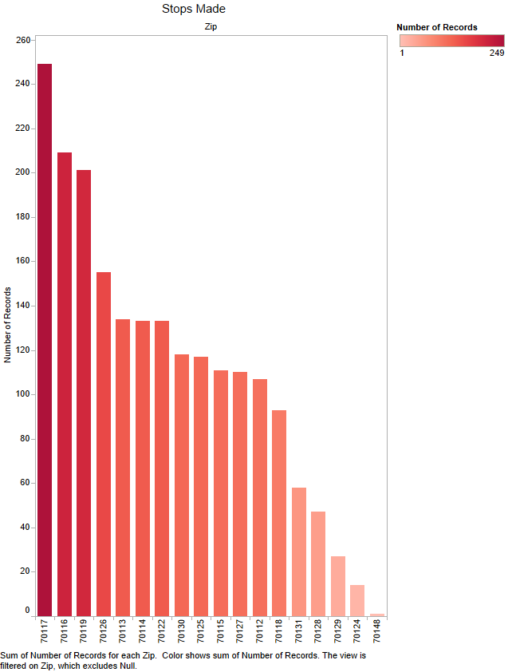
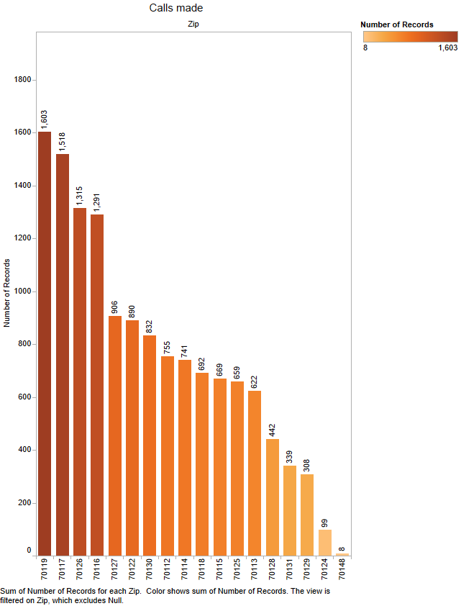
No. of crime rate, stops & searches by zip code

Slide 7
Stop & Search - Impacts of stops and searches
T1
T2
T3
Time
Time Frame
Time Window
Current
effects
Lag
effects
Number of stops & search
Number of crimes
Correlation

Slide 8
Stop & Search - Impacts of stops and searches
 | Time Frame | Time Window | Correlation Coefficient
1 | Month | Month | 0.747
2 | Month | Half a month (2 weeks) | 0.863
3 | Month | A week | 0.899
4 | Half a month | Half a month | 0.792
5 | Half a month | A week | 0.839
6 | Half a month | A day | 0.832
7 | A week | A week | 0.517
8 | A week | A day | 0.423
Positive correlation between crimes and stops and searches
All strong correlation (>0.75) except 1, 7, and 8

Slide 9
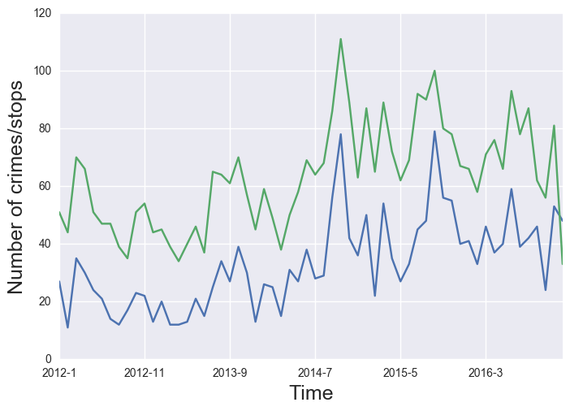
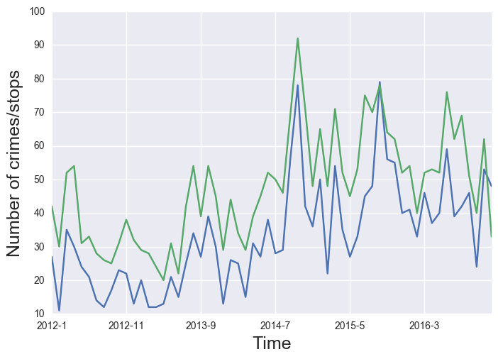
Impacts of stops and searches in violent
A month + half a month, Correlation - 0.863
A month + a week, Correlation - 0.899

Slide 10
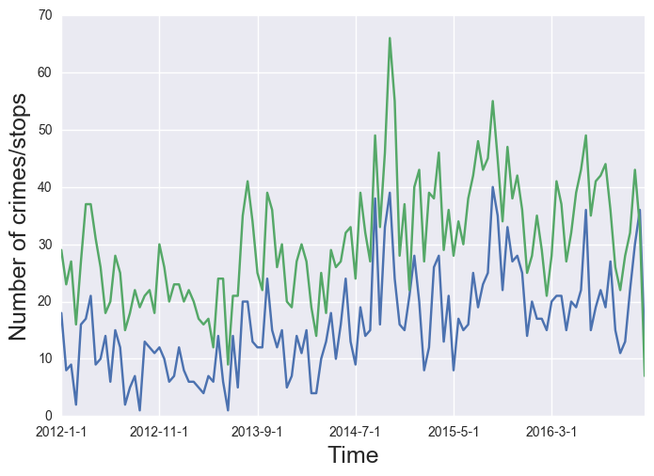
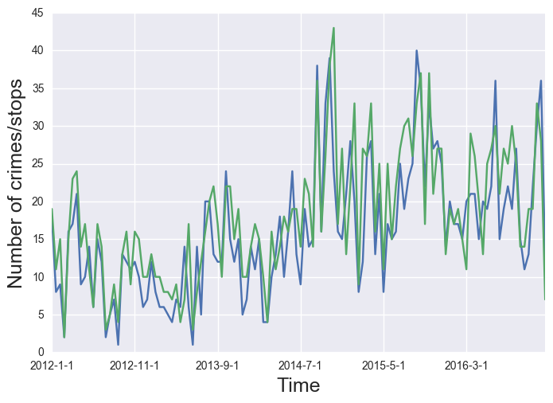
Impacts of stops and searches in violent
Half a month + a week, Correlation - 0.839
Half a month + a day, Correlation - 0.832

Slide 11
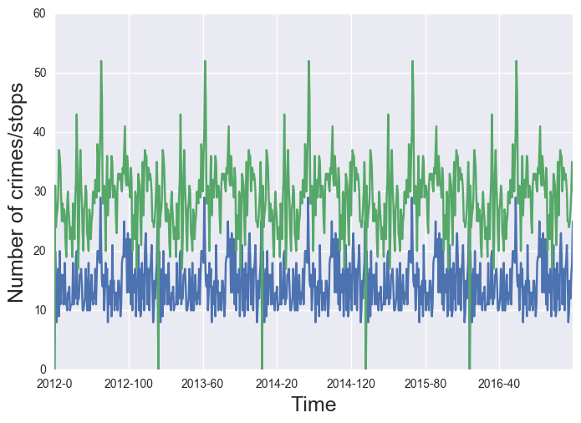
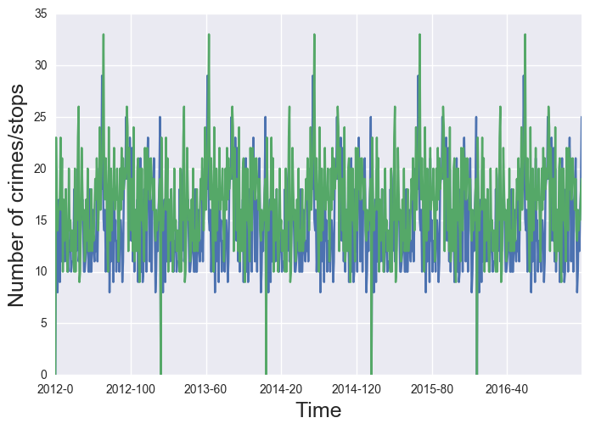
Impacts of stops and searches in violent
A week + a week, Correlation – 0.517
A week + a day, Correlation - 0.432

Slide 12
Next Steps
Stops & Searches
Fix the time frame and the time window
Aggregate data including other variables by the frame and the window and then build a regression model
Check the model coefficient of number of stops and searches (size & significance)
Make predictions
Quality of Life
What resolved quality of life indicators result in a reduction in violent crime?
What unresolved quality of life indicators are leading indicators of violent crime?

