Slide 1




NEW ORLEANS POLICE DEPARTMENT
Reducing Violent Crime Through Analytics
March 6th, 2017
Notes:
Chnaged: Added Date - Nikhil

Slide 2







CARNEGIE MELLON UNIVERSITY
Ronak Saradhi
Niteesh Reddy
Xinyao Li
Christina Gan
Karthik Balasubramanian
Nikhil Agarwal
Tim Zak
Project Advisor

Slide 3

NEW ORLEANS POLICE DEPARTMENT
Benjamin N. Horwitz
Director of Analytics at New Orleans Police Department
Paul Noel
Eric Melancon
Preston Bax
Deputy Superintendent
Field Operations Bureau
Deputy Chief of Staff for the Superintendent
Detective Investigative Unit Lieutenant, 4th District
Chris Hart
Caesar Ruffin
Hans Ganthier
Frank Young
Lieutenant TIGER Unit
Commander
4th District
Commander
1st District
Commander
5th District

Slide 4
AGENDA
Introduction
Data Analysis
Results
Next Steps

Slide 5
BACKGROUND
The New Orleans Police Department (NOPD) is part of the DOJ’s Violence Reduction Network that aims at reducing the outbreak of violent crime and allocate resources effectively when tackling violent crimes
Reduce Violent Crime
Proactively conduct stops and searches
Quality of life issues as indicators of violent crime
Where should stops happen?
How many stops should happen?
What actions should be taken?
Do quality of life issues impact violent crime?
What are leading indicators of violent crime?

Slide 6



ROAD MAP
Descriptive Analysis
Predictive Analysis
Raw Data Sets
Preliminary Analysis
Results
Call for services
Stop and searches
Quality of life issues
Identify Crime prone areas
Identify Quality of life indicators
Impact of SNS on Violent Crime
To be implemented..

Slide 7
AGENDA
Introduction
Data Analysis
Results
Next Steps
Notes:
CHECK slide numbers

Slide 8

DATA MANIPULATION
Raw Data, 2014 - 2016
Stops and Search
Call for Services
Qualify of Life
Crime Type / Disposition
Violent Crime/Reports to Follow
# Violent Crime
Top 2 locations with the highest violent crime

Slide 9
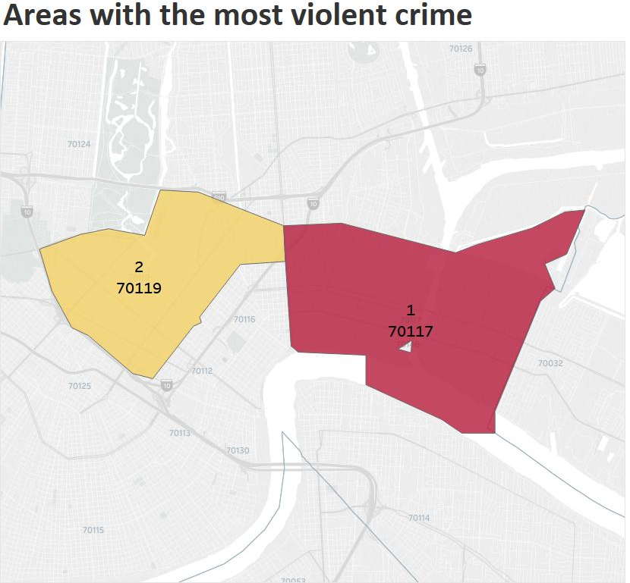
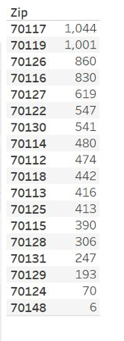
DATA EXPLORATION
Total# crimes
8879

Slide 10
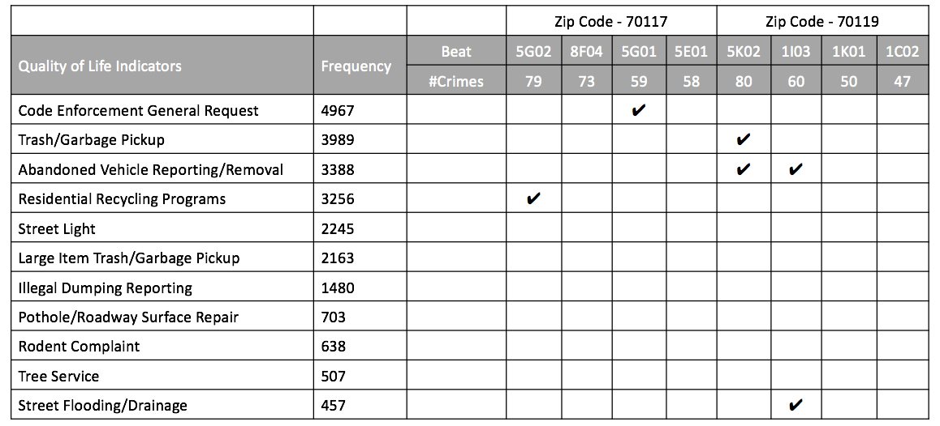
QUALITY OF LIFE ANALYSIS
Notes:
Mention key findings next to graphs for SNS and QoL

Slide 11
METHODOLOGY
A QOL Indicator
Create Date - T
Create Date
T
Closed Date
Closed Date + T
Time
Number of Crimes
Number of Crimes
Number of Crimes
Comparison (Mean / 95% CI)
Notes:
Mention key findings next to graphs for SNS and QoL

Slide 12
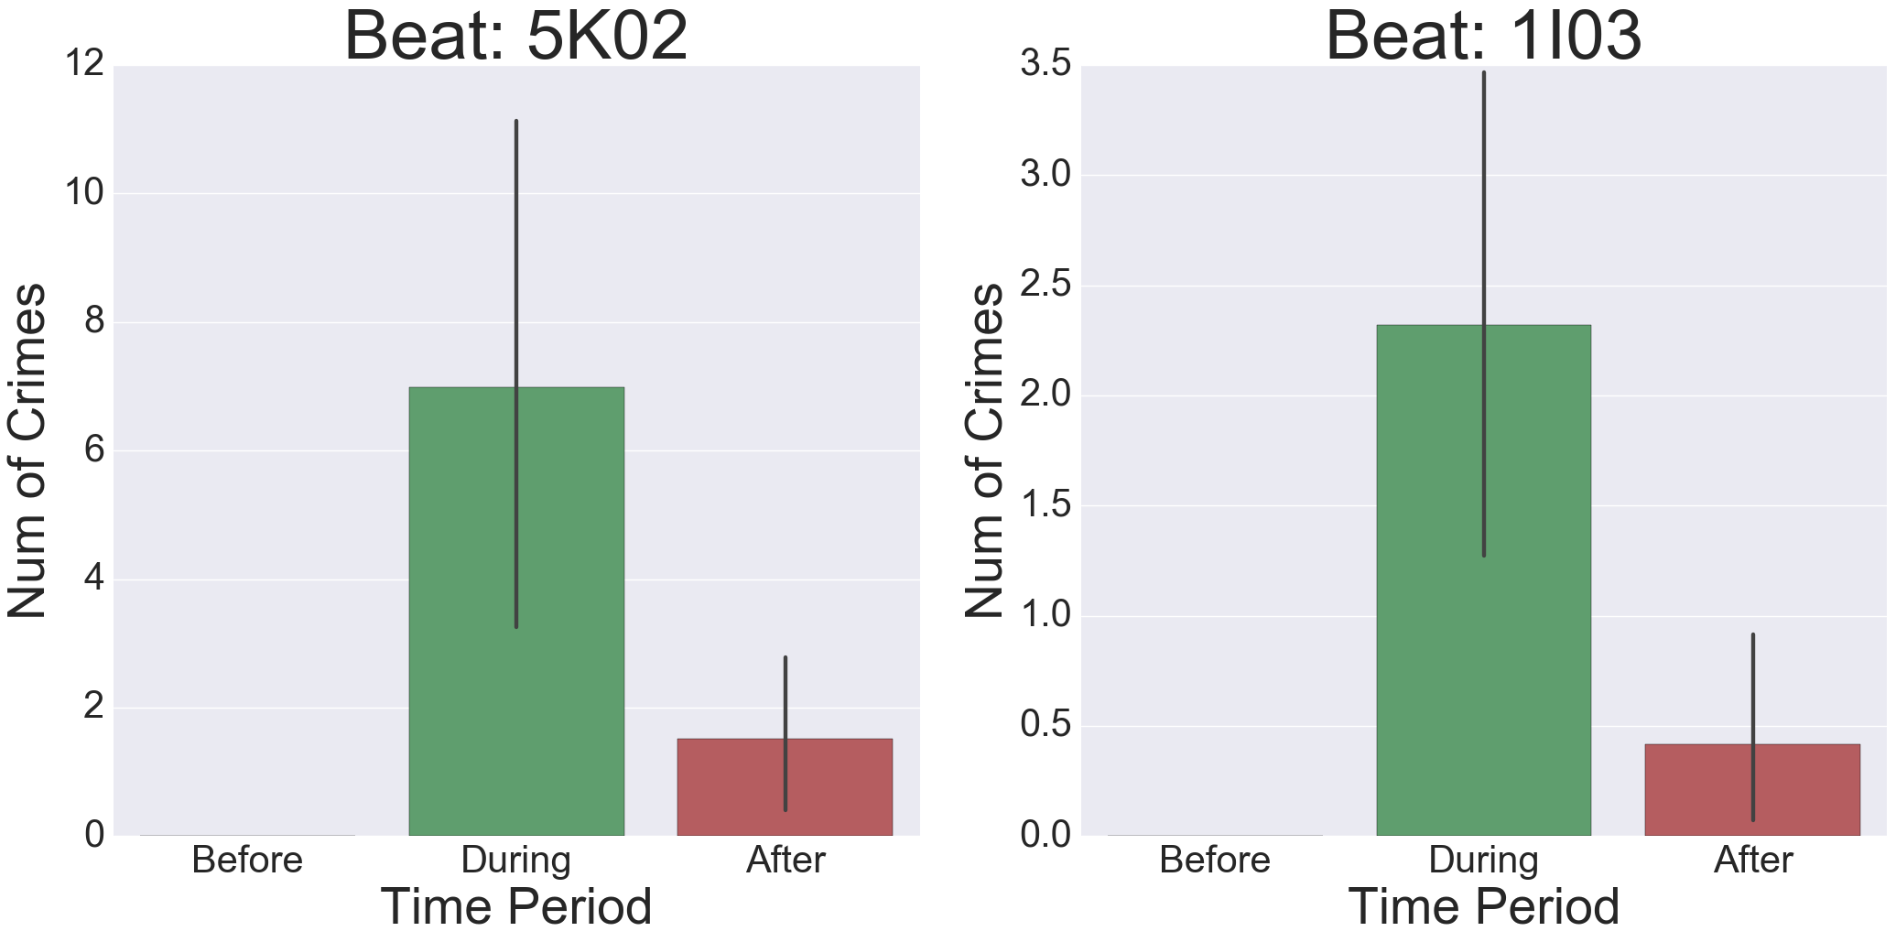
ABANDONED VEHICLE REPORTING
Key Findings
Reasons for abandonment - related to crimes
Shelter for illegal activities
Notes:
Mention key findings next to graphs for SNS and QoL

Slide 13
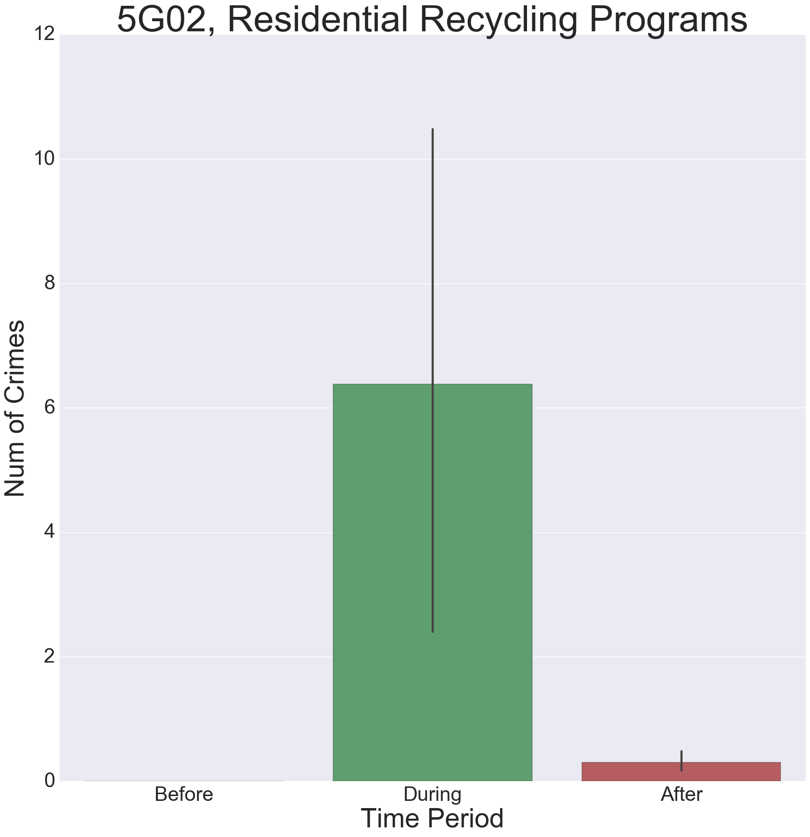
RESIDENTIAL RECYCLING PROGRAMS
Key Findings
Residents might have some specific reasons for not recycles
Garbage related to illegal activities
Frequent change of tenements
Few people live and walk, sheltering crimes
Notes:
Mention key findings next to graphs for SNS and QoL

Slide 14
QUALITY OF LIFE ANALYSIS
Notes:
Mention key findings next to graphs for SNS and QoL

Slide 15
DESCRIPTIVE ANALYSIS - II
Exploration of Data
CFS | SNS
Notes:
Mention key findings next to graphs for SNS and QoL

Slide 16
DESCRIPTIVE ANALYSIS - III
Exploration of Data
CFS | QOL

Slide 17
DESCRIPTIVE ANALYSIS - IV
Exploration of Data
CFS | QOL

Slide 18
AGENDA
Introduction
Data Analysis
Results
Next Steps

Slide 19
INFERENCE
What is the business implication? Are the findings interesting for the client?

Slide 20
Facing the Challenges
Challenges
Actions should be taken
Missing/limited data
Tackle missing data
NOPD side
Lack of domain knowledge
Based on our findings
Data amount/dimensions -> inconsistent results / variance
Geocode the address to generate BEAT for 2012-1013. Have more data points.
CMU side
Notes:
Limited Data – as we have one in on granular level of beats, we might be having large SE
Insufficient beat data for low level location based analysis

Slide 21
AGENDA
Introduction
Data Analysis
Results
Next Steps

Slide 22
FUTURE ROAD MAP
Descriptive
Analysis
Predictive
Analysis
Raw Data sets
Preliminary analysis
Final Results
Call for services
Stop and searches
Quality of life issues
Identify Crime prone areas
Identify Quality of life indicators
Impact of SNS on Violent Crime
Results of advanced analysis
Models to tackle Violent Crime
Model performance evaluation

Slide 23
PLANNED APPROACH
Extend analysis based on prior results
Use machine learning techniques, build different models
Select metrics to evaluate model performance
Run the model on live data!
Known desired output values, y are available for training
Input :
Time info
Geographic info
Violent Crime info
Output :
Number of Stops
Location of Stops
…
Model
(and its adaptive parameters)
Notes:
Extend analysis based on prior results to all other beats, and all other quality of life issues
Using machine learning techniques, build different models to tackle specific Violent Crime issues

Slide 24




TOOLS
Github
Coding & Analysis
Collaboration
Visualization

Slide 25

QA
THANK YOU!
Notes:
The image gets pixelated when viewed on large screen

