Slide 1




March 6th, 2017
NEW ORLEANS POLICE DEPARTMENT
Reducing Violent Crime Through Analytics
Notes:
Chnaged: Added Date - Nikhil

Slide 2







CARNEGIE MELLON UNIVERSITY
Presented By
Ronak Saradhi
Niteesh Reddy
Xinyao Li
Christina Gan
Karthik Balasubramanian
Nikhil Agarwal
Project Advisor
Tim Zak
Notes:
Changed: Updated my image - Nikhil

Slide 3

NEW ORLEANS POLICE DEPARTMENT
Director of Analytics at New Orleans Police Department
Benjamin N. Horwitz
Deputy Superintendent
Field Operations Bureau
Deputy Chief of Staff for the Superintendent
Detective Investigative Unit Lieutenant, 4th District
Paul Noel
Eric Melancon
Preston Bax
Lieutenant TIGER Unit
Commander
4th District
Commander
1st District
Commander
5th District
Chris Hart
Caesar Ruffin
Hans Ganthier
Frank Young
Notes:
Order names and designations

Slide 4
AGENDA
Introduction
Data Analysis
Results
Next Steps
Notes:
Changed: Text Color Blue -> Gray -Nikhil
Changed: Project Introduction -> Introduction
Methodology -> Data Analysis
Key Findings -> Results
- Nikhil

Slide 5
BACKGROUND
The New Orleans Police Department (NOPD) is part of the DOJ’s Violence Reduction Network that aims at reducing the outbreak of violent crime and allocate resources effectively when tackling violent crimes
GOALS
Proactively conduct stops and searches
Quality of life issues as indicators of violent crime
Where should stops happen?
How many stops should happen?
What actions should be taken?
Do quality of life issues impact violent crime?
What are leading indicators of violent crime?
Notes:
Reduce Fonts – Ronak
Changed: slide title from INTRODUCTION to BACKGROUND and removed BACKGROUND AND CONTEXT from the body of slide. - Nikhil

Slide 6




TOOLS
Github
Coding & Analysis
Collaboration
Visualization
Notes:
Changed: Code Analysis -> Coding & Analysis - Nikhil

Slide 7



ROAD MAP
Descriptive Analysis
Predictive Analysis
Raw Data Sets
Preliminary Analysis
Results
Call for services
Stop and searches
Quality of life issues
Identify Crime prone areas
Identify Quality of life indicators
Impact of SNS on Violent Crime
To be implemented..
Notes:
Change arrows from bi direction to uni direction. (arrow points towards the goal) – Nikhil
Changed: Color of Predict.. Analysis from Blue to Gray
Predictive modelling -> Results
Added To be implemented below Results - Nikhil

Slide 8
AGENDA
Introduction
Data Analysis
Results
Next Steps
Notes:
CHECK slide numbers

Slide 9

DATA MANIPULATION
Raw Data
Stops and Search
Call for Services
Qualify of Life
Crime Type / Disposition
Violent Crime/Reports to Follow
# Violent Crime
Top 2 locations with the highest violent crime
Notes:
Mention duration (’14-’16)
Changed: Added Disposition to text -Nikhil

Slide 10
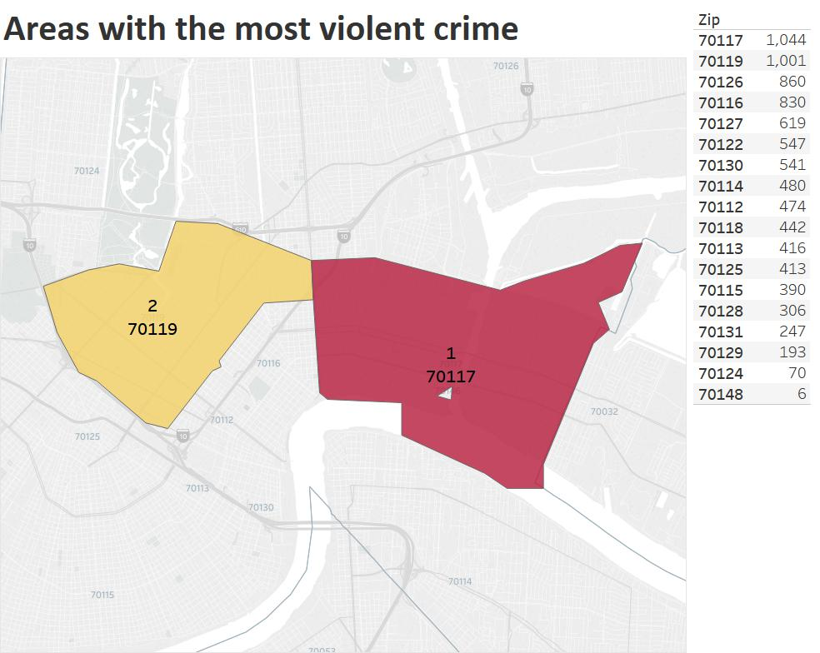
DATA EXPLORATION
Notes:
Increase size of table on the right & HIGHLIGHT GRAND TOTAL

Slide 11
DESCRIPTIVE ANALYSIS - I
Exploration of Data
CFS | SNS
Notes:
Mention key findings next to graphs for SNS and QoL

Slide 12
DESCRIPTIVE ANALYSIS - II
Exploration of Data
CFS | SNS
Notes:
Mention key findings next to graphs for SNS and QoL

Slide 13
DESCRIPTIVE ANALYSIS - III
Exploration of Data
CFS | QOL

Slide 14
DESCRIPTIVE ANALYSIS - IV
Exploration of Data
CFS | QOL

Slide 15
AGENDA
Introduction
Data Analysis
Results
Next Steps

Slide 16
INFERENCE
What is the business implication? Are the findings interesting for the client?

Slide 17
RISKS / CHALLENGES
Missing/limited data
Lack of domain knowledge
Data amount/dimensions -> inconsistent results / variance
Notes:
Limited Data – as we have one in on granular level of beats, we might be having large SE
Insufficient beat data for low level location based analysis
Changed: Added 3rd point -Nikhil

Slide 18
RECOMMENDATIONS / MITIGATION STEPS
What actions should your client take based on your results?
NOPD
1. Based on our findings
2. Tackle missing data
CMU
3. Geocode the address to generate BEAT for 2012-1013. Have more data points.
Notes:
Mention recommendations thus far such as improving data collection etc
Changed: Added NOPD/CMU and #3

Slide 19
AGENDA
Introduction
Data Analysis
Results
Next Steps

Slide 20
FUTURE ROAD MAP
Descriptive
Analysis
Predictive
Analysis
Raw Data sets
Preliminary analysis
Final Results
Call for services
Stop and searches
Quality of life issues
Identify Crime prone areas
Identify Quality of life indicators
Impact of SNS on Violent Crime
Results of advanced analysis
Models to tackle Violent Crime
Model performance evaluation
Notes:
Changed: Build a predictive model to “RESULTS” (Results/Outcome)
Added content to Results
Highlighted Pred.. Analytics
-Nikhil

Slide 21
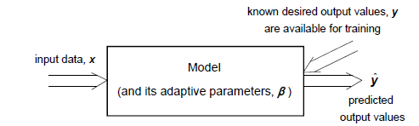
PLANNED APPROACH
Extend analysis based on prior results to all other beats, and all other quality of life issues
Using Machine-learning techniques, build different models to tackle specific Violent Crime issues
Select metrics to evaluate model performance
Run the model on live data!
Time Series info
Geographic info
Violent Crime info
Number of Stops
Location of Stops
Notes:
Changed: Added content - Nikhil

Slide 22

QA
THANK YOU!
Notes:
The image gets pixelated when viewed on large screen

