Slide 1
New Orleans Police Department
Reducing violent crime through analytics

Slide 2
PROBLEM STATEMENT
Goal
To build a model that helps reduce violent crime by improving the responsiveness to emergency calls, by proactively identifying violent crime, and by improving the efficiency of stops and search, thus improving resource allocation.
1
2
Background and context
Stakeholders
The New Orleans Police Department (NOPD) has large amounts of Open Data on crime, quality of life issues, etc.
The NOPD currently does not have a framework in place that utilizes this Open Data to help reduce the occurrence of violent crime
New Orleans Police Department
Other city departments
Heinz College
3
4
Criteria for success
Potential challenges
To have a model in place that analyses existing Open Data to identify violent crimes and effectively allocate the department’s resources
Identify metrics that correlate Quality of life issues to violent crime in the city
Missing/insufficient data
Difficult to accurately quantify certain indicators
5
Links and additional information
Data Analysis ( https://github.com/nikhilba/NOLA/ ):
All data, code, analysis and documents related to the project are available on GitHub
Data Source ( https://data.nola.gov/ ):
Analysis of data from year 2012-2016
Specific to: Call for Service, Field Interview, Quality of life

Slide 3
STOP & SEARCH EDA

Slide 4
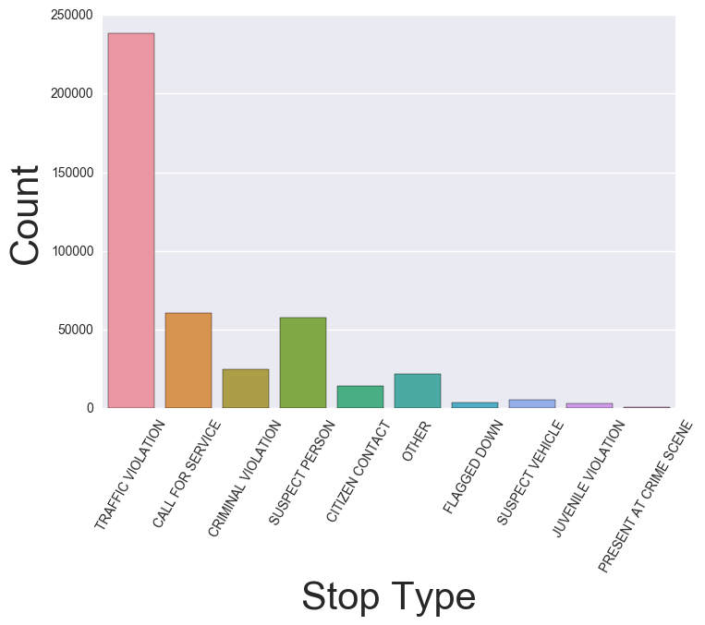
Analysis of Stop and Search
1
2
Types of search distribution
Key findings
Most of the s&s is about the traffic violation
The percentage of violent crime is actually kind of low

Slide 5
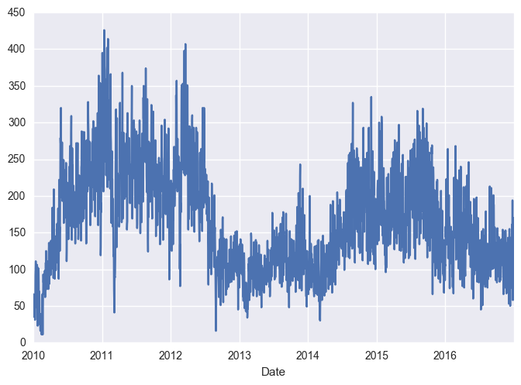
Analysis of Stop and Search
1
2
Time series plot for number of s&s
Key findings
We could see a clear periodical change from 2010 to 2016
we could see a relatively small number of s&s from time range from 2012 to the beginning of 2014, what’s the reason for the small number?
Possible reasons
A decrease in crime rate
A decrease in budget and manpower

Slide 6
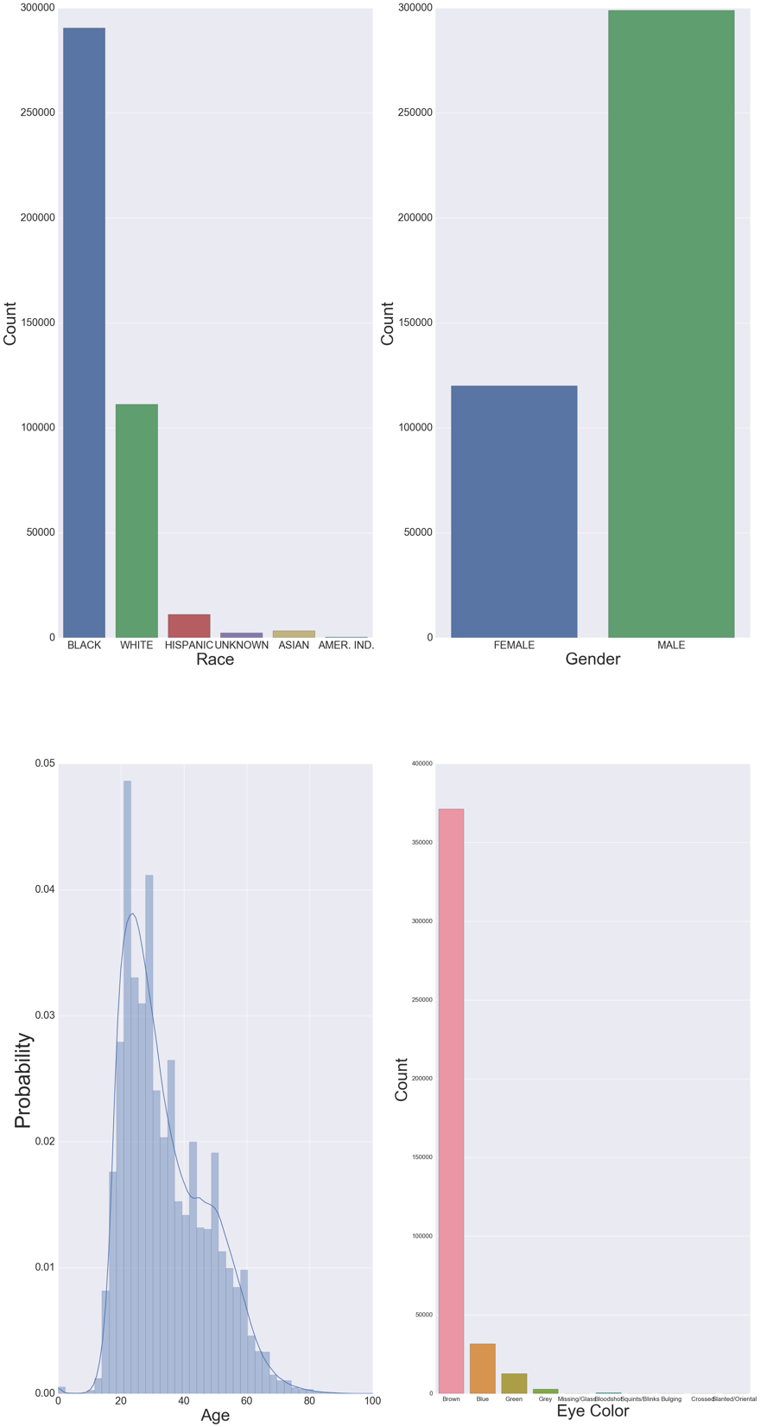
Analysis of Stop and Search
1
2
Demographic features
Key findings
Most of the people have been stopped are black
Male > Female

Slide 7
Analysis of Stop and Search
1
2
Demographic features
Key findings
Majority of the interviewees are aged between 20 and 30
Most of them have brown eyes

Slide 8
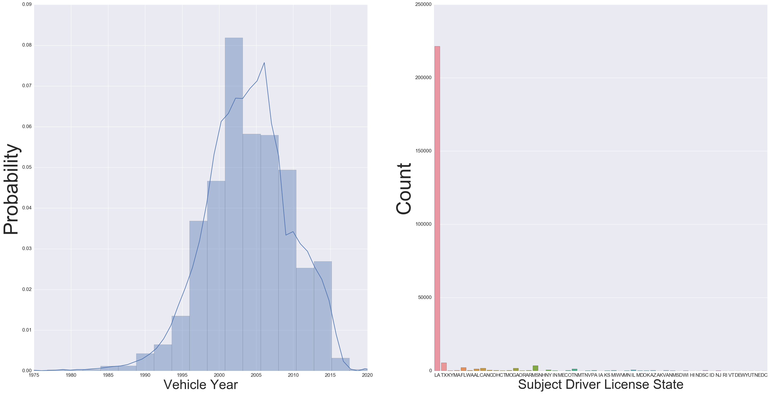
Analysis of Stop and Search
1
2
Vehicle features
Key findings
The made year of the vehicle concentrates from 1999 – 2006
The license is mainly issued in LA

Slide 9
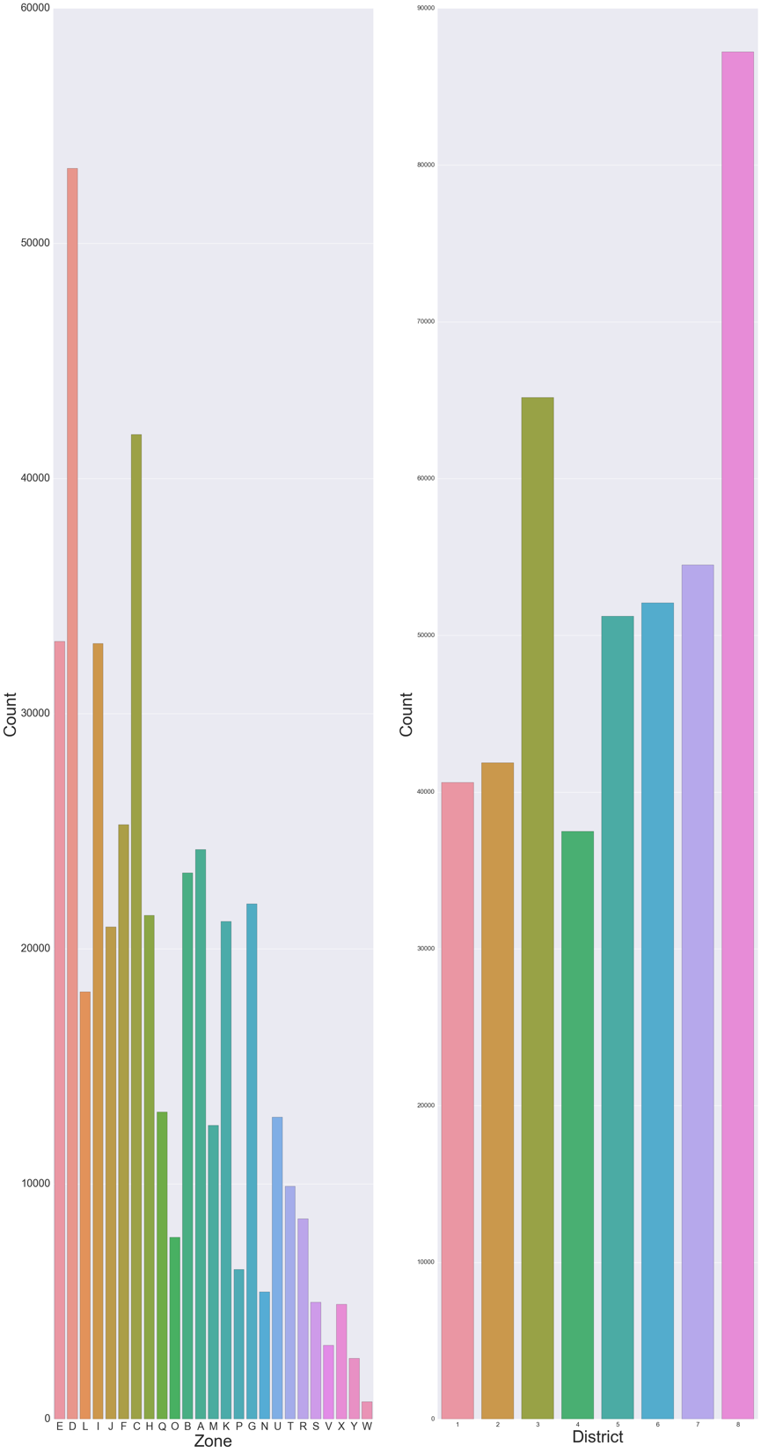
Analysis of Stop and Search
1
2
Geographic distribution
Key findings
Most of the stop and search happened in zone D/C/E/I
Most of the stop and search happened in district 8 and 3
This shows that those mentioned areas above may have a higher potential of crime rates, police may want to take a deeper look into this

Slide 10
Analysis of Stop and Search
1
2
Geographic distribution
Key findings
Most of the stop and search happened in zone D/C/E/I
Most of the stop and search happened in district 8 and 3
This shows that those mentioned areas above may have a higher potential of crime rates, police may want to take a deeper look into this

Slide 11
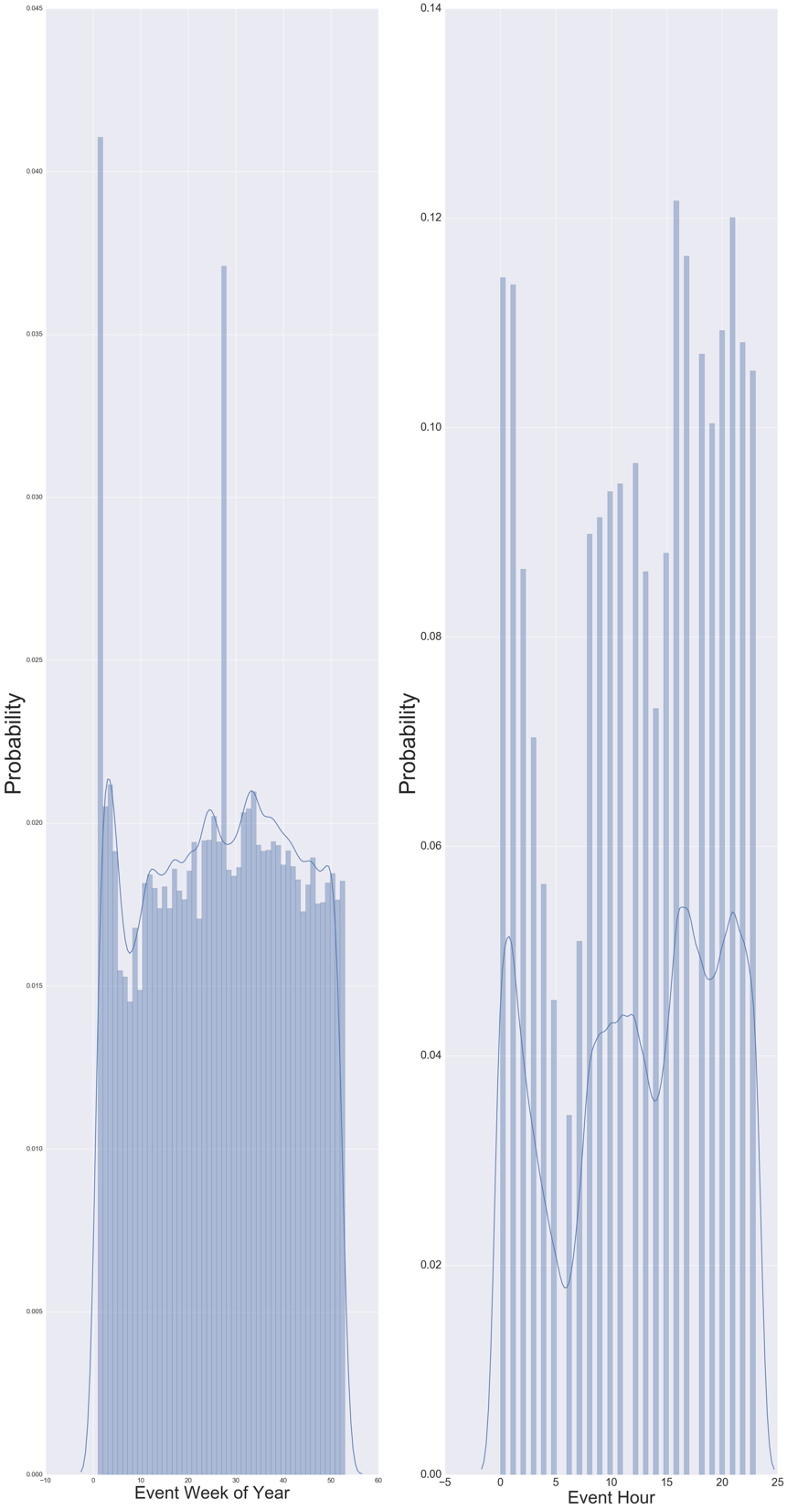
Analysis of Stop and Search
1
2
Chronological distribution
Key findings
The number of stop and search is relatively high in the beginning and the middle of the year within one year
The number of stop and search is relatively high at the night time within one day

Slide 12
Analysis of Stop and Search
1
Subject picture

Slide 13
311 CALLS EDA

Slide 14
Number of Issues by Issue Type (2012-2016)*
 | Issue Type | Number of Issues
1 | Code Enforcement General Request | 30907
2 | Street Light | 29515
3 | Trash/Garbage Pickup | 22091
4 | Residential Recycling Programs | 18468
5 | Abandoned Vehicle Reporting/Removal | 17205
6 | Large Item Trash/Garbage Pickup | 13041
7 | Pothole/Roadway Surface Repair | 12935
8 | General Service Request | 8924
9 | Street Flooding/Drainage | 8742
10 | Illegal Dumping Reporting | 7701
 | Issue Type | Number of Issues
11 | Tree Service | 5452
12 | Traffic Sign | 3066
13 | Traffic Signal | 2968
14 | Rodent Complaint | 2710
15 | Catch Basin Maintenance | 2501
16 | Sidewalk Repair | 2231
17 | Subsidence | 1879
18 | Mosquito Control | 1824
19 | Tree Service Emergency | 1636
20 | Tree Maintenance | 1208
* Limited to Top 20 Issues by number of calls

Slide 15
Analysis of 311 Calls
1
2
Year over year comparison of Issues
Key findings
Calls about “Street Light” issues is on the decline since 2013
“Abandoned Vehicle Reporting/Removal” has been steadily increasing YOY

Slide 16
