Slide 1
QOL Analysis

Slide 2
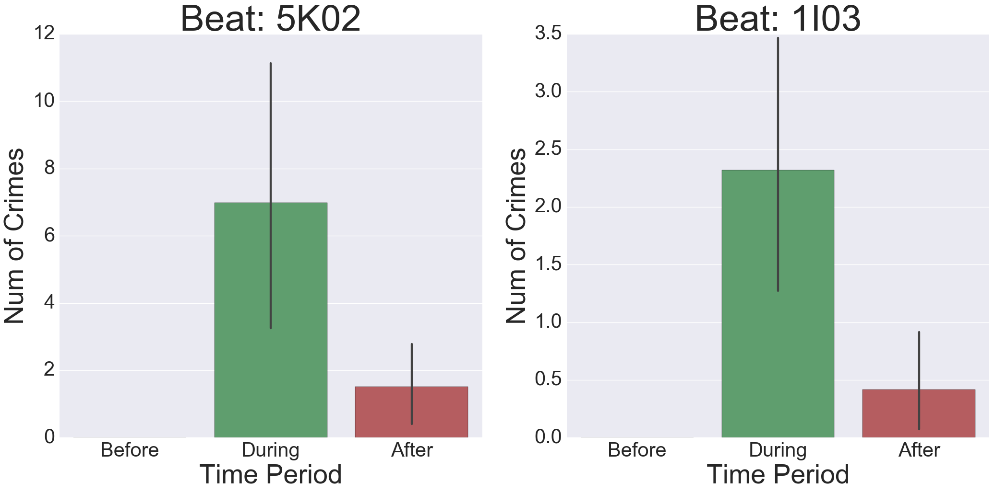
Quality of life Analysis
Stage 1 – Relationship detection between qol and crimes
1. Methodology –
(1) Extract data for each pair of beats and quality of life indicators;
(2) For each quality of life indicator, calculate the time window according to it starting and ending date;
(3) Based on the time window, calculate the number of crimes in the window before, during, and after the indicator;
(4) Compare the average number and 95% confidence interval to exam the significance of the indicator.
2. An case analysis – Abandoned Vehicle Reporting in beat 5K02
(1) Violent crime significantly increased when issue was open &
significantly decreased after issue was fixed;
(2) The vehicles might be abandoned due to reasons related to crimes or provide shelters for future crimes;
(3) When an abandoned vehicle is reported, effective actions should be taken to prevent crimes based on the strong relation between it with crimes;
(4) In future, relevant agencies should make effort to reduce the indicator.
3. Key findings & Recommendations
Zip Code | Beat | Important Quality of Life Issues
70117 | 5G02 | Residential Recycling Programs
 | 5G01 | Code Enforcement General Request
70119 | 5K02 | Trash/Garbage Pickup Abandoned Vehicle Reporting/Removal
 | 1I03 | Abandoned Vehicle Reporting/Removal Street Flooding/Drainage

Slide 3
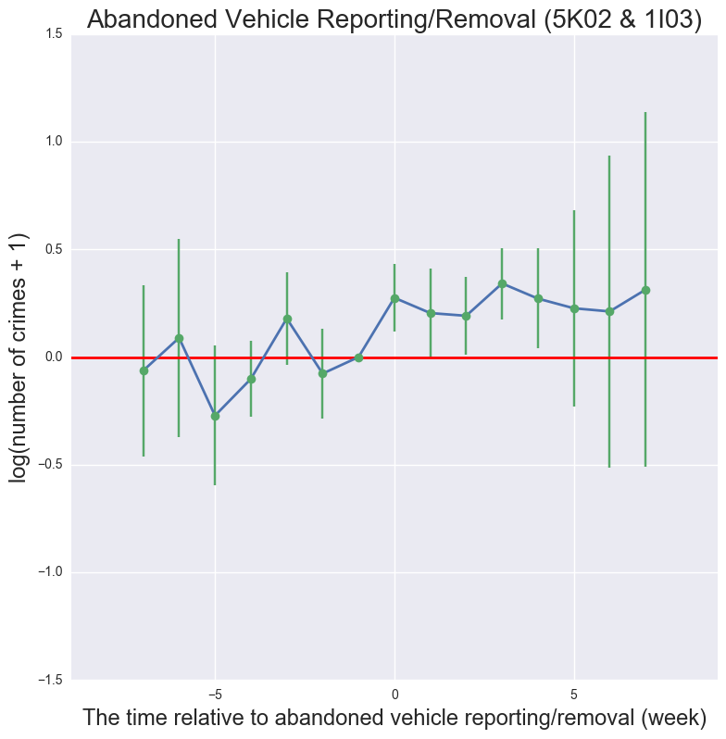
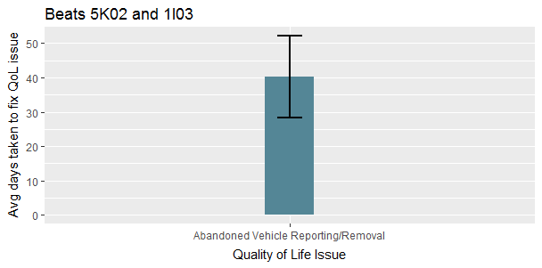
Stage 2 – Time window measurement between qol happens and crime increases
1. Methodology –
(1) For each significant quality of life indicator, calculate the time between (e.g. day, week, and month) the date it happened and the date each crime happened;
(2) Based on the time difference, create corresponding dummy variables (e.g. 5 days between = 1 for all rows time difference = 5);
(3) Calculate the average number and 95% confidence interval for each dummy variable with its value to exam the more detailed crime change over time;
(4) Compare the time from indicator happens and crime significant increases to make recommendations.
2. An case analysis –
Abandoned Vehicle Reporting in beat 5K02 & 1I03
(1) Violent crime significantly increased within one week after the issue was;
(2) Current average time fix the issue is about 40 which is much longer than the time it might significant drive crimes ;
(3) In future, relevant agencies should narrow down the time to fix the issue. Especially, the ideal time is within a week to avoid crime increase;
(4) In future, relevant agencies should make effort to reduce the indicator.
3. Key findings & Recommendations
Zip Code | Beat | Important Quality of Life Issues | Recommended Time to Fix | Future Efforts
70117 | 5G01 | Code Enforcement General Request | 1 Month | Reduce the frequency of the indicator
70119 | 5K02 | Trash/Garbage Pickup Abandoned Vehicle Reporting/Removal | 2 Month 1 Week | Reduce the frequency of the indicator Reduce the fixing time and the frequency of the indicator
 | 1I03 | Abandoned Vehicle Reporting/Removal | 1 Week | Reduce the fixing time the frequency of the indicator

