Slide 1
New Orleans Police Department
Reducing violent crime through analytics

Slide 2
PROBLEM STATEMENT
Goal
To build a model that helps reduce violent crime by improving the responsiveness to emergency calls, by proactively identifying violent crime, and by improving the efficiency of stops and search, thus improving resource allocation.
1
2
Background and context
Stakeholders
The New Orleans Police Department (NOPD) has large amounts of Open Data on crime, quality of life issues, etc.
The NOPD currently does not have a framework in place that utilizes this Open Data to help reduce the occurrence of violent crime
New Orleans Police Department
Other city departments
Heinz College
3
4
Criteria for success
Potential challenges
To have a model in place that analyses existing Open Data to identify violent crimes and effectively allocate the department’s resources
Identify metrics that correlate Quality of life issues to violent crime in the city
Missing/insufficient data
Difficult to accurately quantify certain indicators
5
Links and additional information
Data Analysis ( https://github.com/nikhilba/NOLA/ ):
All data, code, analysis and documents related to the project are available on GitHub
Data Source ( https://data.nola.gov/ ):
Analysis of data from year 2012-2016
Specific to: Call for Service, Field Interview, Quality of life

Slide 3
Calls For Service EDA

Slide 4
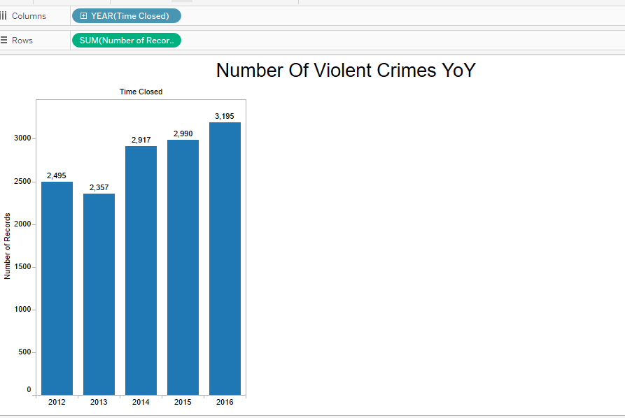
Statistics on Violent Crimes YoY

Slide 5
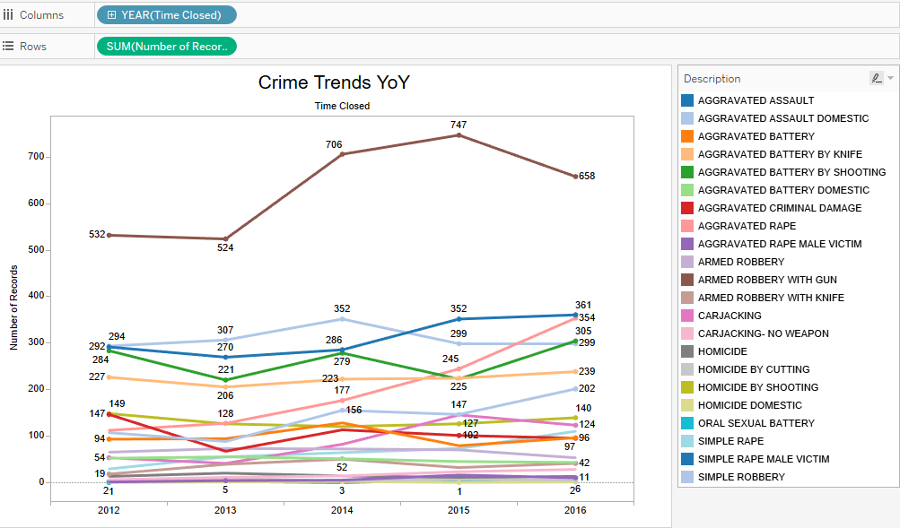

Slide 6
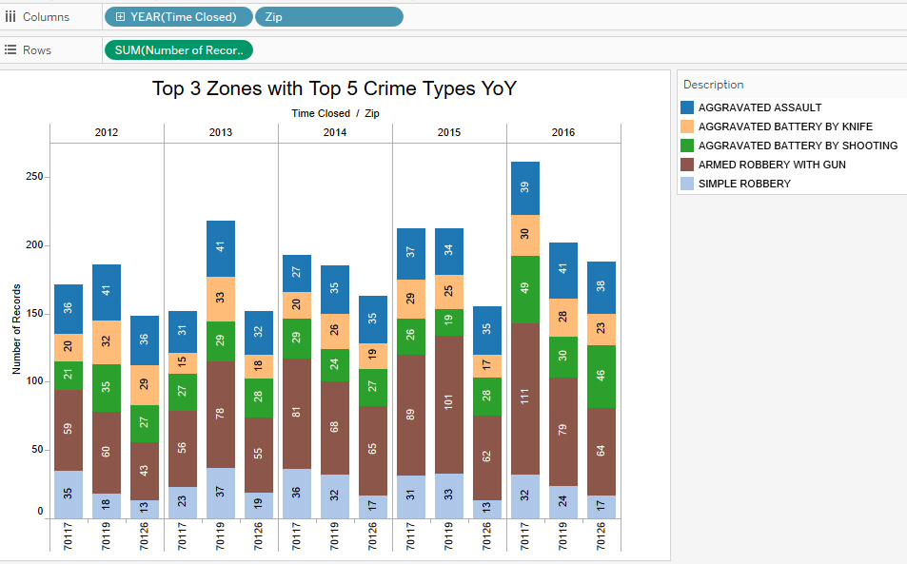

Slide 7
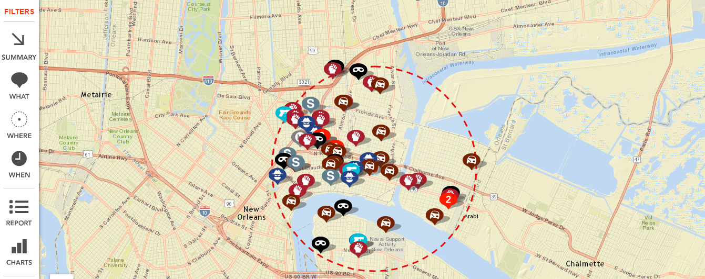
Live Crime Stats data from Violent crime areas
70117:
The Most notorious Neighborhood of New Orleans

Slide 8
Facts on 70117 Neighborhood
Have neighborhood with lower rate of College graduates in the City.
Last four years this zip code has registered most number of cases than any other.
Some neighborhood are among the lowest income earning neighborhoods in America.

Slide 9
Live Crime Stats data from Violent crime areas
70119:
Second most crime-prone zone in New Orleans

Slide 10
Facts on 70119 Neighborhood
Close to Tulane University
Has a City Park close to the neighborhood

Slide 11
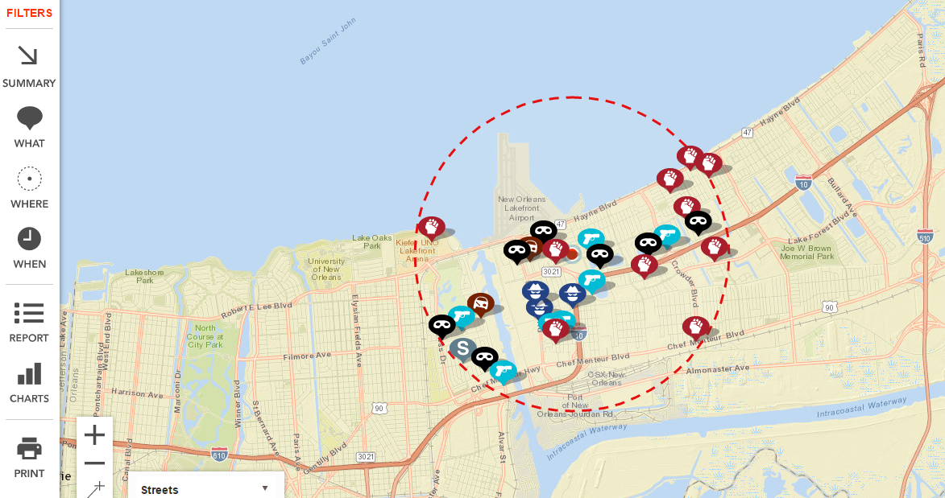
Live Crime Stats data from Violent crime areas
70126:
Third most crime prone zone in New Orleans

Slide 12
Facts on 70126 Neighborhood
Hayne Blvd / Mercier St neighborhood has more single mother households than 97.2% of the neighborhoods in the U.S. Often high concentrations of single mother homes can be a strong indicator of family and social issues such as poverty, high rates of school dropouts, crime, and other societal problems.
Source

Slide 13
STOP & SEARCH EDA

Slide 14
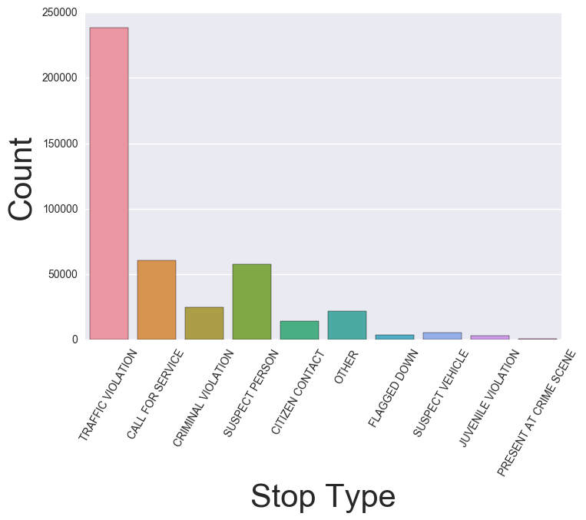
Analysis of Stop and Search
1
2
Types of search distribution
Key findings
Most of the s&s is about the traffic violation
The percentage of violent crime is actually kind of low

Slide 15
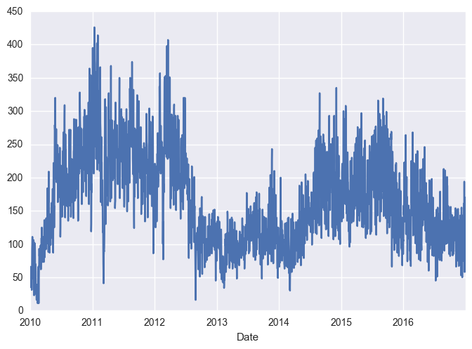
Analysis of Stop and Search
1
2
Time series plot for number of s&s
Key findings
We could see a clear periodical change from 2010 to 2016
we could see a relatively small number of s&s from time range from 2012 to the beginning of 2014, what’s the reason for the small number?
Possible reasons
A decrease in crime rate
A decrease in budget and manpower

Slide 16
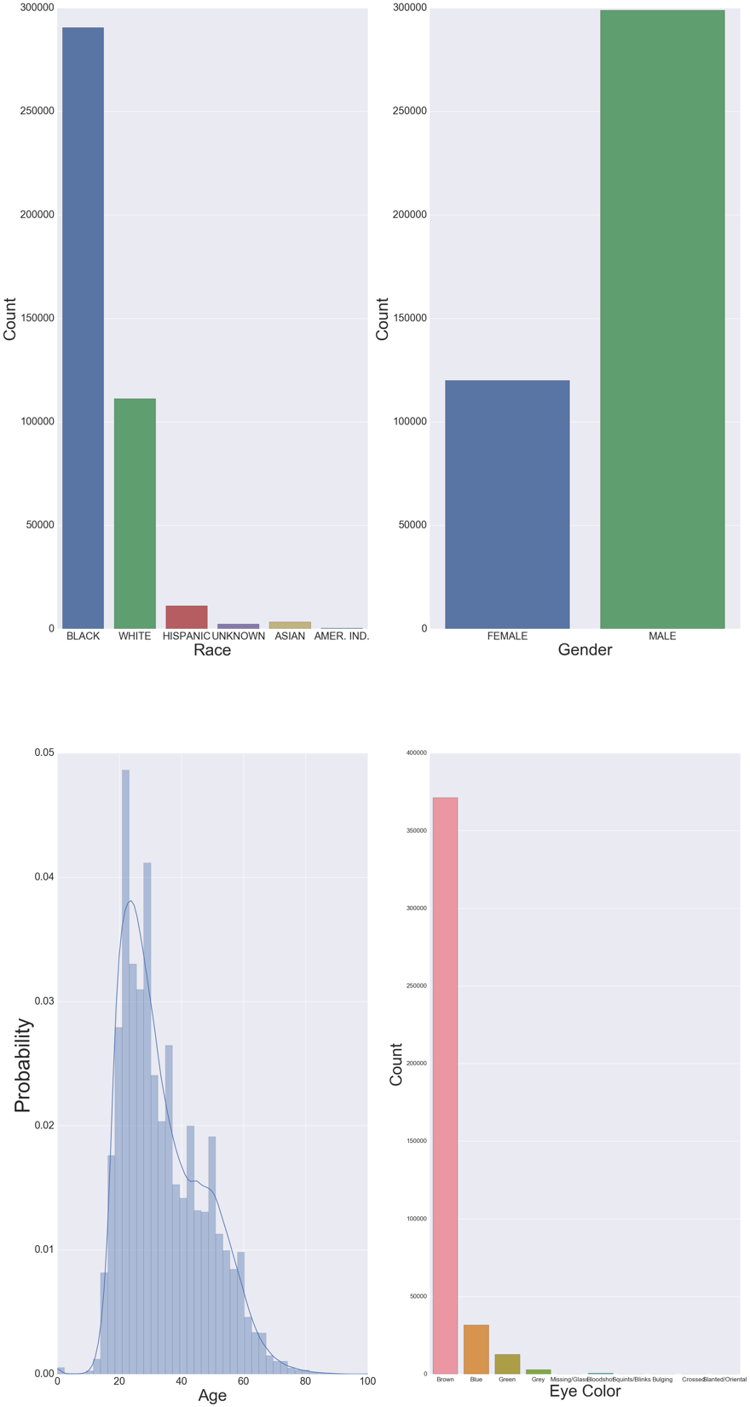
Analysis of Stop and Search
1
2
Demographic features
Key findings
Most of the people have been stopped are black
Male > Female

Slide 17
Analysis of Stop and Search
1
2
Demographic features
Key findings
Majority of the interviewees are aged between 20 and 30
Most of them have brown eyes

Slide 18
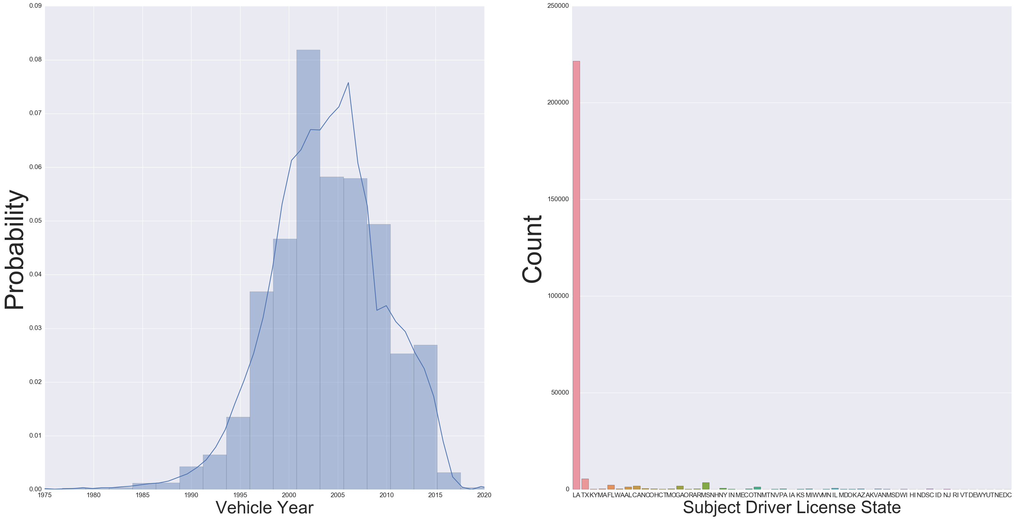
Analysis of Stop and Search
1
2
Vehicle features
Key findings
The made year of the vehicle concentrates from 1999 – 2006
The license is mainly issued in LA

Slide 19
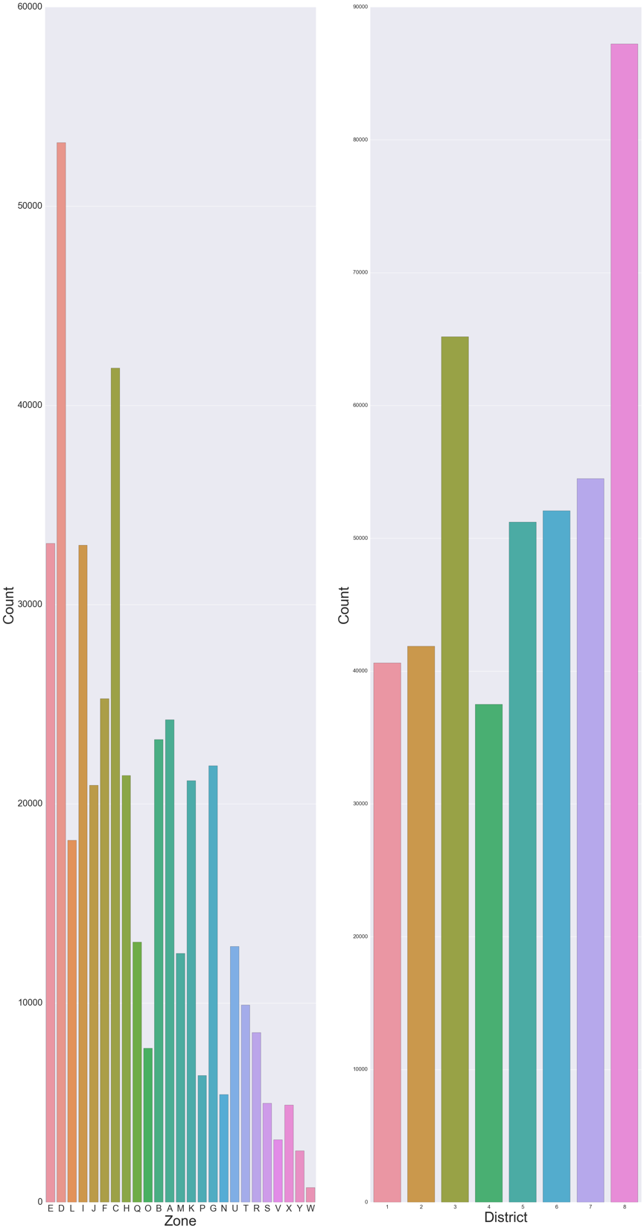
Analysis of Stop and Search
1
2
Geographic distribution
Key findings
Most of the stop and search happened in zone D/C/E/I
Most of the stop and search happened in district 8 and 3
This shows that those mentioned areas above may have a higher potential of crime rates, police may want to take a deeper look into this

Slide 20
Analysis of Stop and Search
1
2
Geographic distribution
Key findings
Most of the stop and search happened in zone D/C/E/I
Most of the stop and search happened in district 8 and 3
This shows that those mentioned areas above may have a higher potential of crime rates, police may want to take a deeper look into this

Slide 21
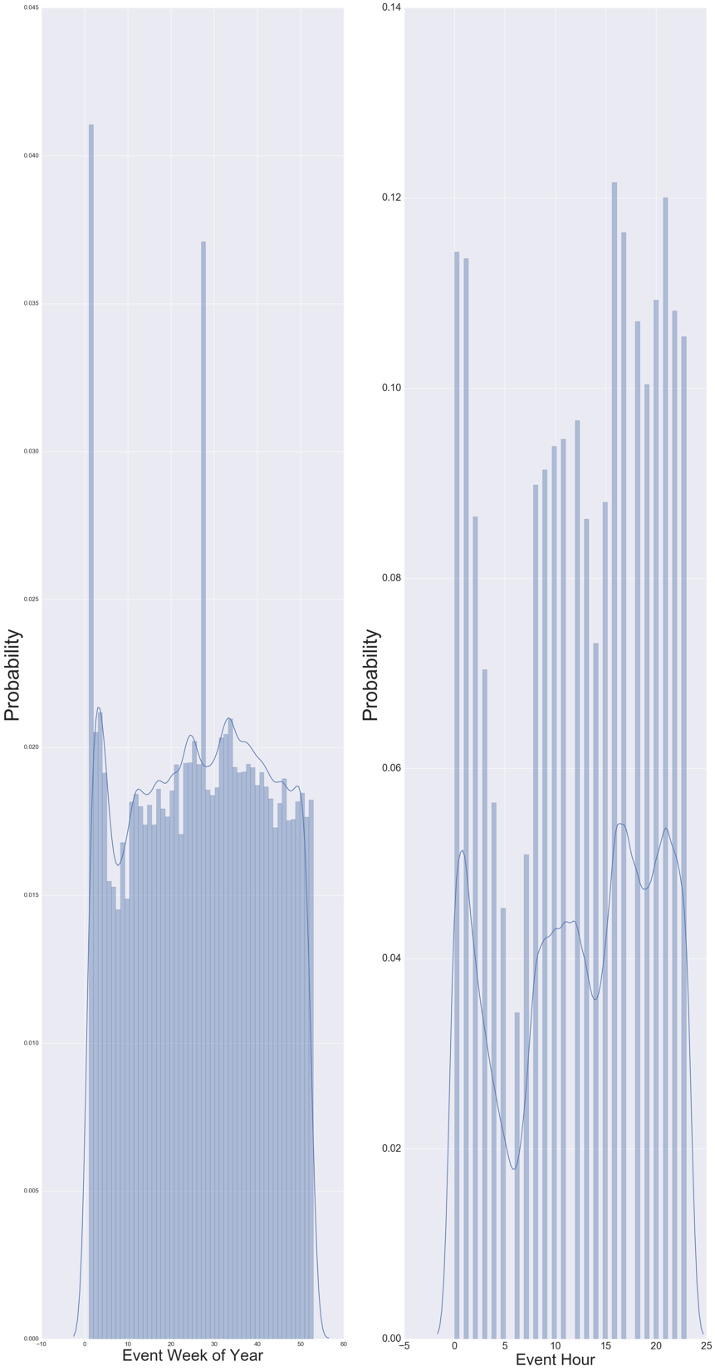
Analysis of Stop and Search
1
2
Chronological distribution
Key findings
The number of stop and search is relatively high in the beginning and the middle of the year within one year
The number of stop and search is relatively high at the night time within one day

Slide 22
Analysis of Stop and Search
1
Subject picture

Slide 23
311 CALLS EDA

Slide 24
Number of Issues by Issue Type (2012-2016)*
 | Issue Type | Number of Issues
1 | Code Enforcement General Request | 30907
2 | Street Light | 29515
3 | Trash/Garbage Pickup | 22091
4 | Residential Recycling Programs | 18468
5 | Abandoned Vehicle Reporting/Removal | 17205
6 | Large Item Trash/Garbage Pickup | 13041
7 | Pothole/Roadway Surface Repair | 12935
8 | General Service Request | 8924
9 | Street Flooding/Drainage | 8742
10 | Illegal Dumping Reporting | 7701
 | Issue Type | Number of Issues
11 | Tree Service | 5452
12 | Traffic Sign | 3066
13 | Traffic Signal | 2968
14 | Rodent Complaint | 2710
15 | Catch Basin Maintenance | 2501
16 | Sidewalk Repair | 2231
17 | Subsidence | 1879
18 | Mosquito Control | 1824
19 | Tree Service Emergency | 1636
20 | Tree Maintenance | 1208
* Limited to Top 20 Issues by number of calls

Slide 25
Analysis of 311 Calls
1
2
Year over year comparison of Issues
Key findings
Calls about “Street Light” issues is on the decline since 2013
“Abandoned Vehicle Reporting/Removal” has been steadily increasing YOY

Slide 26
