Slide 1




NEW ORLEANS POLICE DEPARTMENT
Reducing Violent Crime Through Analytics
March 6th, 2017

Slide 2







Carnegie Mellon University
Ronak Saradhi
Niteesh Reddy
Xinyao Li
Christina Gan
Karthik Balasubramanian
Nikhil Agarwal
Tim Zak
Project Advisor

Slide 3

New Orleans Police Department
Benjamin N. Horwitz
Director of Analytics at New Orleans Police Department
Paul Noel
Eric Melancon
Preston Bax
Deputy Superintendent
Field Operations Bureau
Deputy Chief of Staff for the Superintendent
Detective Investigative Unit Lieutenant, 4th District
Chris Hart
Caesar Ruffin
Hans Ganthier
Frank Young
Lieutenant TIGER Unit
Commander
4th District
Commander
1st District
Commander
5th District

Slide 4



Advisory Board
Tony D’Abruzzo
Alexandra Chouldechova
Edson R Severnini
Crime Analysis Program Technology and Training Coordinator
NYS Division of Criminal Justice Service
Assistant Professor of Statistics and Public Policy
Carnegie Mellon University
Assistant Professor of Economics and Public Policy
Carnegie Mellon University

Slide 5
Agenda
Introduction
Data Analysis
Results
Next Steps

Slide 6
Background
The New Orleans Police Department (NOPD) is part of the DOJ’s Violence Reduction Network that aims at reducing the outbreak of violent crime and allocate resources effectively when tackling violent crimes
Reduce Violent Crime
Proactively conduct stops and searches
Quality of life issues as indicators of violent crime
Where should stops happen?
How many stops should happen?
What actions should be taken?
Do quality of life issues impact violent crime?
What are leading indicators of violent crime?

Slide 7



Road Map
Descriptive Analysis
Predictive Analysis
Raw Data Sets
Preliminary Analysis
Outcome
Calls for service
Stop and search
311 calls (Quality of Life)
Identify crime prone areas
Identify quality of life indicators
Impact of stops and searches on violent crime
To be implemented..

Slide 8
Agenda
Introduction
Data Analysis
Results
Next Steps
Notes:
CHECK slide numbers

Slide 9

Data Manipulation
2014 - 2016
Raw Data
Stop and Search
Calls for Service
Qualify of Life
Crime Type / Disposition
Violent Crime/Reports to Follow
Violent Crime
Top 2 locations with the highest violent crime

Slide 10
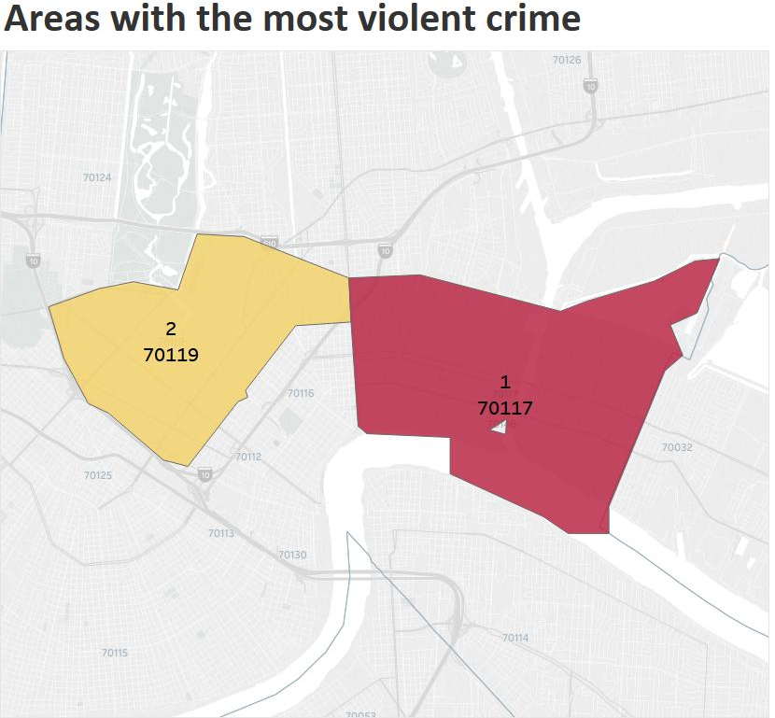
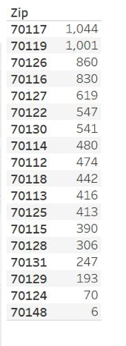
Data Exploration
Total crimes
8879

Slide 11
Methodology – Quality of life
A QOL Indicator
Create Date - T
Create Date
T
Closed Date
Closed Date + T
Time
Number of Crimes
Number of Crimes
Number of Crimes
Comparison (Mean / 95% CI)

Slide 12
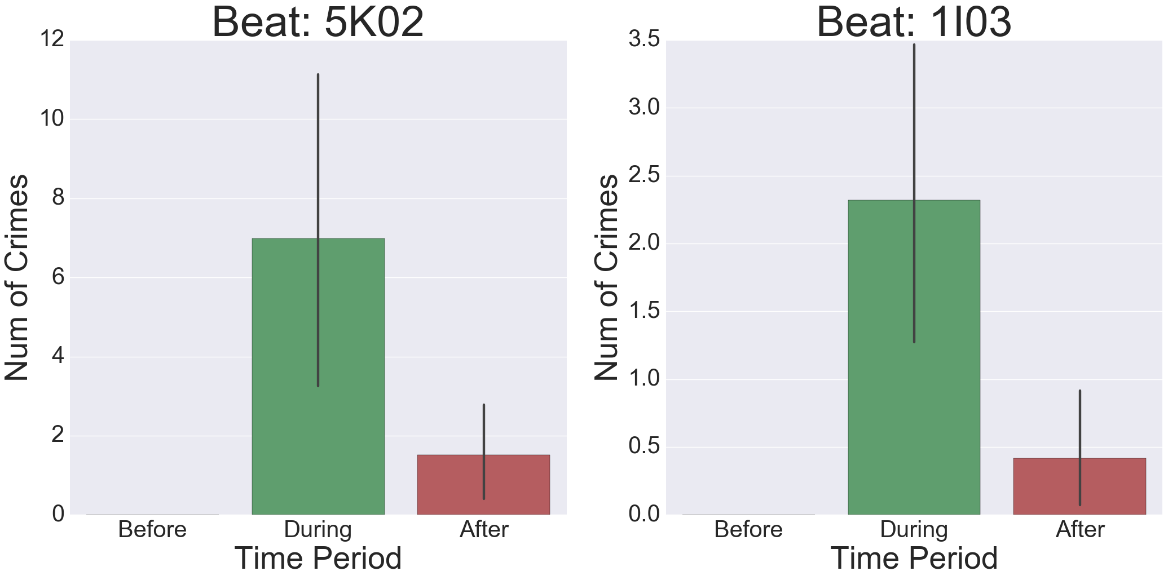
Abandoned Vehicle Reporting
Key Findings
Violent crime significantly increased when issue was open &
significantly decreased after issue was fixed

Slide 13
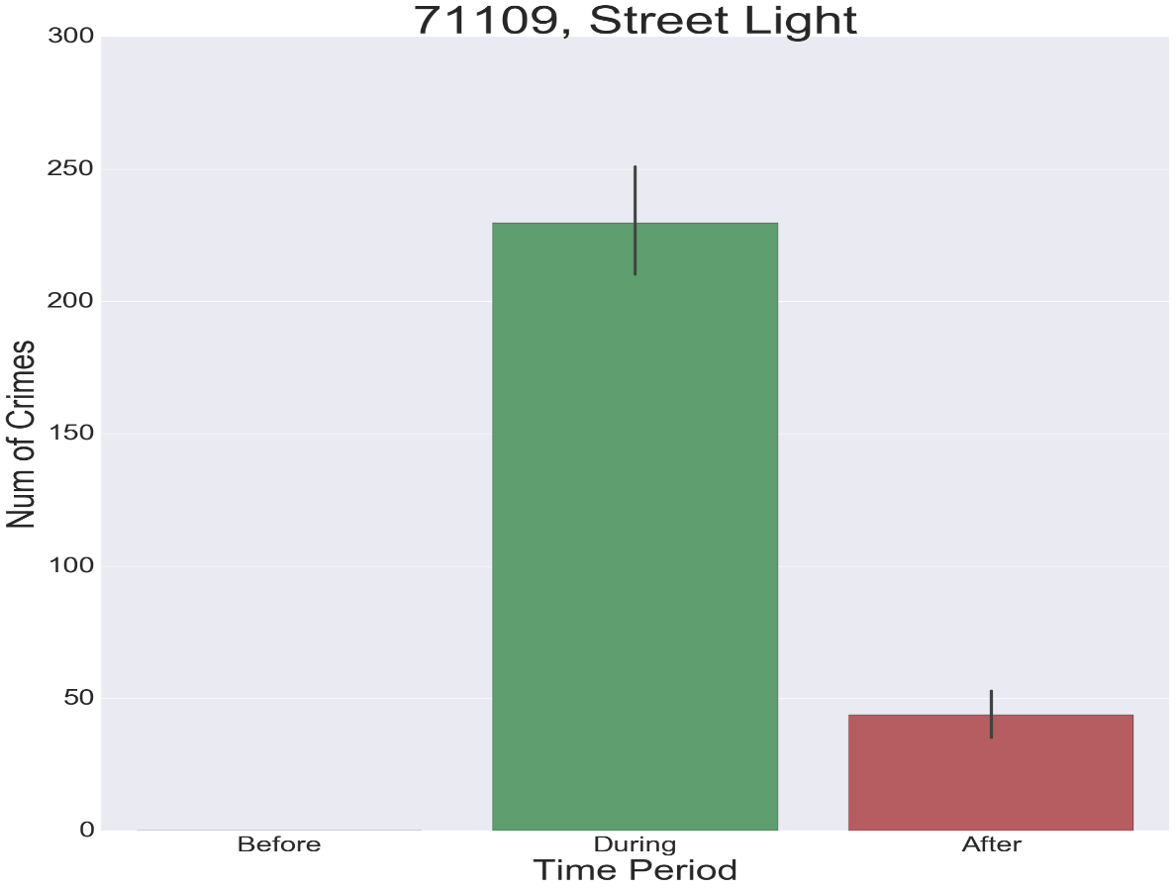
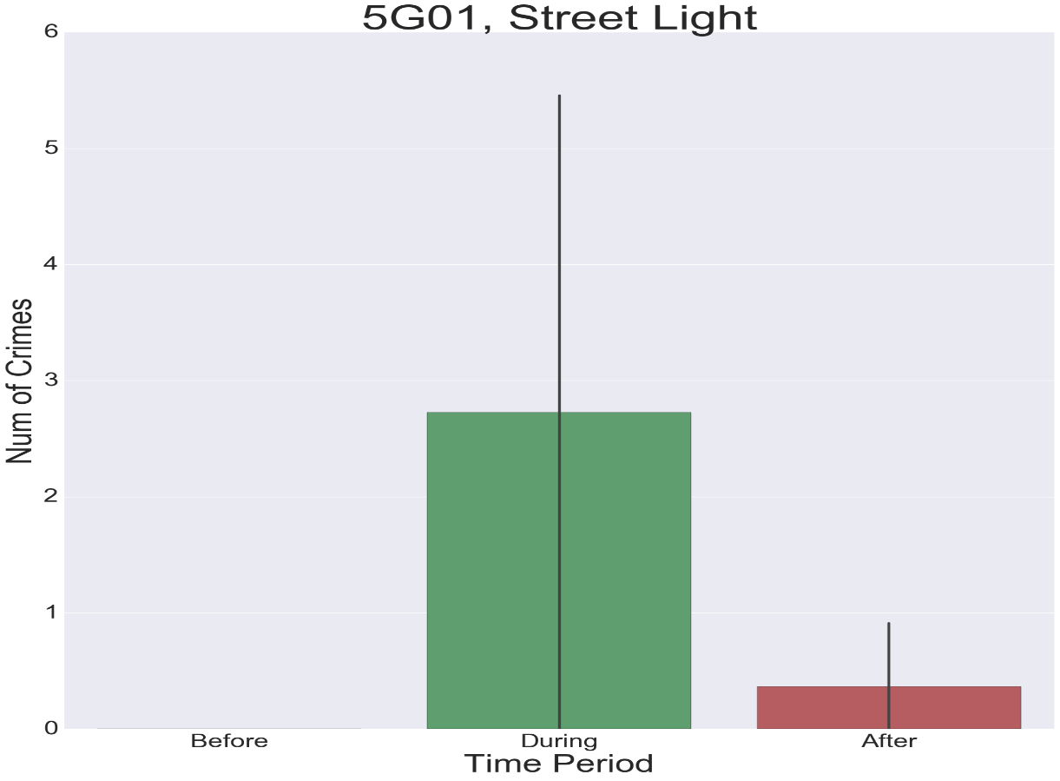
Street Lights (Zip Code vs Beat)
Key Findings
Zip level analysis gives significant results
Beat level analysis doesn’t give significant results

Slide 14
Quality of Life Analysis
Zip Code | Beat | Total Crimes | Quality of Life Issues
70117 | 5G02 | 79 | Residential Recycling Programs
 | 8F04 | 73
 | 5G01 | 59 | Code Enforcement General Request
 | 5E01 | 58
70119 | 5K02 | 80 | Trash/Garbage Pickup Abandoned Vehicle Reporting/Removal
 | 1I03 | 60 | Abandoned Vehicle Reporting/Removal Street Flooding/Drainage
 | 1K01 | 50
 | 1C02 | 47

Slide 15
Methodology - Stop and Search
Stops & Searches vs Crimes
Stops Window
Crimes Window
Time
Number of Stops
Number of Crimes
Comparison (Mean / 95% CI)
Notes:
Mention key findings next to graphs for SNS and QoL

Slide 16
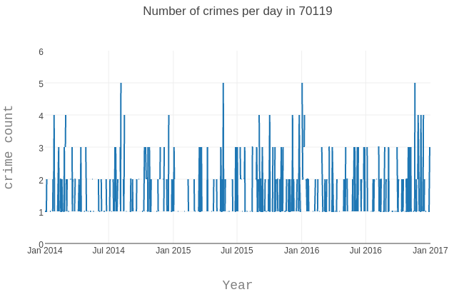
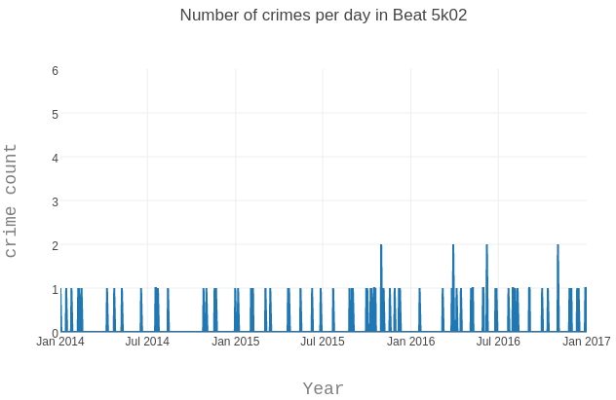
Distribution of Crimes (Zip vs Beat)
Key Findings
Number of crimes in beat level are few and hence analysis on beat level will be skewed
Notes:
Mention key findings next to graphs for SNS and QoL

Slide 17
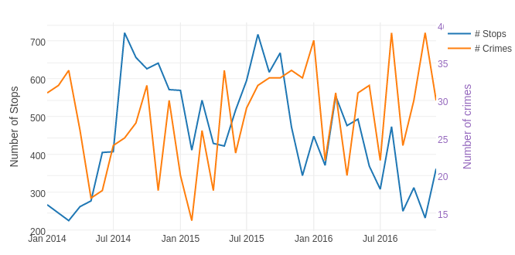
Stop and Search vs Crime
Key Findings
Beat level analysis is difficult
Stops and searches may attribute towards Violent crime reduction

Slide 18
Agenda
Introduction
Data Analysis
Results
Next Steps

Slide 19
Results
Despite the limited data points, we can still find QOL indicators that impact violent crime for certain beats
Stops and searches could reduce violent crime
These findings will form the basis for future analysis

Slide 20
Challenges
Challenges
Actions to be taken
Missing/limited data
NOPD side
Tackle missing data
Data might lack important indicators of violent crime
Lack of domain knowledge
Data amount/dimensions -> inconsistent results, high variance
Generate beat info for 2012-2013 to increase data points
CMU side
Notes:
Limited Data – as we have one in on granular level of beats, we might be having large SE
Insufficient beat data for low level location based analysis

Slide 21
Agenda
Introduction
Data Analysis
Results
Next Steps

Slide 22
Future Road Map
Descriptive
Analysis
Predictive
Analysis
Raw Data Sets
Preliminary Analysis
Outcome
Calls for service
Stop and search
311 calls (Quality of Life)
Identify crime prone areas
Identify quality of life indicators
Impact of stops and searches on violent crime
Models to tackle violent crime
Model performance evaluation
Results of advanced analysis

Slide 23
Next Steps
Extend analysis based on current results
Use machine learning techniques to build different models
Select metrics to evaluate model performance
Run the model on live data!
Known desired output values
Input :
Time info
Geographic info
Violent Crime info
Output :
Number of stops
Location of stops
Action taken on stops
Priority of quality of life issues
Model
Notes:
Extend analysis based on prior results to all other beats, and all other quality of life issues
Using machine learning techniques, build different models to tackle specific Violent Crime issues

Slide 24




Tools
Github
Coding & Analysis
Collaboration
Visualization

Slide 25

Q&A
THANK YOU!
Notes:
The image gets pixelated when viewed on large screen

