Slide 1
New Orleans Police Department
Reducing violent crime through analytics

Slide 2
PROBLEM STATEMENT
Goal
To build a model that helps reduce violent crime by improving the responsiveness to emergency calls, by proactively identifying violent crime, and by improving the efficiency of stops and search, thus improving resource allocation.
1
2
Background and context
Stakeholders
The New Orleans Police Department (NOPD) has large amounts of Open Data on crime, quality of life issues, etc.
The NOPD currently does not have a framework in place that utilizes this Open Data to help reduce the occurrence of violent crime
New Orleans Police Department
Other city departments
Heinz College
3
4
Criteria for success
Potential challenges
To have a model in place that analyses existing Open Data to identify violent crimes and effectively allocate the department’s resources
Identify metrics that correlate Quality of life issues to violent crime in the city
Missing/insufficient data
Difficult to accurately quantify certain indicators
5
Links and additional information
Data Analysis ( https://github.com/nikhilba/NOLA/ ):
All data, code, analysis and documents related to the project are available on GitHub
Data Source ( https://data.nola.gov/ ):
Analysis of data from year 2012-2016
Specific to: Call for Service, Field Interview, Quality of life

Slide 3
Logic Flow
Call for services
Stop and search
Quality of life issues
How the interview conducted of time prior impact violent crime in a subsequent time period
Unresolved life issues
Resolved life issues
QoL issues should be indicators of violent crime
Questions to answer
How the QoL issues resolved of time prior impact violent crime in a subsequent time period
Where Stop and Search Happen
Impact of Stop and Search
Action Taken

Slide 4
Stop & Search
Where stops and searches happen
Already happened – visualized the geographic distribution of stop and search
Should happen - visualized the geographic distribution of violence crimes
2. Impacts of stops and searches
The correlation between stop & search and violence crimes
The impact of stop & search on crimes (next step)
3. Actions taken analysis (Next step)
The correlation between stop & search with effective actions and violence crimes
The impact of effective stop & search on crimes
“Good” stop and search prediction and factor exploration

Slide 5
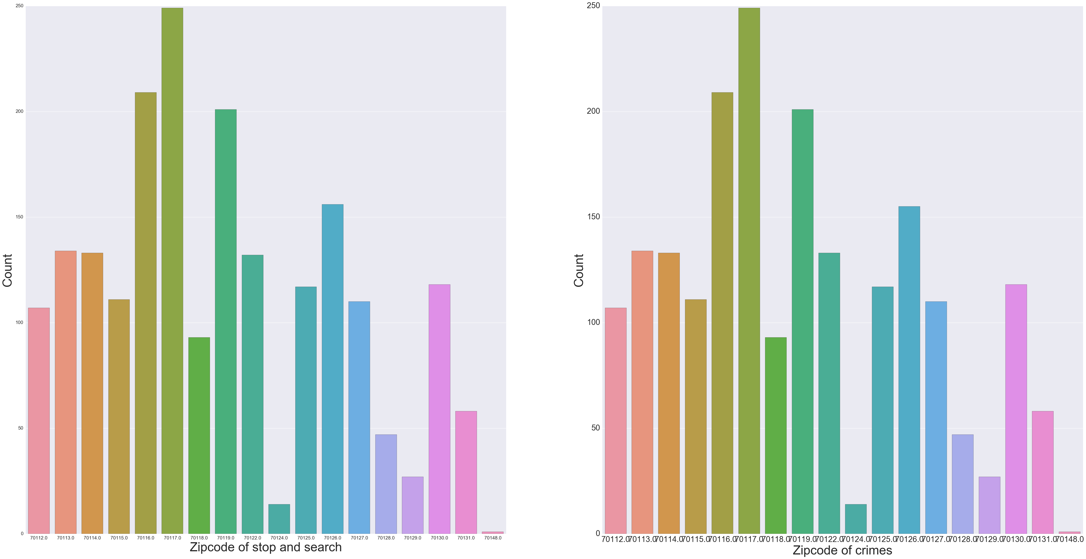
Stop & Search - Where stops and searches happen
Geographic distributions of crimes and stops & searches are consistent

Slide 6
Stop & Search - Impacts of stops and searches
T1
T2
T3
Time
Time Frame
Time Window
Current
effects
Lag
effects
The number of stop & search
The number of crimes
Correlation

Slide 7
Stop & Search - Impacts of stops and searches (Cont.)
 | Time Frame | Time Window | Correlation Coefficient
1 | Month | Month | 0.747
2 | Month | Half a month (2 weeks) | 0.863
3 | Month | A week | 0.899
4 | Half a month | Half a month | 0.792
5 | Half a month | A week | 0.839
6 | Half a month | A day | 0.832
7 | A week | A week | 0.517
8 | A week | A day | 0.423
Positive correlation between crimes and stops and searches
All strong correlation (>0.75) except 1, 7, and 8

Slide 8
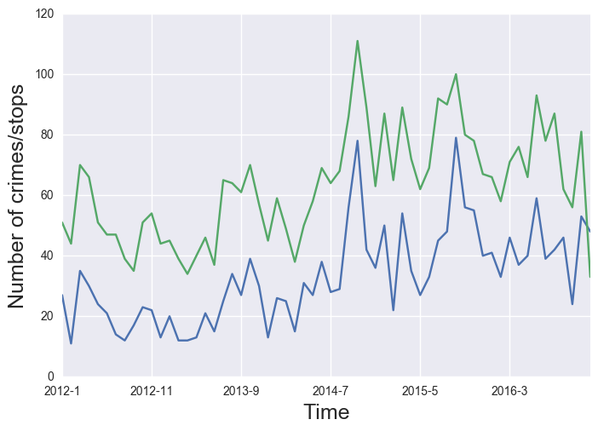
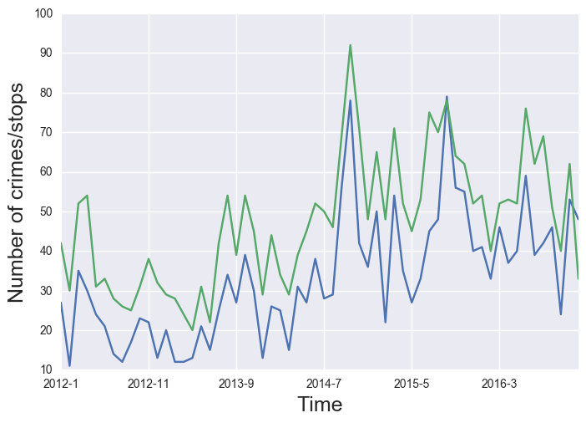
Stop & Search - Impacts of stops and searches (Cont.)
A month + half a month, Correlation - 0.863
A month + a week, Correlation - 0.899

Slide 9
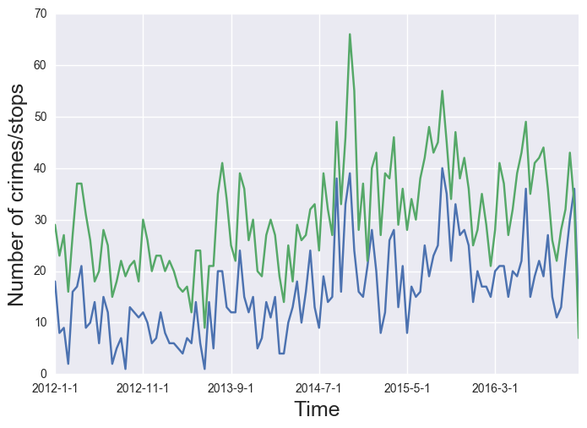
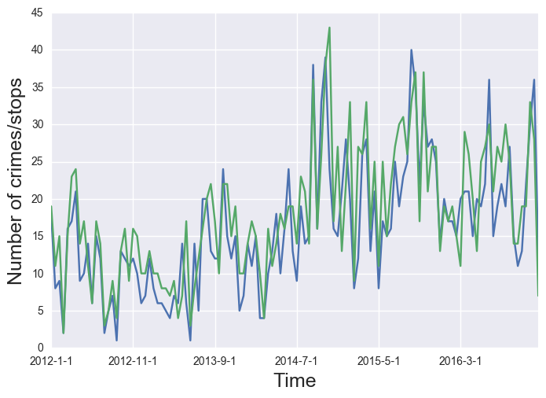
Stop & Search - Impacts of stops and searches (Cont.)
Half a month + a week, Correlation - 0.839
Half a month + a day, Correlation - 0.832

Slide 10
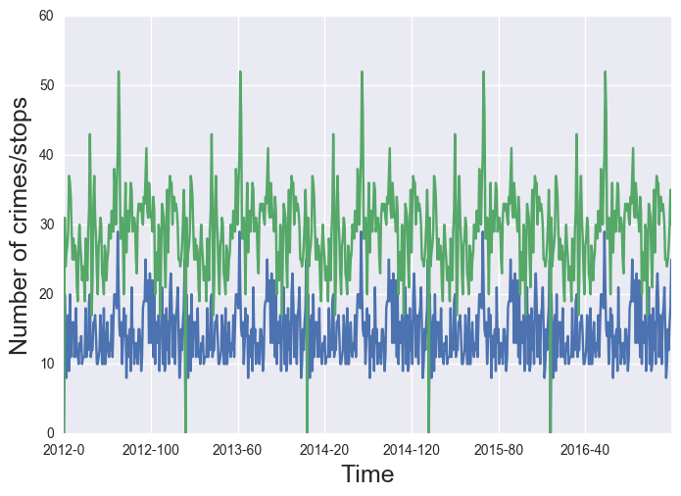
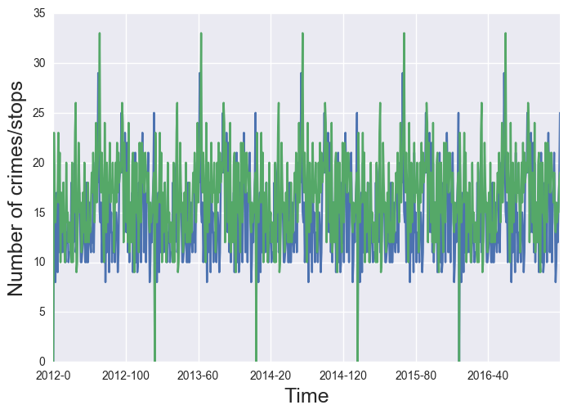
Stop & Search - Impacts of stops and searches (Cont.)
A week + a week, Correlation – 0.517
A week + a day, Correlation - 0.432

Slide 11
Stop & Search - Impacts of stops and searches (Cont.)
Next step –
Fix the time frame and the time window
Aggregate data including other variables by the frame and the window and then build a regression model
Check the model coefficient of number of stops and searches (size & significance)
Make predictions

