Slide 1
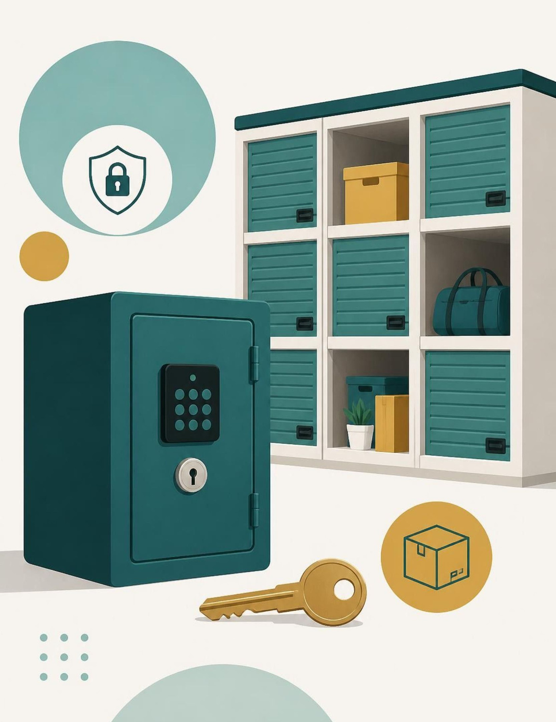

ACADEMIC YEAR 2026–2027
RentSphere
Peer-to-Peer Asset Rental & Micro-Storage Management System
Object-Oriented Technology Lab Project
Team Members:
Mohammed Faaris Khan 2664
Ketan Naik 2623
Nikhil baiju 2665
Deepak Devan 2616
Notes:
Good morning everyone. Today, we are presenting RentSphere, a peer-to-peer asset rental and micro-storage management system developed for our Object-Oriented Technology lab project.

Slide 2
The beginning
Introducing RentSphere
Bridging idle capital and temporary utility through a single verified platform.
Idle Assets & Storage
RentSphere Core
Verified Utility
Underutilized personal goods and empty storage slots sit unused.
Central platform coordinates listings, reservations, and state control.
Renters gain affordable short-term access without full ownership.
Asset Rental Flow
Micro-Storage Flow
Asset Owner → RentSphere Engine → Verified Renter with explicit lease tracking.
Space Owner → RentSphere Slot Allocator → Temporary Storage User.
Notes:
The main idea behind RentSphere is that some people have assets or storage spaces that they are not using, while other people need them temporarily.
For example, someone might need a camera for a day but may not want to buy one.

Slide 3
CHALLENGES & OBJECTIVES
The Problem We Want to Solve
Core Project Objectives
Current Operational Challenges
  Organize assets and storage spaces.
  Track availability and reservations.
  Model the rental lifecycle with clear state transitions.
  Apply Java OOP for maintainable software.
  Validate operations and handle invalid requests.
  Hard to discover suitable assets or storage.
  Unclear availability and rental status.
  Manual booking and contract tracking.
  Risk of inconsistent rental operations.
  Returns and inspections must be managed.
Notes:
There are several challenges in the rental process. It can be difficult to find suitable items, check their availability, and track bookings manually.
Manual tracking can also cause confusion about reservations, returns, and inspections.
Our objectives are to organize assets and storage spaces, track availability, manage reservations, and use Java object-oriented programming to structure the system.

Slide 4
FUNCTIONAL SCOPE
Core Features
Core modular capabilities designed for deterministic rental operations.
01
02
03
04
05
Asset Listing
Availability Management
Reservation Management
Rental Lifecycle
Micro-Storage Management
Display rentable items.
Check whether an asset can be reserved.
Handle requests for available assets.
Reservation, active lease, return, and inspection.
Represent and manage storage slots.
END-TO-END USER JOURNEY
Browse
Select
Reserve
Rent
Return
Inspect
Notes:
RentSphere focuses on five main features: asset listing, availability management, reservations, rental lifecycle, and micro-storage. Users can browse and select items before making a reservation. After renting, the item is returned and inspected. These steps create an organized rental workflow.

Slide 5
LANDSCAPE COMPARISON
Where RentSphere Fits
Comparing verified competitor information with RentSphere’s implemented capabilities.
Platform | General discovery | Product rental | Storage management | Explicit lifecycle tracking
OLX | Yes, local classifieds to buy, sell and rent used goods | Limited: rent ads exist, mainly property | Not offered | No rental lifecycle (ad listings only)
SharePal | Browse by category and city | Yes: trekking and riding gear, cameras, consoles | Not offered (delivery and return model) | Not publicly documented
StoreSpace | No, it’s a B2B warehouse service | No | Yes: pay-as-you-go warehousing | Inventory tracking only (WMS), not a rental lifecycle
RentSphere (Proposed) | Peer-to-peer asset discovery | Product rental | Micro-storage management | 5 explicit states with validated transitions
Notes:
This slide compares RentSphere with platforms such as OLX, SharePal, and StoreSpace. These platforms focus on different areas, such as classified listings, product rentals, or storage services. RentSphere aims to combine asset rentals and micro-storage management. Our key idea is structured rental lifecycle tracking.

Slide 6
FINANCIAL SUSTAINABILITY
How RentSphere Could Generate Revenue
Theoretical monetization avenues for platform self-sufficiency.
Transaction Fee
Storage Cut
Discovery
Protection
Rental Commission
Storage Fees
Promoted Listings
Trust & Verification
Percentage-based platform fee deducted upon successful booking settlements.
Fixed platform slice per micro-storage time slot booked by users.
Optional paid search placement tier for owners seeking rapid bookings.
Optional security verification charge, subject to technical and legal feasibility.
Consider an item leased at a transaction value of ₹1,000. Under a hypothetical 10% platform commission, RentSphere retains ₹100 gross platform margin prior to hosting and infrastructure expenses. Presented purely for conceptual mechanism demonstration; no commercial figures or market projections assumed.
Notes:
RentSphere could generate revenue through several methods. These include rental commissions, storage fees, promoted listings, and optional verification charges. For example, a hypothetical 10% commission on a ₹1,000 rental would be ₹100. This is an illustration of the proposed business model, not actual revenue.

Slide 7
SYSTEM ARCHITECTURE
Technology stack
Presentation Layer ↓ | HTML5, CSS3 and JavaScript
Application Layer ↓ | Java SE 17+ with the built-in JDK HttpServer on port 8080. REST API with JSON.
Business Logic Layer ↓ | Asset lifecycle management; reservation validation; rental contracts; storage-slot management
Data Layer | Zero database. In-memory ConcurrentHashMap saved to pipe-delimited flat files in data/, with an append-only audit log.
Tech Stack Verification
Core Language: Java 17+
Application Framework: JDK HttpServer
UI Layer:Web UI (HTML, CSS, JS)
Database: Flat files, no H2 and no SQL
Notes:
Our system has four layers: presentation, application, business logic, and data. The frontend uses HTML, CSS, and JavaScript, while the backend uses Java. We use ConcurrentHashMap for in-memory data and flat files for persistent storage. Flat files simplify our prototype, while an SQL database is a possible future improvement.

Slide 8
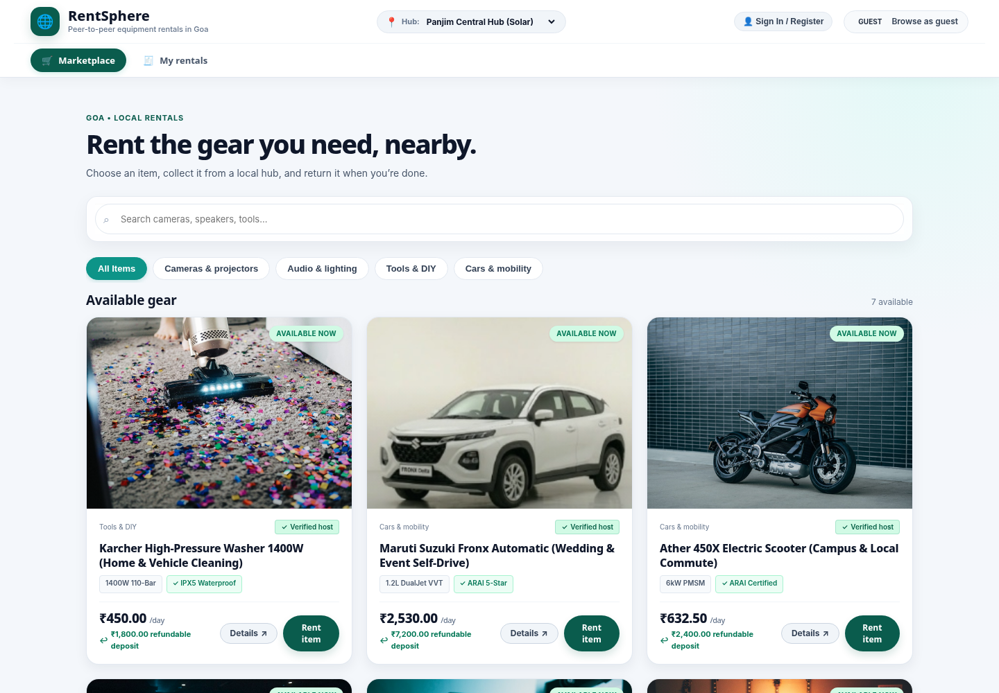
SYSTEM VERIFICATION & DEMO
RentSphere in Action
RentSphere Marketplace and Equipment Listing interface.
Notes:
This screen shows the RentSphere marketplace interface. Users can browse available equipment and select an item they want to rent. The system can check availability before a reservation. This is the first stage of our rental workflow.

Slide 9
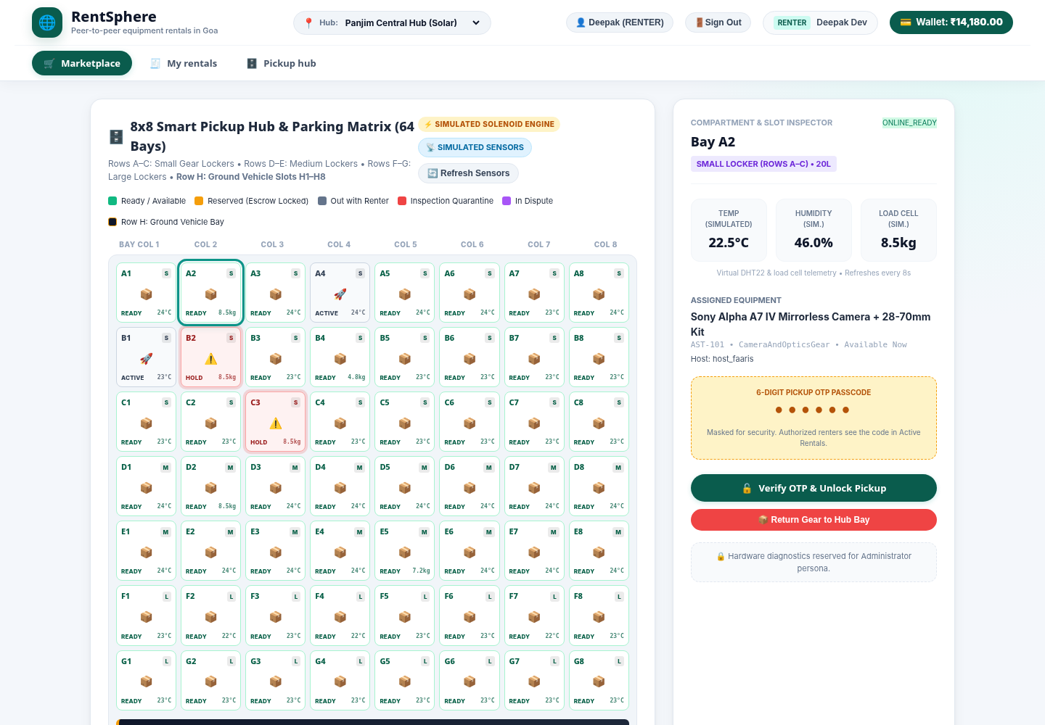
SYSTEM VERIFICATION & DEMO
RentSphere in Action
RentSphere 8×8 Smart Pickup Hub and Parking Matrix.
Notes:
This screen shows an 8×8 matrix representing pickup or storage slots. It provides a structured way to visualize different locations. Such an arrangement can help organize storage allocation. It demonstrates RentSphere's micro-storage concept.

Slide 10
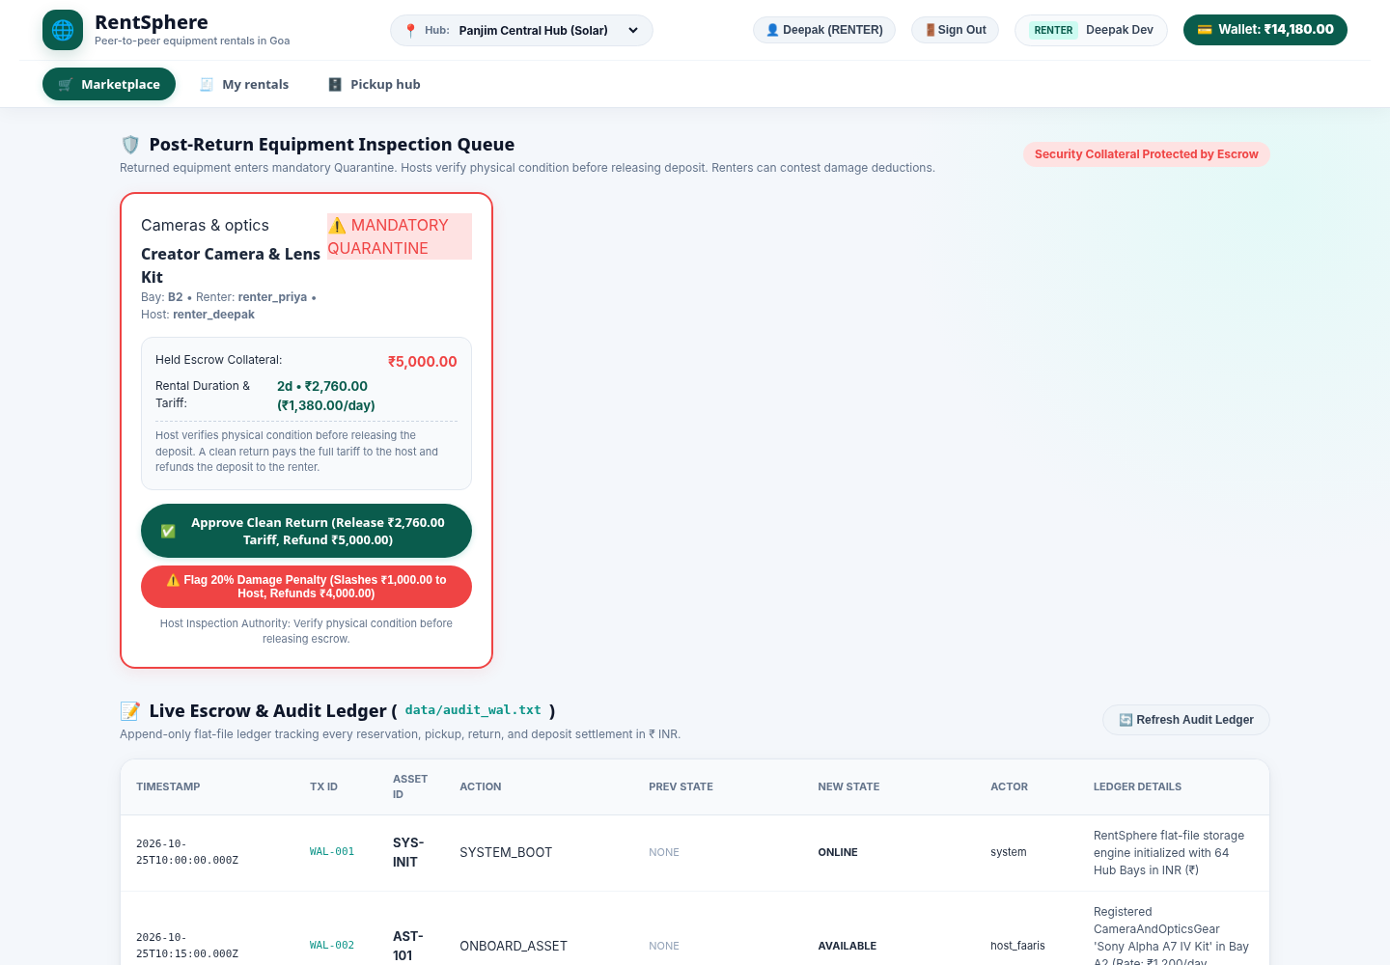
SYSTEM VERIFICATION & DEMO
RentSphere in Action
RentSphere Post-Return Inspection, Escrow and Audit Ledger interface.
Notes:
This screen demonstrates post-return inspection, escrow concepts, and the audit ledger. Inspection helps check an item's condition after it is returned. Escrow refers to holding payment until agreed conditions are met. The audit ledger helps record important rental operations.

Slide 11
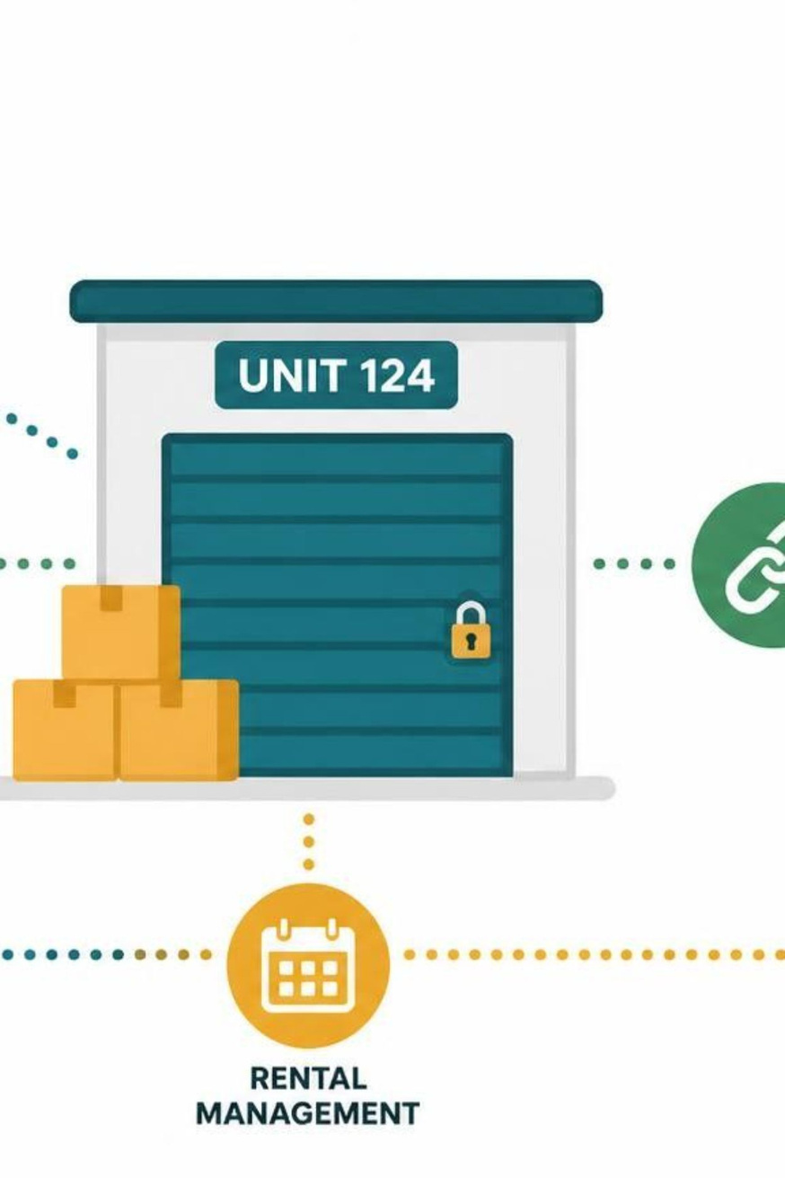
CONCLUSION & FUTURE SCOPE
From Asset Sharing to Structured Rental Management
RentSphere implements a asset rental and micro-storage platform. Java OOP structures users, assets, contracts and rental operations.
FUTURE SCOPE
  Real payment gateway
  SQL database for scale
  Native mobile app
  Multi-hub network
  Aadhaar / DigiLocker KYC
Notes:
RentSphere aims to make asset rental and micro-storage management more organized. Java OOP helps structure the assets and rental operations. Future improvements could include an SQL database, real payment integration, and a mobile application. We could also add multiple hubs and identity verification.

Slide 12
Thank you

