Slide 1
PWR CONN
VCC_3V3
LDO – 4V
VCC_4V0
LDO – 3.3 V
VCC_3V3
TM66FA-04-STDN (Quectel)
3V3 – 5V
BIDIR BUFF
SPKR, MIC, DBG AND AUX UART
EXT CONN HEADERS
12 PIN (6*2)
SIM SIGNALS
SIM CARD (PLACED ON HOLDER)
BLUETOOTH ANT
GSM ANTENNA
3V3 – 5V
BIDIR BUFF
MAIN UART (AT COMM)
DM, DP
TYPE C USB CONN
USB 5V0

Slide 2
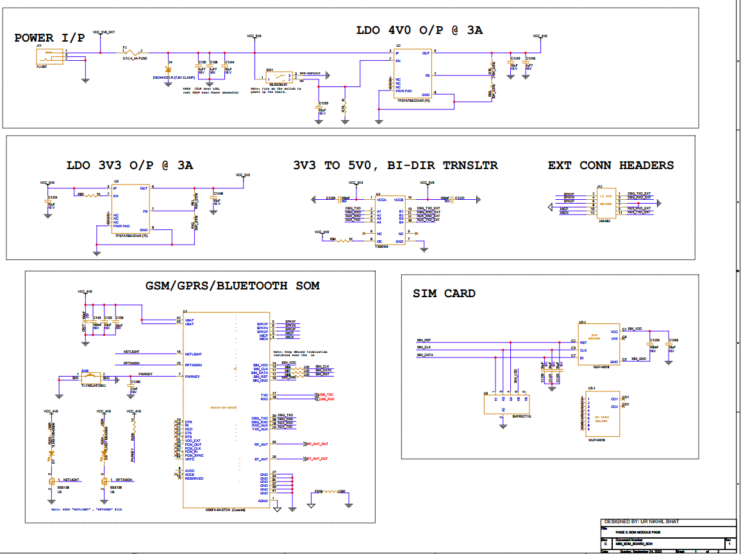

Slide 3
