Slide 1
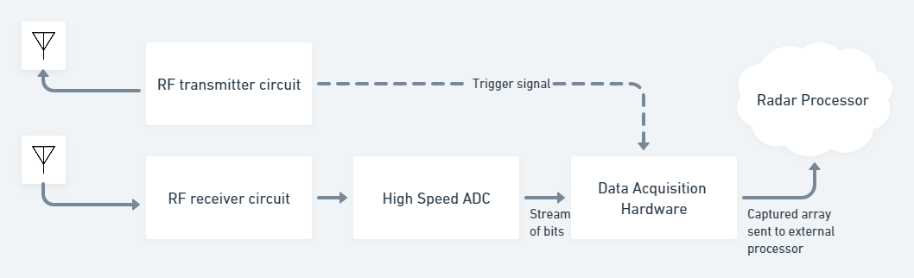
Problem statement for Hardware Design Engineer
A company uses a Radar Antenna, and they are required to constantly record variations in distance and velocity of the scene from the antenna’s field of view. For this Purpose they design their requirements of operation of the Radar in the following way
The Radar sends out a pulse of time duration 100μs through the transmitting antenna and receives the reflected pulse signal through receiver antenna and repeats this transmission every 10ms.
The Radar has a high-speed ADC that samples the data at a rate of 1 GSPS/second and sends out an output stream of bits through 8 LVDS output channels.
The Radar also sends a level trigger during the period of time the pulse is being transmitted.
Since ADC only outputs a stream of data bits, the data acquisition system must use the help of this trigger to identify when the signal is starting to be captured.
Each received pulse being captured will be stored as a 1-D array of 16-bit data.
The system once started will be constantly in operation for a period of 30 minutes.

Slide 2
Tasks:
Design a block diagram level architecture for the Data Acquisition Hardware that can satisfy the functional requirements of the system and give out a hardware specification sheet. Hint: Choose required memory, processor/FPGA/SoC, interfaces, etc. give justification if we would require an ASIC.
Scout for block level or circuit level components after the design architecture is made and create a BOM (bill of materials).
Justify the adaptability and interoperability of the chosen components/blocks
Briefly describe how the board will be configured/programmed to meet the desired functionality.
Kindly present these tasks in a PPT format with required architecture, block diagram, etc.
The Deadline for completing the task is 3 days (by the end of 12th August starting from today)

Slide 3
BLOCK DIAGRAM
DAC
FPGA:
1 DB ATTN
LNA
22.1 dB.
2X
800 Mhz
50 ohm SMA CONN
GTX
JESD 204B
1 GB
RAM
Fs: 2400 MSPS
ADC
JESD 204B
64MB
QSPI NOR
LIMITER
LNA
22.1 dB.
800 Mhz
50 ohm SMA CONN
SYSREF
Fs: 2400 MSPS
200 MHz
REFCLK
2400 MHz
200 Mhz LVDS OSC
LVDS 1:4 CLK BUF
LMX2592 CLOCK SYNTH

Slide 4
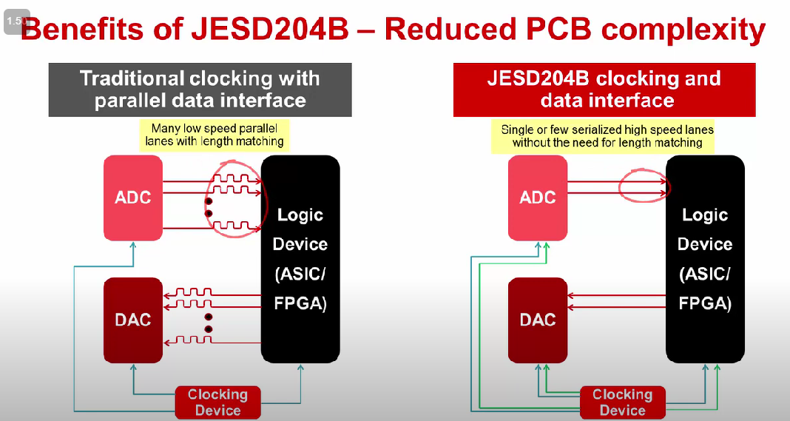
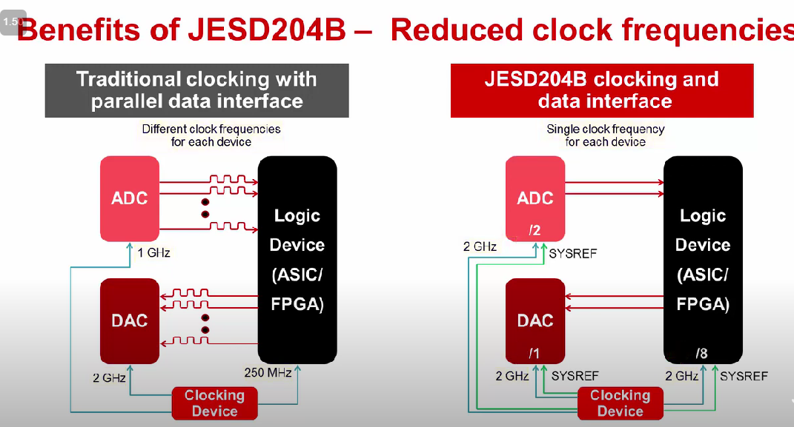
WHY JESD204B?

Slide 5
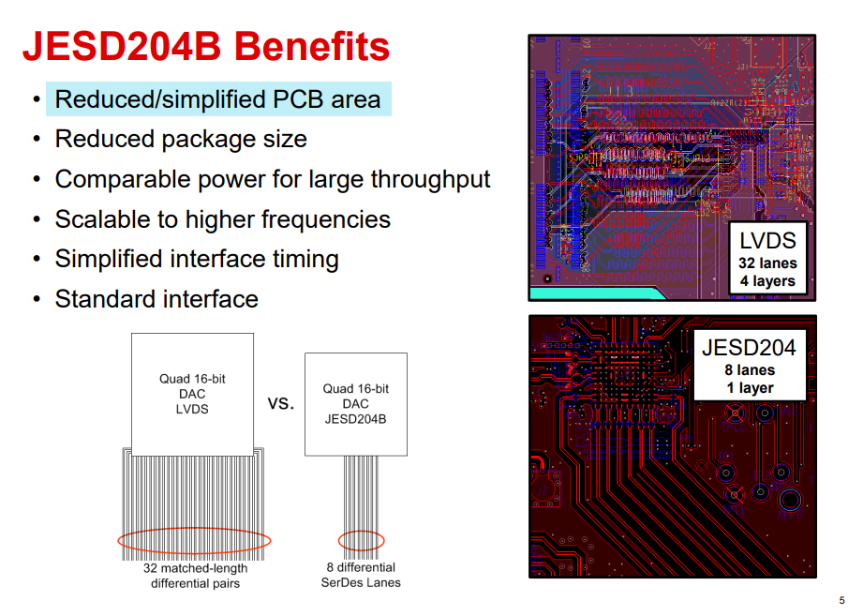

Slide 6
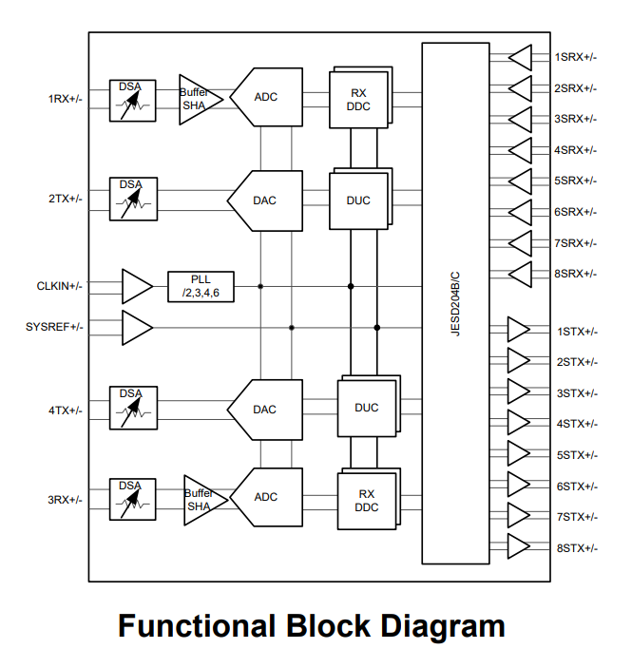
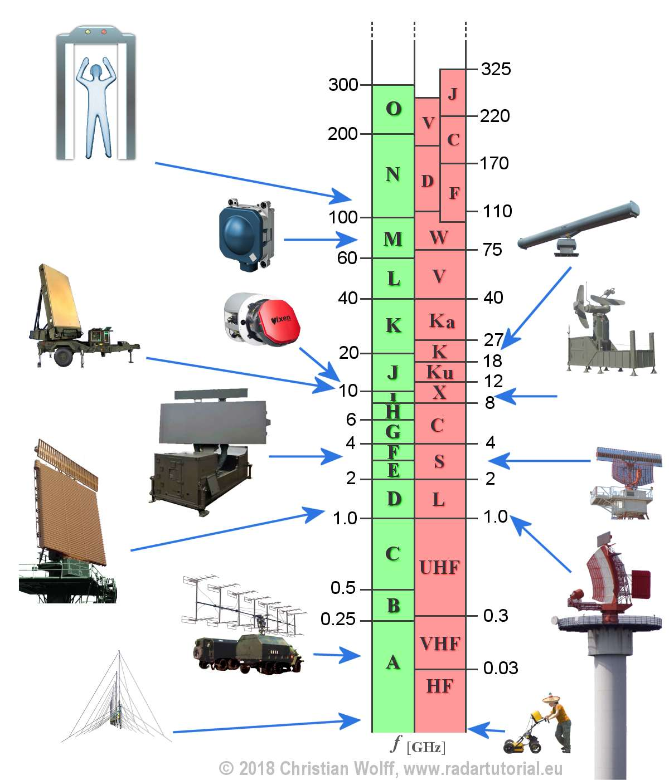
RF TRANSCIEVER: AFE7903IABJ
12 GSPS :Fs: DAC
3.0 GSPS :Fs: ADC
RF frequency range: 5 MHz - 7.4 GHz
Digital step attenuators (DSA):
TX: 40 dB range, 0.125 dB steps
RX: 25 dB range, 0.5 dB steps

Slide 7
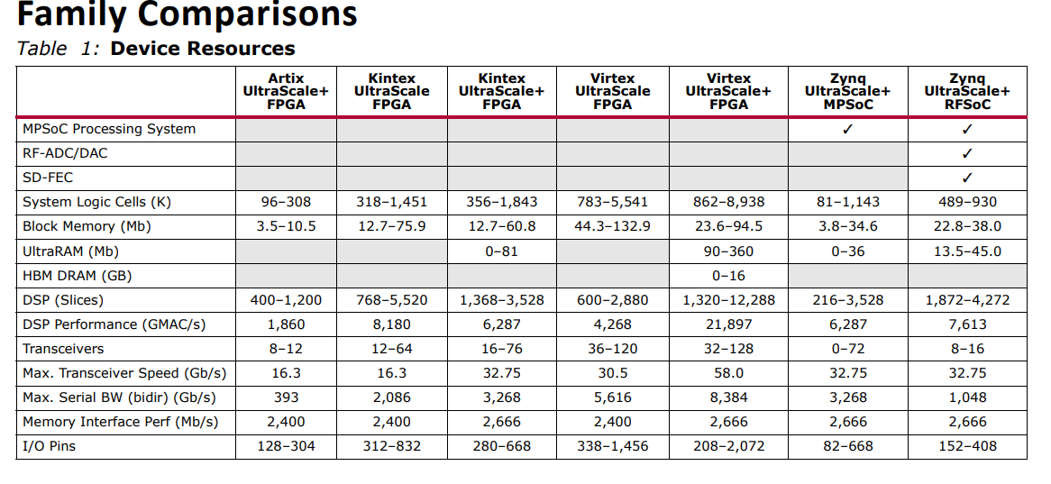
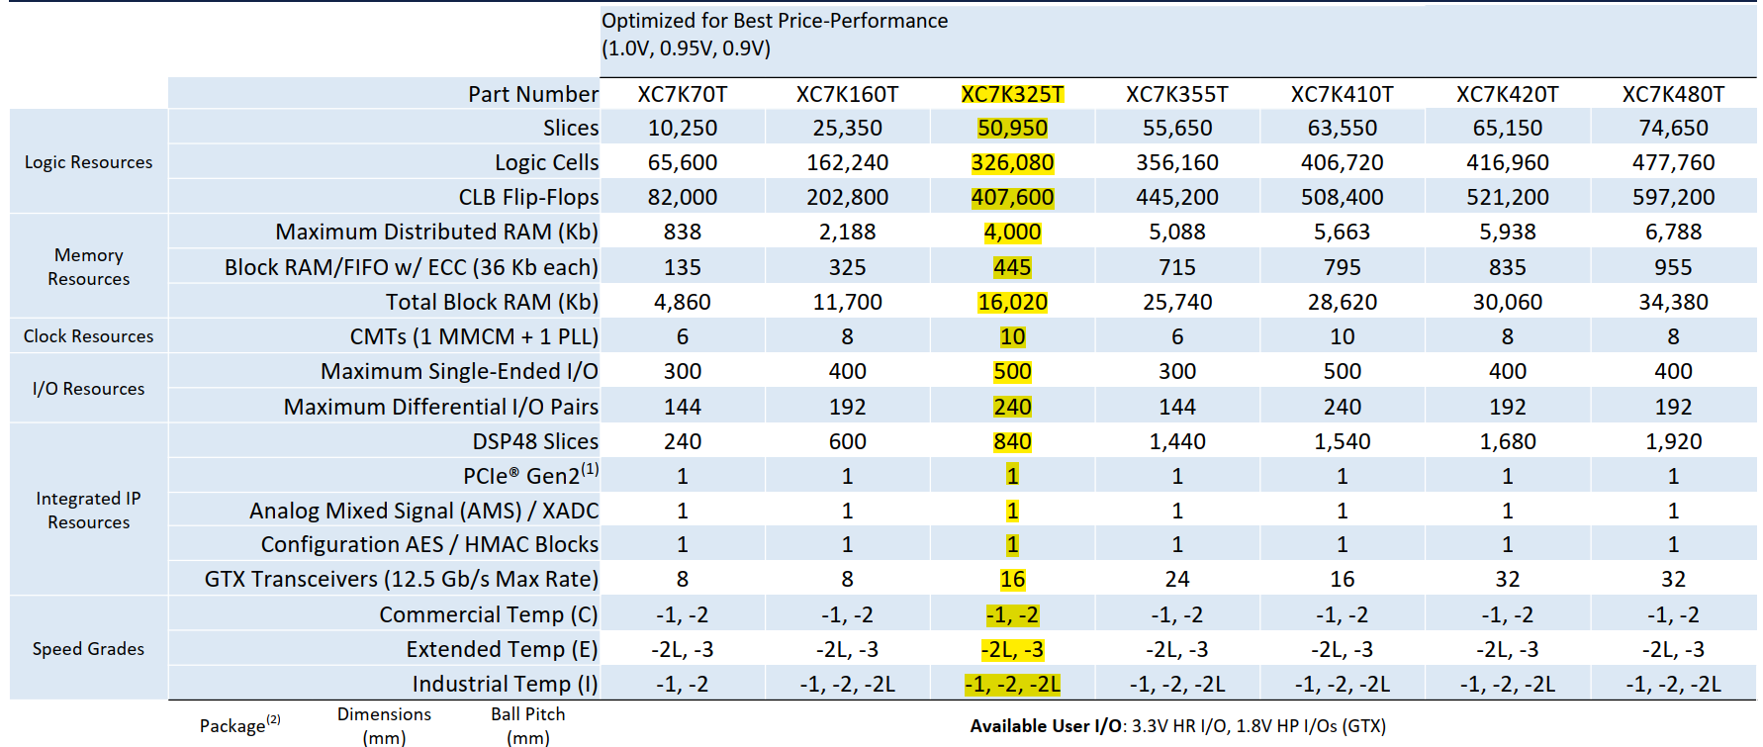
FPGA:
XCKU035-1FFVA1156C

Slide 8
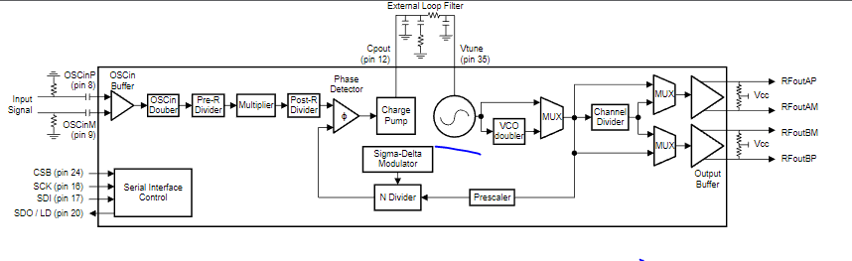
CLOCK SYNTH: LMX2592
Integrated VCO: Yes (Board Space savings)
Output frequency : 20 Mhz
Output frequency : 9800 MHz
Normalized PLL phase noise :-231 dBc/Hz

Slide 9
BOM (BILL OF MATERIALS)
SL No. | Description | Part No | Manufacturer | QTY
1 | FPGA | XCKU035-1FFVA1156C | Xilinx | 1
2 | RF TRANSCIEVER DUAL CHANNEL | AFE7903IABJ | TI | 1
3 | Clock Synth | LMX2592 | TI | 1
4 | MEMS OSC VCTCXO 200.0000MHZ LVDS | SIT5021AI-2BE-33VQ200.000000X | SiTime | 1
5 | DDR3L 4Gb (256M x 16) 96-FBGA | MT41K256M16TW-107 AIT:P | Micron Technology Inc. | 2
6 | IC FLASH 512Mb SPI 8WPDFN | MT25QL512ABB1EW9-0SIT | Micron Technology Inc. | 1
7 | RF Balun 4.5MHz ~ 3GHz 1:1 | MABA-007159-000000 | MACOM | 2
8 | Wideband LNA 0.5-8 Ghz, 22.1 dB | PMA3-83LN+ | Mini Circuits | 2
9 | RF Wireless Misc LIMITER / SURF MOUNT / RoHS | RLM-33+ | Mini Circuits | 1
10 | ATT 1 DB 50 OHM 0805 SMD | PAT1220-C-0DB-T5 | Susumu | 1
11 | Clock Drivers 1:4 Distribution | AD9508BCPZ | A.D | 1

Slide 10
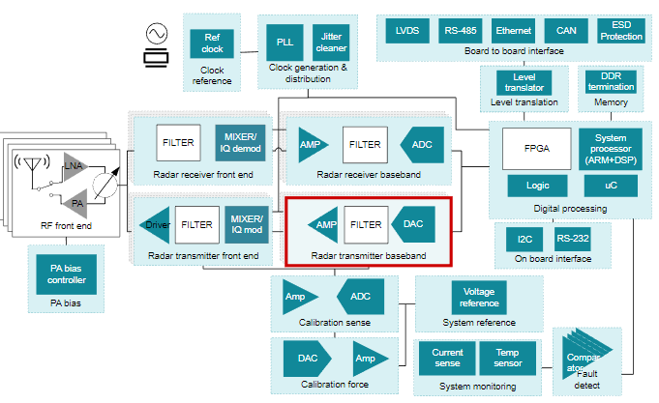
Q. Briefly describe how the board will be configured/programmed to meet the desired functionality.
RF transceiver: AFE7903 is a high performance, wide bandwidth multi-channel transceiver, integrating two RF sampling transmitter chains and two RF sampling Receiver chains. With operation up to 7.4 GHz, this device enables direct RF sampling in the HF, VHF, UHF, L, S and C-band frequency ranges without the need for additional frequency conversions stages. Also ADC, DAC Comes in a single chip saving Power, Cost, Design Complexity and Layout Area.
FPGA Chosen, Supports DDR3L memory.
FPGA has 16 GTX High Speed lanes (that can support JESD204B Interface, i.e the defacto standard b/w high speed data converters and FPGA). 8TX (for DAC) AND 8RX (for ADC) Lanes compromise 16 GTX Lanes. Xilinx provides a Comprehensive JESD204B IP Core.

Slide 11
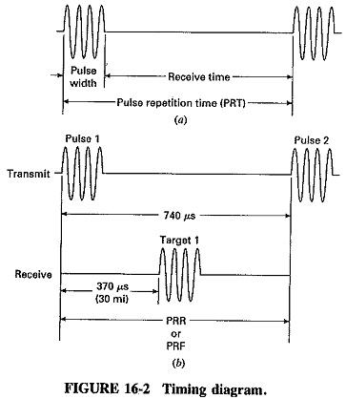
Clock Synthesizer is Chosen to Support Wide RF Clock Rates with Lowest Phase Noise.
Clock Divider is Chosen to Provide
A) SYSTEM Clock /DDR3 Reference Clock.
B) GTX BANK1 REFCLK.
C) GTX BANK2 REFCLK.
D) REFCLK For Clock Synthesizer.
RF Range of Operation: 800Mhz. Hence Data Converter Sampling frequency is chosen as 2400 MSPS so that signal is sufficiently up-sampled to keep Images far away from range of interest (1st Nyquist Band). Internal PLL isn’t used to Improve Phase Nosie, SNR Performance.
TX Output Power ( 20 to 40 dBm),
RX LNA ( 20 to 40 dBm), is need to keep Noise Figure of RX Path Low.
Pulse Width, Receive time, PRT Time and ADC/DAC On Chip Attenuator Can Be Programmed to Transceiver via SPI Interface of FPGA.
The System Designed is Highly Adaptable to Wide range of Sampling Frequency, Wide range of Input and Output RF Frequency.
2 Highly Directional Antenna With Rotating Disk is needed for knowing Angle of Target.

