Slide 1
StructNet - Structural Damage Identification of Infrastructure Building Using Computer Vision
Nikhil Bhide
November 2020

Slide 2
Construction Industry - Life Cycle
1
Architectural blueprint & Structural planning
2
Construction
3
Maintenance

Slide 3
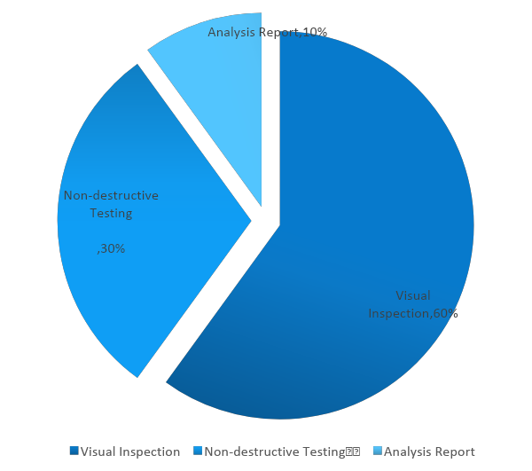
Motivation and Background
Drawbacks
Time-consuming
Labor intensive
Error Prone

Slide 4
Structural Auditing Process Stats
~2 months
Accuracy
55%
Average time
3 years
~10
Repeat
Staffing

Slide 5
Research Question
Can deep learning’s computer vision framework can facilitate more accurate visual inspection of structural auditing that can be performed on-demand and using much lower resources and in quicker time?

Slide 6
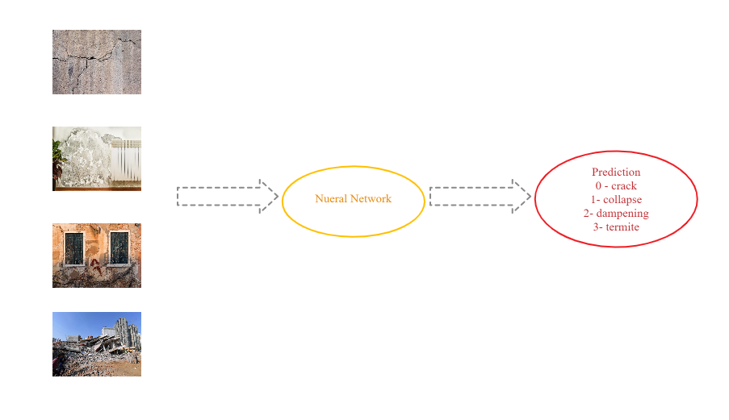
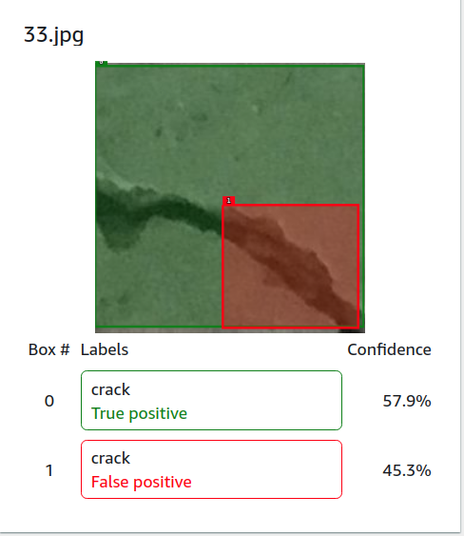
Bigger Picture
Automated classification of damage using Image Classification
Recognition of damage using bounding boxes

Slide 7
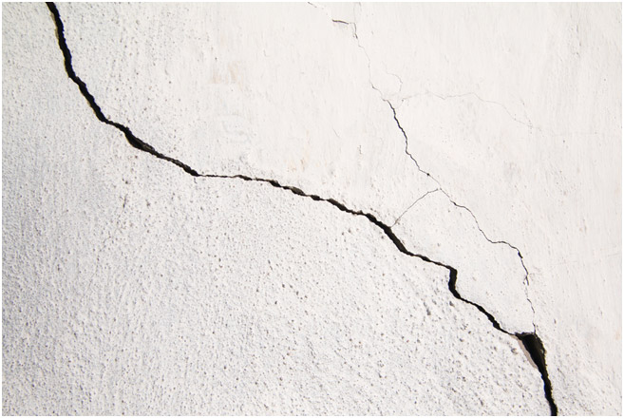
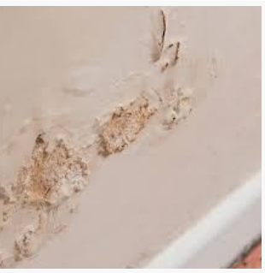
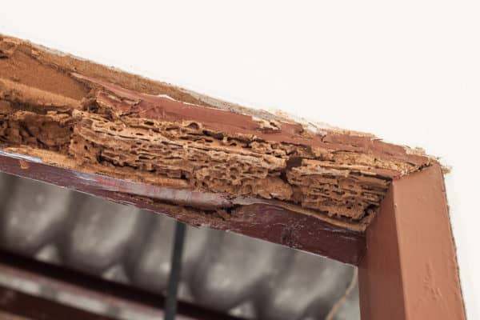
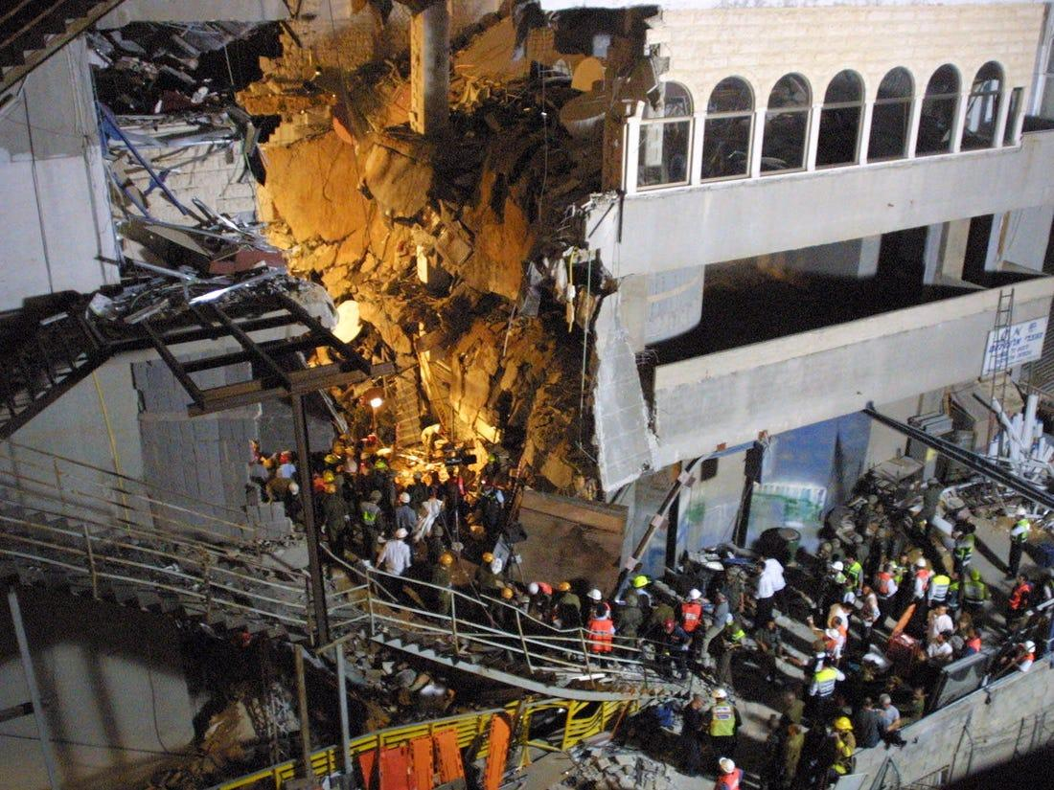
Structural Damages – Our Categories
Crack
Dampening
Termite
Collapse

Slide 8
Plan of Attack
Object
Recognition
Yolo – You Look Only Once!
Object Localization
Bounding Box Identification
Object Classification
Convolution Neural Network

Slide 9
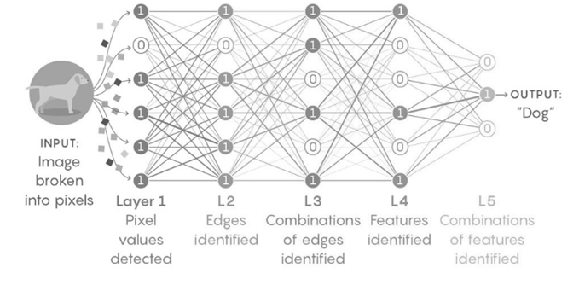
CNN Anatomy
Convolution Layer
Pooling Layer
Flattening
Fully Connected Layer

Slide 10
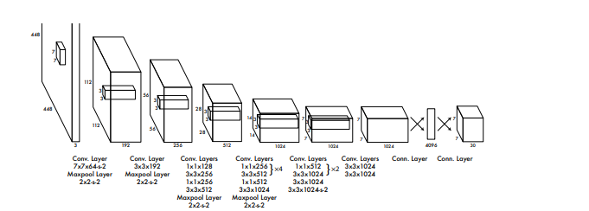
YOLO Anatomy
Bounding Box
Intersection over union
Anchor Boxes
Non-max suppression

Slide 11
Employed Algorithms
Custom Convolution Neural Network
VGG-19 Convolution Neural Network
ResNet50 Convolution Neural Network
YOLO – You Look Only Once

Slide 12
Methodology
Model Deployment
Data Collection
Model Evaluation
Data Processing
Feature Extraction

Slide 13
Object Classification - Results
Model | Training Error Rate | Test Error Rate
Custom CNN | 15% | 25%
VGG-19 | 4% | 8%
Restnet-50 | 2.5% | 3.5%

Slide 14
Object Recognition - Results
Model | Yolo V3
Precision | 0.8429
Recall | 0.7964
F1 score | 0.8189

Slide 15
Conclusion and Discussions
We achieved ~98% accuracy in classification and ~81% accuracy in recognition
Structural audit process can be performed on demand
Visual inspection part of the process is now fully automated

Slide 16
Future Work
Our algorithm cannot detect multiple objects in the same anchor box
For localization, we are not currently back-propagating through the whole network; it is supposed to improve the accuracy
IOU accuracy can be improved by optimizing the intersection-over-union (iou) criterion

Slide 17
Demo

Slide 18
Thank You

