Slide 1
CS F320 Foundations of data scienCe
Assignment-2 Presentation
Group 7
2016A4PS0248P Nikhil Agrawal
2016A4PS0609P Chinmay Garg
2016A4PS0021P Ruddhi Prasad Panda

Slide 2
Problem Statement
Train a model to predict occupancy in an office room, using a time-series data with variables :
Date-time year-month-day hour:minute:second
Temperature, in Celsius
Relative Humidity, %
Light, in Lux
CO2, in ppm
Humidity Ratio, Derived quantity from temperature and relative humidity, in kgwatervapor/ kg-air
Occupancy, 0 or 1, 0 for not occupied, 1 for occupied status

Slide 3
Datasets used
Dataset link:
http://archive.ics.uci.edu/ml/datasets/Occupancy+Detection+#
Dataset:
Occupancy_data.zip

Slide 4
Data Description
Training Data Details
'data.frame’: 8143 obs. of 7 variables:
$ data : Factor w/ 8143 levels "2015-02-04 17:51:00",..: 1 2 3 4 5 6 7 8 9 10 ...
$ Temperature : num 23.2 23.1 23.1 23.1 23.1 ...
$ Humidity : num 27.3 27.3 27.2 27.2 27.2 ...
$ Light : num 426 430 426 426 426 ...
$ CO2 : num 721 714 714 708 704 ...
$ HumidityRatio : num 0.00479 0.00478 0.00478 0.00477 0.00476 ...
$ Occupancy : int 1 1 1 1 1 1 1 1 1 1 ...

Slide 5
Data Description
Pre-processed Training Data Details
'data.frame': 8143 obs. of 13 variables:
$ Temperature : num 23.2 23.1 23.1 23.1 23.1 ...
$ Humidity : num 27.3 27.3 27.2 27.2 27.2 ...
$ Light : num 426 430 426 426 426 ...
$ CO2 : num 721 714 714 708 704 ...
$ HumidityRatio : num 0.00479 0.00478 0.00478 0.00477 0.00476 ...
$ Occupancy : int 1 1 1 1 1 1 1 1 1 1 ...
$ month : num 2 2 2 2 2 2 2 2 2 2 ...
$ day : num 4 4 4 4 4 4 4 4 4 4 ...
$ hour : num 17 17 17 17 17 17 17 17 17 18 ...
$ minute : num 51 52 53 54 55 56 57 58 59 0 ...
$ second : num 0 59 0 0 0 59 0 59 59 0 ...
$ htm : num 1071 1072 1073 1074 1075 ...
$ mtd : num 34 34 34 34 34 34 34 34 34 34 ...

Slide 6
Preprocessing
Separation of time-series data into day, month, year, hour, minute and second.
Further, removing the date-time attribute.
“day” and “month” data was combined to represent a time-series step of a month in days
E.g. month-2 ; day-12 = day-42
“hour” and “minute” data was combined to represent a time-series step of a day in minutes
E.g. hour-4 ; minute-35 = minute-275

Slide 7
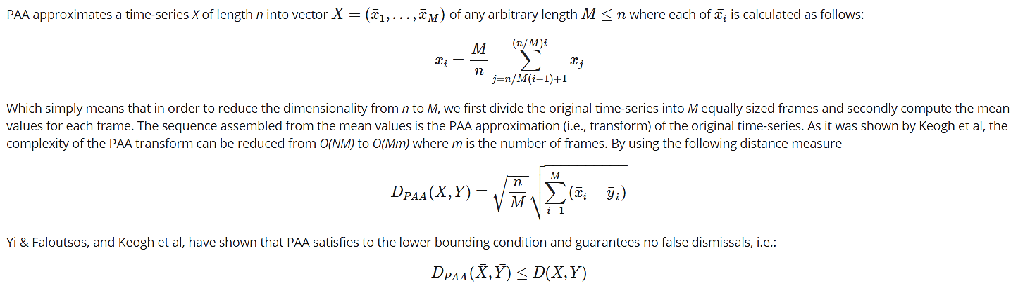
Time series analysis – classification techniques
Piecewise Aggregate Approximation of time-series (PAA)

Slide 8
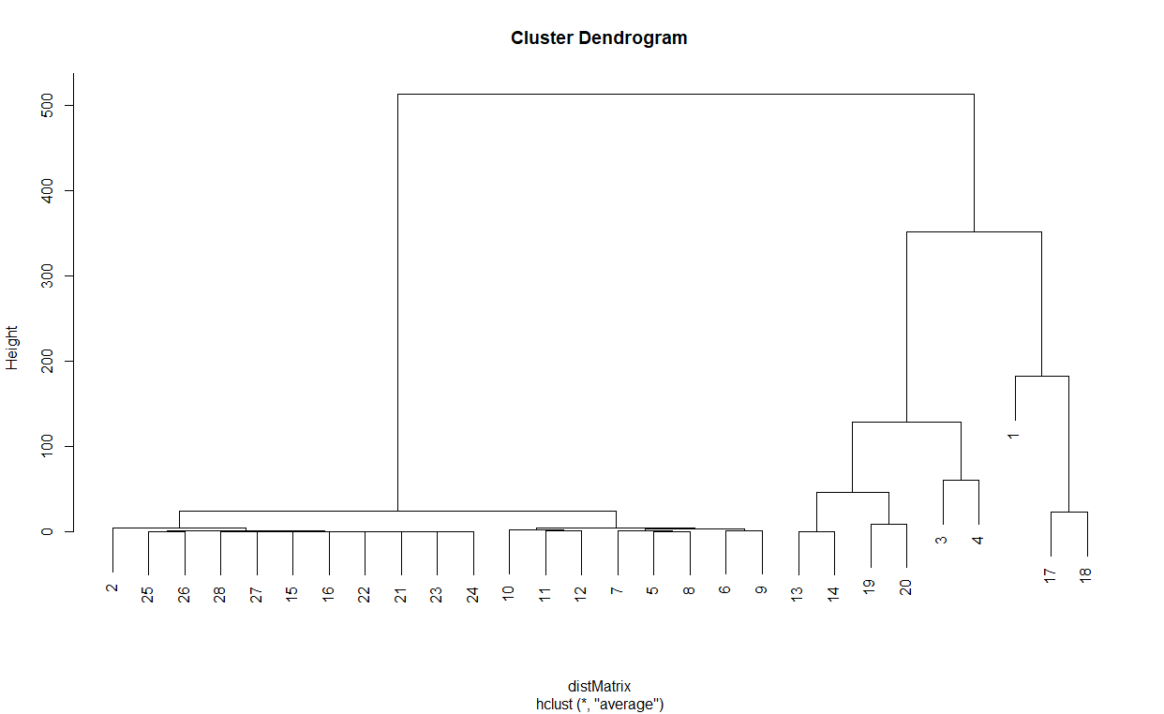
Time series analysis – clustering techniques
Hierarchical Clustering
No. of Samples = 2

Slide 9
Techniques used for occupancy detection
Decision Trees
Random Forest
Logistic Regression
Support Vector Machines (SVM)

Slide 10
Details of Techniques used for occupancy detection
Decision Trees
A decision tree is a decision support tool that uses a tree-like model of decisions and their possible consequences, including chance event outcomes, resource costs, and utility. It is one way to display an algorithm that only contains conditional control statements.
Random Forest
Random forests or random decision forests are an ensemble learning method for classification, regression and other tasks that operates by constructing a multitude of decision trees at training time and outputting the class that is the mode of the classes or mean prediction of the individual trees.
Logistic Regression
In statistics, the logistic model is a widely used statistical model that in its basic form uses a logistic function to model a binary dependent variable, although many more complex extensions exist. In regression analysis, logistic regression is estimating the parameters of a logistic model.
SVM
In machine learning, support-vector machines are supervised learning models with associated learning algorithms that analyze data used for classification and regression analysis.

Slide 11




Results and findings
Random Forest
Accuracy = 94.03%
SVM Linear
Accuracy = 97.90%
Logistic Regression
Accuracy = 97.26%
SVM Radial
Accuracy = 97.78%

