Slide 1
Application Delivery Fundamentals 2.0
Spring /JPA Transaction Management
Notes:
Faculty Notes:
Introduce yourself, if necessary.
Introduce the module and time frame, which is approximately 4 hours
Verify the students have the proper handouts for the module.
Ensure the students have access to the required software for the practice exercises.
Participant Notes:
N/A

Slide 2
Course Goals / Objectives
At the end of this module, participants will be able to:
Demonstrate an understanding Transaction Management Basics
Identify the different Transaction Isolation Levels
Explain the need for JDBC Transaction Management
Understand the Spring Transaction Management
Understand the Programmatic approach of Spring JPA Transaction Management

Slide 3

Agenda
This module will cover the following topics:
Transaction Management Basics
JDBC Transaction Management
Introduction to Spring Transaction
Spring Transaction Properties
Spring JPA Transaction Management
Spring Transactional Attribute

Slide 4
Transaction Management Basics
What is Transaction ?
A transaction can be defined as an indivisible unit of work comprised of several operations, all or none of which must be performed in order to preserve data integrity.
In computer programming, a transaction usually means a sequence of information exchange and related work (such as updating multiple task at the same time)
It is treated as a unit for the purposes of satisfying a request and for ensuring database integrity.
For a transaction to be completed and database changes to made permanent, a transaction has to be completed entirely
Transaction Example Contd…

Slide 5

Transaction Management Basics (Continued…)
For Example :
An online purchase where the customer use his Credit/Debit card and purchase things where the amount has to be debited from one account and the same should be credited in another account so this is treated as single transaction. The transaction is treated successful when the database is actually changed to reflect the process. If something happens before the transaction is successfully completed, any changes to the database must be kept track of so that they can be undone.

Slide 6
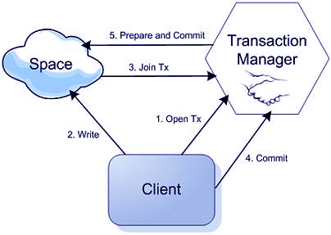

Slide 7
JDBC Transaction Management
JDBC transactions are controlled through the Connection object. There are two modes for managing transactions within JDBC:
auto-commit
manual-commit.
The setAutoCommit method is used to switch between the two modes.

Slide 8
JDBC Transaction Management
Auto-commit Mode
Auto-commit mode is the default transaction mode for JDBC. When a connection is made, it is in auto-commit mode until setAutoCommit is used to disable auto-commit.
In auto-commit mode each individual statement is automatically committed when it completes successfully, no explicit transaction management is necessary. However, the return code must still be checked, as it is possible for the implicit transaction to fail.
(Contd…)

Slide 9
JDBC Transaction Management (Continued…)
Manual-commit Mode
When auto-commit is disabled, i.e. manual-commit is set, all executed statements are included in the same transaction until it is explicitly completed.
When an application turns auto-commit off, the next statement against the database starts a transaction. The transaction continues either the commit or the rollback method is called. The next command sent to the database after that starts a new transaction.

Slide 10
Introduction to Spring Transaction Management
Provides flexible and powerful layer for transaction management
Provides a consistent programming model across different transaction APIs.
Masks/hides differences between local and distributed/global (JTA) transactions for the client code
Choice of transaction demarcation strategy and choice of transaction manager are independent of each other.
(Contd…)

Slide 11
Introduction to Spring Transaction Management
For any transaction manager chosen, both programmatic and declarative transaction demarcation work equally well.
No application code needs to be changed when the transaction manager is changed – only configuration files are updated.
Spring provides implementations of Transaction managers for both Hibernate and JPA:
HibernateTransactionManager
JpaTransactionManager
(Contd…)

Slide 12
Introduction to Spring Transaction Management
DataSource Transaction manager -
We can use DataSourceTransactionManager for simple JDBC persistence mechanism. Sample configuration of DataSourceTransactionManager looks like below
<bean id=”transactionManager”
class=”org.springframework.jdbc.datasource.DataSourceTransactionManager>
<property name=”dataSource” ref= “datasource” />
</bean>

Slide 13
Introduction to Spring Transaction Management
Hibernate Transaction manager – Hibernate transaction manager should be used when our application is using Hibernate. Sample configuration of HibernateTransactionManager looks like below
<bean id=”transactionManager”
class=”org.springframework.orm.hibernate3.HibernateTransactionManager>
<property name=”sessionFactory” ref= “sessionFactory” />
</bean>

Slide 14
Introduction to Spring Transaction Management
Jdo Transaction manager –Use below configuration to use Java data object transaction manager .
<bean id=”transactionManager”
class=”org.springframework.orm.jdo.JdoTransactionManager>
<property name=”persistanceManagerFactory” ref= “persistanceManagerFactory” />
</bean>

Slide 15
Introduction to Spring Transaction Management
Jta Transaction manager – If our transaction is across multiple data sources than we need to use Java Transactions API transactions . Internally JTA implementation handles transaction responsibility.
Use below configuration to configure JTA transaction manager.
<bean id=”transactionManager”
class=”org.springframework.transaction.jta.JtaTransactionManager>
<property name=”transactonManagerName” ref= “java:/TransactionManager” />
</bean>

Slide 16
Introduction to Spring Transaction Management
These can be used to back Spring annotation-based transaction management
Will automatically commit or rollback appropriately on annotated methods

Slide 17
Spring :Transaction Properties
Transaction Properties
All transactions share these properties: atomicity, consistency, isolation, and durability (represented by the acronym ACID).
Atomicity: This implies indivisibility; any indivisible operation (one which will either complete fully or not at all) is said to be atomic.
Consistency: A transaction must transition persistent data from one consistent state to another. If a failure occurs during processing, the data must be restored to the state it was in prior to the transaction.
(Contd..)

Slide 18
Spring :Transaction Properties
Isolation: Transactions should not affect each other. A transaction in progress, not yet committed or rolled back (these terms are explained at the end of this section), must be isolated from other transactions. Although several transactions may run concurrently, it should appear to each that all the others completed before or after it; all such concurrent transactions must effectively end in sequential order.
Durability: Once a transaction has successfully committed, state changes committed by that transaction must be durable and persistent, despite any failures that occur afterwards.

Slide 19
Spring : Transaction Choice
Traditionally developers have two choices for transaction management.
Global transactions.
Local transactions.
Global Transactions
Global transactions are managed by the application server, using the Java Transaction API (JTA).
global transactions provide the ability to work with multiple transactional resources (typically relational databases and message queues).

Slide 20
Spring : Transaction Choice
Local transactions
Local transactions are resource-specific, the most common example would be a transaction associated with a JDBC connection.
With local transactions, the application server is not involved in transaction management and cannot help ensure correctness across multiple resources.

Slide 21
Spring : JPA Transactions
Uses JPATransactionManager – daoContext.xml
JpaTransactionManager manages JTA transactions using the configured JTA DataSource from entityManagerFactory.
@Transactional annotation abstracts the transactional semantics – begin, commit and rollback from the developer.
(Contd…)
<!-- Setup Transactions -->
<bean id="transactionManager" class="org.springframework.orm.jpa.JpaTransactionManager"
p:entityManagerFactory-ref="entityManagerFactory" />
<!-- activates @Transactional -->
<tx:annotation-driven transaction-manager="transactionManager" />

Slide 22
Spring : JPA Transactions
JPaTransactionManager begins a JTA transaction, invokes the method and either commits or rollback the global transaction.
@Transactional
public Order modifyOrder( Order entity ) {
setTotalOrderAmount( entity );
this.orderDao.persist( entity );
return entity;
}

Slide 23
Spring : @Transactional
Declarative transaction management was only available in EJB containers. But now Spring offers support for declarative transactions to POJOs.
This is done through spring AOP frame work using auto proxies.
Spring enables declarative transaction management to be applied to any class or method.
If applied at class level will apply to all methods including getters and setters
It offers configurable propagation and rollback rules.

Slide 24
Spring : Transaction Attributes
All the transaction manager have the following transaction attributes that can be configured.
Propagation behavior
Isolation level
Read-only hints
The transaction timeout period
(Contd…)

Slide 25
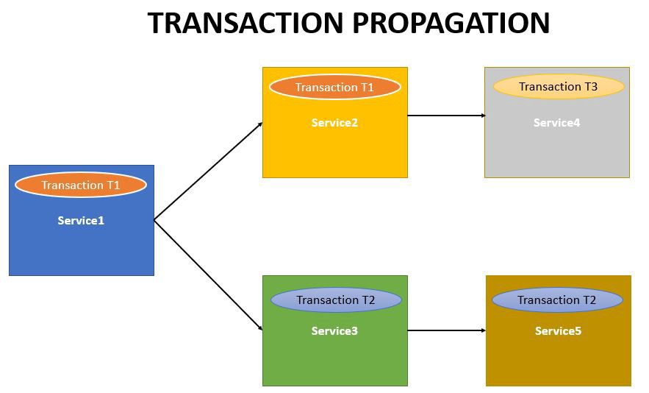

Slide 26
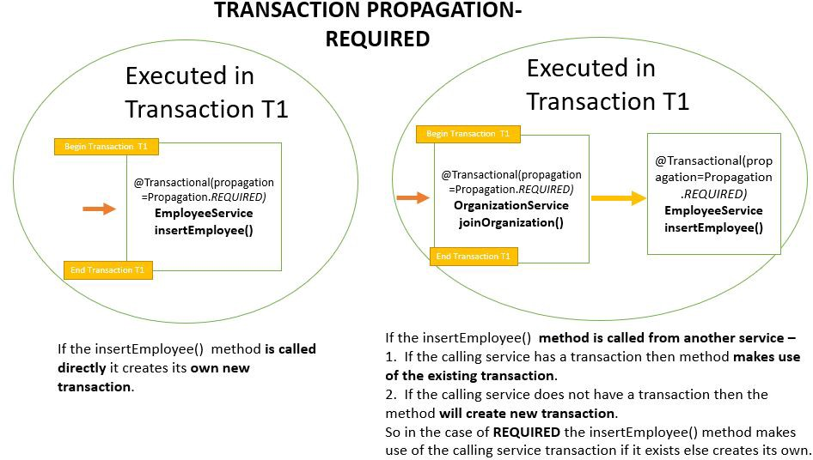

Slide 27
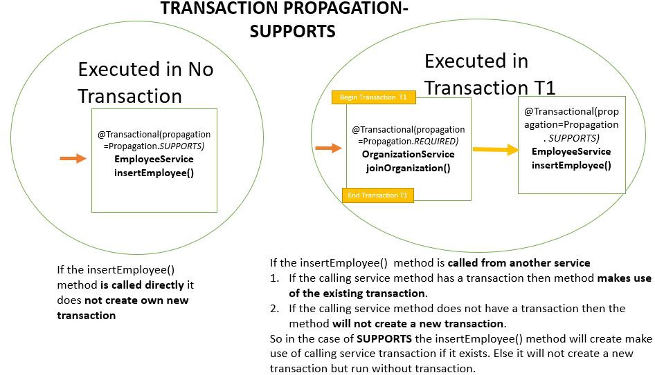

Slide 28
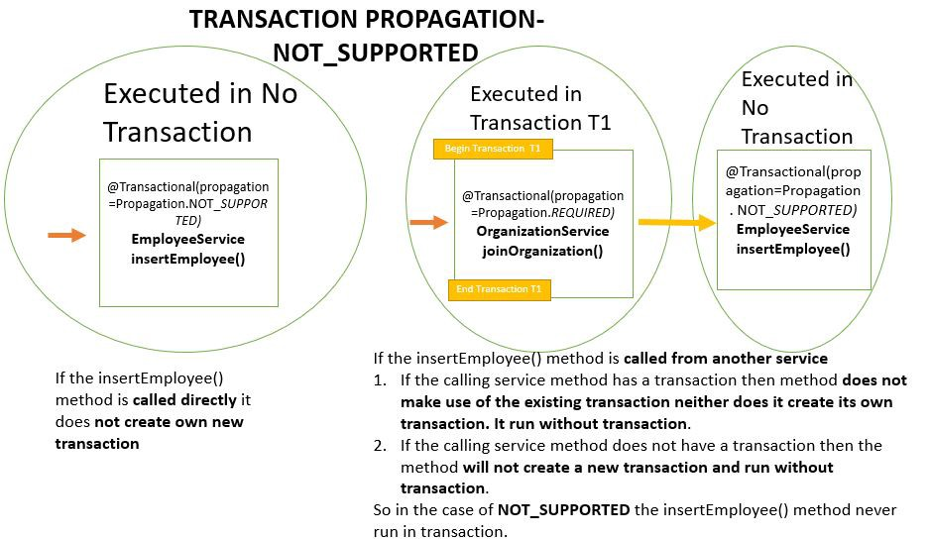

Slide 29
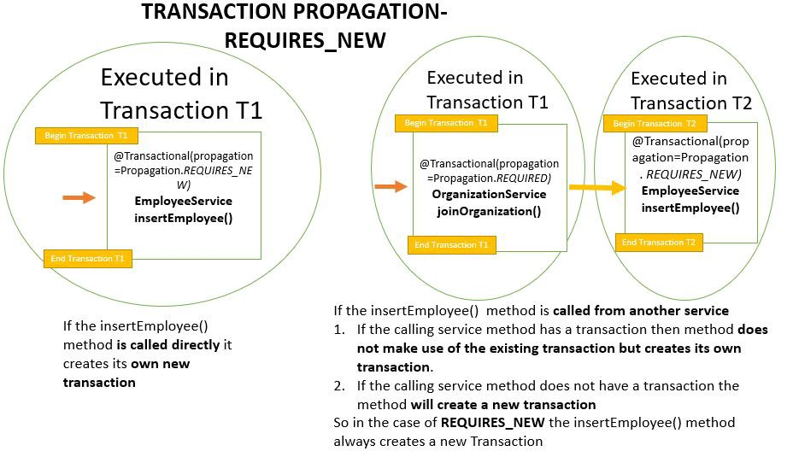

Slide 30
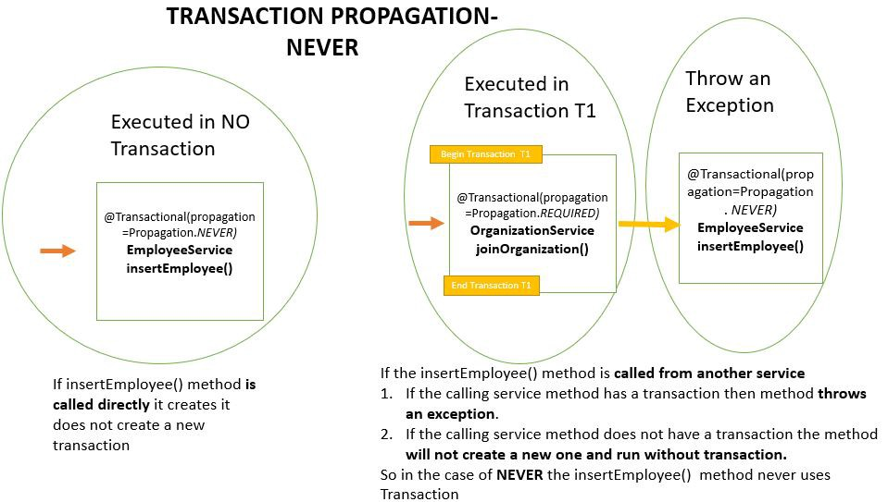

Slide 31
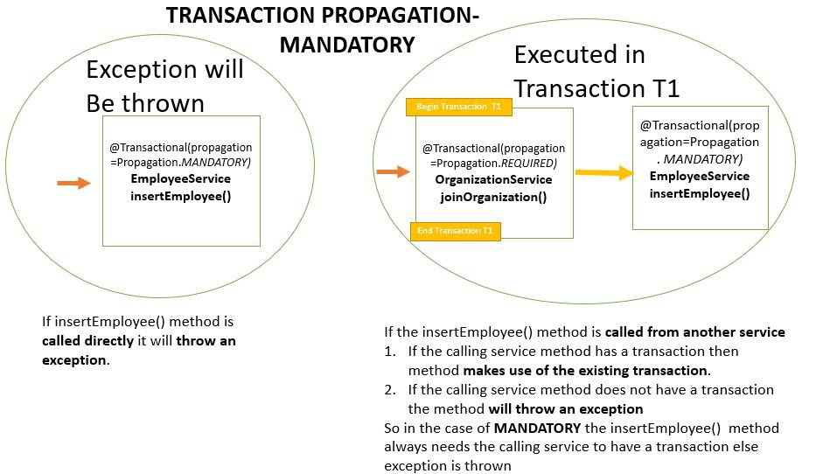

Slide 32
Spring : Transaction Attributes
Propagation behavior defines the boundaries of the transaction with respect to the client and to the method being called. Spring defines seven distinct propagation behaviors, as cataloged.
PROPAGATION_MANDATORY: Indicates that the method must run within a transaction. If existing transaction is in progress, an exception will be thrown
(Contd…)

Slide 33
Spring : Transaction Attributes
PROPAGATION_NESTED: Indicates that the method should be run within a nested transaction if an existing transaction is in progress. The nested transaction can be committed and rolled back individually from the enclosing transaction.
PROPAGATION_REQUIRED: Beware that vendor support for this propagation behavior is spotty at best. Consult the documentation for your resource manager to determine if nested transactions are supported.
(Contd…)

Slide 34
Spring : Transaction Attributes
PROPAGATION_NEVER: Indicates that the current method should not run within a transactional context. If there is an existing transaction in progress, an exception will be thrown.
PROPAGATION_NOT_SUPPORTED:Indicates that the method should not run within a transaction. If an existing transaction is in progress, it will be suspended for the duration of the method. If using JTATransactionManager,access to TransactionManager is required.

Slide 35
Spring : @Transactional attributes
@Transactional(
propagation=Propagation.REQUIRED,
isolation=Isolation.READ_COMMITTED,
rollbackFor = {RuntimeException.class},
readOnly = true )
public Order findEntry( Object pk ) {
return (Order)this.orderDao.findEntry( pk );
}

Slide 36
Spring JPA Transaction Management (1 of 2)
Transaction semantics:
Semantic | Description | Default Value
Propagation | Defines scope and interaction of transactions | PROPAGATION_REQUIRED
Isolation | Defines concurrent transactions' capacity to view data during another transaction | ISOLATION_DEFAULT (uses the default value of the underlying data source)
Timeout | Defines the number of seconds a transaction can run | TIMEOUT_DEFAULT (can be changed to any positive integer/number)
Read-only | (Boolean) Indicates whether a transaction can modify any persistent state | FALSE (transactions are read/write)
ExceptionHandling | Defines how the checked and runtime exceptions should be handled | RuntimeExceptions: Rollback; Normal/Checked Exceptions: Commit
Notes:
Faculty Notes :
This helps us to understand the transaction semantics and some important classes/interfaces.
TIMEOUT_DEFAULT is -1; it can be changed to 0 or any positive integer above 0 .

Slide 37
Spring JPA Transaction Management (2 of 2)
Transaction semantics can be defined either programmatically or declaratively:
Programmatic | Declarative
Instantiate an instance of DefaultTransactionDefinition class that implements the TransactionDefinition and sets the transaction properties | Declare the transaction semantics in a configuration file in this element <tx:attributes>
Notes:
Faculty Notes :
When the <tx:attributes> element is used in declarative transaction management, Spring instantiates DefaultTransactionAttribute in the background.
DefaultTransactionAttribute implements the TransactionDefinition interface in addition to the TransactionAttribute interface.

Slide 38
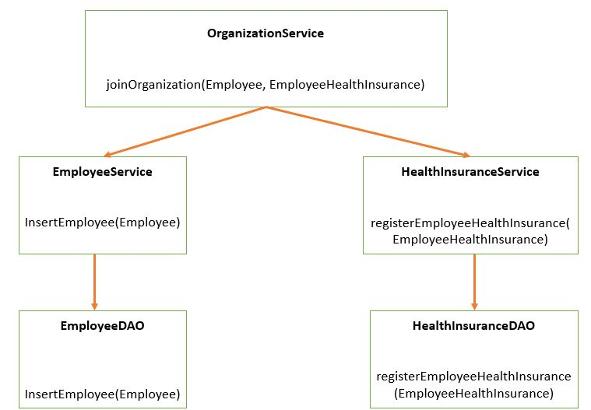
Join Work flow

Slide 39
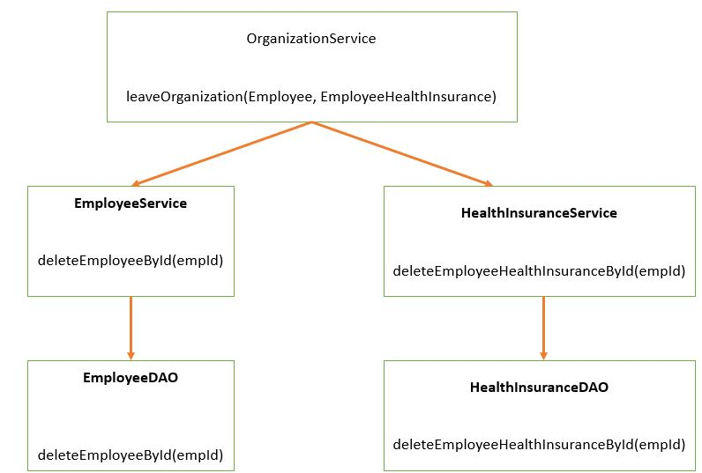
Exit Work flow

Slide 40
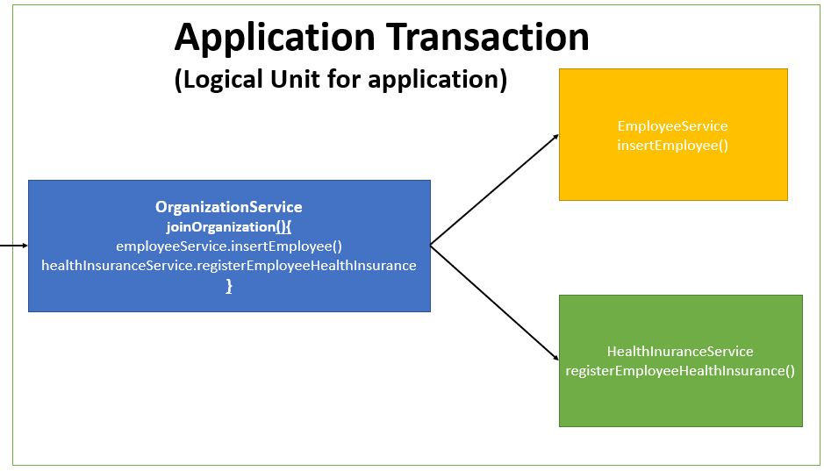
Join Organization

Slide 41
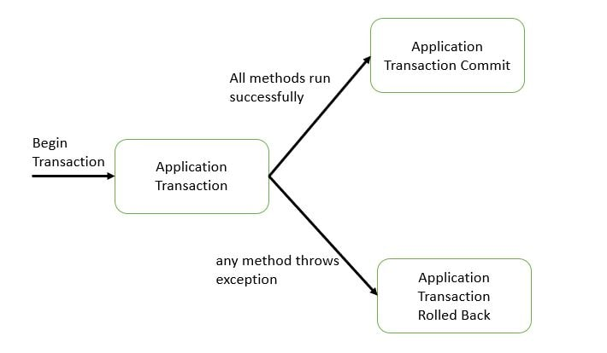
Join Organization

Slide 42
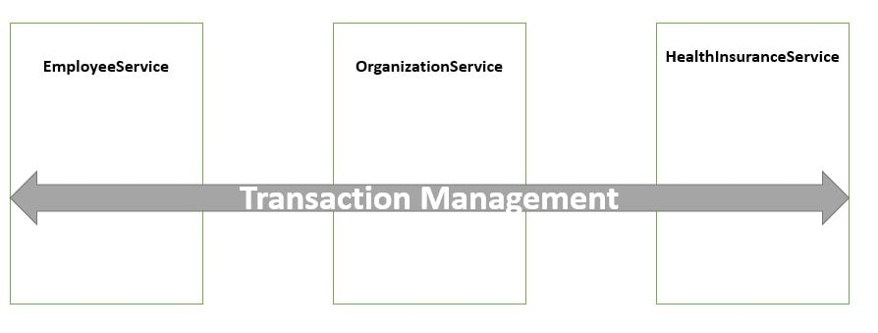
Join Organization

Slide 43
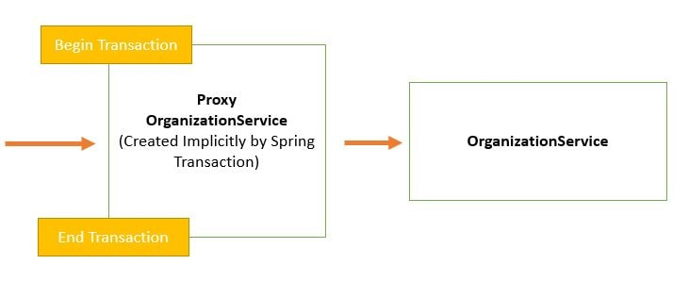
Join Organization

Slide 44
See It
Demonstration:
Faculty will demonstrate how to implement JPA Transaction in Spring application.
Environment – Eclipse
Time – 30 Minutes
Instructions Contd…

Slide 45
See It- Instructions
File
MuseumDaoImpl.java / JPAMuseumSample.java / applicationContext.xml
Steps
Open the project ADFExtensionCodebaseM10JPATransaction_participant in Eclipse
Open JPAMuseumSample.java and run as java application.
Refer the log for queries and result.
Refer applicationContect.xml for JPA configurations.
Try various combinations, refer the log and see how it behaves.

Slide 46
Try It
Activity
Insert the Customer details in to the Table using Transaction Management
Environment – Eclipse
Time – 90 Minutes
Instructions Contd…

Slide 47
Try It- Instructions
File
CustomerDaoImpl.java / JPACustomerActivity.java / applicationContext.xml
Steps
Open the project ADFExtensionCodebaseM10JPATransaction_participant in Eclipse
Complete CustomerDaoImpl.java and complete TO DOs
Complete JPACustomerActivity.java and complete TO DOs and run as java application.
Refer the log for queries and result.
Refer applicationContect.xml for JPA configurations.
Try various combinations, refer the log and see how it behaves.

Slide 48
Course / Module Summary
Spring transaction management is a set of computations producing changes to recoverable data which demonstrate atomicity, consistency, isolation, and durability (ACID) properties.
Spring transaction management support can be availed either programmatically or declaratively.

Slide 49
Questions

