Slide 1
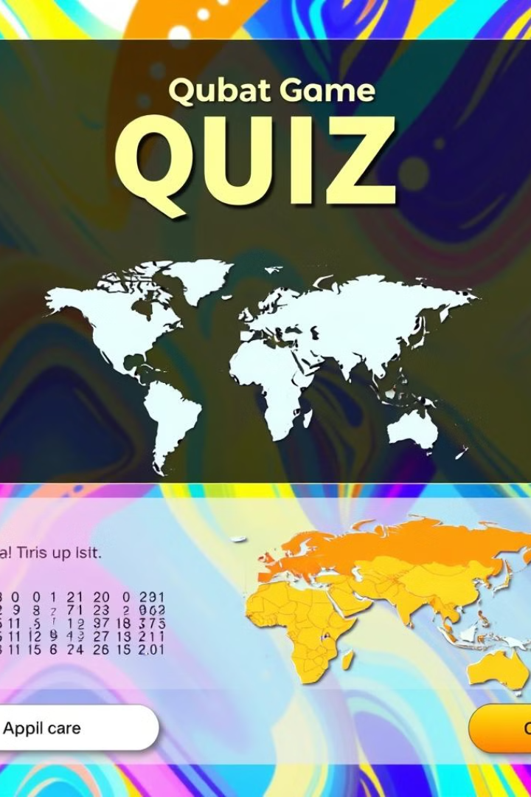
Online Quiz System
Team Members:
V Nikhil Chandra - 2310030366
N Charan Reddy - 2310030322
K Sai Dheeraj - 2310030353
G Sai Krishna - 2310030291

Slide 2


Introduction to the Online Quiz System
The Online Quiz System is a user-friendly application designed to create and manage quizzes.
It utilizes Java Collections such as List and Map for efficient storage and retrieval of questions and scores.
The system provides a seamless experience for both admins (adding questions) and users (taking the quiz).
It evaluates answers in real-time and generates a final score, making it ideal for educational and training purposes.
Key focus areas:
Object-Oriented Design
Clean and maintainable code
Practical use of design patterns

Slide 3

Key Features
Interactive and User-Friendly Interface
Robust Question Management using Maps
Efficient Scoring and Leaderboard Tracking
Real-Time Performance Analytics
The system features a simple and intuitive interface, making it accessible to users with varying levels of technical expertise.
Advanced data structures, including maps, are employed to effectively manage questions, ensuring efficient organization and retrieval.
The system automatically calculates scores and tracks user progress, allowing for competitive leaderboard functionality.
Comprehensive real-time analytics provide insights into user performance, enabling informed decision-making and improvement strategies.

Slide 4
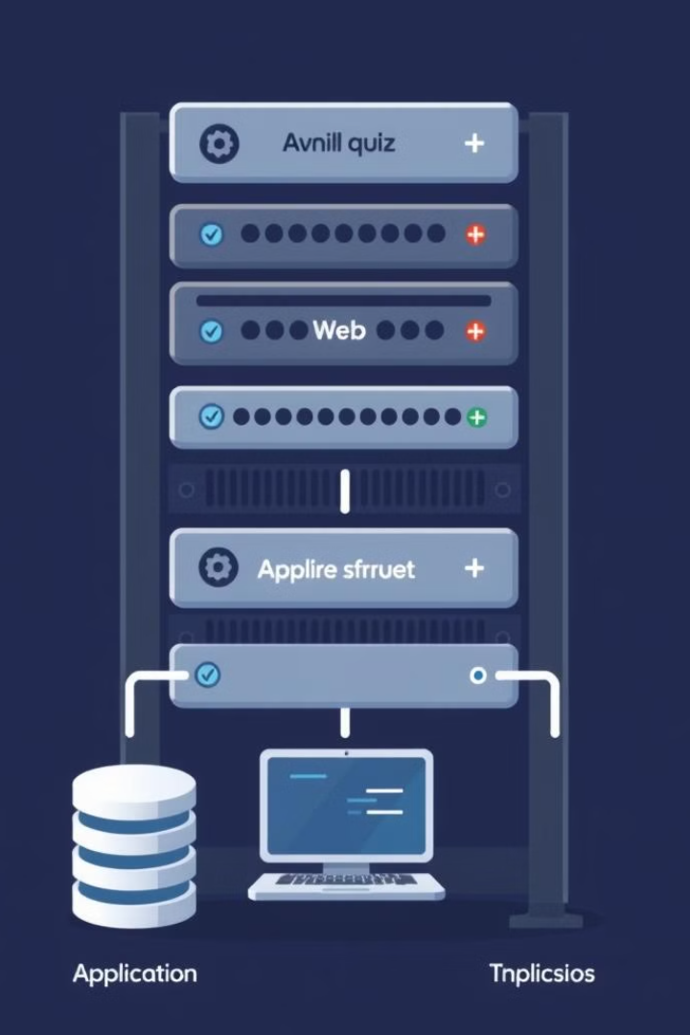


Hardware and Software Requirements
Web Server
Database
A powerful web server capable of hosting the online quiz platform.
A robust database for storing and managing user data, questions, scores, and other system information.
Application Software
The software development kit (SDK) and necessary frameworks to build and deploy the interactive quiz platform.

Slide 5


Other Technical Components
Network Infrastructure
A secure network infrastructure with sufficient bandwidth to support the online quiz system's operations.

