Slide 1
Baseball analytics · Research summary
Productive Out Runs Above Average
What a hitter’s outs are worth, 1908–2025
Data: Retrosheet (retrosheet.org), parsed with Chadwick
Notes:
Introduce PORAA as a stat for how well a hitter manages the out he makes.

Slide 2
Not every out costs the same
Runner on 2nd, 0 outs | Run expectancy | Change
Start of the at-bat | 1.14 | –
Groundout, runner to 3rd | 0.96 | −0.18
Strikeout | 0.70 | −0.44
Average out (illustrative) | – | −0.38
Approximate run-expectancy values. Moving the runner still lowers expectancy, so it earns credit only against the average out.
PORAA · Retrosheet play-by-play, 1908–2025
Notes:
Illustrative values. Credit is always relative to other outs.

Slide 3
The measure
PORAA = Σ [ ΔRE(out) − average ΔRE of all outs in the same season and base-out state ]
All outs count
Average out, not average PA
No leverage weighting
Not only “productive” ones, so strikeouts can cost.
Otherwise it just reproduces RE24.
Keeps it from becoming a clutch stat.
PORAA · Retrosheet play-by-play, 1908–2025
Notes:
Baseline is the average out across all types.

Slide 4
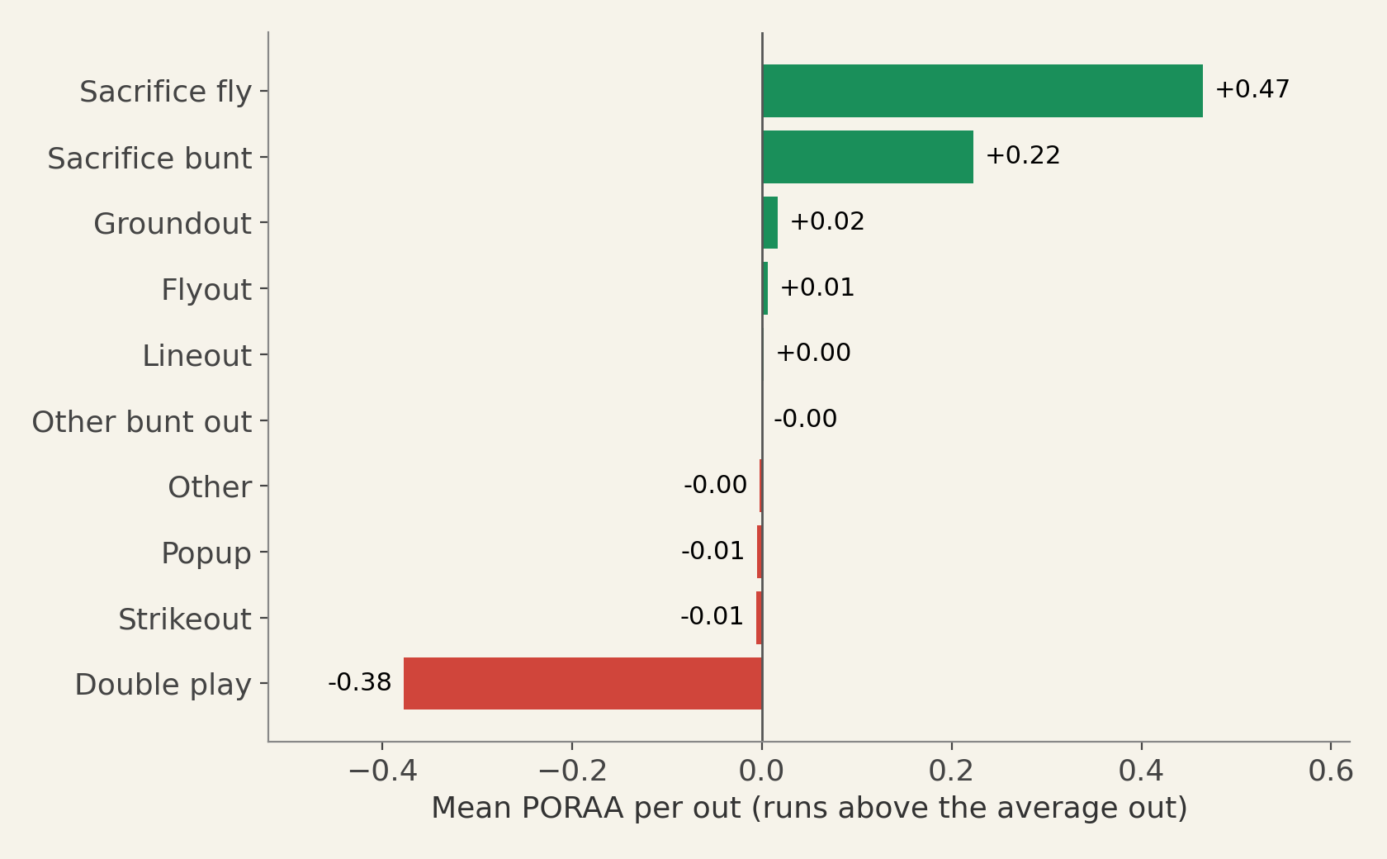
Average PORAA by type of out
Runs above the average out in the same state, across 9.66 million outs.
Successful sacrifice bunts beat the typical out. This is a success-only sample.
PORAA · Retrosheet play-by-play, 1908–2025
Notes:
Strikeouts are close to average; double plays are the big negative; successful bunts beat the typical out.

Slide 5
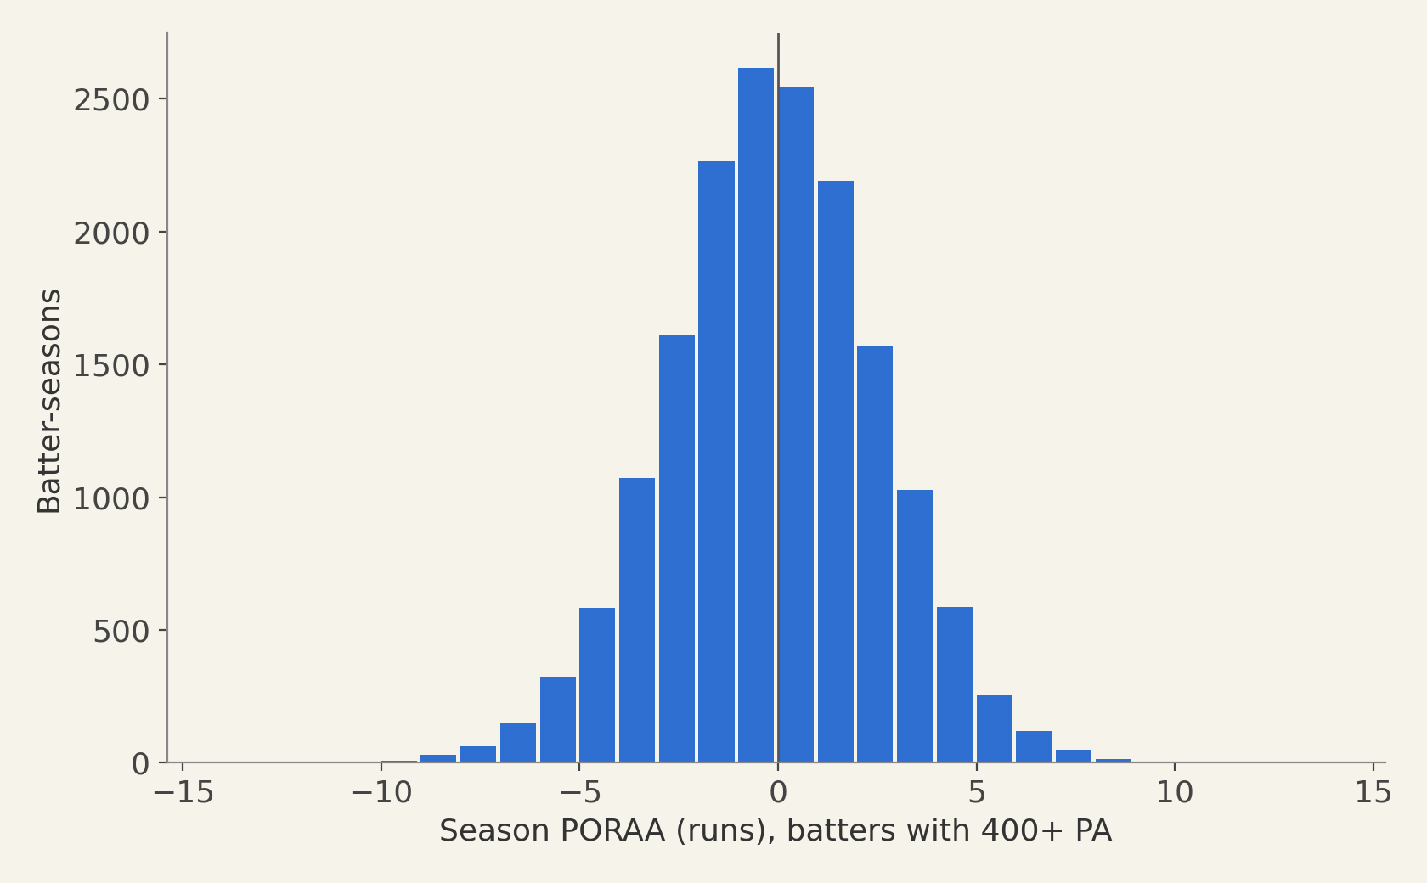
Season-long spread
2.65
runs, one standard deviation
±10
runs at the extremes
PORAA · Retrosheet play-by-play, 1908–2025
Notes:
17,089 batter-seasons with 400+ PA.

Slide 6
Leaders
Best seasons
Worst seasons
Careers (3,000+ PA)
Thomas Herr 1985 +12.3
Robert Wilfong 1979 +12.2
Charles Gehringer 1935 +11.2
Stanley Harris 1924 +10
Thomas Herr 1987 +9.7
Carson Bigbee 1922 +9.7
Timothy Foli 1982 +9.4
David Ortiz 2011 -10.7
Carlos Correa 2023 -10.3
Harmon Killebrew 1970 -10.2
Antonio Armas 1983 -10
Dale Murphy 1988 -9.8
Ronald Santo 1973 -9.6
Charles Knight 1987 -9.5
Edward Collins +69.5
Fred Walker +53.9
Samuel West +50
Charles Gehringer +48.4
Ernesto Lombardi -79.5
Ivan Rodriguez -59.3
Joseph Torre -56.7
PORAA · Retrosheet play-by-play, 1908–2025
Notes:
Names are Retrosheet given names, e.g. Edward Collins is Eddie Collins.

Slide 7
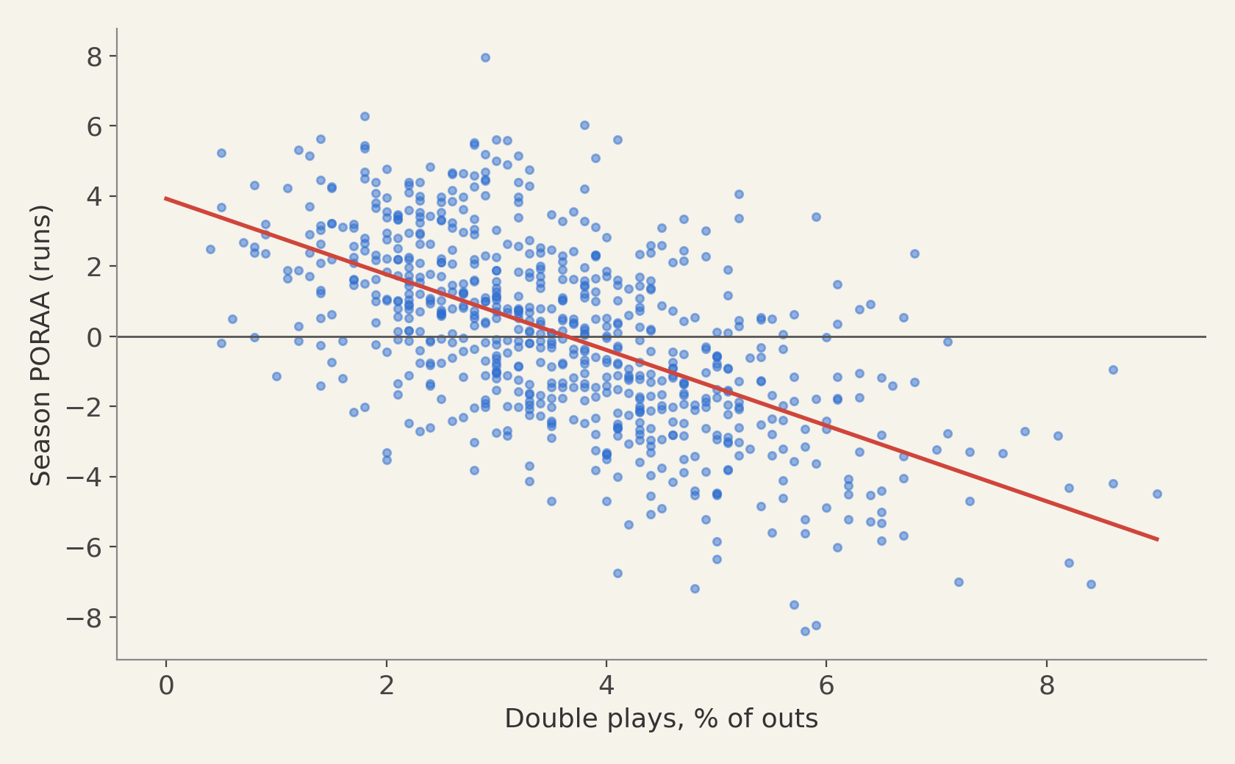
Double plays drive PORAA
700 random batter-seasons with 400+ PA.
−0.59
vs double-play rate
−0.14
vs strikeout rate
PORAA · Retrosheet play-by-play, 1908–2025
Notes:
Correlation with GIDP rate −0.59; with strikeout rate −0.14.

Slide 8
Real, but modest and noisy
Check | Result
Split-half reliability (300+ outs) | 0.17
Implied full-season reliability | 0.29
Year-to-year correlation | 0.28
Variance explained by K and GIDP rates | 40%
Year-to-year r after removing K and GIDP | 0.21
PORAA · Retrosheet play-by-play, 1908–2025
Notes:
Persistent skill beyond K and GIDP exists but is small.

Slide 9
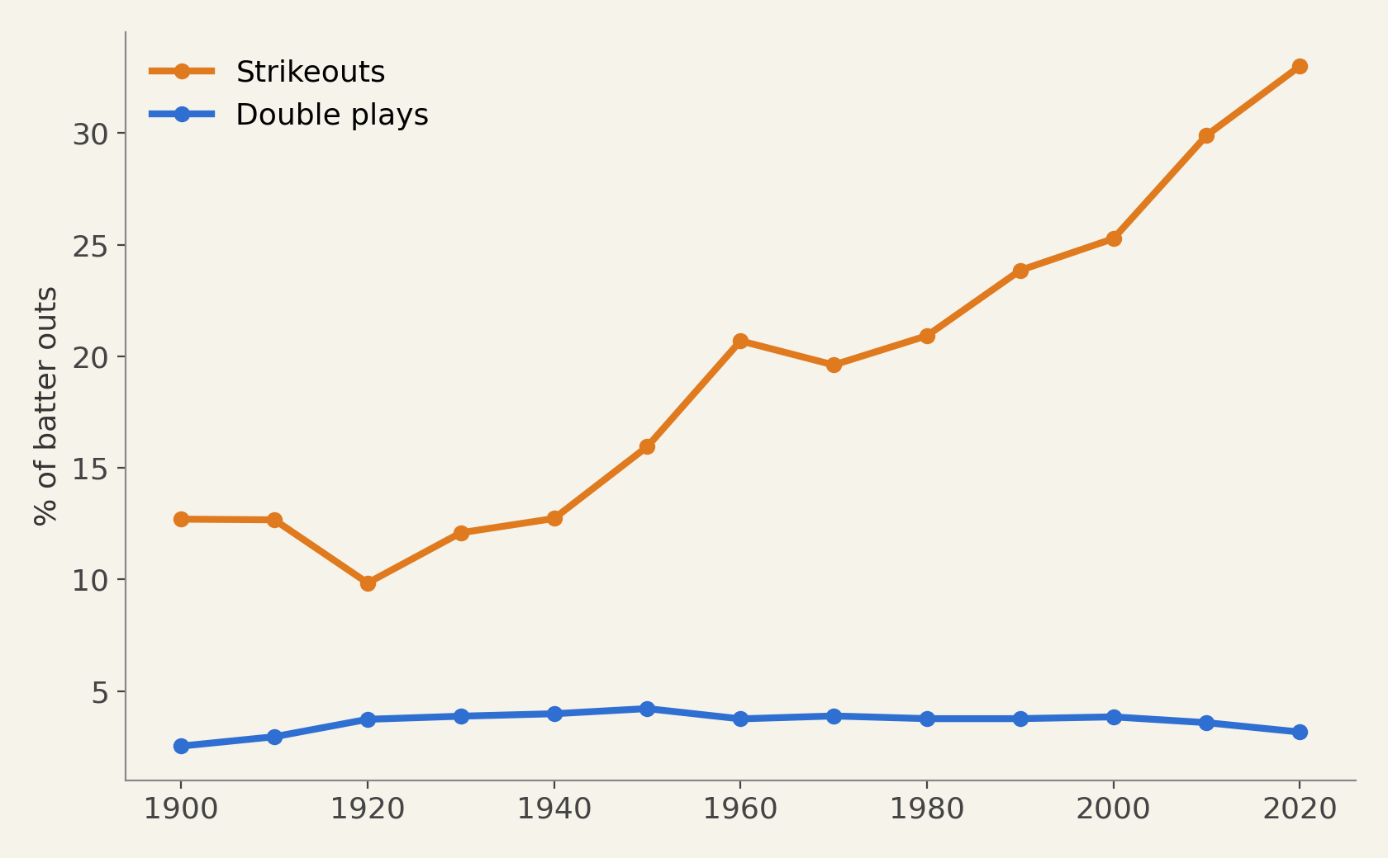
Eras: strikeouts rose, double plays did not
Strikeouts went from about 13% of batter outs to 33%. Double plays stayed near 3–4%, so they remain the main driver of PORAA across eras.
PORAA · Retrosheet play-by-play, 1908–2025
Notes:
Share of outs by decade, batters with 400+ PA.

Slide 10
Limits and next steps
Limits
No runner-speed or batted-ball adjustment yet
Success-only view of bunts and fielder’s choices
Single-season reliability near 0.3
Next
Adjust for runner sprint speed and Statcast contact
Regress to stabilized estimates
Test pull-side contact with a runner on 2nd
PORAA · Retrosheet play-by-play, 1908–2025

