Slide 1
Throwing Exposure in the PLL, 2019–2026
What public box-score data can and cannot say about shoulder-loading demands
Eight seasons, 1,868 player-season rows, 609 players

Slide 2
Research question
How much throwing-related activity do PLL players publicly record, and how does it vary by season and position?
The data are exposure counts: shots and passes. They are not shoulder forces, tissue damage, or injury risk.

Slide 3
Data and method
Source: official PLL player stats exports, 2019–2026 (assumed regular season)
Sample: field players with ≥ 3 games played (n = 1,173 player-seasons)
Passes and touches are not recorded for 2019–2021
Stats: season means with 95% CI, Kruskal–Wallis, Spearman, OLS on season means

Slide 4
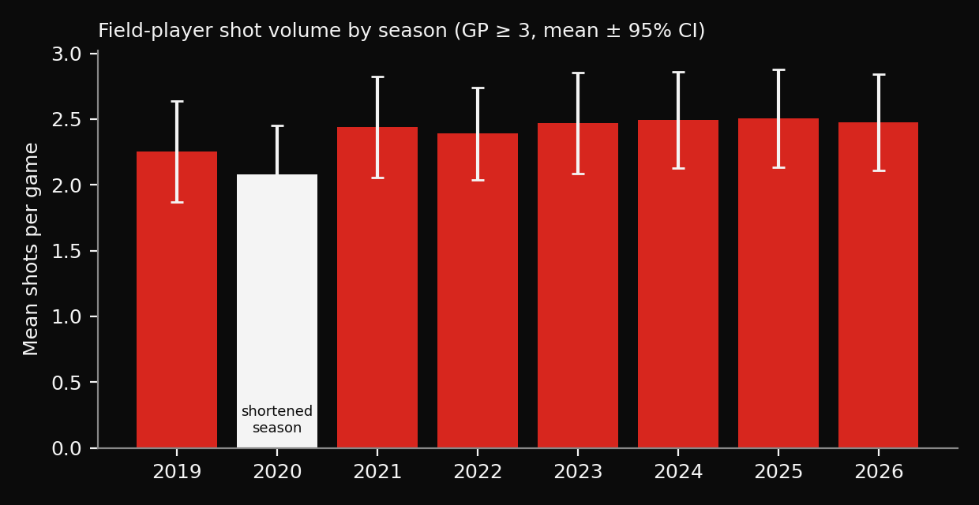
Shot volume has been steady
About 2.1–2.5 shots per eligible player per game
2020 was a shortened Championship Series

Slide 5
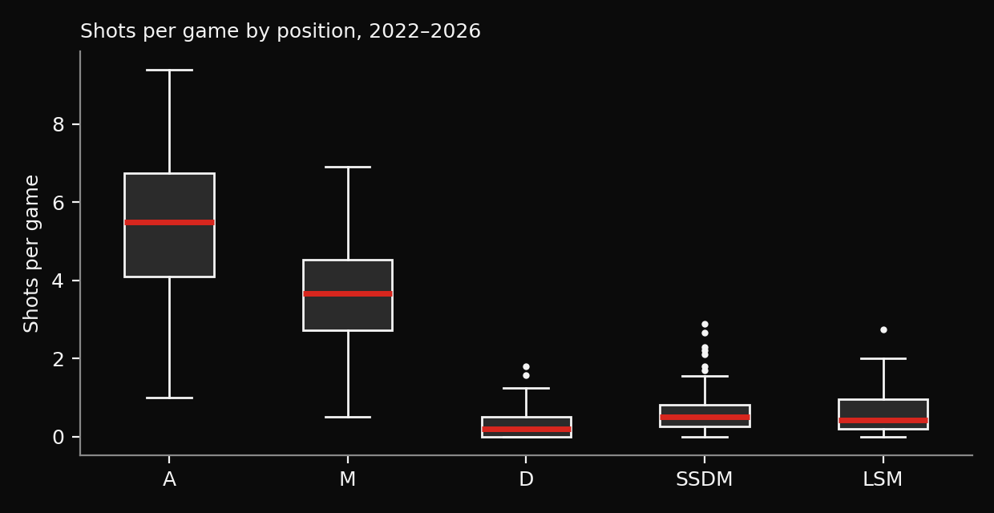
Exposure is set by role
Attack: 5.4 shots, 20.6 passes per game
Defense: 0.3 shots, 5.8 passes per game
Defenders throw mostly passes, not shots

Slide 6
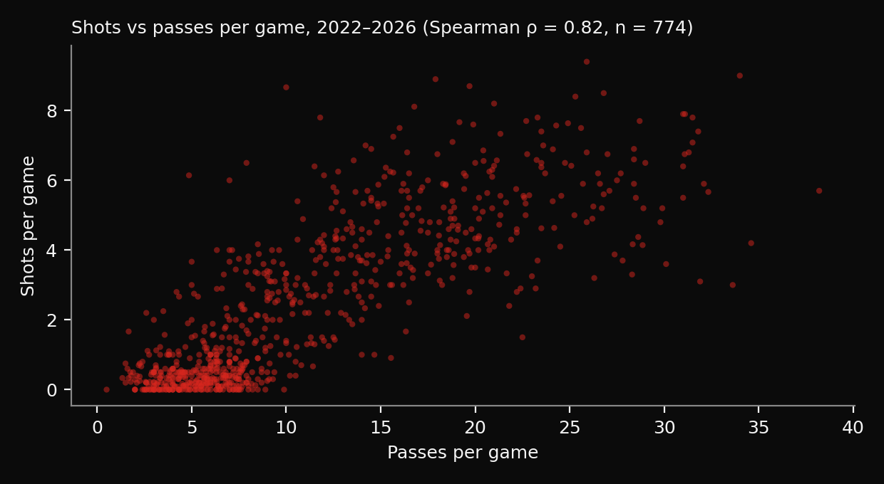
Shots understate total throwing
Spearman ρ = 0.82, largely driven by position
A shots-only exposure measure misses passing volume

Slide 7
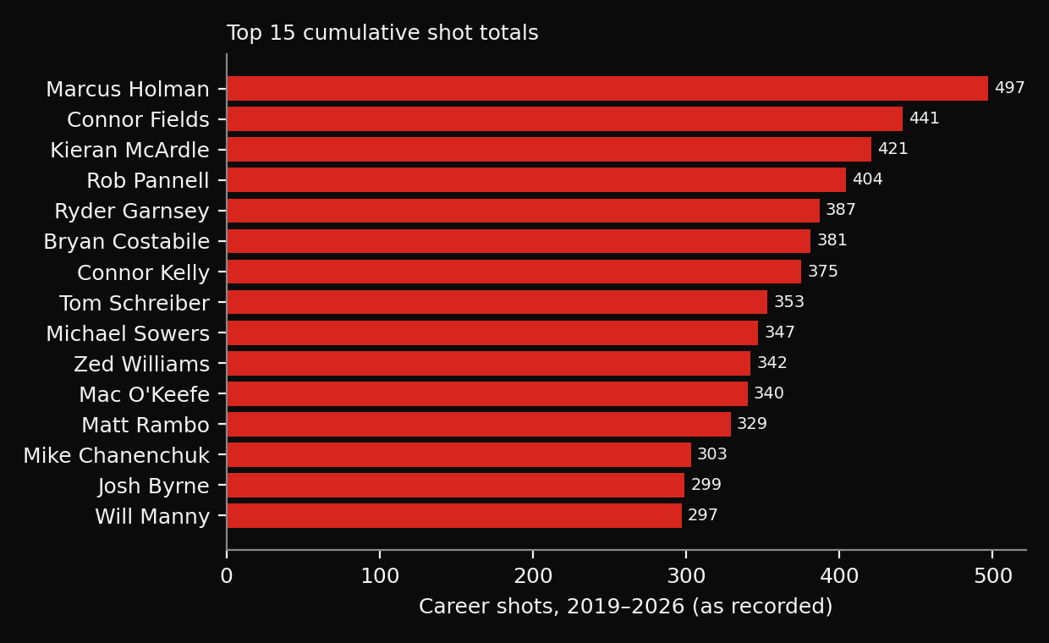
Cumulative recorded shots
Top totals are almost all attackers
Counts are lower bounds: practice and warm-ups are unrecorded

Slide 8
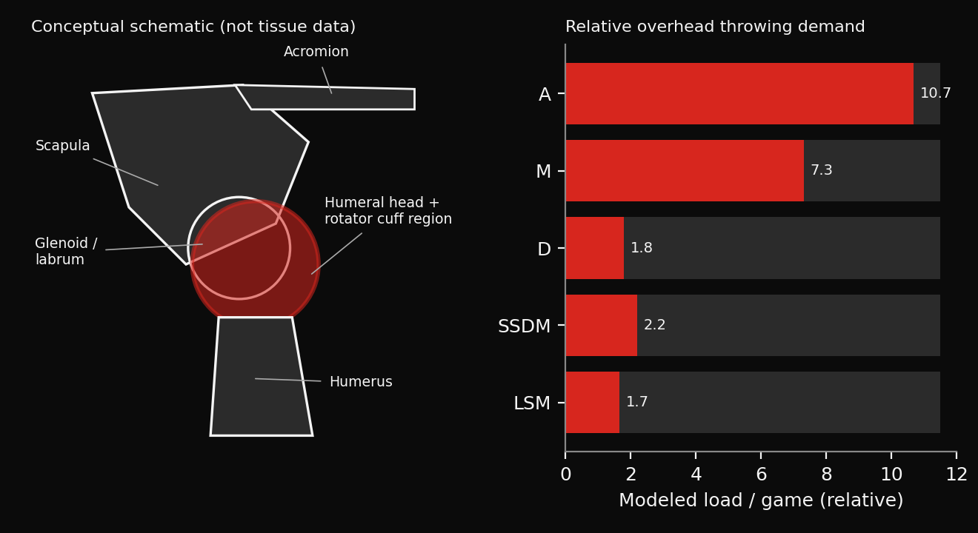
Modeled shoulder load
Load = shots × 1 + passes × (pass speed / 138 km/h)²
Pass speed assumed 70 km/h (tested 55–85)
Relative index, not tissue stress or injury risk

Slide 9
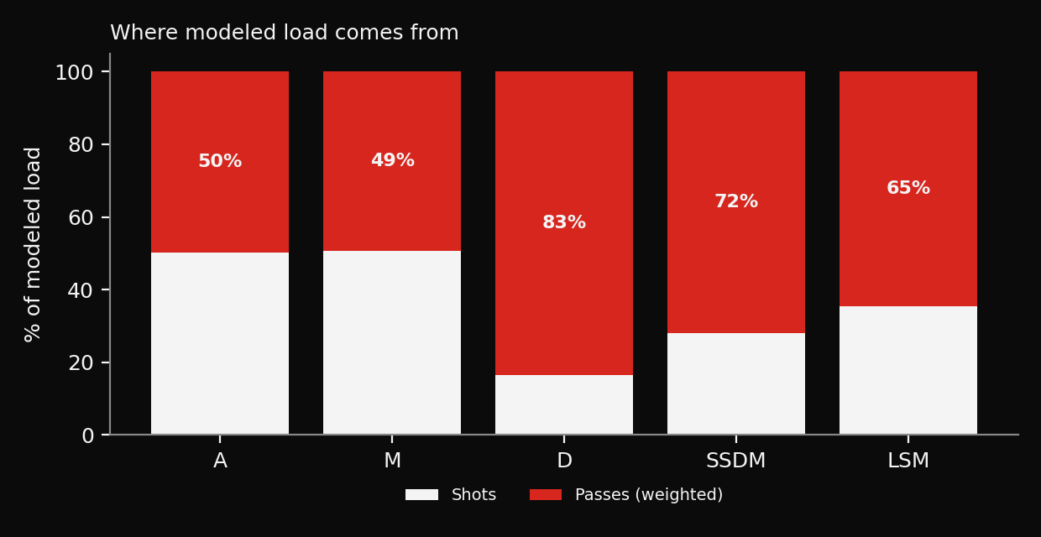
Defenders' load is mostly passing
Passes make up about 50% of attackers' modeled load
and about 83% of defenders'

Slide 10
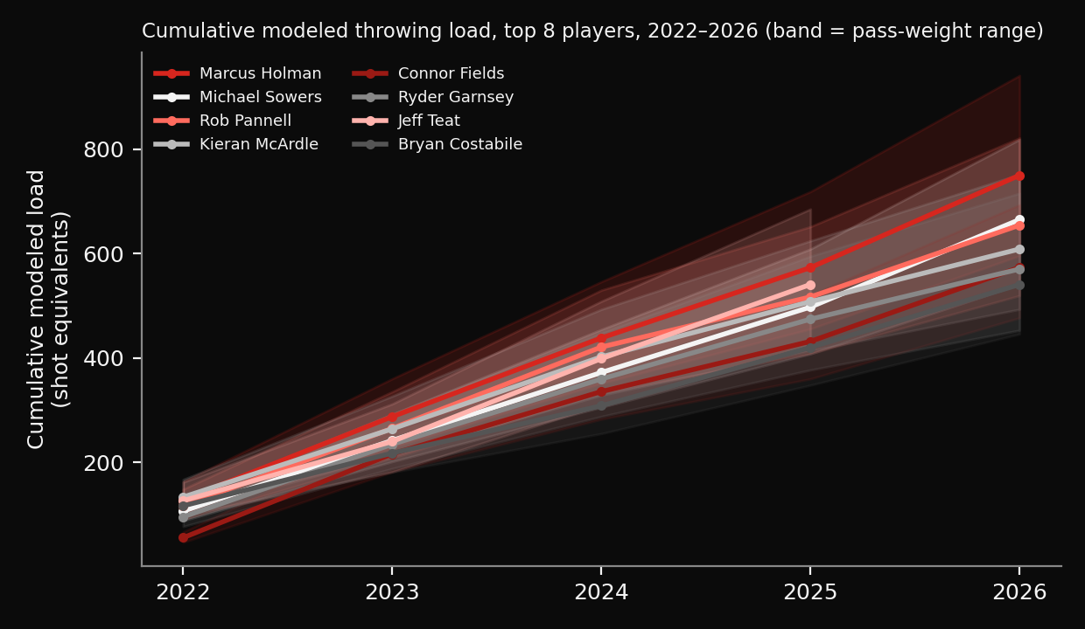
Cumulative modeled load, 2022–2026
Marcus Holman: about 750 shot equivalents
Range 596–941 across pass-speed assumptions

Slide 11
Literature context
Vincent et al. (2015): 39 male players, 6 professionals, lab overhead shot
Professional ball speed 138 ± 7 km/h vs 112 ± 15 km/h for high-school players
About 21% faster crosse angular velocity in professionals
Laboratory results, not measurements of PLL players

Slide 12
Limitations and next steps
Box-score counts are not joint kinetics or injury data
Season assignment and regular-season status inferred; name-based player matching
Next: pass-based exposure index (2022+), then motion-capture or wearable data to weight exposure by intensity

