Slide 1
PERFORMANCE SCIENCE RESEARCH
What Drives Athletic Performance?
Identifying the Physical and Training Factors Associated With Performance in College Athletes
15,000 college athletes • 8 sports • 18 variables
Performance Science Research Project | September 2026

Slide 2
RESEARCH QUESTION
Which physical and training characteristics best predict athletic performance?
H1
Greater sprint speed will be associated with higher performance.
H2
Greater muscular strength will be associated with higher performance.
H3
Greater endurance will be associated with higher performance.
H4
Training frequency and intensity will show positive associations with performance.
H5
The important physical predictors will differ between sports.
2

Slide 3
DATASET & METHODOLOGY
15,000 College Athletes, 8 Sports, 18 Variables
15,000
8
14
5
Athletes
Sports
Numeric variables
Performance tiers
Variables analyzed
Analytic approach
Physical: sprint speed, running time, jumping ability, flexibility, muscular strength, endurance
Physiological: resting heart rate
Training: session duration, activity intensity, weekly frequency
Demographic: age, height, weight, BMI
Spearman correlations (ordinal outcome)
Kruskal–Wallis group comparisons
Sport-by-sport predictor comparison
Random forest + logistic regression
3

Slide 4
KEY FINDING
Explosive power — not training volume — drives performance
Sprint speed
0.59
Muscular strength
0.55
Jumping ability
0.52
Endurance
0.30
Training duration
0.14
Spearman's ρ with performance rank
4

Slide 5
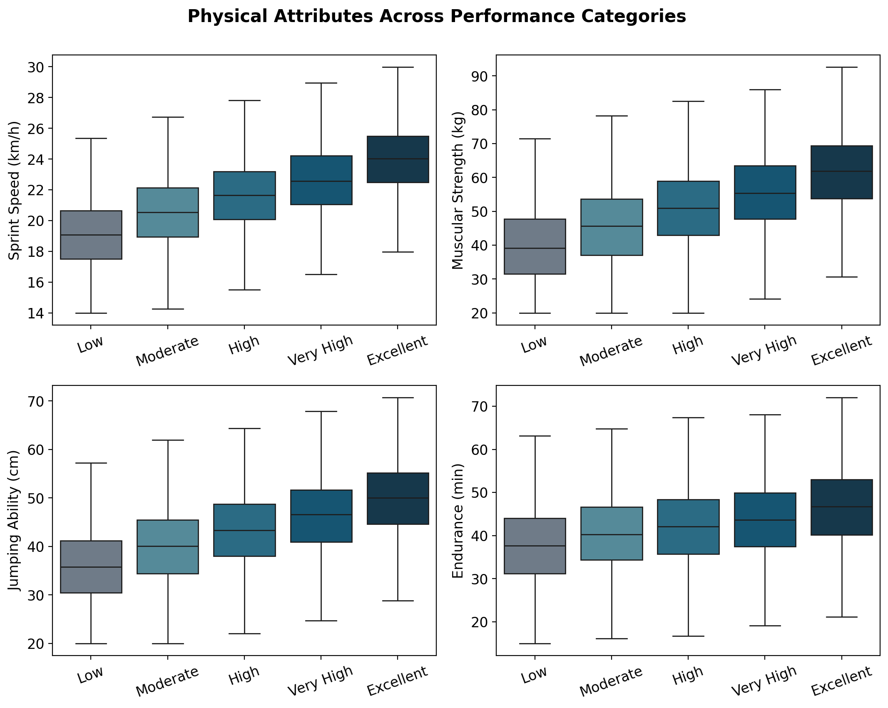
PHYSICAL ATTRIBUTES & PERFORMANCE
Every top predictor rises monotonically with performance tier
5

Slide 6
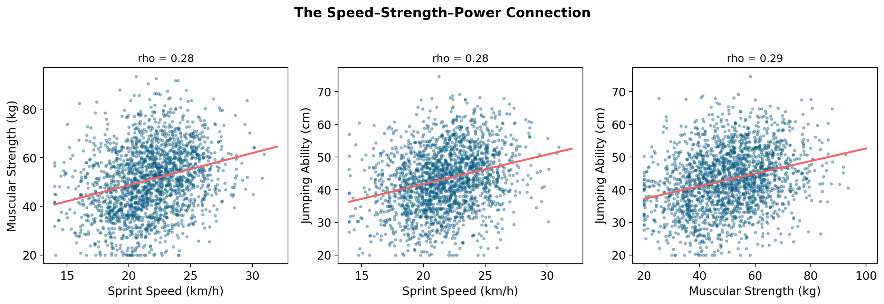
THE SPEED–STRENGTH CONNECTION
Faster athletes also tend to be stronger and jump higher
Sprint speed, muscular strength, and jumping ability are all positively intercorrelated (ρ ≈ 0.28–0.29), pointing to a shared underlying power/explosiveness quality — while each still adds independent predictive value for performance.
6

Slide 7
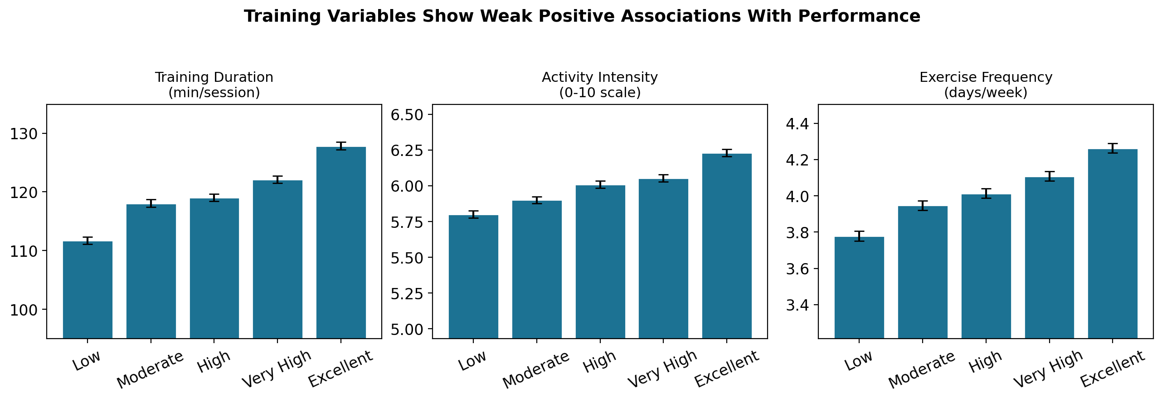
HEART RATE & TRAINING DOSE
Training helps — but the effect is modest next to raw physical capacity
Resting heart rate showed only a weak association with performance (ρ = −0.11) and was essentially uncorrelated with endurance or sprint speed — it carries little independent signal in this dataset.
7

Slide 8
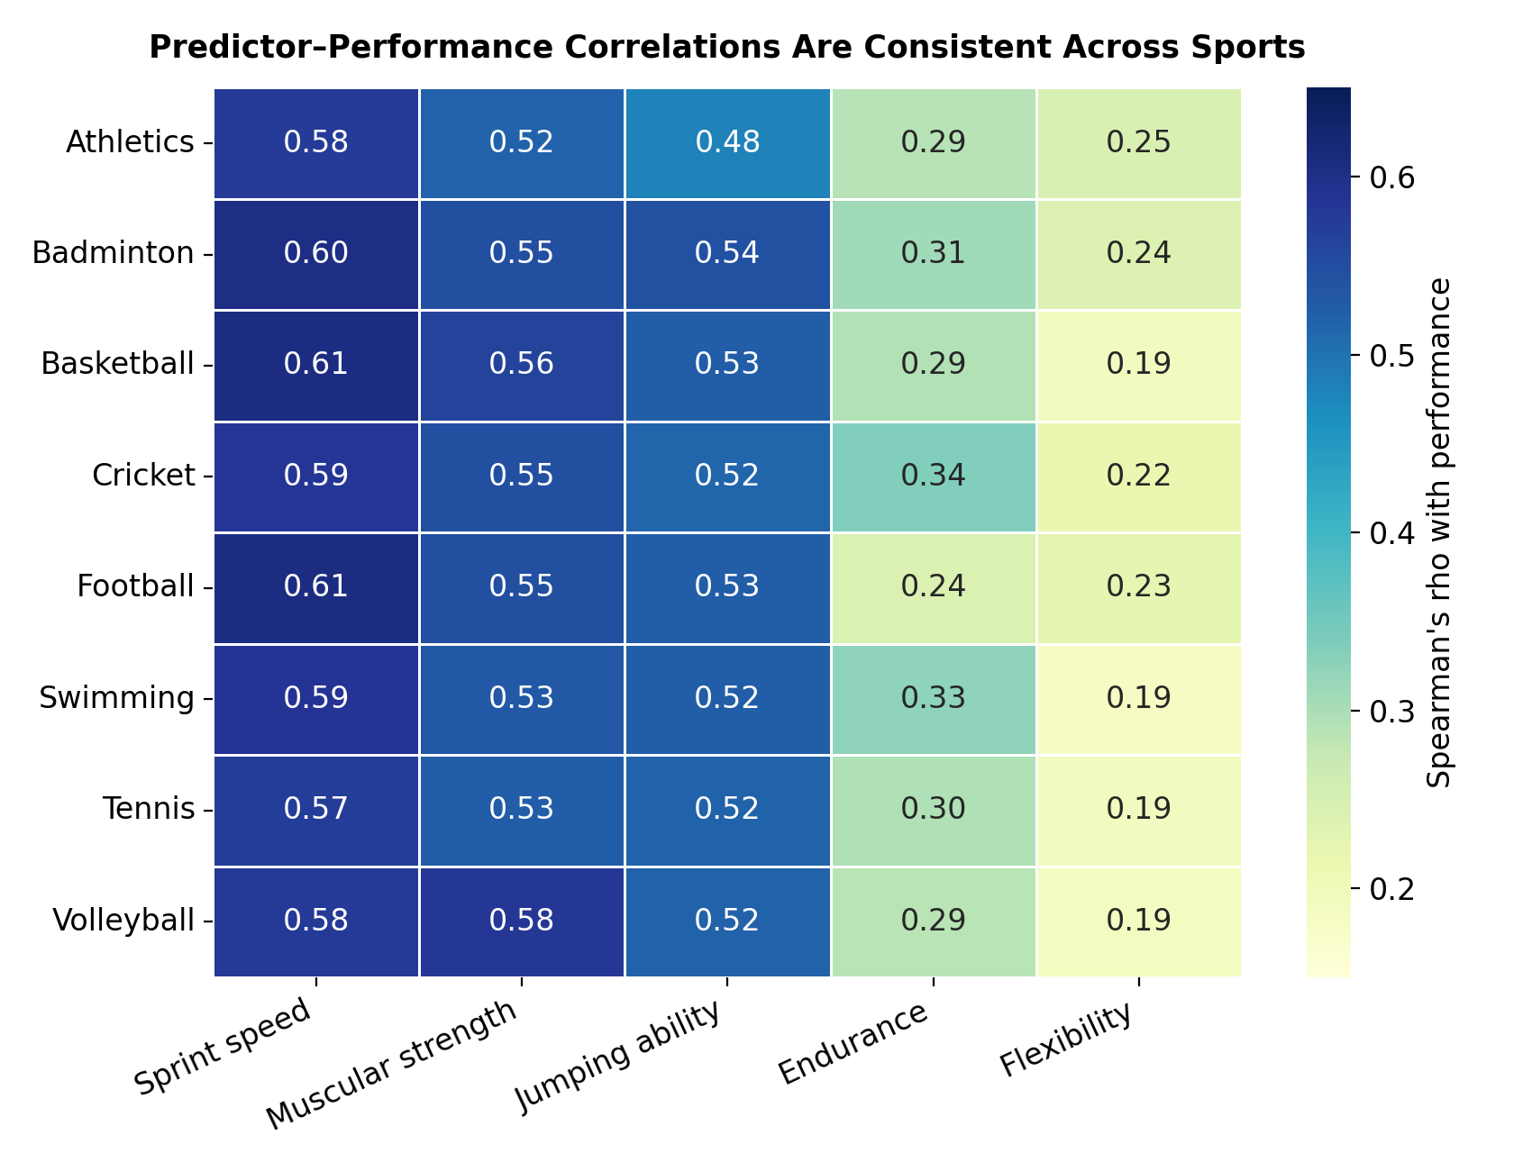
SPORT-SPECIFIC PATTERNS
Surprise: the same traits predict performance in every sport
8

Slide 9
INTERPRETATION
H5 was not supported
Sprint speed, muscular strength, and jumping ability were the top three predictors in all eight sports (Athletics through Volleyball), with nearly identical correlation sizes.
A one-way ANOVA found no difference in mean performance rank across sports (F = 0.30, p = .95).
This points to a generalized athleticism factor — not sport-specific performance profiles — in this dataset.
9

Slide 10
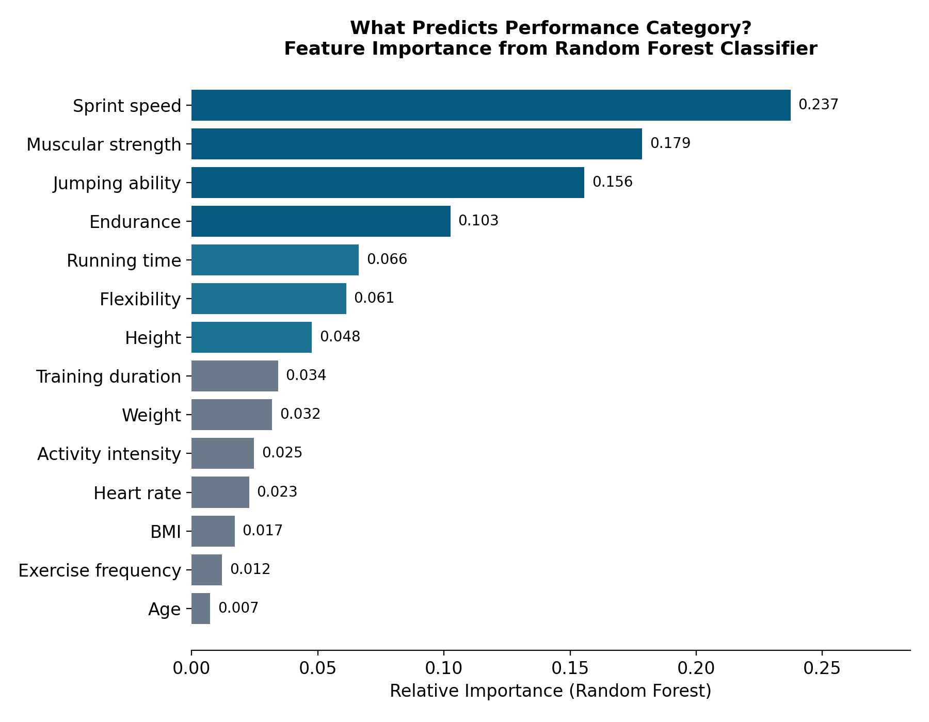
PREDICTING PERFORMANCE CATEGORY
Can we predict performance from physical + training data?
10

Slide 11
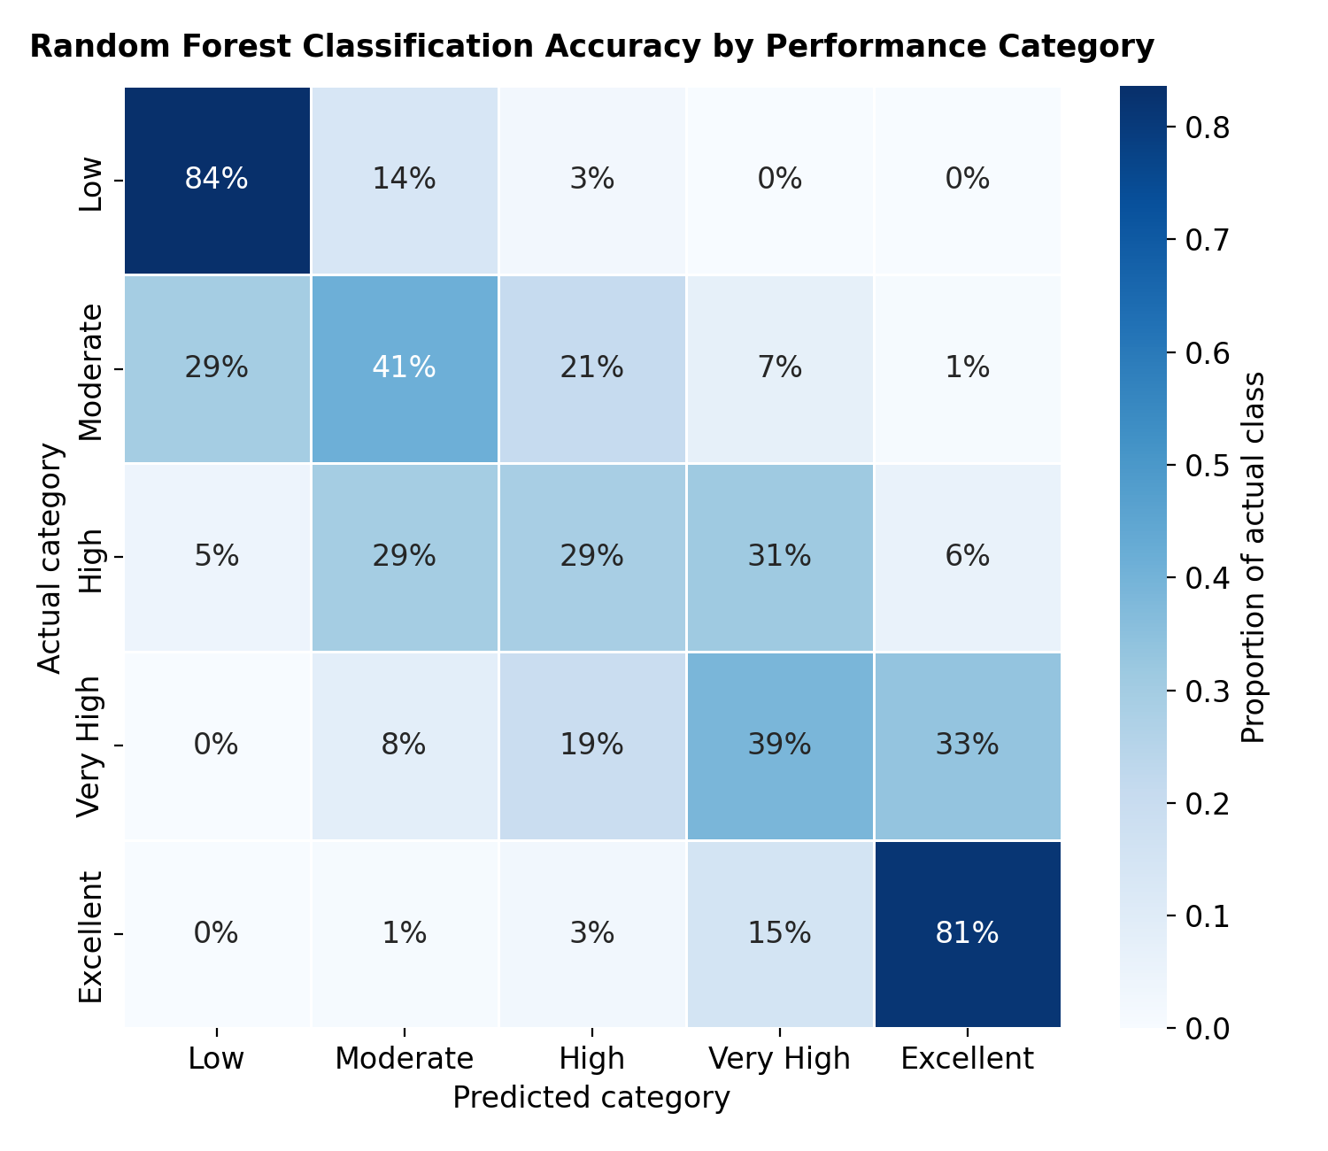
MODEL PERFORMANCE
54.8% accuracy — 2.7× better than chance
Random forest classifier
300 trees • 5-fold cross-validation • stratified 75/25 split
Extreme categories are easy:
Low: 84% correct • Excellent: 81% correct
Middle categories blend together —
most errors fall on adjacent tiers, consistent with performance being a continuum artificially cut into five labels.
11

Slide 12
LIMITATIONS
What this study can't tell us
Observational data
Associations only — training cannot be shown to cause higher performance.
Single, narrow population
College athletes aged 17–25 from one country; may not generalize to elite or younger athletes.
Unusual sport uniformity
Identical predictor patterns across sports may reflect a generic fitness composite rather than sport-specific performance.
12

Slide 13
CONCLUSIONS
Power beats volume; general athleticism beats specialization
Explosive power (speed, strength, jump) is the strongest, most consistent correlate of performance
Training dose matters, but its marginal association is modest once physical capacity is accounted for
The same physical profile predicts success across all eight sports studied
Future research
Sport-specific performance metrics • Longitudinal training records • Technique-level data
13

