Slide 1
The Pitt — ED Resilience Simulator
• Synthetic simulation of surge, staffing loss and EHR downtime
• Simulation findings, not clinical predictions

Slide 2
Problem and questions
• How do surges, call-outs and EHR outages change ED flow?
• Does adding staff reduce waits?
• Which resource is the bottleneck?
• How does downtime affect throughput?
• Which response combination balances waiting and resource use?

Slide 3
Method
• Minute-step model of a 12-hour shift; 21 arrivals/hr
• Priority queue → physician evaluation → treatment space
• Capacity = min(spaces, nurses × 3)
• Strategies: surge space, staff reallocation, acuity priority, downtime procedure
• 30 runs per scenario, 95% confidence intervals

Slide 4
Calibration to the synthetic data
• Tuned evaluation time and nurse ratio by grid search
• Baseline p90 wait: model 49 min vs data 53
• Baseline mean wait: model 17 min vs data 32 (under-shoots)
• Model waits are more skewed than the data's
• High-acuity waits shorter than data

Slide 5
Scenario results (mean of 30 runs)
Scenario | Mean wait | P90 | Treated
Normal | 17 | 49 | 222
2 call-outs | 38 | 115 | 206
Call-outs + EHR outage | 60 | 197 | 191
Surge +20 | 54 | 157 | 227
Surge + call-outs + outage | 108 | 375 | 181
Combined + all strategies | 70 | 213 | 217

Slide 6
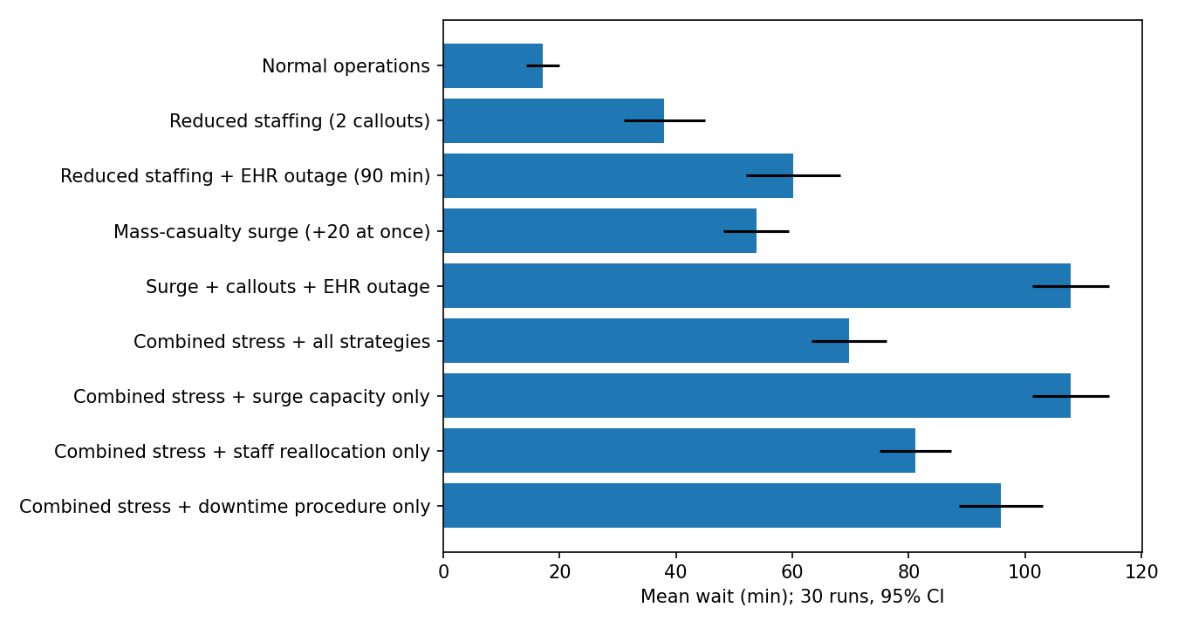
Mean wait by scenario

Slide 7
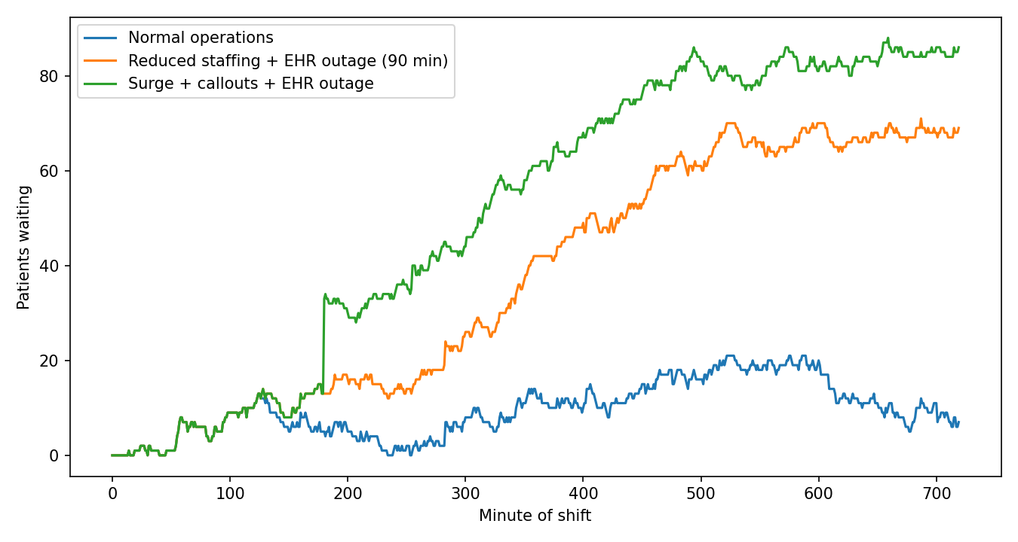
Queue length over the shift
• Surge, call-outs and outage compound
• Peak queue ~18 normal vs ~75 combined

Slide 8
What helps
• Staff reallocation: 108 → 81 min mean wait
• Downtime procedure: 108 → 96 min
• Surge capacity alone: no change (nurse-limited)
• All strategies: 108 → 70 min (~35% lower)
• ESI 1–2 waits stayed under 4 min with priority

Slide 9
Limitations and next steps
• Synthetic data; simplified logic; not clinically validated
• Nurse-bottleneck finding depends on 3 patients/nurse assumption
• Next: test earlier triggers and two-strategy combinations
• Next: replace assumptions with local data; run tabletop exercises

