Slide 1









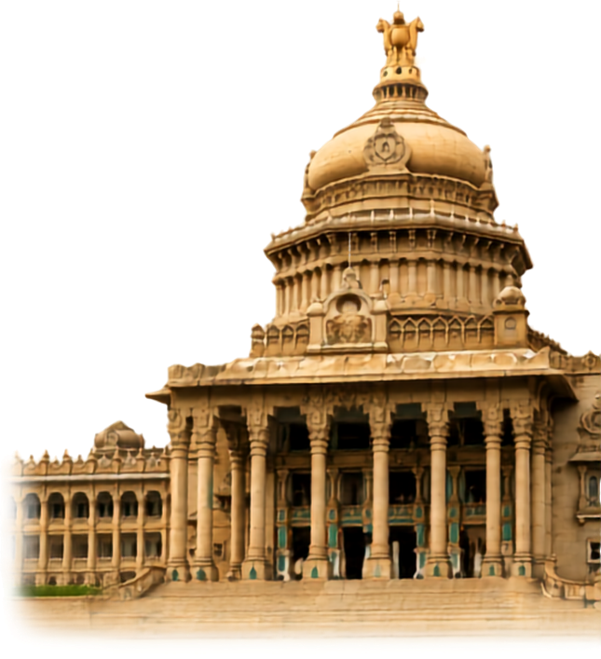



MANIPAL
  ACADEMY OF HIGHER EDUCATION
  Institution of Embrace Diamant in the University
HackSprint
24-Hour Hackathon
17-18
VENUE DETAILS
Manipal Academy of Higher Education (MAHE)
SATURDAY
OCTOBER
09 A.M. Onwards
YOUR NAME: Nikhil, Shreyas, Koustav, Deekshitha
TEAM NAME: Chaukanna
TRACK NO: PS22 · AI Automation with n8n
REGISTER NOW
Team Size
1-4 Members
ORGANIZED BY:
MANIPAL
  ACADEMY OF HIGHER EDUCATION
  Institution of Embrace Diamant in the University

Slide 2
Solution
Chaukanna (चौकन्ना): alert, watchful. The call guardian that acts for you.
OUR SOLUTION: LISTEN → UNDERSTAND → INTERVENE → RESPOND
THE PROBLEM
Digital-arrest & KYC scam calls run on panic
A fake police, CBI or bank caller keeps the victim on the line and demands secrecy, OTPs and transfers.
The response is repetitive and fragmented: call the bank, call 1930, file on cybercrime.gov.in, warn family, keep evidence.
In a panic, almost nobody does any of it in time, and scripts change language by language, so static block-lists miss them.
1
Listen
2
Understand
Calls run through the app, so both legs are heard separately and live.
Indic speech-to-text, then a typed verdict: scam type, pressure 0–3, OTP/PIN ask, secrecy demand.
3
Intervene
4
Respond (n8n)
Only the victim hears a whispered warning in their own language, plus an alarm.
An AI agent alerts family, drafts the 1930 complaint, logs evidence and updates a shared scam-number list.

Slide 3
Tech Stack & Architecture
CAPTURE
Flutter app (Android) · LiveKit WebRTC calling · Python agent hears caller and victim legs separately
SPEECH
Sarvam STT & TTS: Hindi, Kannada, English and code-mixed speech, in and out
BRAIN
Keyword fast path + Jev typed judgments: calibrated, milliseconds per chunk · Gemini fallback
AUTOMATION
n8n (self-hosted): webhook trigger · AI Agent node with tools · Switch/IF branching · retries · human-approval step
DATA & NOTIFY
Supabase: evidence log + shared scam-number list · Telegram alerts to trusted contacts
Open, cheap and auditable: the classifier answers in milliseconds, and self-hosted n8n keeps call data under our control.

Slide 4
Beyond Task Automation
WHEN THE AGENT SEES…
…IT DECIDES AND ACTS
Pressure ≥ 2 and asks for OTP / PIN
Whisper “Do not share that code”, ring the alarm, and ping trusted contacts now
Poses as police / CBI and demands secrecy
Highest severity: send family the call summary and the next steps to follow
Number already in the shared scam list
Raise confidence, block, and skip the guessing
Call ends, victim confirms what happened
Agent drafts the 1930 / cybercrime.gov.in complaint in their language with transcript timestamps
Money already moved
Switch to the time-critical checklist: bank freeze steps and helpline, in order
Multi-step reasoning, autonomous execution. A human confirms only the one irreversible step: submitting the complaint.

Slide 5
Data Flow Diagram
Call audio
LiveKit WebRTC, caller & victim legs captured separately
Sarvam STT
Indic speech to text, streaming chunks
Jev classifier
Typed verdict: scam type, pressure 0–3, OTP ask, secrecy
Risk gate
Threshold crossed: both paths fire
fires in parallel
n8n AI Agent (self-hosted)
Webhook receives the verdict + transcript · agent plans the response, calls tools, branches on severity
Live path
Victim only
Family alert
Summary + next steps to trusted contacts
1930 complaint
Draft in victim's language, confirm, file
Evidence + shared list
Supabase log, scam number added
Alarm + TTS whisper
In their own language
Feedback loop: every caught scam number joins the shared list and sharpens the next call's verdict.

Slide 6
Screenshot of Your Project
Concept screens: the live build is demoed at the event.
n8n · Chaukanna response workflow
⚠ LIVE CALL
Possible digital-arrest scam
Caller claims to be CBI and asks you to keep this secret.
PRESSURE ■ ■ ■
Do NOT share any OTP or PIN.
Call summary
Webhook
AI Agent
✔ Family alerted
2 trusted contacts
Switch: severity
✔ 1930 complaint drafted
Review and confirm
Family alert
1930 draft
✔ Evidence saved
Transcript + timestamps
✔ Number added
Shared scam list
Wait: confirm
Supabase log
END CALL
Alarm screen
After-call report
n8n workflow

Slide 7
Others
Impact
Protects the people scammers target most: elders and first-time digital users, in their own language.
Turns minutes of panic into steps that run on their own.
Every report grows a shared scam-number list that protects the next person.
Why n8n
Visual, auditable response flow that judges and families can follow.
AI Agent node with tools gives multi-step reasoning, not just triggers.
Retries, branching and a human-approval step built in.
Self-hosted, so call data stays ours.
Roadmap
Hackathon: app-to-app guardian calls with the full n8n response.
Next: real phone numbers via SIP (Exotel / Plivo / Twilio into LiveKit).
Then: more Indic languages, and sharing scam signals with banks and telecoms.

