Slide 1
Course Management and Timetable System
GROUP : 1

Slide 2
Team Members
PARTH SONI
NIKHIL CHHABRIA
202112007
202112026
RAVI AGARWAL
VIVEK DOSHI
202112021
202112063
KABIR KANJNANI
202112025

Slide 3
SCOPE OF THE PROJECT
Course Management and Timetable System aim to create a systematic process using which the faculty in charge can allocate courses and create a timetable for a semester. In the current system creating a timetable took a lot of time as constraints were checked manually. Since many entities like courses, faculty, programs, etc., data visualization and constraint checks become difficult and tedious. With this system, one can easily allocate courses and also generate timetables by checking constraints programmatically.
Along with creating a timetable, students and faculty can view the finalized timetable and filter it based on their course or faculty name.

Slide 4
FUNCTIONAL REQUIREMENTS
Admin
Student
Admin can add other users as admins.
Admin can remove other users.
Admin can import bulk data to any table by uploading CSV files.
Admin can export entire table to CSV file, which can be used as a backup.
Admin can view, insert, update and delete specific records of any table.
Admin can view and edit timetable.
After editing, Admin can validate the timetable.
Admin can view faculty approval and comments.
Admin can download the timetable.
Student can register to system
Student can log in.
Student can view the timetable.
Student can download the timetable
Faculty
Faculty can register to system.
Faculty can log in to system.
Faculty can view and download the timetable.
Faculty can approve/reject the timetable and provide comments.

Slide 5
NON-FUNCTIONAL REQUIREMENTS
Non-Functional Requirements
Security :
The system will hold sensitive data so it must be ensured that it is not accessible from the external environment. So, it will be hosted on DA-IICT local area network only.
Availability :
The system will be available during the main usage period i.e during the start of
the semesters so that the Timetable is prepared well before time.
Reliability :
The system will be highly reliable as all the important constraints will be handled properly so that clashes could be easily avoided.

Slide 6
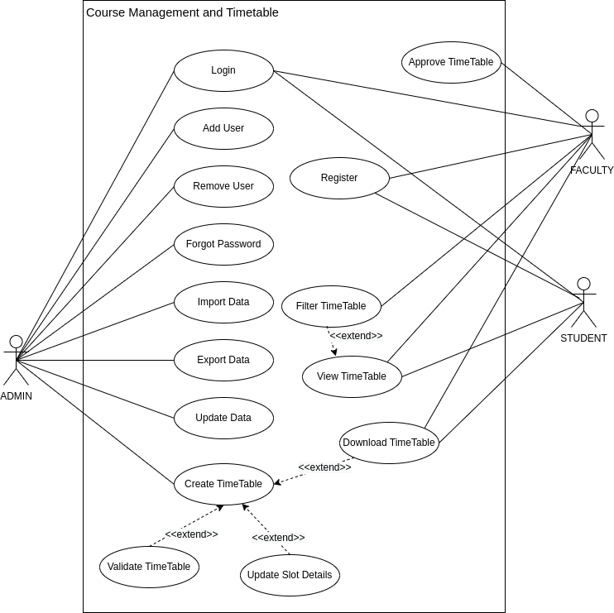

Usecase
Diagram

Slide 7
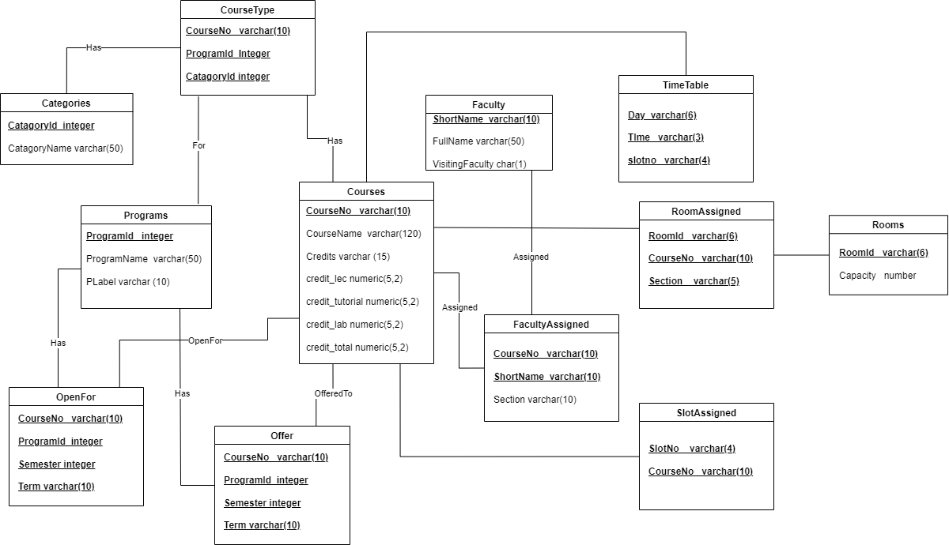
Schema
Diagram

Slide 8
Complete Analysis Class Diagram
Drive Link :
https://drive.google.com/file/d/13WMH3xbJekWWzxXaJAhKRehq1RYA7WKw/view?usp=share_link

Slide 9
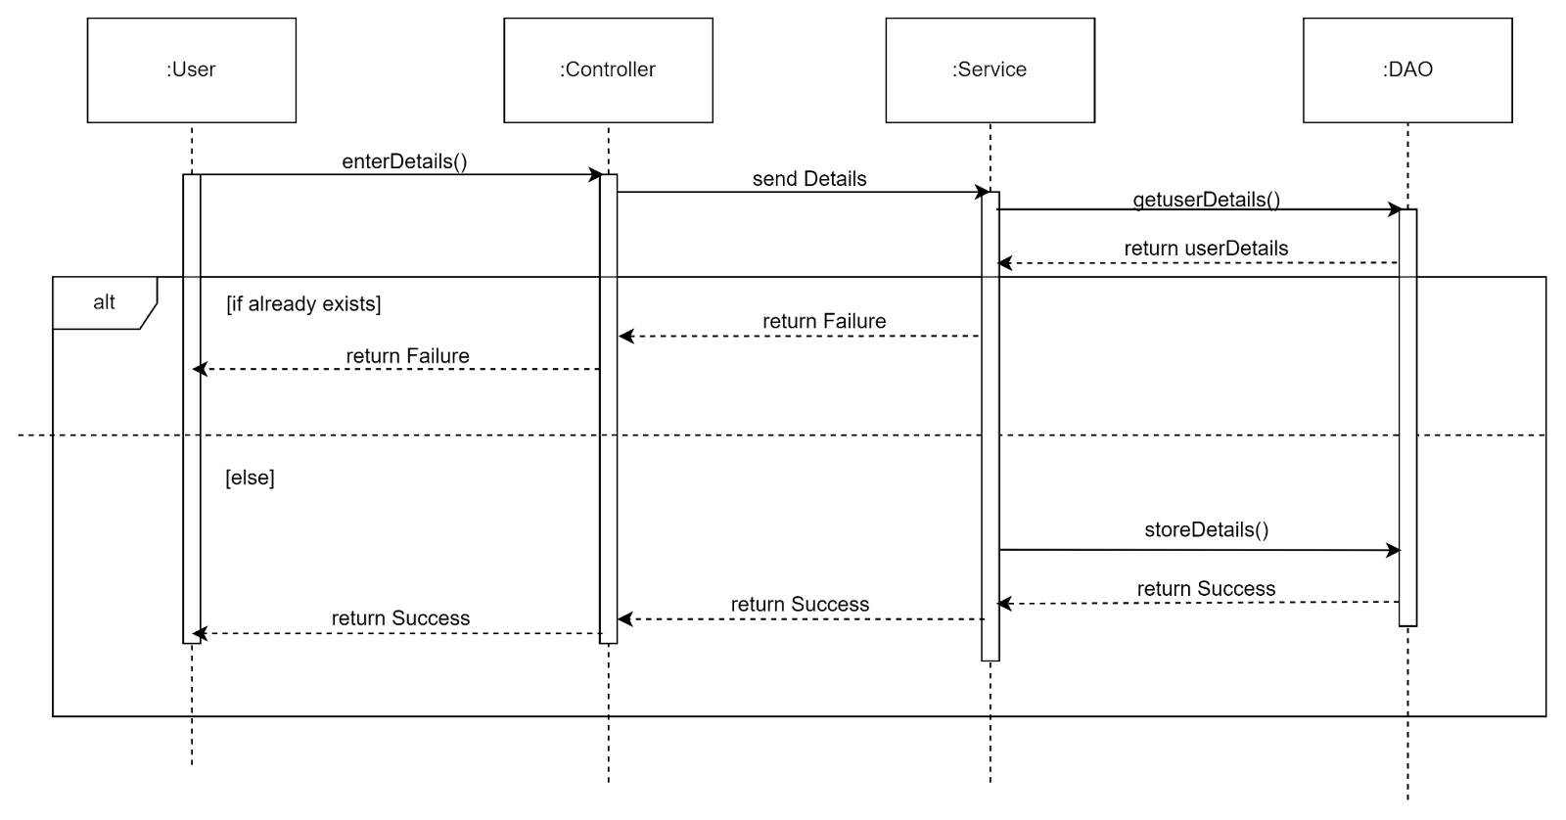
SEQUENCE DIAGRAMS
Registration :

Slide 10
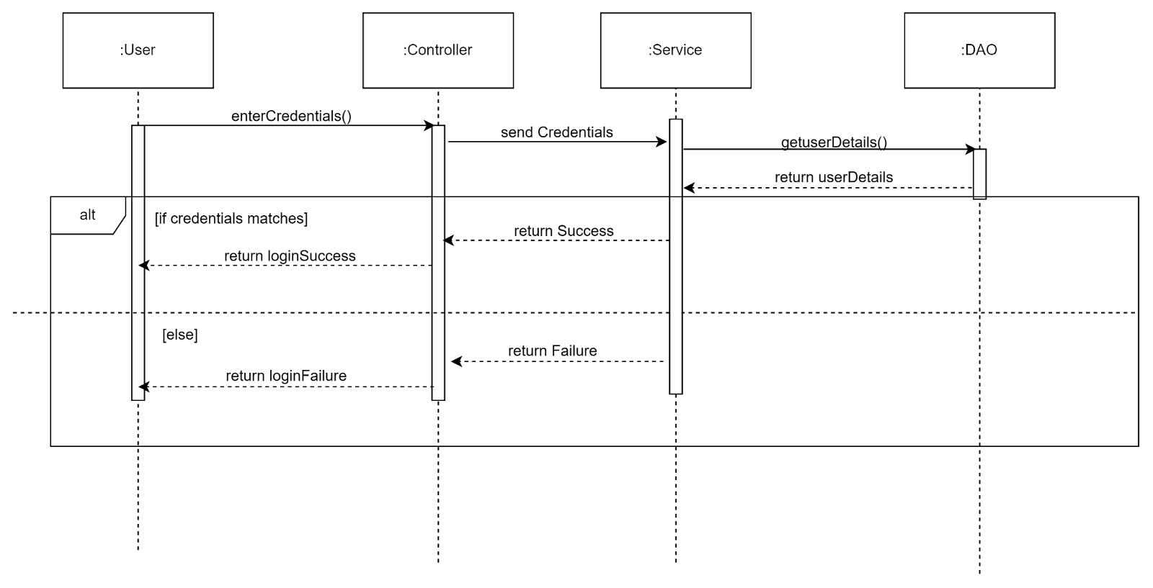
SEQUENCE DIAGRAMS
Login :

Slide 11
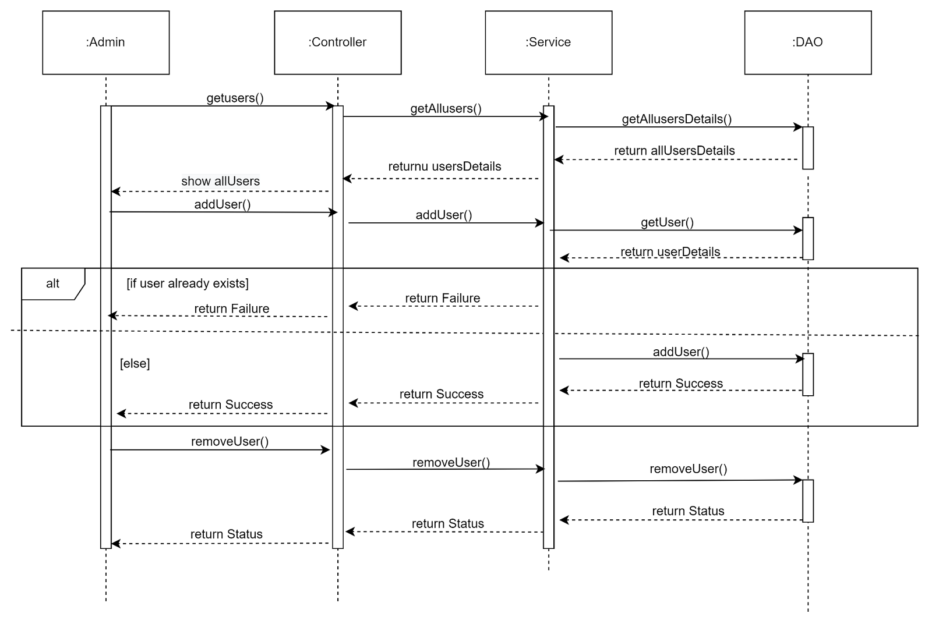
SEQUENCE DIAGRAMS
Add and Remove user -

Slide 12
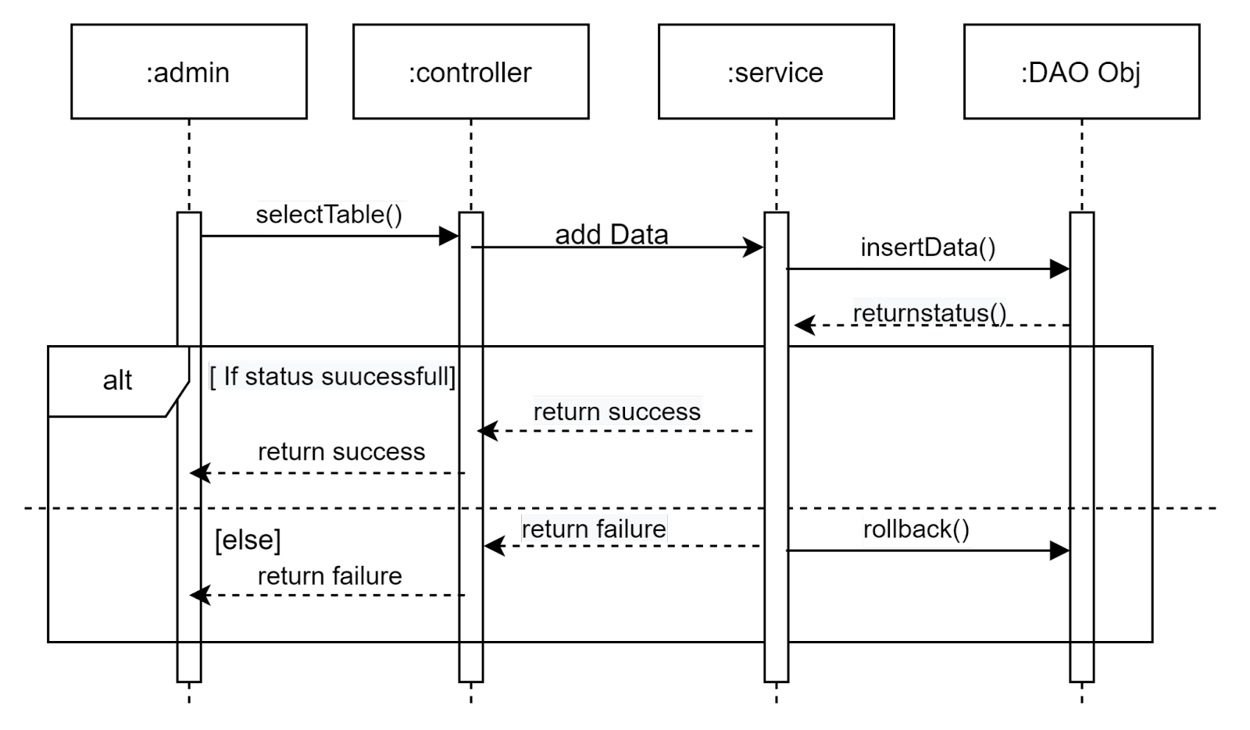
SEQUENCE DIAGRAMS
Import Data :

Slide 13
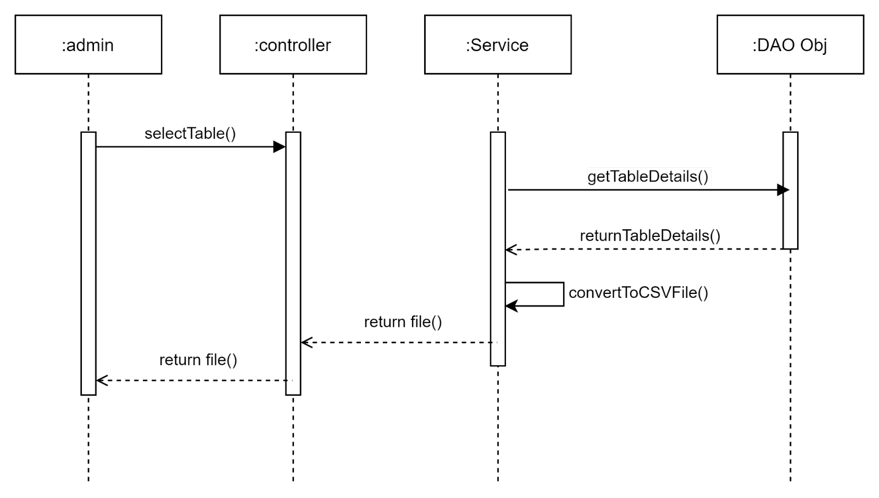
SEQUENCE DIAGRAMS
Export Data :

Slide 14
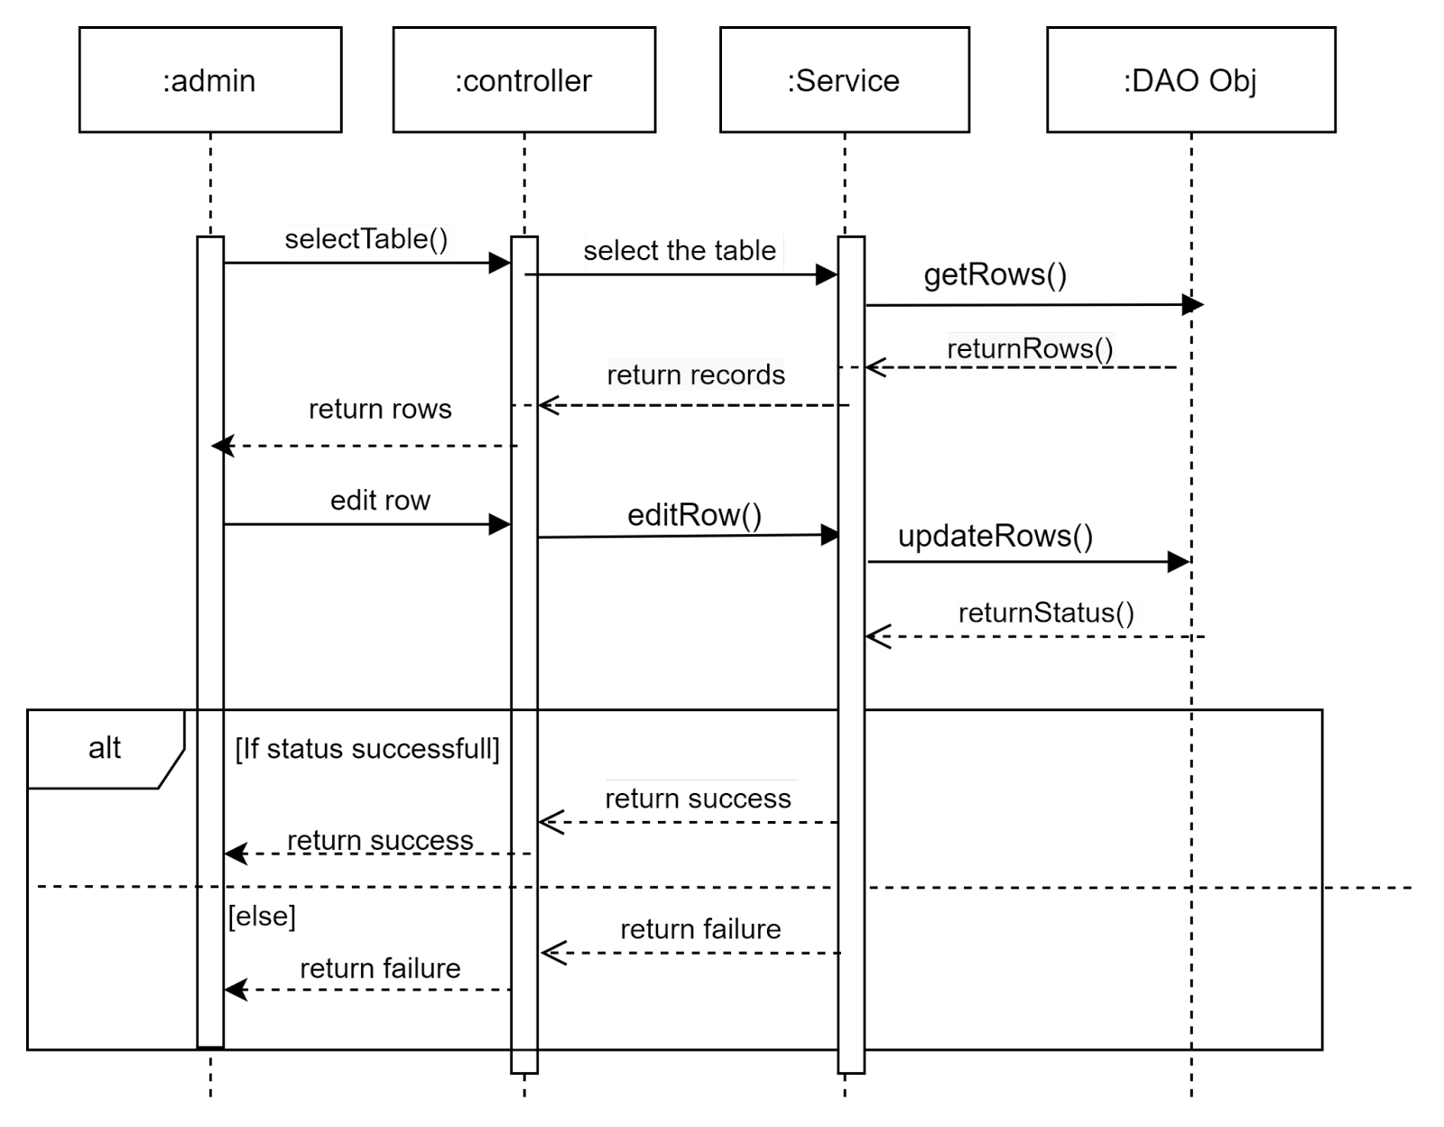
SEQUENCE DIAGRAMS
Update Data :

Slide 15
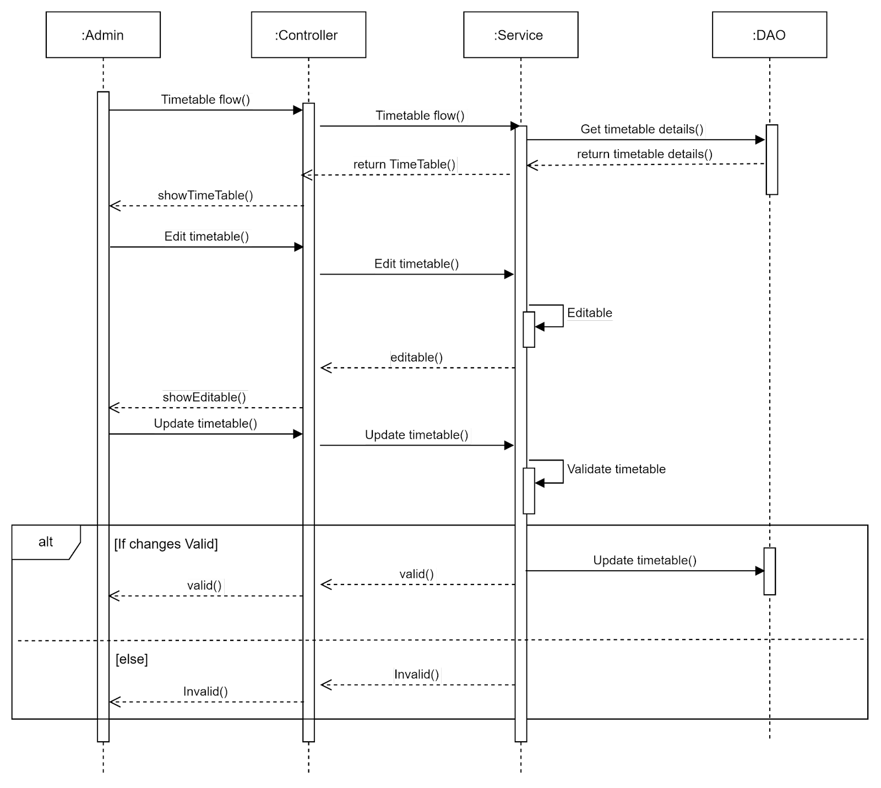
SEQUENCE DIAGRAMS
Create Time Table :

Slide 16
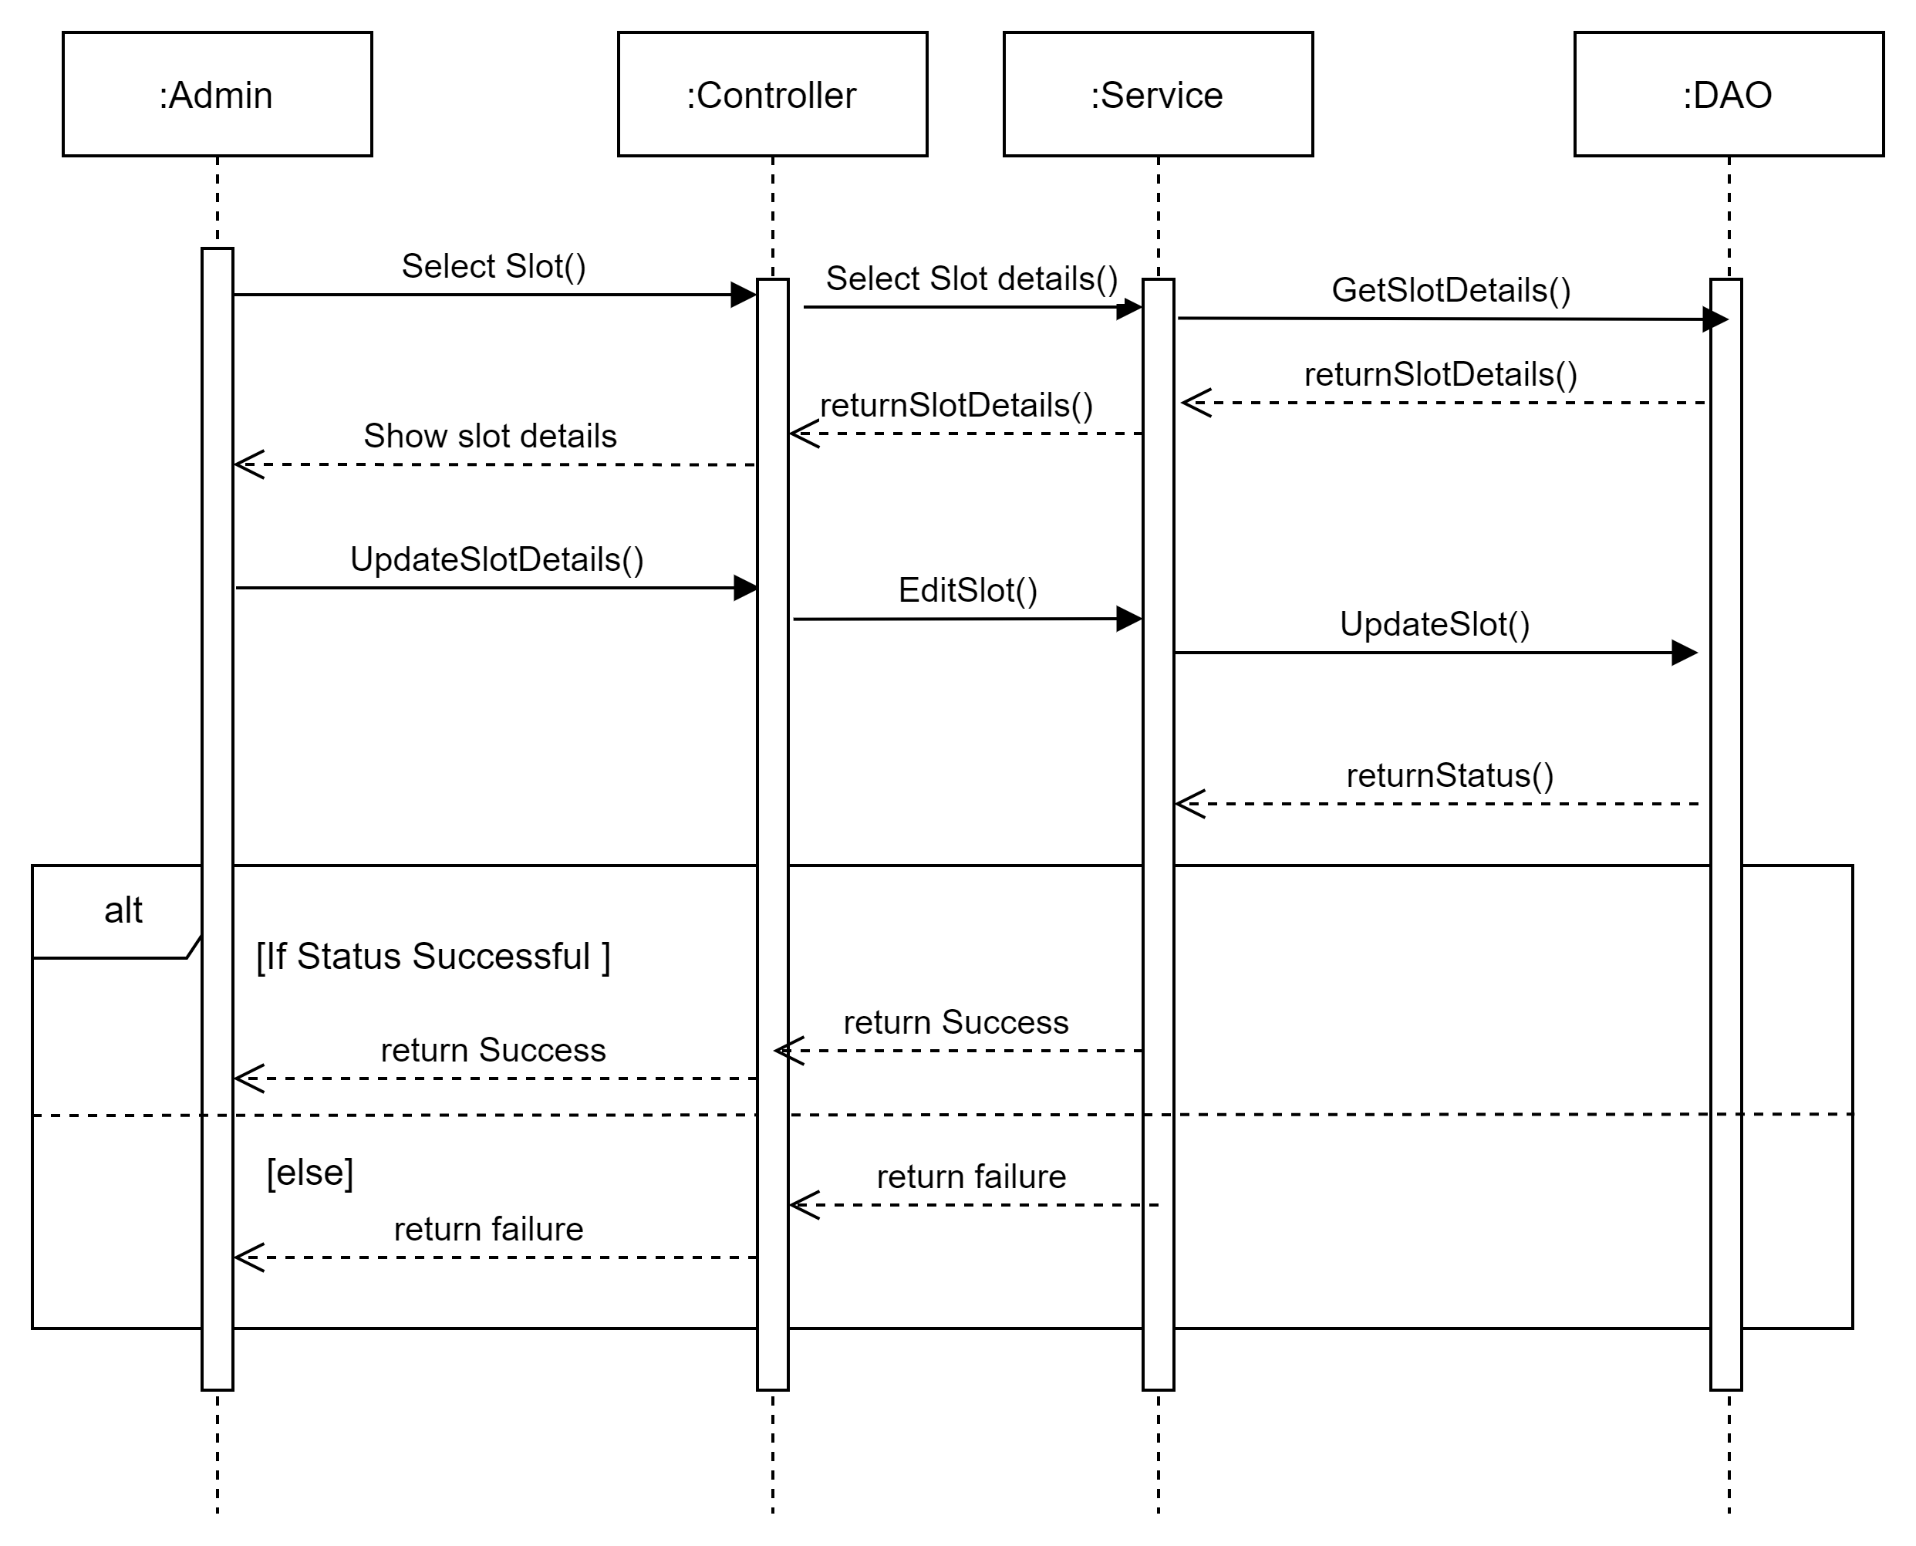
SEQUENCE DIAGRAMS
Update Slot :

Slide 17
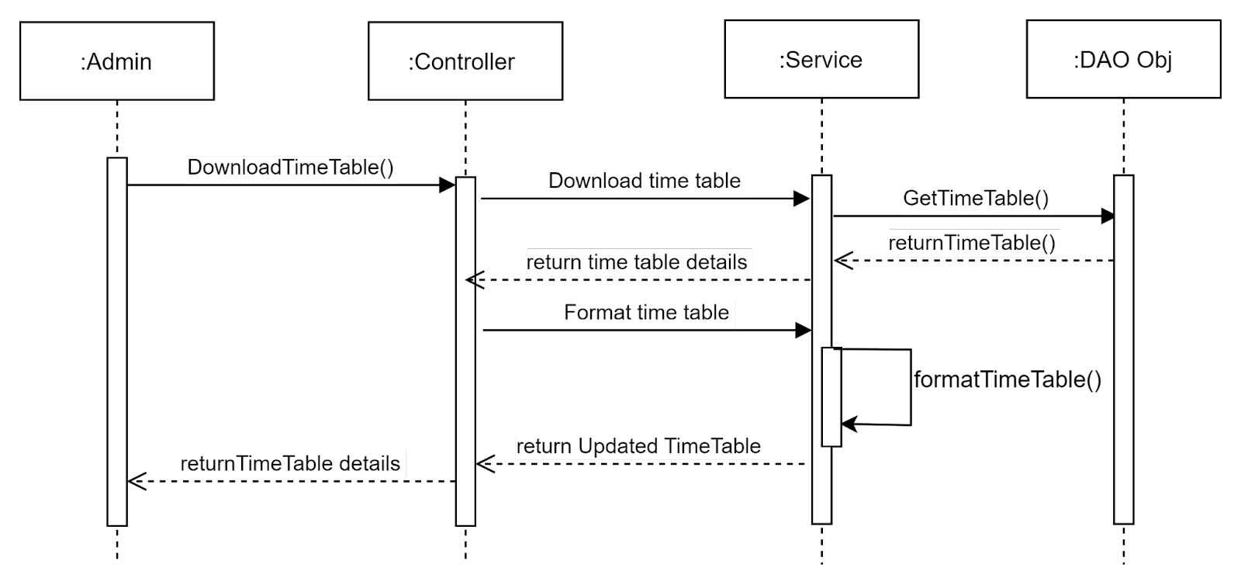
SEQUENCE DIAGRAMS
Download Time Table :

Slide 18
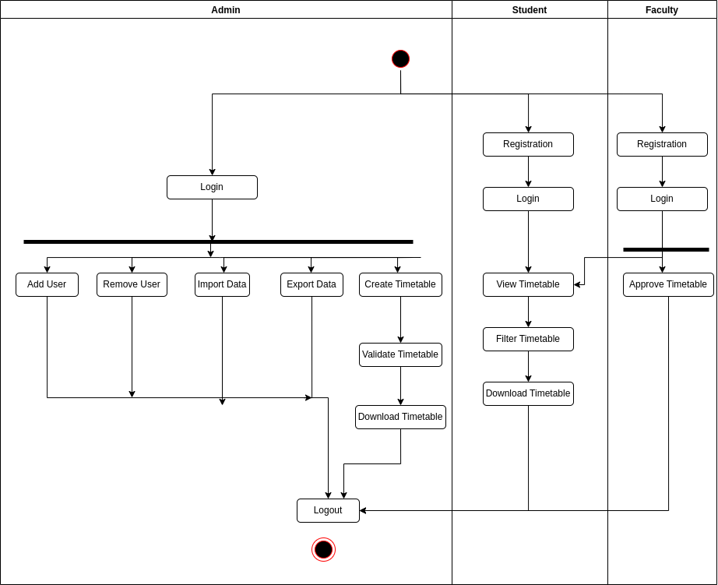
ACTIVITY DIAGRAM

Slide 19


