Slide 1
Credit Card Defaulter Prediction Using Machine Learning

Slide 2
Problem Statement
Predicting whether a customer is defaulting credit payment for the next month
The findings of the project aim to assist financial institutions by addressing the below:
1) Risk Management:
- To proactively reduce credit limits of users based on their profile and mitigate losses.
2) Customer Retention:
- Retaining customers by providing tailored incentives to low-risk customers using
customer segmentation.

Slide 3
About Dataset
This dataset contains information on default payments, demographic factors, credit data, history of payment, and bill statements of credit card clients
Source: https://archive.ics.uci.edu/ml/datasets/default+of+credit+card+clients
UCI Machine learning repository
The dataset has over 30,000 observations and 24 features.

Slide 4
Dataset Description
Features:
LIMIT_BAL: continuous. Credit Limit of the person.
SEX: Categorical: 1 = male; 2 = female
EDUCATION: Categorical: 1 = graduate school; 2 = university; 3 = high school; 4 = others
MARRIAGE: 1 = married; 2 = single; 3 = others
AGE: num. continuous.
PAY_0,PAY_2 to PAY_6: Categorical :-
2: Payment made in full and on time
-1: payment made in full but past the due date0: payment of the minimum amount was made
1: payment amount less than the minimum amount due
2: payment amount is between the minimum amount due and the full amount due
3: payment amount is between one and two months late
4: payment amount is between two and three months late
5: payment amount is between three and four months late
6: payment amount is between four and five months late
7: payment amount is between five and six months late
8: payment amount is between six and seven months (or more) late.
BILL_AMT1 to BILL_AMT6: Amount of bill statements.
PAY_AMT1 to PAY_AMT6: Amount of previous payments
Target:
Default Categorical
0:The Person will not be in the defaulter list for the next month
1: The Person will be in the defaulter list for the next month

Slide 5
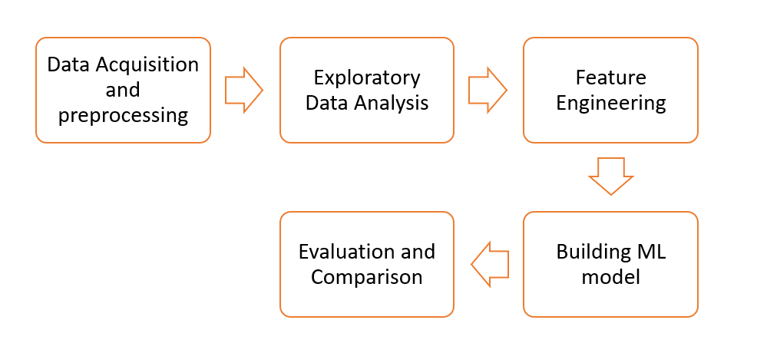
Flow Chart

Slide 6
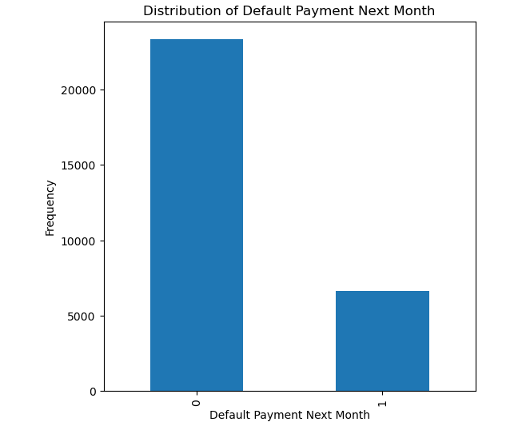
EXPLORATORY DATA ANALYSIS
The plot shows the distribution of default Payment showing unbalanced class
Class 0 – has 23364 non-defaulters (Max)
Class 1 – has 6636 defaulters (Min)

Slide 7
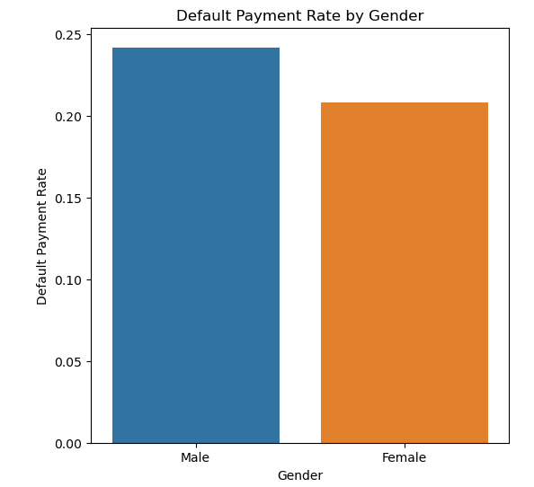
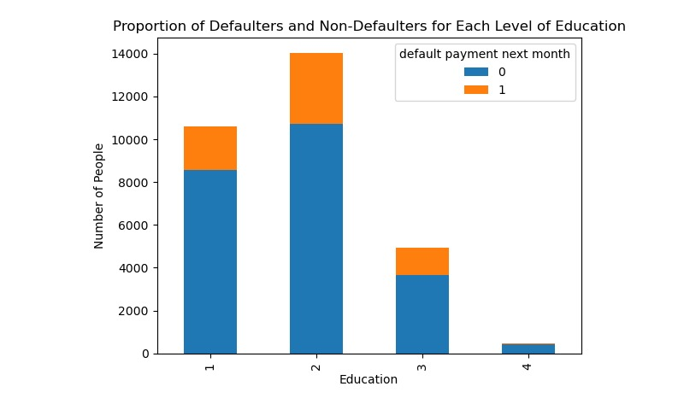
Plot shows the default payment distribution of both Gender and Education categories
Gender Category plot indicates non defaulters are high in males.
Education Category plot indicates that University students contribute to max defaulters.

Slide 8
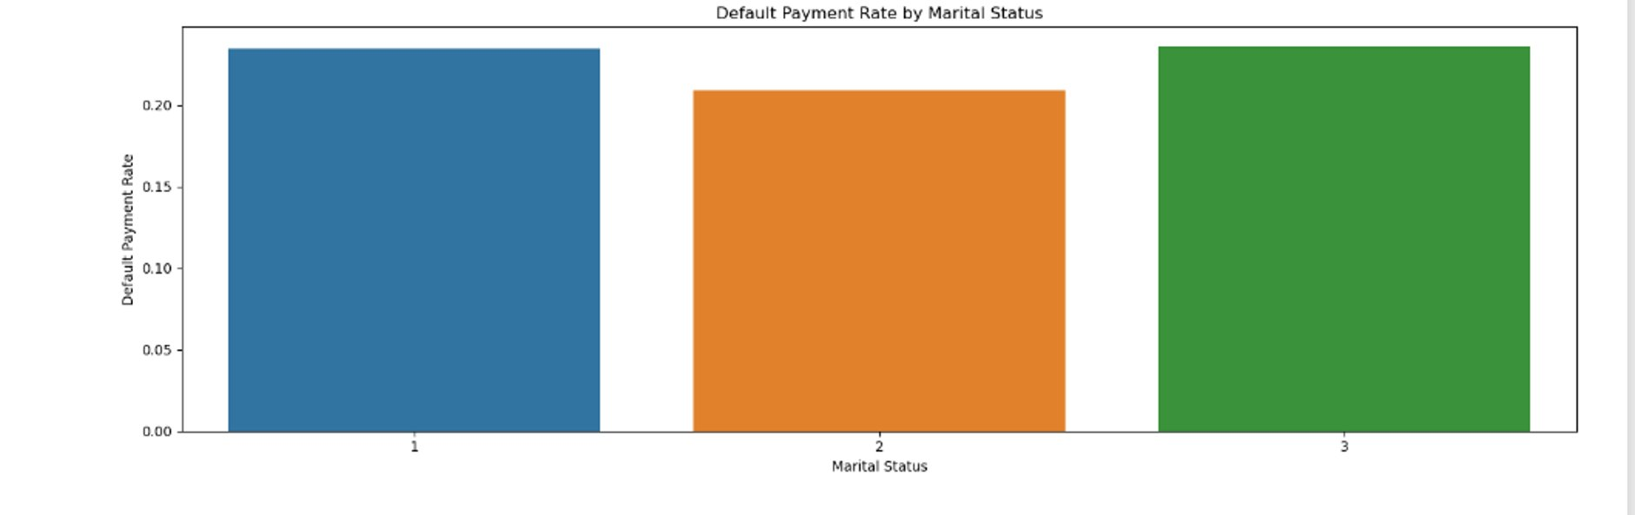
Default payment rate by marital status:
From this visualization , divorced or widowed category has the highest default rate. But there not that significant difference

Slide 9
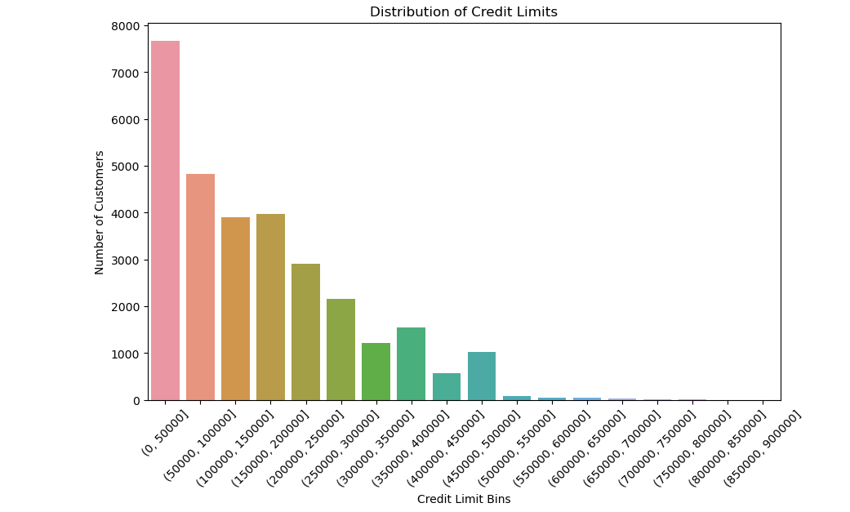
Distribution of credit limits (LIMIT_BAL) among the customers?
It can be clearly seen that majorly all people falls under the credit limit of 300000 where majorly people fall in basic credit limit that is (0-50000)

Slide 10
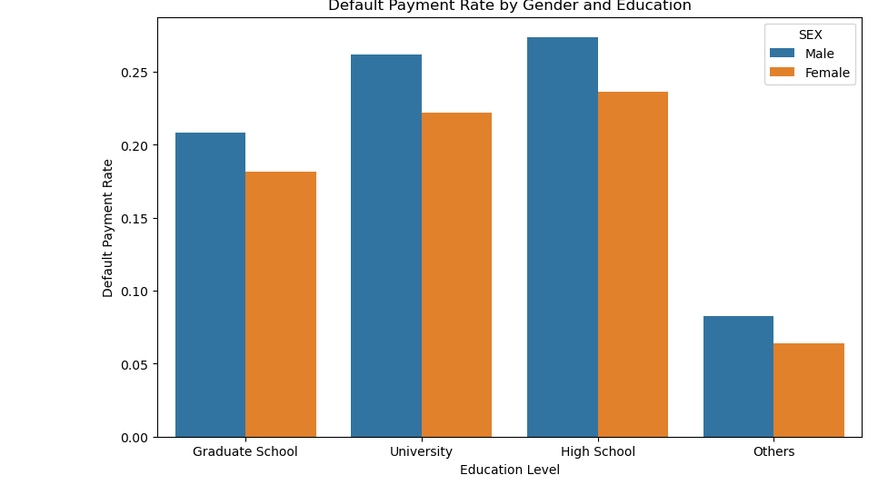
How does the distribution of default payments vary across different genders, education levels
The most number of default payments are recorded from university and high school students

Slide 11
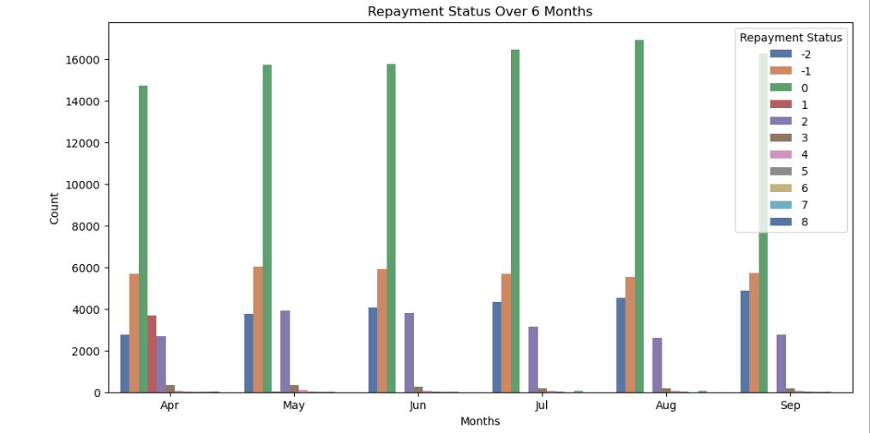
How do the repayment statuses (PAY_1 to PAY_6) vary over the six months?
It can be clearly interpreted that many people choose to pay their minimum amount every month. And the point to be noted is there are good number of people who pay full amount on time . There are good number of people who are not paying the minimum amount but they are attempting to pay

Slide 12
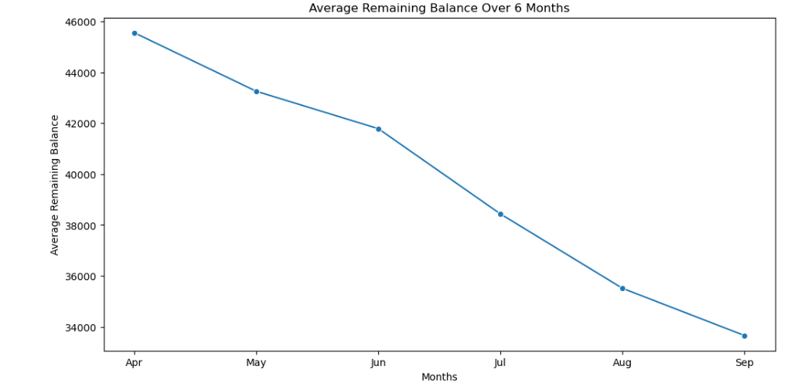
How do the repayment statuses (PAY_1 to PAY_6) vary over the six months? Are there any trends or patterns?
It can be clearly seen that more people tend to pay their credit card bills as they are approaching end of the year.

Slide 13
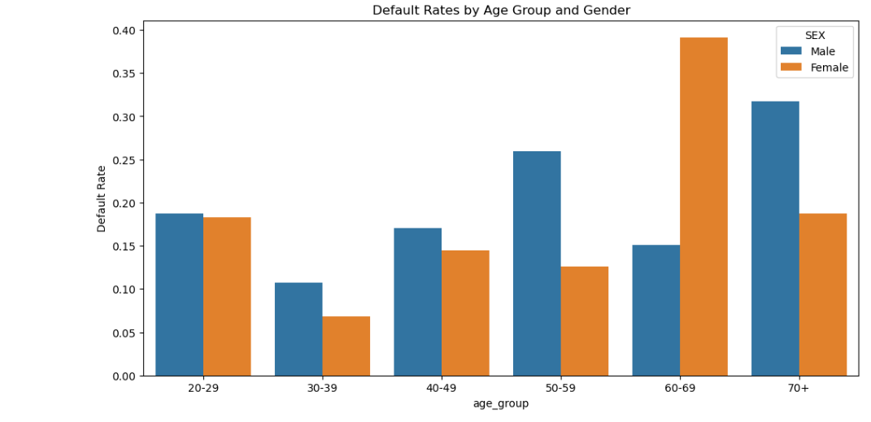
How does the distribution of default payments vary across different genders, Age Groups
From the plot it can be inferred that most of the credit card defaulters are above 50 both in males and females.
I feel this is so because of lack of knowledge.

Slide 14
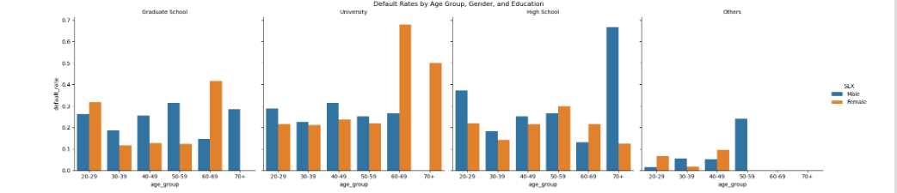
How does the distribution of default payments vary across different genders, Age Groups, Education
Females with University education and "Others" marital status, aged 60-69, have the highest default rate of 100% (1 out of 1 defaulted).
Females with University education and single marital status, aged 60-69, have the second highest default rate of 75% (3 out of 4 defaulted).
Males with High School education, married and aged 70+, have a default rate of 66.67% (2 out of 3 defaulted).
Females with Graduate School education, "Others" marital status, and aged 20-29, have a default rate of 60% (3 out of 5 defaulted).
Females with High School education, "Others" marital status, and aged 50-59, have a default rate of 52.63% (10 out of 19 defaulted).

Slide 15
Feature Engineering
Encode Categorical Features
Split dataset into train and test subsets (70:30)
Sampling training data
SMOTE(Synthetic Minority Oversampling Technique)
Oversampling
Undersampling

Slide 16
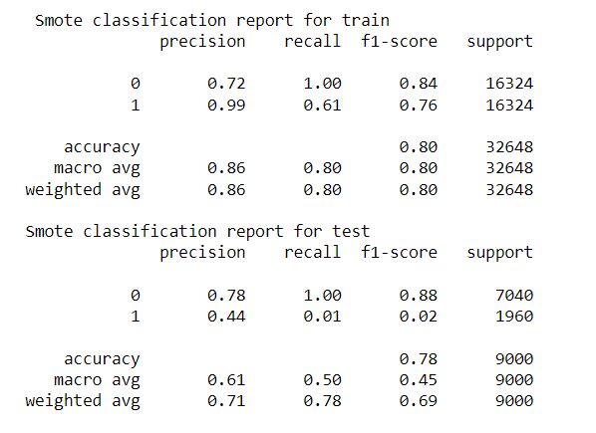
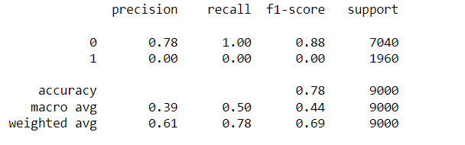
Logistic Regression
The model using SMOTE to balance the data achieved an accuracy of 80% on the training set and 78% on the test set. However, the precision, recall, and F1-score for the minority class (class 1) were much lower than the majority class (class 0) in both training and test sets.

Slide 17
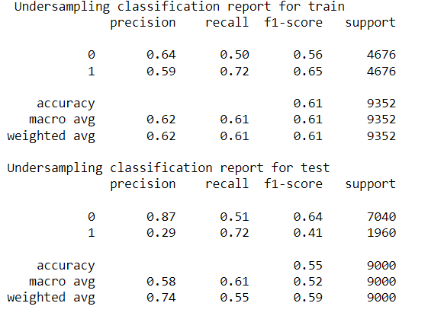
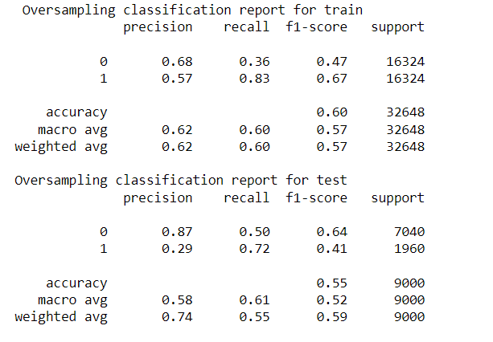
The oversampling method results in higher recall for the minority class in both train and test sets compared to SMOTE, but lower precision for the minority class. The overall accuracy is lower for the oversampling method compared to SMOTE.
In undersampling, the precision and recall for the minority class (class 1) is higher than in oversampling, but the overall accuracy is lower. The F1-score is also lower compared to SMOTE.

Slide 18
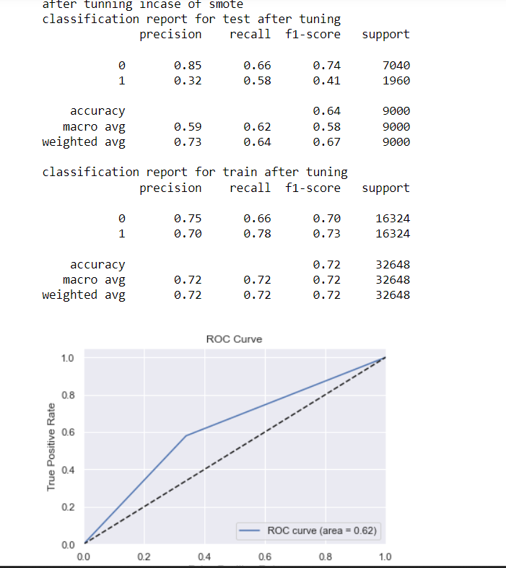
After tuning hyperparameters
After tuning, the Smote sampling technique shows improved performance on the training set with an accuracy of 0.72 and an f1-score of 0.73 for the minority class. However, the performance on the test set is not very good with an accuracy of 0.64 and an f1-score of 0.41 for the minority class.

Slide 19
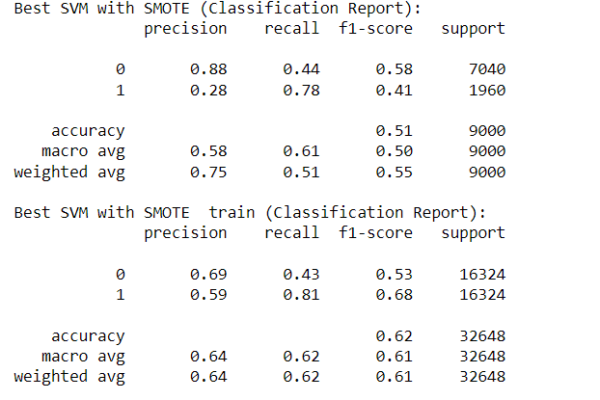
Support Vector Machine(Kernel)
The SVM Linear Kernel model has a low accuracy and F1-scores for both classes in both training and test sets with 62% and 51% respectively

Slide 20
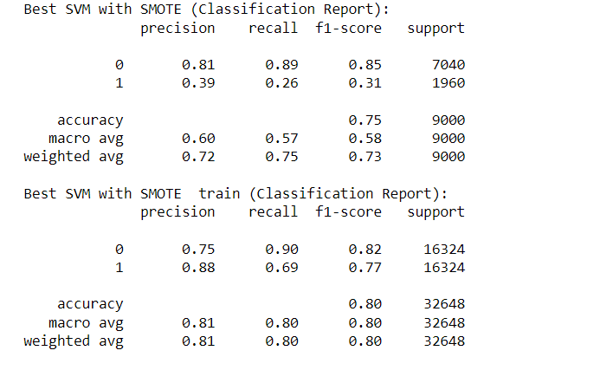
Rbf Kernel
The SVM with rbf kernel achieved an accuracy of 0.75 and an F1-score of 0.31 for the positive class on the test set. On the other hand, on the training set, it achieved an accuracy of 0.80 and an F1-score of 0.77 for the positive class.

Slide 21
Decision tree classifier
Partitions the input space into regions based on feature values, making sequential decisions at each internal node to reach a final prediction at the leaf nodes.
Can capture complex decision boundaries and also can handle both numerical and categorical features.
Decision trees can suffer from overfitting, where they become too specific to the training data and by pruning, limiting tree depth we can mitigate overfitting.

Slide 22
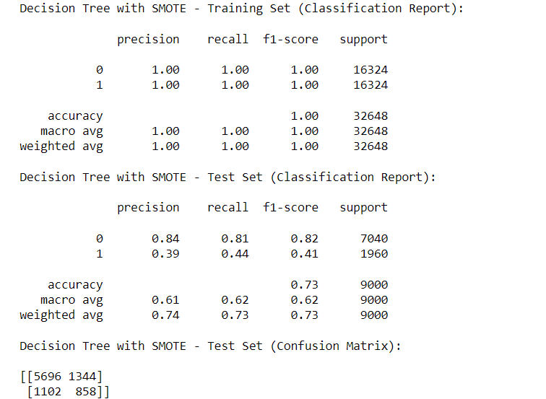
Decision Tree Classifier
The decision tree model with have performed well on the training set, achieving perfect precision, recall, and f1-score for both classes but on the test set, the model has lower performance, with lower precision, recall, and f1-score for the minority class. However, the overall accuracy of 0.73 is still reasonable.

Slide 23
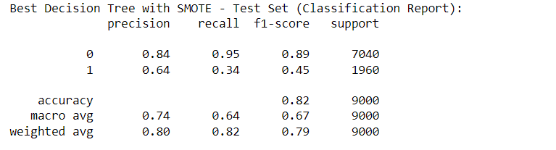
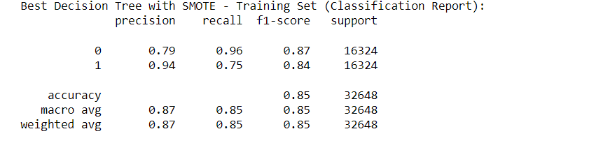
Tunning Decision Tree Classifier
After tuning, the decision tree has improved results on both the training and test sets. The best decision tree has an accuracy of 85% on the training set and 82% on the test set. It has higher precision and recall scores for both classes

Slide 24
Adaboost classifier
Adaptive Boosting, is a boosting algorithm used for binary classification problems which combines multiple weak learners (classifiers that perform slightly better than random guessing) to create a strong classifier.
It works iteratively by giving higher weights to misclassified examples in each round, Weak learners are trained on weighted versions of the training data, and their predictions are combined using a weighted voting scheme.
The final prediction of the Adaboost classifier is determined by the weighted combination of individual weak learner predictions. It has high accuracy, can handle complex datasets, and is less prone to overfitting compared to individual weak learners

Slide 25
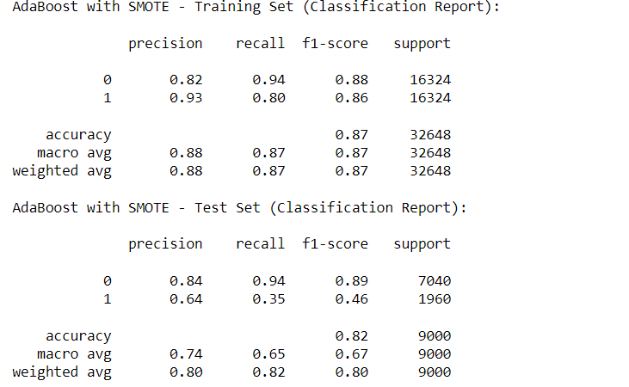
Adaboost Classifier
The AdaBoost model has a high precision and recall for the positive class (1) in the training set, with an overall accuracy of 0.87. In the test set, the precision and recall for the positive class are lower, but still accuracy is 0.82.

Slide 26
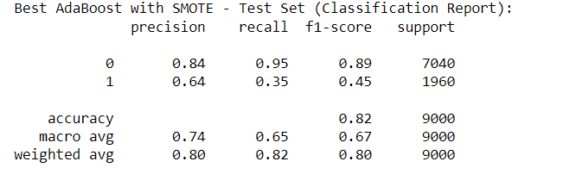
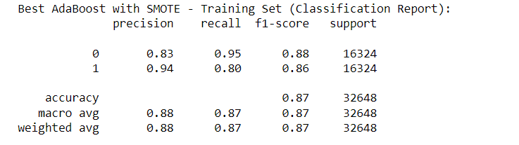
Tunned Adaboost Classifier
The best AdaBoost has an accuracy of 87% on the training set and 82% on the test set, with a precision of 84% for the majority class and 64% for the minority class on the test set

Slide 27
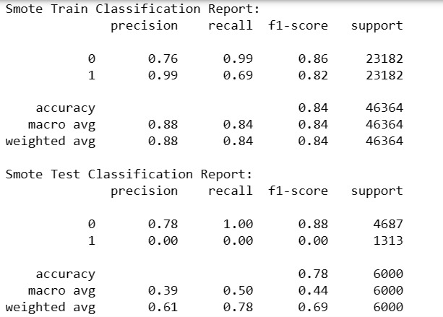
K-Nearest Neighbors
The output shows that the k-NN model has achieved a good accuracy score of 0.84 on the training dataset, indicating that it has learned the patterns in the data well. However, on the testing dataset, the model has an accuracy score of 0.78, It also shows that the model has correctly predicted all instances of the majority class (0), But has failed to predict any instances of the minority class (1). This suggests that the model may be overfitting to the majority class, and further hyperparameter tuning may be needed to improve the model's performance.

Slide 28
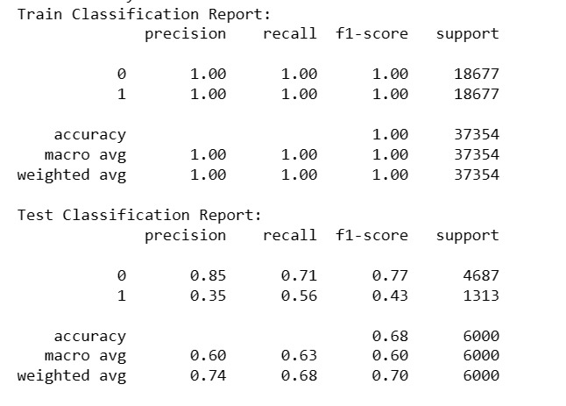
After Hyperparameter tuning
After performing hyperparameter tuning using grid search, the output shows the performance metrics for both the training and testing data
In this case, the training data shows perfect classification performance with 100% precision, recall, and F1-score for both classes. However, the testing data shows lower performance with an accuracy score of 68%. The precision, recall, and F1-score for class 0 are relatively good with values of 0.85, 0.71, and 0.77, respectively. However, the performance is poorer for class 1, with values of 0.35, 0.56, and 0.43 for precision, recall, and F1-score, respectively.

Slide 29
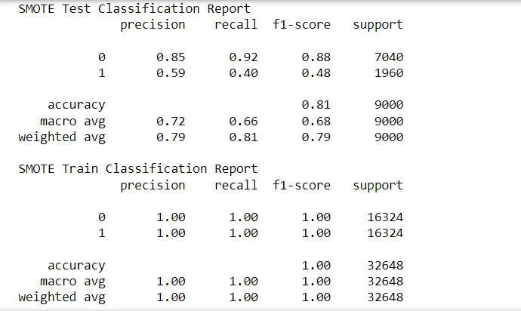
Random Forest Classifier
The Random Forest Classifier model has an accuracy of 81% on the test data and 100% on the training data. However, the model performs better at predicting the majority class (0) than the minority class (1), as indicated by the lower precision, recall, and F1-score values for the minority class in the test classification report.
These metrics suggest that the model may be overfitting to the training data additional evaluation and fine-tuning may be needed to improve the performance of the model.

Slide 30
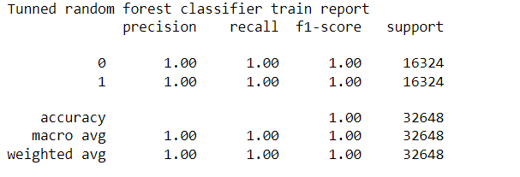
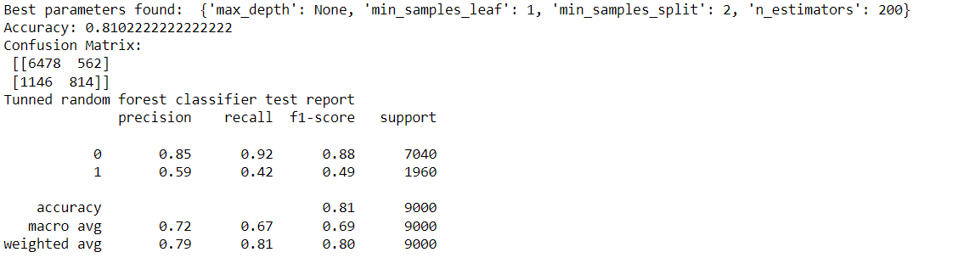
Tunned RandomForest Classifier
The tuned random forest classifier achieved an accuracy of 0.81 on the test set and 1.00 on the training set. The precision, recall and F1-score for the test set were 0.85, 0.92 and 0.88 for the majority class (0) and 0.59, 0.42 and 0.49 for the minority class (1).

Slide 31
Gradient boosting:
Gradient Boosting is an ensemble method for both regression and classification problems.
It optimizes a differentiable loss function while building an additive model in a forward stage-by-stage fashion.
Decision trees are used as weak learners in gradient boosting, and each new tree is trained using the residuals from the preceding ensemble.
In addition to allowing for hyperparameter customization, it can manage missing data and outliers.
A well-known method in the data science community, gradient boosting has been demonstrated to work effectively on a variety of machine learning problems.

Slide 32
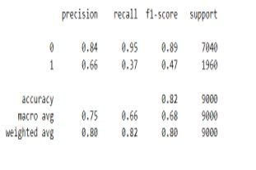
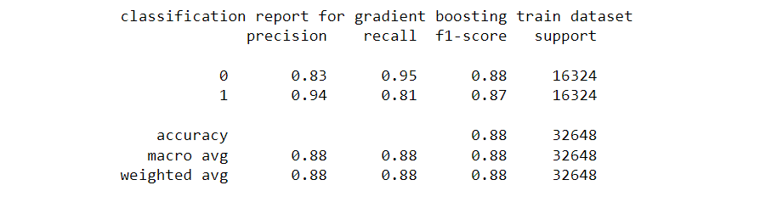
Gradient boosting :
The classification report provides information on the model's performance on the test set. The model achieved an accuracy of 82%, with a precision of 0.66 and a recall of 0.37 for predicting the positive class (default payment). The F1-score for the positive class is 0.47, indicating room for improvement. The model's overall performance is decent, but there is potential for improvement through hyperparameter tuning or exploring other algorithms.

Slide 33
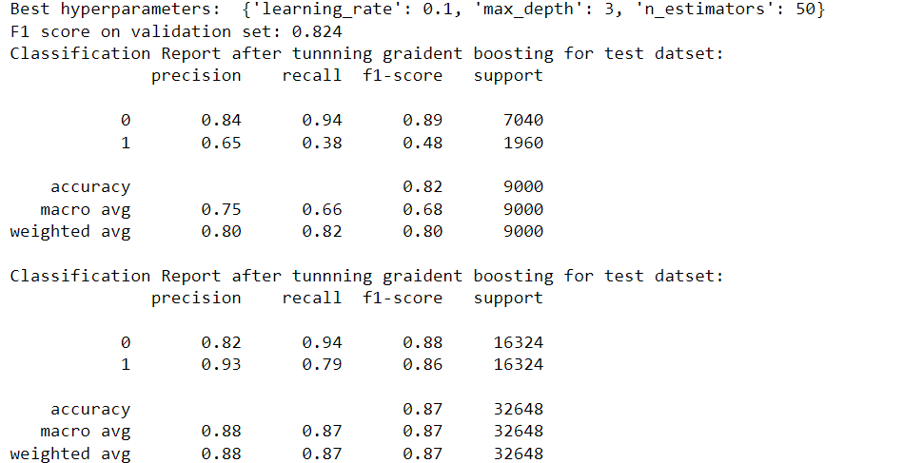
Gradient Boosting After hyperparameters tuning
The tuned gradient boosting model achieved good performance on both the validation and test sets, with high accuracy, precision, and recall. The F1 scores for the positive class and overall were also strong. Overall, the model appears to be an effective approach for predicting default payment.

Slide 34
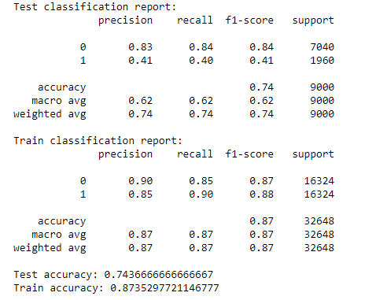
XG BOOST ALGORITHM
The XGBoost model achieved an accuracy of 80% on the training set and 78% on the test set, which is relatively high. The precision, recall, and F1-score for the minority class (class 1) were much lower than the majority class (class 0) in both training and test sets. This indicates that the model is better at predicting the majority class than the minority class.Overall, the XGBoost model performs similarly to the decision tree model, with a similar accuracy of 77%.

Slide 35
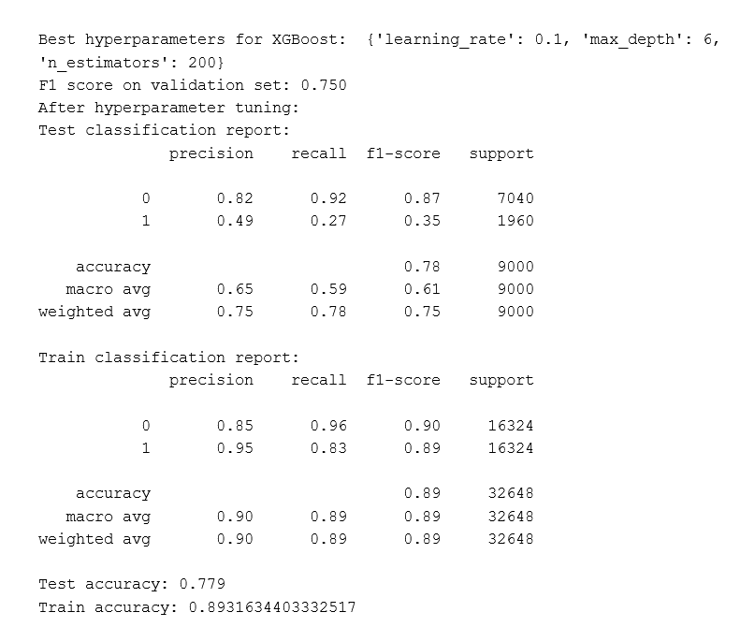
After Hyperparameter Tuning
The best hyperparameters for the XGBoost model were found to be a learning rate of 0.1, a maximum depth of 6, and 200 estimators. After hyperparameter tuning, the model achieved an F1-score of 0.750 on the validation set, which is an improvement over the initial model.
On the test set, the XGBoost model with the optimized hyperparameters achieved an accuracy of 78%, with a precision of 0.82 for the majority class (class 0) and a precision of 0.49 for the minority class (class 1). The recall and F1-score were also higher than the initial model, with a recall of 0.92 and an F1-score of 0.87 for the majority class, and a recall of 0.27 and an F1-score of 0.35 for the minority class.

Slide 36
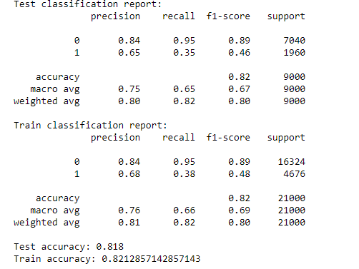
RNN
The RNN model achieved an accuracy of 82% on the test set, with a precision of 0.84 for the majority class (class 0) and a precision of 0.65 for the minority class (class 1). The recall and F1-score were also higher for the majority class than the minority class, with a recall of 0.95 and an F1-score of 0.89 for the majority class, and a recall of 0.35 and an F1-score of 0.46 for the minority class.

Slide 37
Customer Segmentation
Customer segmentation is the process of dividing customers into groups based on shared characteristics or behaviors, and it can help credit card companies tailor their products and services to better meet the needs of different customer segments.
In this project, we have divided the customers based on Marriage, Age, Gender, Education, and Payment Status
We performed Clustering using K-means Clustering Algorithm.
Kmeans clustering is a popular unsupervised machine learning algorithm used for clustering or grouping similar data points together. The algorithm works by iteratively partitioning data into K clusters, where K is a predefined number of clusters.

Slide 38
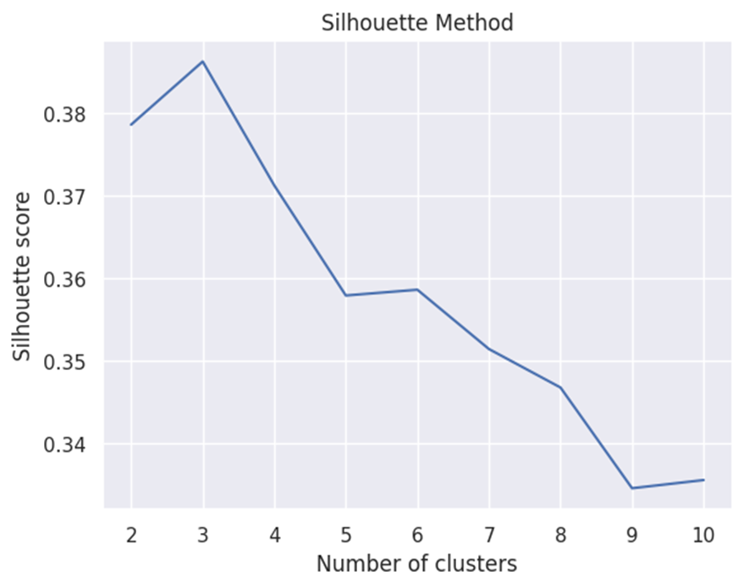
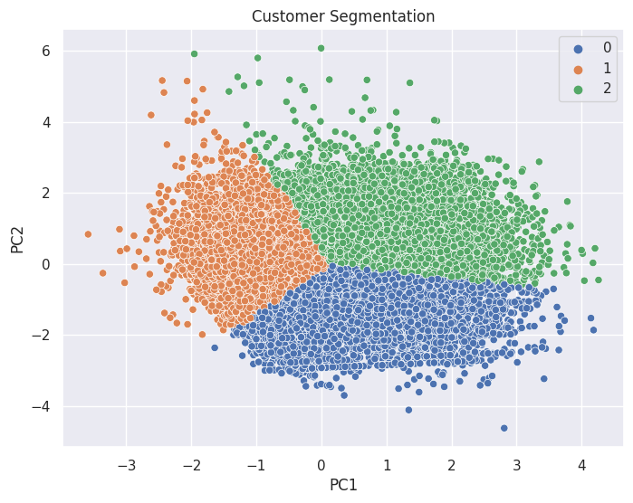
Finding the number of clusters
Customer Segmentation based on the 3 clusters

Slide 39
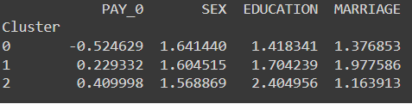
Cluster 0: Customers with low credit risk
Customers in this cluster have a lower average value of PAY_0, indicating that they have a history of paying their bills on time.
They are more likely to be female (SEX = 1.64) and have an education level (EDUCATION = 1.41) compared to other clusters.
They are also more likely to be married (MARRIAGE = 1.37).
Cluster 1: Customers with medium credit risk
Customers in this cluster have a higher average value of PAY_0, indicating that they have a history of delayed payments.
They are more likely to be female (SEX = 1.60) and have a good education level (EDUCATION = 1.70) compared to other clusters.
They are also more likely to be single (MARRIAGE = 1.97).
Cluster 2: Customers with high credit risk
Customers in this cluster have the highest average value of PAY_0, indicating that they have a history of defaulting on their payments.
They are more likely to be male (SEX = 1.56) and have the lowest education level (EDUCATION = 2.40) compared to other clusters.
They are also more likely to be married (MARRIAGE = 1.16).

Slide 40
Conclusion
Algorithm | Train Accuracy | Test Accuracy
Logistic Regression | 72 | 64
Support Vector Machine | 80 | 75
K-Nearest Neighbors | 100 | 68
Decision Tree | 85 | 82
Random Forest | 100 | 81
Adaboost Classifier | 87 | 82
Gradient Boosting Classifier | 88 | 82
XGBoost Classifier | 89 | 78
RNN | 82 | 82
The top three models based on the Test Accuracy are Decision Tree Classifier, Adaboost Classifier, and RNN.
PAY_02,LIMIT_BAL are the most important features from feature ranking calculation.

Slide 41
Questions

Slide 42
Thank you

