Slide 1

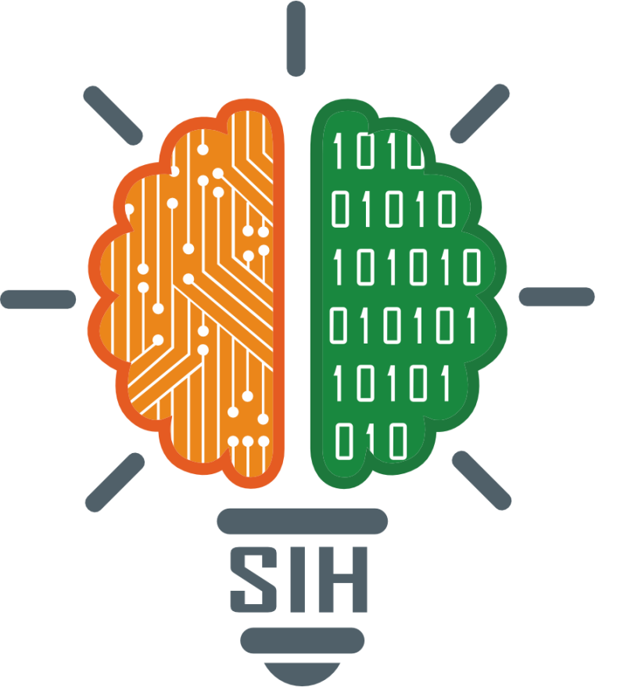
SMART INDIA HACKATHON 2024
TITLE PAGE
Problem Statement ID – 1640
Problem Statement Title– Assure Contract
Farming System for Stable Market Access
Theme- Agriculture, FoodTech & Rural
Development
PS Category- Software
Team ID- DYP_SIH_56
Team Name – Farmers(

Slide 2
IDEA TITLE
Farmers
Problem:
As we know in India, Farmers frequently protest due to unfair pricing and lack of market access Insufficient income. also customer struggles to get fresh, hygienic food daily. Because of this Lots of problems are created suicide, Food crises etc..
Solution:
To address this problem, we are developing a website Named "Stopper" with an AI/ML feature for prediction of Crops and Maintaining water and fertilizer levels. This platform connects farmers directly with buyers, eliminating the middleman and Ensuring that farmers receive full income for their products at a fixed price. By collecting data from users, we suggest to farmers what crops to grow based on buyer data, reducing waste and overproduction. also buyers get fresh, hygienic food daily. Supporting the Ecosystem and GDP by creating an Efficient demand and supply chain.
Key Features/Innovations/uniqueness :
Monthly Data Collection: Gather user data monthly to recommend crops to farmers based on buyer data.
City-Based Supply: Supply products based on city names for efficient distribution.
Continuous Help Support: Secure, direct messaging between farmers, buyers, and website helper anytime.
Crisis Alerts: Instant alerts for natural crises for both farmers and buyers.
ML Model for Crop Suggestions: Suggest crops based on soil and environmental factors also maintain water level.
Nearest City Supply Guidance: Guide farmers on where to supply food based on proximity.
AI Model for Weather Prediction: Predict rainfall patterns for better farming decisions.

Slide 3

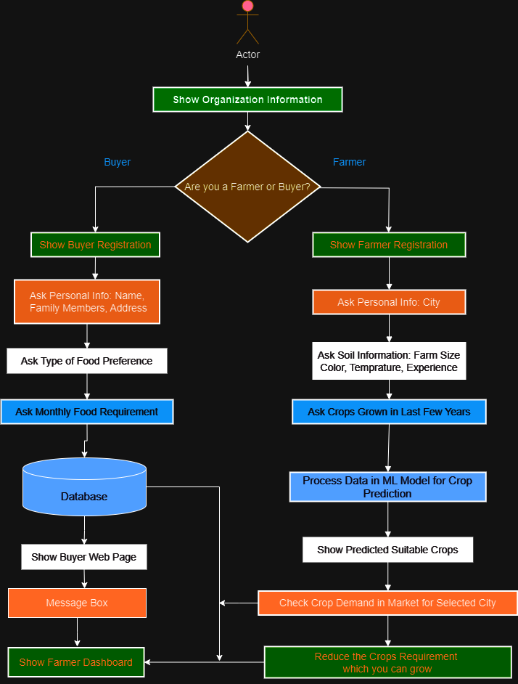













TECHNICAL APPROACH
Process Flow :-
Technology Stack :-

Slide 4
FEASIBILITY AND VIABILITY
Feasibility :-
Existing Systems: Our platform is different because current systems are B2B, involve middlemen, and they buy food in bulk amount when they have least price and then frozen it. so farmers and buyers does not get benefits from it .
Profitability: By cutting out the middlemen, our system helps farmers earn more income and gives buyers fresh food at a lower cost on the daily basis.
Demand-Driven Farming: We grow crops based on what people actually need, preventing waste and reducing overproduction. we sure that supply matches demand and demand supply chain will be created.
Target Audience Reach: Unlike some current systems that only focus on a 5% People of the market, we target rural areas and middle-class families so it help them to grow with the world. Also alert, Ai/ml model makes feasible more.
Risks/Problems:- Educating farmers on technology, data and payment security, natural crises affecting crops, data accuracy for ML models, delivering food on time, fluctuating food prices.
Risks/Solutions:
Educating Farmers on Technology: Ensure easy-to-use platform ,proper training so farmers can effectively use technology.
Data Security: Implement strong security measure for payment, analyses farmers & buyers data & send alert on problem.
Natural Crises Alerts: Use AI/ML to predict and alert farmers about natural crises to prepare and respond effectively.
Data Accuracy for ML Models: Maintain and update data regularly, with agricultural experts to improve model accuracy.
Delivery System: Develop a timely and efficient delivery system that also creates job opportunities for bikers.

Slide 5
IMPACT AND BENEFITS
Potential Impact on the Target Audience:
Farmers: They Gain direct access to buyers, so increasing their income and reducing dependence on middlemen. They also get suggestion for a crops so they can produce crops effectively and also alerts natural crises so they respond effectively.
Buyers: Access to fresh, hygienic product at stable prices, with more transparency and clarity.
Rural and Middle-Class Communities: the main focused is on rural and Middle-Class families so they are aware about the technology and grow with the word. contributing both environment and India's development. As there are many technology present in a market but they don’t connect the rural areas with them so they does not get benefits we are doing this.
Benefits:
Awareness in rural areas: Helps rural and middle-class families to grow with technology and improve their lives.
Increased income for farmers: Direct market access boosts farmers' earnings and reduces financial stress.
Better food for buyers: buyers get fresh, healthy food, so it reducing healthcare issues .
Stop of farmer suicides: Farmers earn a fair income now , reducing financial burdens so now the suicides are stopped.
Environmental benefits: Reduces overproduction and waste, promoting organic farming and sustainability.
Reduced protests: a fair income is for farmers, so the less dissatisfaction are there so no protests against the government.
Boost to GDP: When our needs are met, we can export the food , contributing to national economic growth.

Slide 6
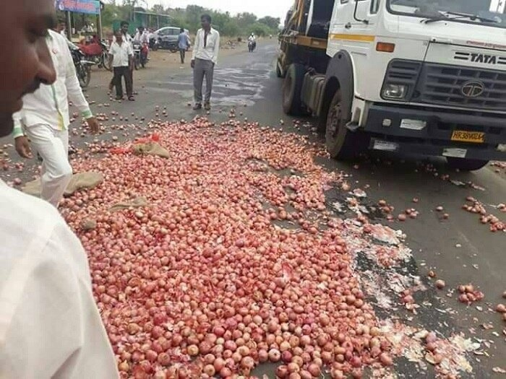
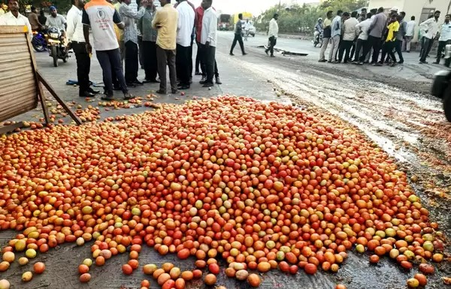
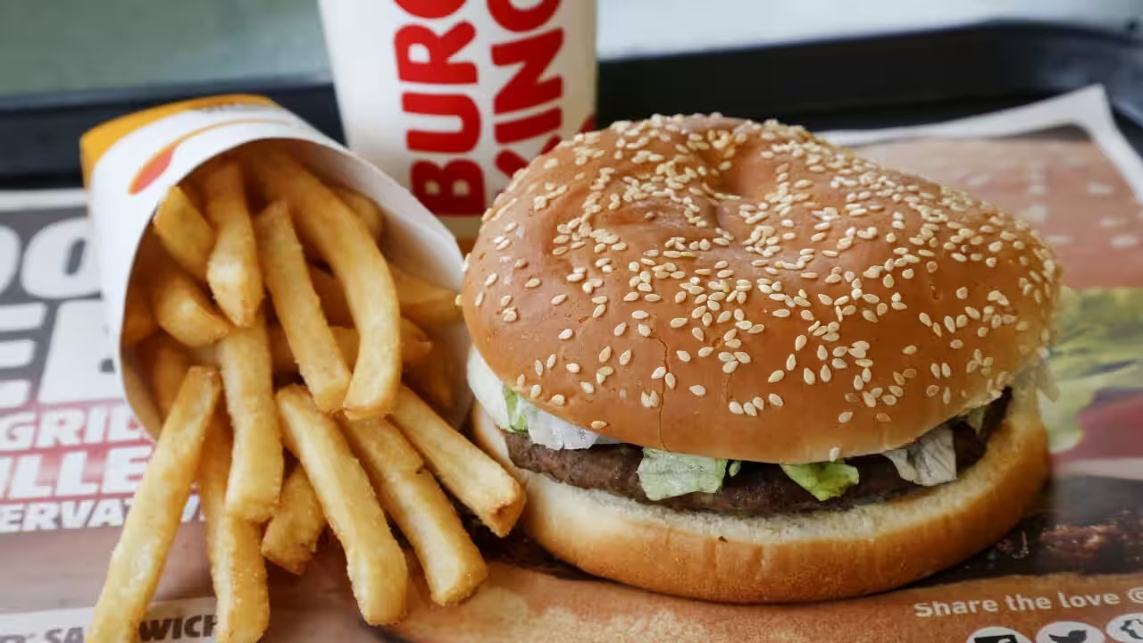
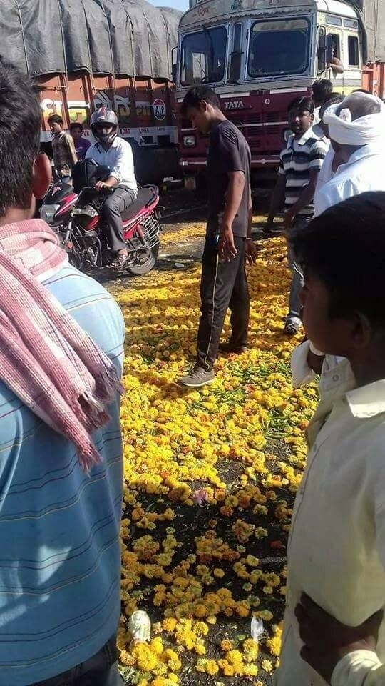
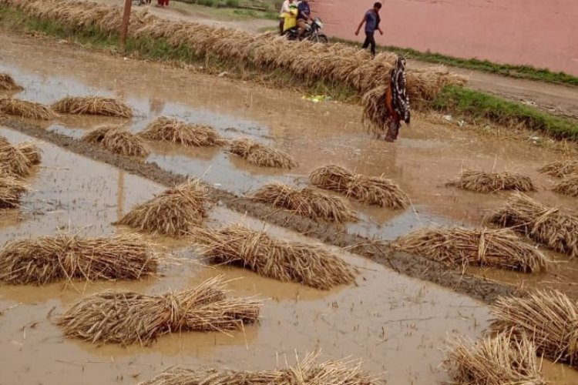
RESEARCH AND REFERENCES
Farmer sells at ₹10.
Market tax ₹2, total price becomes ₹12.
Middleman sells at ₹15.
Small dealer sells to customer at a higher price.

