Slide 1
Theme 1
Problem Statement 3 -Unilever Data Science POC Use Case
Team Members:
Harshit Trivedi
Nikhil Darade

Slide 2
Problem Statement
Problem Definition:
One of our brands is going through some major changes in business execution plans and will like to know.
i. What are the major drivers for sales(EQ)? ii. Knowing the drivers, how accurately we can predict future sales for next 6 periods?
Problem Solving:
i. One Bayesian method
ii. One general ML/ forecasting approach

Slide 3
Observations:
Using Linear Regression and Decision Tree Regressor
What are the major drivers for sales(EQ)?
Inflation,
pct_PromoMarketDollars_Subcategory
pct_PromoMarketDollars_Category
Median_Rainfall

Slide 4
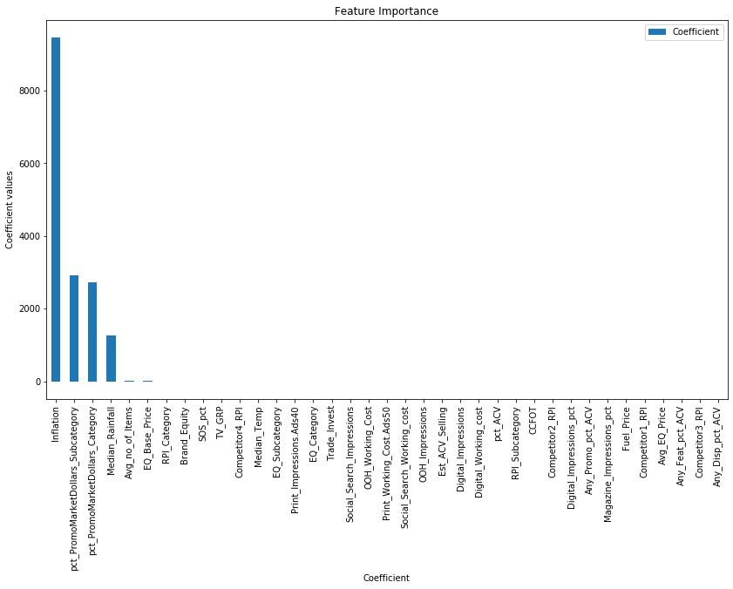

Slide 5
InComplete …

