Slide 1



Slide 2
Types of Joins
Inner Join
Natural Join
Left (Outer) Join
Right (Outer) Join
(Full) Outer Join
Left (Outer) Join Excluding Inner Join
Right (Outer) Join Excluding Inner Join
(Full) Outer Join Excluding Inner Join
Cross Join
Left Anti Join
Right Anti Join

Slide 3
Sample Tables
TableA
TableB
PK | Value
1 | FOX
2 | COP
3 | TAXI
6 | WASHINGTON
7 | DELL
5 | ARIZONA
4 | LINCOLN
10 | LUCENT
PK | Value
1 | TROT
2 | CAR
3 | CAB
6 | MONUMENT
7 | PC
8 | MICROSOFT
9 | APPLE
11 | SCOTCH

Slide 4
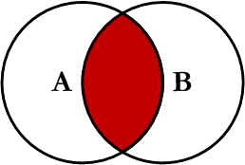
Inner Join
Inner join produces only the set of records that match in both Table A and Table B
Most commonly used, best understood join

Slide 5
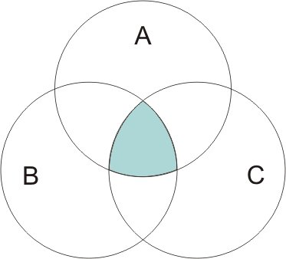
Inner Join
An inner join includes only records in which a value for the key field is common to all input tables.
That is, unmatched records will not be included in the output dataset.

Slide 6
Inner Join
TableA Value | PK | TableB PK | Value
FOX | 1 | 1 | TROT
COP | 2 | 2 | CAR
TAXI | 3 | 3 | CAB
WASHINGTON | 6 | 6 | MONUMENT
DELL | 7 | 7 | PC
SELECT * FROM TableA INNER JOIN TableB ON
TableA.PK = TableB.PK
This is the same as doing
SELECT * FROM TableA, TableB WHERE TableA.PK = TableB.PK

Slide 7
Inner Join (continued)
TableA PK | Value | TableB PK | Value
2 | COP | 1 | TROT
3 | TAXI | 1 | TROT
3 | TAXI | 2 | CAR
4 | LINCOLN | 1 | TROT
4 | LINCOLN | 2 | CAR
4 | LINCOLN | 3 | CAB
5 | ARIZONA | 1 | TROT
5 | ARIZONA | 2 | CAR
5 | ARIZONA | 3 | CAB
… | More… | Rows…
SELECT * FROM
TableA INNER JOIN TableB ON TableA.PK = TableB.PK

Slide 8
Inner Join/Natural Join
A NATURAL join is just an inner equi-join where the join is implicitly created using any matching columns between the two tables
Example:
SELECT * FROM TableA NATURAL JOIN TableB
Same results as inner equi-join?
Which columns match?

Slide 9
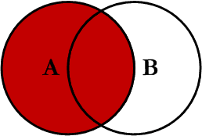
Left Outer Join
Left outer join produces a complete set of records from Table A, with the matching records (where available) in Table B. If there is no match, the right side will contain null.

Slide 10
Left Outer Join
TableA Value | PK | TableB PK | Value
FOX | 1 | 1 | TROT
COP | 2 | 2 | CAR
TAXI | 3 | 3 | CAB
LINCOLN | 4 | NULL | NULL
ARIZONA | 5 | NULL | NULL
WASHINGTON | 6 | 6 | MONUMENT
DELL | 7 | 7 | PC
LUCENT | 10 | NULL | NULL
SELECT * FROM TableA LEFT OUTER JOIN TableB ON TableA.PK = TableB.PK

Slide 11
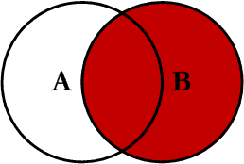
Right Outer Join
Right outer join produces a complete set of records from Table B, with the matching records (where available) in Table A. If there is no match, the left side will contain null.

Slide 12
Right Outer Join
TableA Value | PK | TableB PK | Value
FOX | 1 | 1 | TROT
COP | 2 | 2 | CAR
TAXI | 3 | 3 | CAB
WASHINGTON | 6 | 6 | MONUMENT
DELL | 7 | 7 | PC
NULL | NULL | 8 | MICROSOFT
NULL | NULL | 9 | APPLE
NULL | NULL | 11 | SCOTCH
SELECT * FROM TableA RIGHT OUTER JOIN TableB ON TableA.PK = TableB.PK

Slide 13
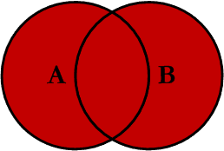
Full Outer Join
Full outer join produces the set of all records in Table A and Table B, with matching records from both sides where available. If there is no match, the missing side will contain null.

Slide 14
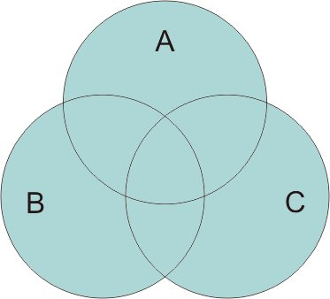
Full Outer Join
A full outer join includes all records, both matching and nonmatching, from the input tables.
Left and right outer joins are referred to as partial outer joins and are described below.

Slide 15
Full Outer Join
TableA Value | PK | TableB PK | Value
FOX | 1 | 1 | TROT
COP | 2 | 2 | CAR
TAXI | 3 | 3 | CAB
LINCOLN | 4 | NULL | NULL
ARIZONA | 5 | NULL | NULL
WASHINGTON | 6 | 6 | MONUMENT
DELL | 7 | 7 | PC
LUCENT | 10 | NULL | NULL
NULL | NULL | 8 | MICROSOFT
NULL | NULL | 9 | APPLE
NULL | NULL | 11 | SCOTCH
SELECT * FROM TableA FULL OUTER JOIN TableB ON TableA.PK
= TableB.PK

Slide 16
Full Outer Join in MySQL
MySQL doesn’t have FULL OUTER JOIN
Simulate using UNION, LEFT and RIGHT JOINs
SELECT * FROM TableA LEFT JOIN TableB ON TableA.PK = TableB.PK
UNION
SELECT * FROM TableA RIGHT JOIN TableB
ON TableA.PK = TableB.PK

Slide 17
Full Outer Join in Snowflake
Snowflake Support Full Outer Join as compare to MySQL
Returns all joined rows, plus one row for each unmatched left side row (extended with nulls on the right), plus one row for each unmatched right side row (extended with nulls on the left).
SELECT * FROM Table A FULL OUTER JOIN Table B ON TableA.PK = TableB.PK

Slide 18
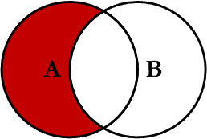
Left Join Excluding Inner Join
This query will return all of the records in the left table (table A) that do not match any records in the right table (table B).

Slide 19
Left Join Excluding Inner Join
TableA Value | PK | TableB PK | Value
LINCOLN | 4 | NULL | NULL
ARIZONA | 5 | NULL | NULL
LUCENT | 10 | NULL | NULL
SELECT * FROM TableA LEFT JOIN TableB ON TableA.PK = TableB.PK
WHERE TableB.PK IS NULL
Perform left outer join, then exclude the records we don't want from the right side via a where clause.

Slide 20

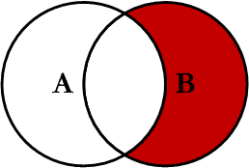
Right Join Excluding Inner Join
This query will return all of the records in the right table (table B) that do not match any records in the left table (table A).

Slide 21
Right Join Excluding Inner Join
TableA Value | PK | TableB PK | Value
NULL | NULL | 8 | MICROSOFT
NULL | NULL | 9 | APPLE
NULL | NULL | 11 | SCOTCH
SELECT * FROM TableA RIGHT JOIN TableB ON TableA.PK = TableB.PK
WHERE TableA.PK IS NULL
Perform right outer join, then exclude the records we don't want from the left side via a where clause.

Slide 22

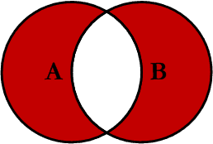
Full Outer Excluding Inner Join
This query will return all of the records in Table A and Table B that do not have a matching record in the other table.
(If you find a useful application, let me know! ☺)

Slide 23

Full Outer Excluding Inner Join
TableA Value | PK | TableB PK | Value
NULL | NULL | 8 | MICROSOFT
NULL | NULL | 9 | APPLE
NULL | NULL | 11 | SCOTCH
LINCOLN | 4 | NULL | NULL
ARIZONA | 5 | NULL | NULL
LUCENT | 10 | NULL | NULL
SELECT * FROM TableA FULL OUTER JOIN TableB ON TableA.PK = TableB.PK
WHERE TableA.PK IS NULL OR TableB.PK IS NULL

Slide 24

How Can We Do This in MySQL?
MySQL doesn’t have FULL OUTER JOIN
Simulate using UNION, LEFT and RIGHT JOINs
SELECT * FROM TableA LEFT JOIN TableB ON TableA.PK = TableB.PK
WHERE TableB.PK IS NULL UNION
SELECT * FROM TableA RIGHT JOIN TableB
ON TableA.PK = TableB.PK WHERE TABLEA.PK IS NULL

Slide 25
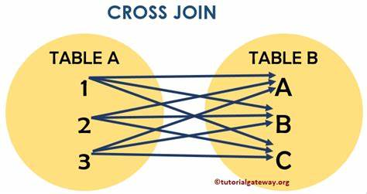
Cross Join
A cross join is a Cartesian Product join – it is every record in Table A combined with every record in Table B.
It gives the same results as not using a WHERE clause when querying two tables in MySQL
SELECT * from TableA CROSS JOIN TableB
SELECT * from TableA, TableB

Slide 26
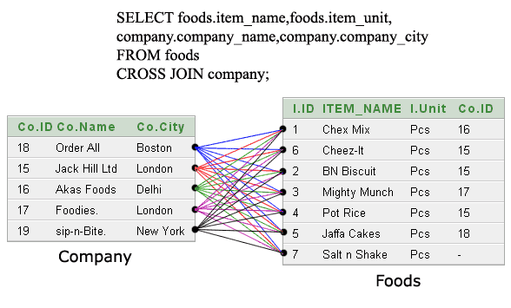
Cross Join

Slide 27
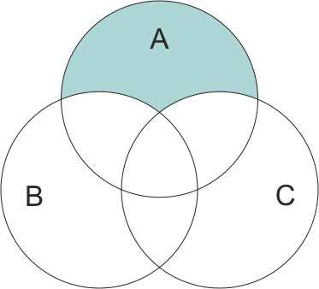
Anti Join
An anti-join includes only unmatched records for the first input table (Table A shown here).
This type of join is the opposite of an inner join and does not include complete records in the output dataset.

Slide 28
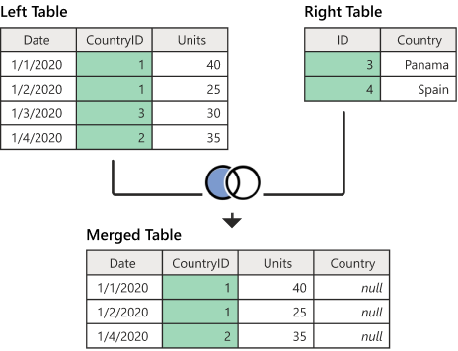
Left Anti join
One of the join kinds available in the Merge dialog box in Power Query in POWER BI is a left anti join, which brings in only rows from the left table that don't have any matching rows from the right table.

Slide 29
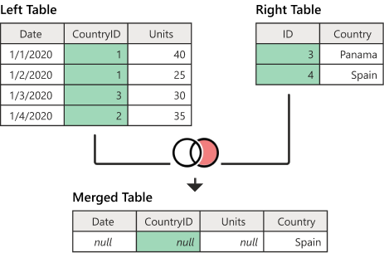
Right Anti join
One of the join kinds available in the Merge dialog box in Power Query IN POWER BI is a right anti join, which brings in only rows from the right table that don't have any matching rows from the left table

Slide 30
THANK
YOU

