Slide 1
Rust
Nikhilesh Singh & Alexander Wreschnig

Slide 2
Introduction
Rust is a functional programming language that has three main focuses:
safety
speed
concurrency

Slide 3
Why Rust?
Open Source (crates)
Excellent Performance (Just as good as C/C++)
Memory safe
Portable (runs everywhere)
Has the same use cases with other popular languages like C
Reduced side effects

Slide 4
Basic Syntax
Superficially, the language operates a lot like C, with minor syntactic differences
However, Rust is a functional language, and lends itself to a different paradigm than the object-oriented programming we might be accustomed to
Variables by default are immutable
let _immutable_binding = 1; // immutable
However you can make a variable to be mutable using the ‘mut’ keywork
let mut mutable_binding = 1; // mutable

Slide 5
Types
Rust allows you to specifically declare data types (including number of bits for numerical types):
let float_num: f32 = 1921312.23131; // declare float of 32 bits
let integer_num: i16 = 1921312.23131; // declare 16 bits
let xs: [i32; 5] = [1, 2, 3, 4, 5]; // declare array of 32 bit integers of size 5

Slide 6
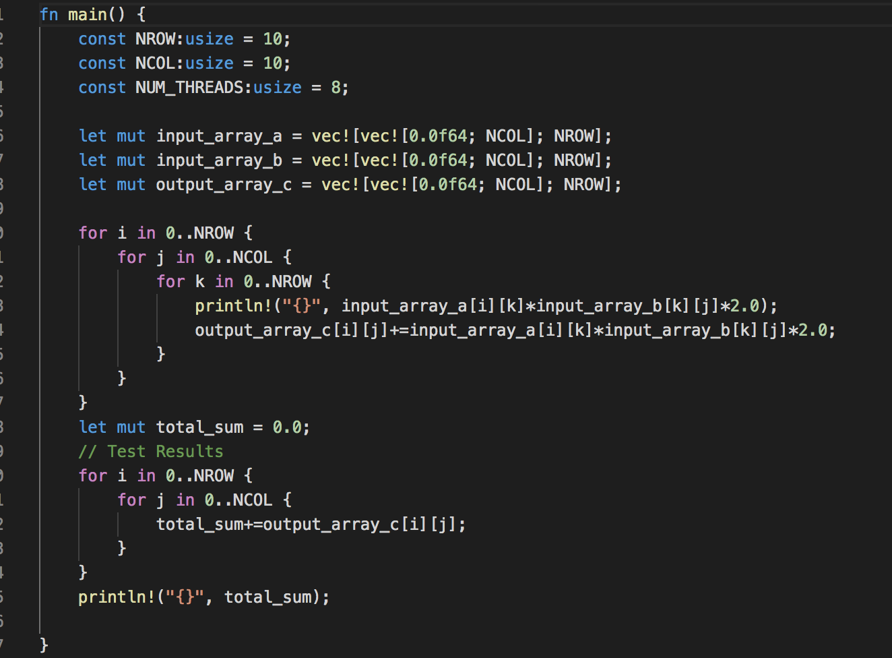
Syntax Example (Serial Matrix Multiplication)

Slide 7
Safety
Safety especially when dealing with parallel programming is a big problem developers have to tackle.
Two Main types:
Memory Safety
Type Safety

Slide 8
Memory Safety
There are many types of safety errors. These include
Buffer overflow
Stack overflow
Use after free
Double free
Data races
Segmentation fault

Slide 9
Memory Safety and Rust
One of Rust’s big selling point is delivering memory safe code.
At compile time it is guaranteed that your code will not incur a segmentation fault.
It also makes it difficult (not guaranteed) to have memory leaks

Slide 10
How?
Rust augments Memory Safety through its ownership and borrowing paradigm.
Each value in Rust has associated with it a variable that is its owner.
Only one owner at a time can exist
When the owner leaves the scope, the value is eliminated

Slide 11
Borrowing
You are allowed to borrow a reference to any value. A reference can be seen as a smart pointer. At any given point in time you can have one of the two (not both)
A single mutable reference
Any # of immutable references.
This allows data to be accessed without having to take ownership of it

Slide 12
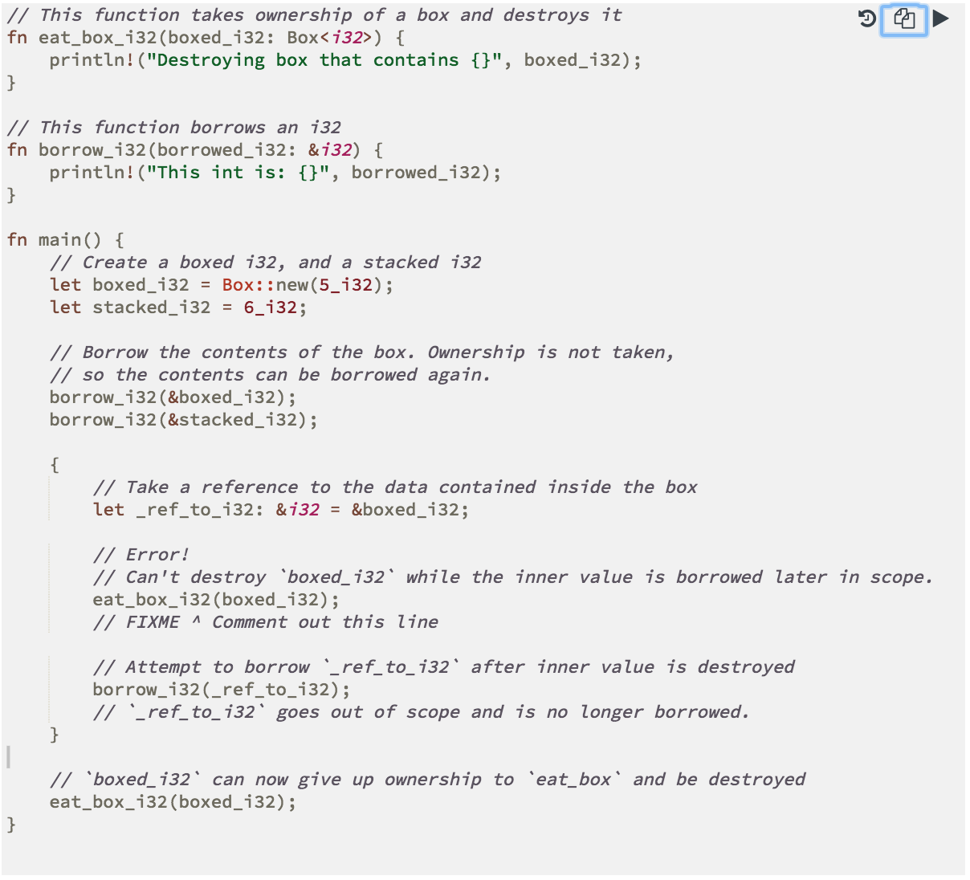
Image from https://doc.rust-lang.org/

Slide 13
Parallel Executions
Rust Provides numerous ways to achieve parallelism.
To augment this Rust has module like libraries that can be installed call crates.
The package management tool to install crates is called cargo

Slide 14
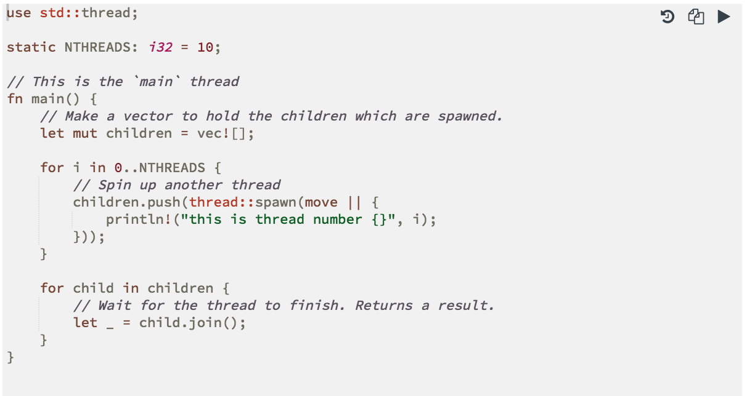
Parallel Executions (cont)
Threading is included with the Rust Standard Library
https://doc.rust-lang.org/stable/rust-by-example/std_misc/threads.html

Slide 15
Parallel Executions (cont)
While the standard library offers an easy way to implement multithreading, libraries (crates) are available to augment parallelization in Rust.
Popular ones include:
rayon**
crossbeam
scoped_threadpool

Slide 16
Rayon
We opted to use Rayon to support parallelization in our project.
Rayon is a “data-parallelism library that makes it easy to convert sequential computations into parallel”.
It makes it easy to write safe, clean and efficient code to handle executing parallel tasks.
It tends to support a higher level of abstraction than Crossbeam, which focuses on lower-level concurrency tools.

Slide 17
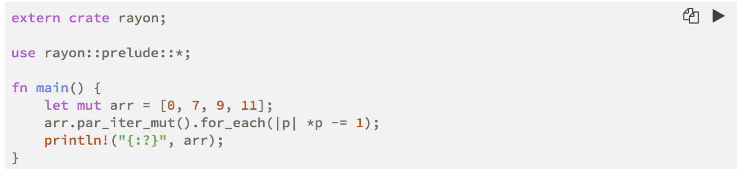
Rayon (cont)
Below is a simple example of how easy it is to implement parallel logic.
https://rust-lang-nursery.github.io/rust-cookbook/concurrency/parallel.html

Slide 18
Rayon (cont)
One of the advantages of Rayon is its support for a parallelized implementaiton of the common iterator programming pattern.
Rust makes heavy use of iterators, and Rayon allows you to very simply implement parallelism by creating a parallel iterator by calling the method
into_par_iter()
From here, there are a vast array of Iterator methods that can be applied, all in parallel.

Slide 19
Rayon (cont)
Rayon also has strong support for slicing a problem into “chunks.”
An example of a very powerful function that allows you to perform operations on chunks of an array/vector is par_chunks_mut(num_chunks).
It handles everything from splitting the array/vector, distributing the workload and running transformation logic.

Slide 20
Rayon (cont)
For the rectangular approximation of a curve, we could use even simpler tools.
Beginning with a parallel iterator built on the cosine curve, we could:
map() each iteration to the calculated value (size of the rectangle), and
sum() the mapped values to get the total

Slide 21
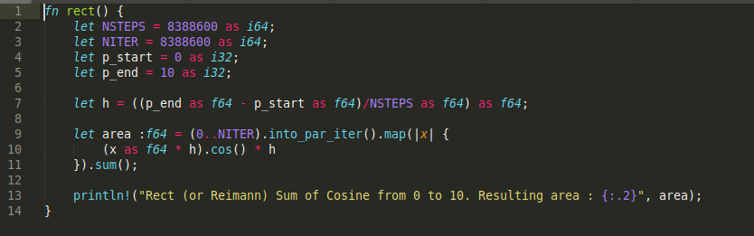
Rayon (cont)
Reimann Method in Rust--code and implementation largely transposed from class project
The actual parallelization happens in lines 9 through 11--only three lines, including a closure expanded slightly for clarity

Slide 22
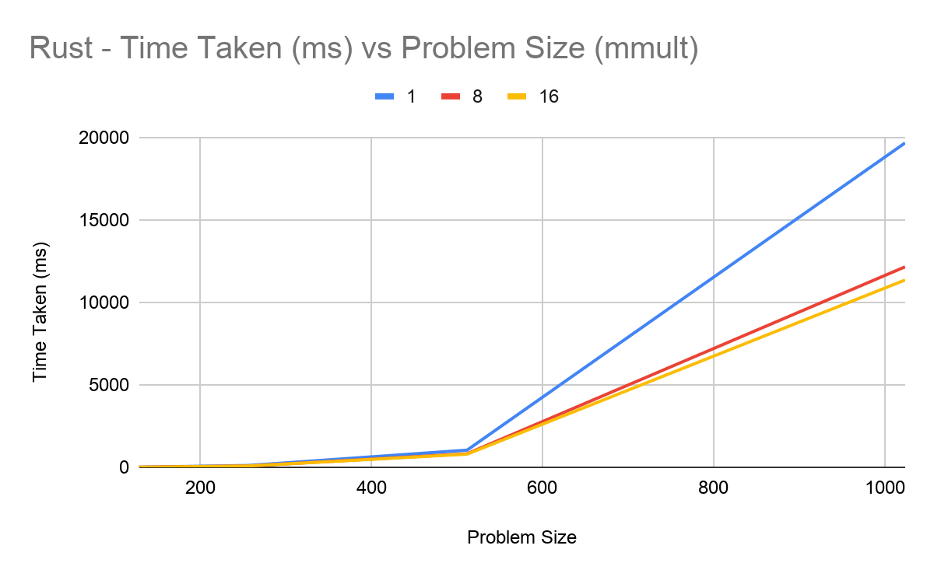

Slide 23
